Slide 1
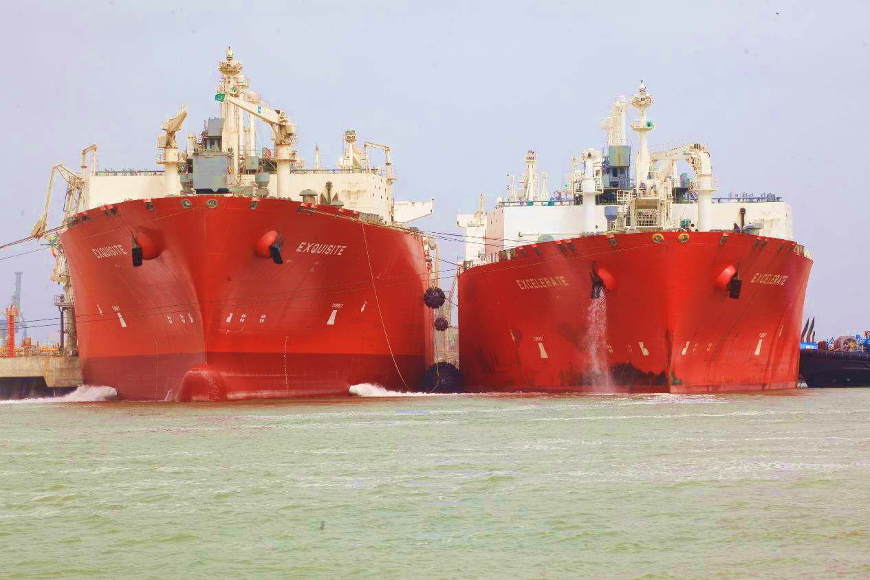
Role of Private Sector in Opening up of
LNG Market in Pakistan
The material and information contained in this presentation is for general information only except for any explicit representations or warranties set forth in a final written definitive agreement. No representation or warranty is made as to the accuracy or completeness of any information provided.

Slide 2
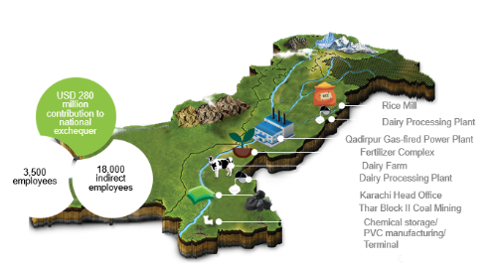
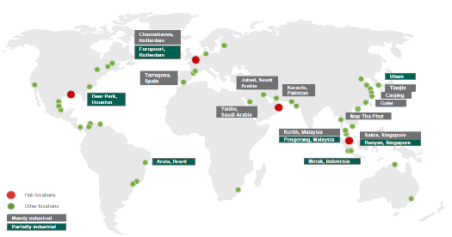
Introduction
Our Company
Our Shareholders
Engro Corporation Limited
First LNG Terminal in Pakistan
Handling 58% of LNG in Pakistan
Commissioned in 2015
Royal Vopak N.V.
Notes:
Engro’s footprint in Pakistan, it is at the very core.
Vopak our global partner, major player in the terminal business. Number of terminals 67, and in business of products Petroleum products, chemicals, Gases and vegoils

Slide 3
Major role of Gas in Energy Mix
For 2018
Gas contribution in Energy Mix 43%
Gas: 05% CAGR for Consumption against -01% CAGR for Indigenous Production b/w 2015-2018
Indigenous Production ~ 3.5 BCFD
Imported LNG ~0.9 BCFD
Gas Reserves ~ 14 TCF
Reserves/Production ~11
.
Pakistan: Primary Energy Supply Mix Shift
MMTOE
08%
13%
11%
11%
09%
06%
31%
31%
32%
01%
06%
47%
48%
43%
Source: PEY, BP

Slide 4
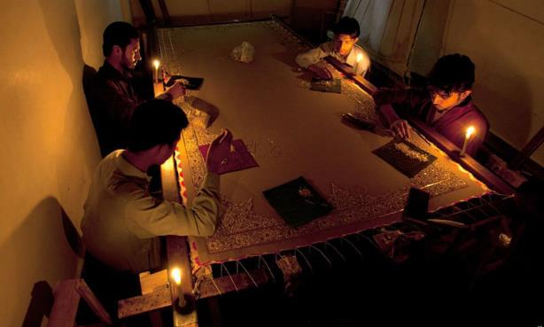
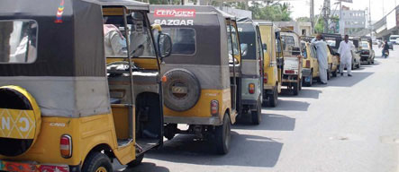
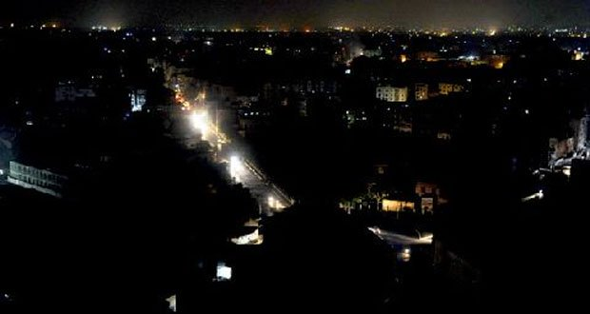

Slide 5
Pakistan Gas Production and Reserves
TCF
mmscfd
Reserves Declining
.
Decreasing indigenous production and LNG coming online
TAPI Conceived
IP
Conceived
LNG Conceived
Engro LNG
PGPC
Period | Consumption CAGR | Production CAGR
1990-2002 | 06% | 06%
2002-2006 | 13% | 13%
2006-2013 | 01% | 01%
2013-2018 | 04% | (01%)
Source: BP
Indigenous Production unable to meet the Gas demand of the country, Also depletion in Gas reserves foreseen
Notes:
5 Gas based Power plants were added with total gas consumption of around 400 mmscfd between 2002-2005

Slide 6
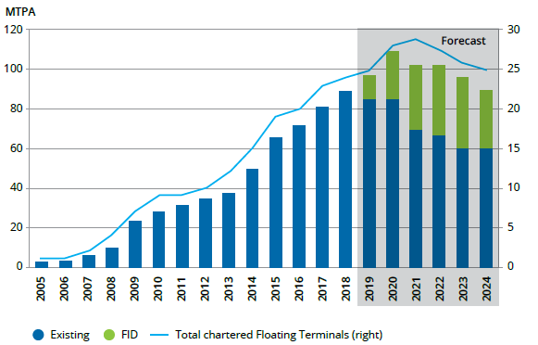
EETL- Pioneer Delivered1st LNG Terminal
Project was commissioned within 330 days – one of the fastest in the world
Operations started on March 27th, 2015
Total project cost: USD 122mn
Project was fully funded by equity
Terminal complied with all regulatory and international standards
Accepted by third party auditors of OGRA, PQA and
international LNG majors
100% risk of ensuring timely completion of a strategically important project – USD 1Mn penalty for delay every 3 days
FSRU by Status and No. of Terminals
.
EETL Awarded
License
Source: IGU

Slide 7
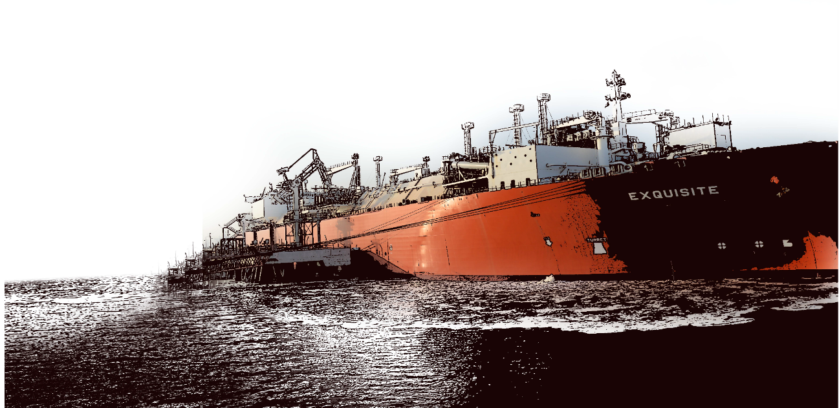
EETL Cruising with Success
Regasification Capacity of 4.5 Mn TPA
Handled ~17 MTPA LNG ( 840 bcf of Gas) in Pakistan, ~75% of LNG in Pakistan since commissioning in 2015- More Gas pumped than Pakistan’s largest gas field (Mari*)
277 Ship-To-Ship successfully & safely done
High Service Factor of 97.8% since commissioning
Zero Safety incident since commissioning
.
*Adjusted for calorific value

Slide 8
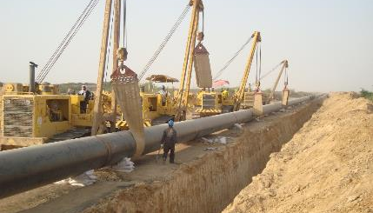
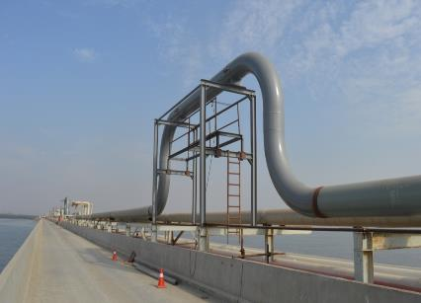
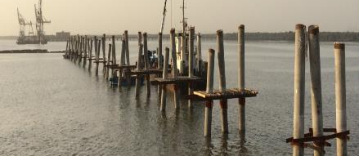
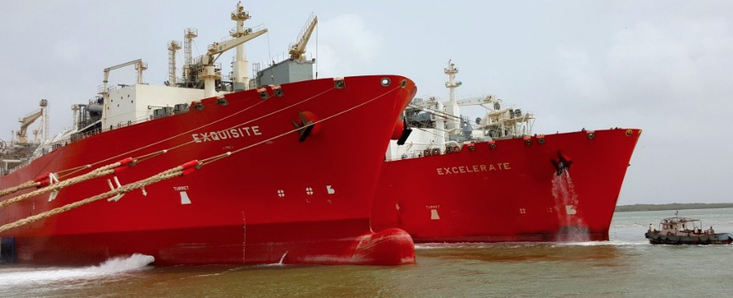
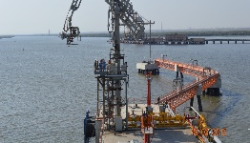

Slide 9
The 1st LNG terminal was an Enabler…
New Gas Pipeline built for RLNG Transmission
Brought Capacity of +3.6 GW dedicated RLNG Powerplants online
Used as mix fuel in reviving power Capacity of 3.5 GW
LNG Sales Purchase agreements signed
Opening up of LNG Market for future LNG Terminals and LNG based projects
Pakistan RLNG Consumption- Sector Wise
.
Notes:
Haveli (1230 MW), Balloki ( 1223 MW), and Bhikki (1180 MW)
3.5 GW- KAPCO, FKPCL, Rousch, Nandipur, Halmore, Orient Power, Saif, sapphire
Add pipeline

Slide 10
RLNG Proving to be Cheap Liquid Fuel
$/mmbtu
Mogas
HSD
.
LPG
FO
RLNG
Source: PSO, OGRA
Price $/mmbtu | Last 5 year Avg Price | Times price of RLNG
RLNG | 11.0 | 1 x
FO | 12.6 | 1.15 x
LPG | 19.8 | 1.80 x
HSD | 20.2 | 1.84 x
MOGAS | 20.4 | 1.85 x
RLNG remains competitive against all other liquid fuels, saving 3-4 Billion USD in substitution of Furnace Oil to national exchequer since its import in 2015

Slide 11
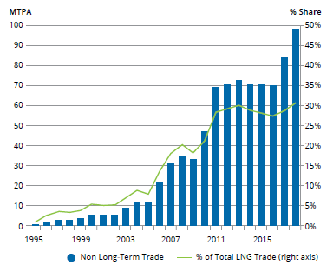
Global Benchmarking – Spot vs Term
Globally
Total LNG Supply stands at 330 MTPA
~30% LNG supplied through Short and Spot contracts (up from 1% in 1995)
Growth in Spot expected as LNG importer & exporter increases and flexibility in market increases
Pakistan
+22 MTPA LNG imported since 2015
Initial contract were term based
Spot increased from 0% in 2015 to 20% in 2018
Global LNG import contract wise
.
Source: IGU
Pakistan LNG import contract wise
MTPA
% Share
100%
100%
95%
90%
80%
Source: PLL, OGRA
Notes:
Dominated by Long term contract.
As of now Pakistan has 4 long term RLNG contracts in place
Gunvor: 0.75 MTPA , expiring in Dec 2020
Gunvor: 0.75 MTPA , expiring in Dec 2022
Qatar Gas: 3.75 MTPA ( expiring in Dec 2031)
ENI SPA: 0.75 MTPA (expiring in Dec 2033)

Slide 12
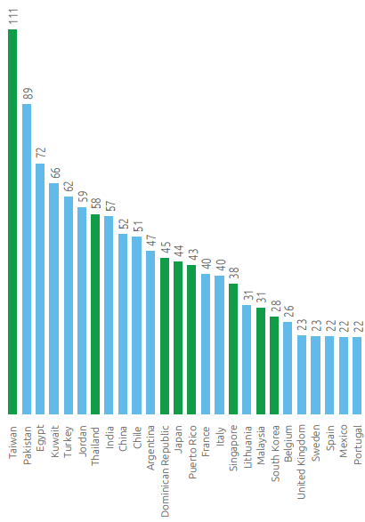
Global Benchmarking - Terminal Utilization
LNG importing countries and volume increasing.
Regas capacity significantly higher than LNG Imports
Avg Global LNG Terminal utilization ~40%
Terminals serve a significant strategic purpose going beyond commercial incentive
Avg Pakistan LNG Terminal utilization ~83%
EETL utilization ~100%
Globally LNG Imports and Regas
Source: IGU
Global Terminal Capacity and its utilization-2016
Source: IGU

Slide 13
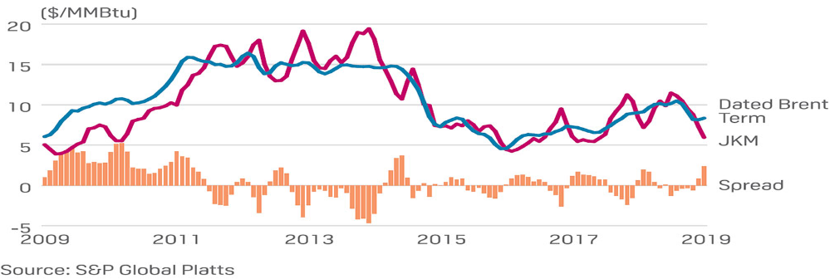
Global LNG Price Trend
Spread between Spot and term LNG Prices has seen fluctuation
Lower prices will further entice economies who are looking for relatively affordable, abundant and clean fuels
Spread between Spot and Term LNG Prices

Slide 14
RLNG Costing
Cheaper spot LNG would be required to maintain optimal cost incase of lower utilization of terminal
RLNG Costing
$/mmbtu
%Brent
-LNG DES Price taken as 13%*60
-Terminal charge is lowest at full utilization-0.43 $/mmbtu

Slide 15
Pakistan Gas Market Outlook
Indigenous gas production, and Gas reserves to see decline ( 2-8% CAGR based on different outlooks)
Gas Demand to increase in Domestic and transport sectors while sustained increase in other sectors
Population of 220 Mn increasing at at 2%
Gas connection of 9.2 Mn increased by 14% from last year
Gas consumption 5% CAGR in past 5 years
Gas Production and Reserves Outlook
TCF
mmscfd
Assuming No new Gas discoveries during this period
Source: Fitch, Bloomberg, Engro.

Slide 16
Fastest way of capacity addition is expanding existing terminals

Slide 17
Expansion of Current Terminals
Fast Track capacity expansion of both existing terminals can bring an additional 2 MTPA (300-400 mmscfd) in the market immediately.
Success and future of Pakistan’s LNG supply chain management is in Introducing private players for RLNG Marketing
Competition
Efficiency
Risk/Reward balance
2nd Terminal on Tolling – Government as counterparty
1st FSRU Terminal on Tolling – Government as counterparty
Expansion of Current Terminal via TPA-private LNG suppliers

Slide 18
EETL’s Expansion
Direction Set
EETL Expansion
Globally 80 MTPA of LNG Regas capacity is managed based on TPA.
Precedence in Indonesia and Lithuania LNG Terminals; All existing LPG import terminals in Pakistan have the scheme implemented and being successfully operated since 2002
As Global LNG prices are bearish, the terminal cost are becoming important (increasing from 3.75% to ~7.00% of LNG DES cost). The focus on terminal utilization increases and cost efficiency is reached through TPA
Terminals from India, China, and Singapore are migrating from sole use to TPA.
ECC has approved sale of additional capacity from existing terminals to private parties
Expansion of existing guaranteed Regas capacity from 630 mmscfd to 780 mmscfd
Increase in storage capacity from 151k cbm to 171k cbm
First gas expected by Q3 2020
Expansion will have the following benefits:
Quickest way to bring more capacity online
Reduce vessels traffic at port – supply chain optimization as larger storage onsite
Cost efficiency via retainage reduction
Access to private players – First step towards opening up of private LNG market

Slide 19
Heading towards On-Shore LNG Terminal
On-shore LNG Terminal is the answer as LNG Market in Pakistan moves towards maturity
1st Open Access Onshore LNG Terminal
2nd Terminal on Tolling – Government as counterparty
1st FSRU Terminal on Tolling – Government as counterparty
Expansion of Current Terminal via TPA-private LNG suppliers
Integrated Private FSRU Based Terminal

Slide 20
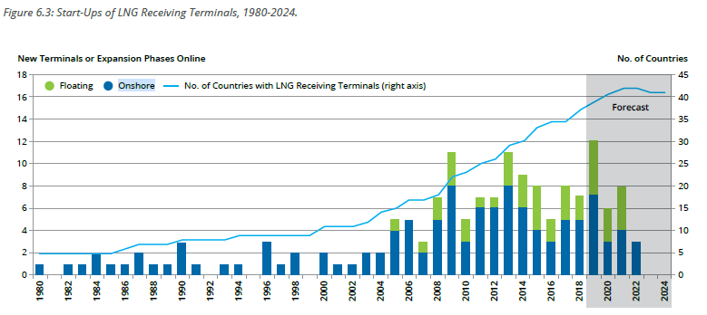
Migration from FSRU to Onshore Terminal
Based on global experience, a first (or second) FSRU is followed by an Onshore Terminal to create a strategic national asset for the critical security of supply of energy
Major importers of LNG (including Japan, Korea, India, Singapore and China) import exclusively via onshore terminals to serve their large and growing economies
Bangladesh recently stepped away from all future floating initiatives to go exclusively for onshore terminals going forward
An onshore LNG regasification terminal on an open access concept is the natural next step and a strategic national asset for Pakistan
Globally-New or Expansion of LNG Terminals (FID Taken)
Onshore LNG Terminal
Source: IGU
Notes:
Forecasted from 2019-2024
On shore Terminals= 17 with capacity of 64 MTPA
Floating Terminals= 12 with capacity of 36 MTPA

Slide 21
Vopak/Engro Again Pioneer- Onshore LNG Terminal
Open Access Model- terminal will operate as an open access model through TPA for interested parties
Larger Capacity in Phased Approach- Regasification capacity of up to 1.2 bcf/d and storage capacity of up to 480K m3; developed in phases on market demand
Greater Flexibility- Onshore storages will provide greater flexibility for inventory management, strategic stock management for demand surges and operational flexibility for ship arrival
Additional Services from Onshore operations
Break bulk, trans-shipment
Bunkering services ,Trucking services for domestic distribution
Our shareholder Royal Vopak has an excellent track record of setting up and operating onshore LNG terminals with combined storage of 840K m3 and throughput capacity of 19.4 BCMA or 2 BCFD
Gate terminal, Rotterdam, the Netherlands (operational since September 2011)
Altamira terminal, Mexico (operational since August 2006)
First Gas targeted for 2023 in a phased approach
Notes:
Long Term strategic asset:
Invested and built in Pakistan, operated by Pakistani workforce
Significant investment in a physical assets in Pakistan vs FSRU-based terminal
Modular Expansion
Modular expansion possible with uninterrupted regas - Extra storage, extra regas, or both
Additional storage beyond 480,000 m3 (Phase 3) would require land reclamation adjacent to the planned site

Slide 22
Government of Pakistan Continues to Play Active Role For National Prosperity
Availability of Pipeline Capacity for gas transmission up to RLNG demand areas up North
Clarity on Gas/RLNG Sector Reforms
Efficient regulatory process
FDI friendly environment
All workstreams continue to progress as we speak….

Slide 23
Concluding Remarks
Pakistan’s indigenous gas production expected to decline & LNG will continue to remain an important part of energy mix for future growth and prosperity
To meet seasonal variability and monetize LNG supply glut, terminal capacity enhancement is required- Fastest way to achieve almost 300-400 mmscfd is via TPA of existing terminals
LNG will force gas sector reforms and Pakistan’s domestic sector to bring their house in order – We cannot afford to waste Pizzas!
Govt. of Pakistan making efforts to address the gas shortfall & a collective effort is required in close coordination to secure the energy future of Pakistan

Slide 24
Thank You

