Slide 1
BioFuels-Why?
Syed Akhtar Ali
Conference organized by Petroleum Division-Islamabad
Feb,3rd,2020

Slide 3
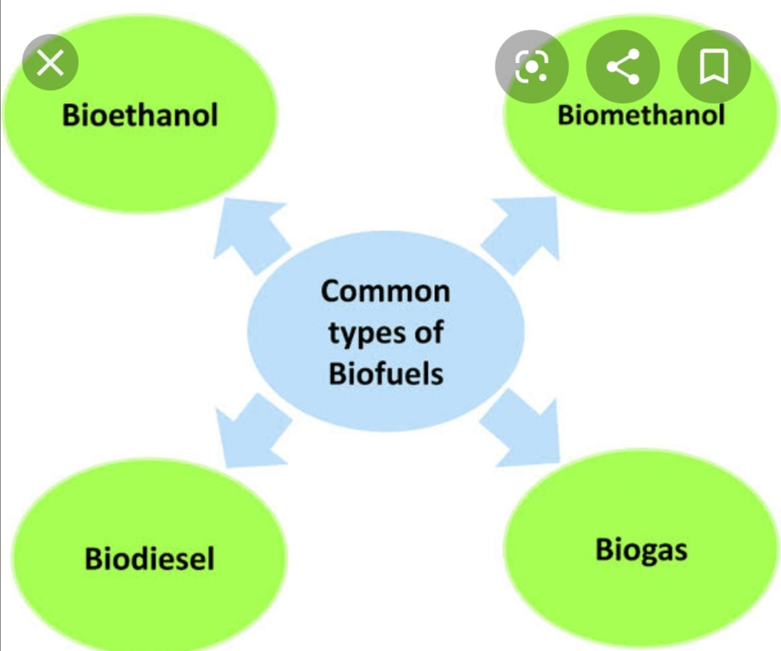

Slide 4
Why Bio-fuels
Energy Security-diversification
Saving foreign exchange
Utilize waste-pollution controls
Finances /subsidizes environmental projects
Health safety-UCO is reycled instead of unhygienic use at Thara and Pakora shops
Increased Farm Incomes & Promotion of Agriculture
Employment generation, SMEs
International cooperation & Conventions

Slide 5
Biofuels Targets -Global
Many countries(45) have set targets for Bio-fuels
to have E10 by 2020 .
EU 12% Biofuels.
In the US, they are now talking of even E15 (15% ethanol).
In China, the target is 15% ethanol blending by 2020.
Many developing countries out of the list of 65 have gone for E5.
India mandated E5 in 2003 in 13 states initially and by 2006 extended it to all over India; actual achievement in India has been 7.2%

Slide 6
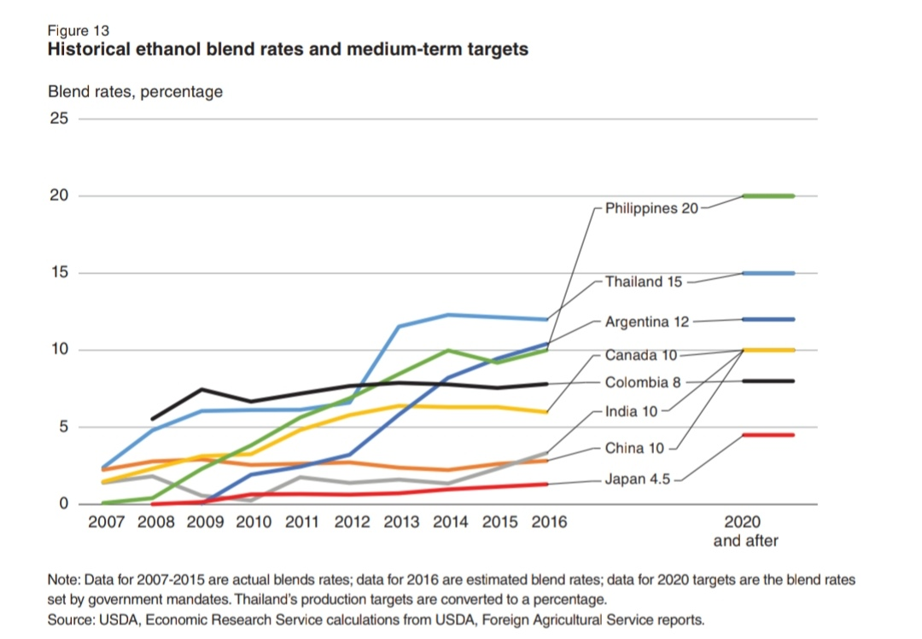

Slide 7
Pakistan World Ranking
Population=6th
Wheat Production=8th
Sugar=8 ^{th consumer-9th producer}
Cotton=5th
Rice=9-10^{th(stubble burning)}
^{Poultry} =14th
Energy Consumption=32th

Slide 8
Biofuels characteristics
Low Sulfur
Low Particulate matter
Lower CO2 foot print
High Octane(Ethanol);High Cetane(Bio-diesel)
Renewable

Slide 9
Biofuel shortcomings
Cannot be used as 100% in normal vehicle
Only in blends up to a maximum 15%
Old vehicles may have problems with rubber
Food vs Fuel Issues
Resource base limited compared to fossil Oil

Slide 11
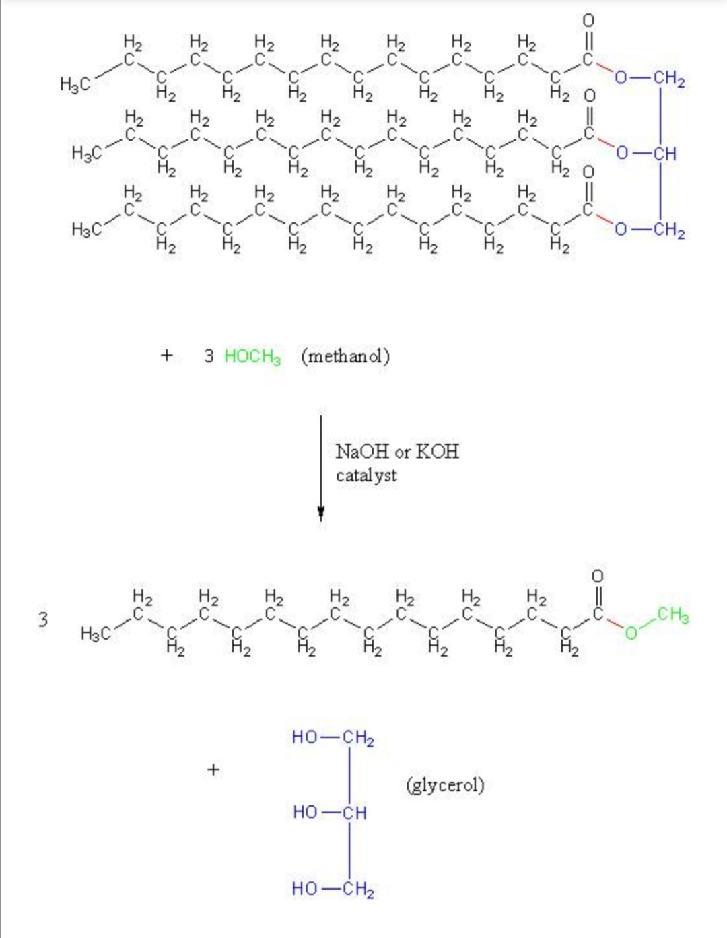

Slide 13
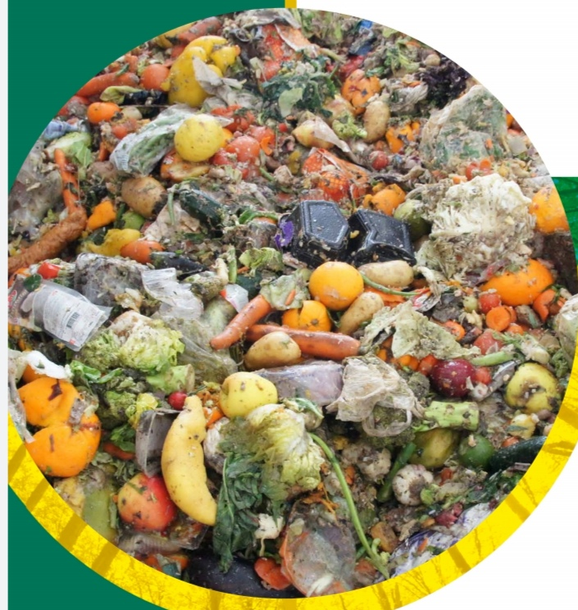
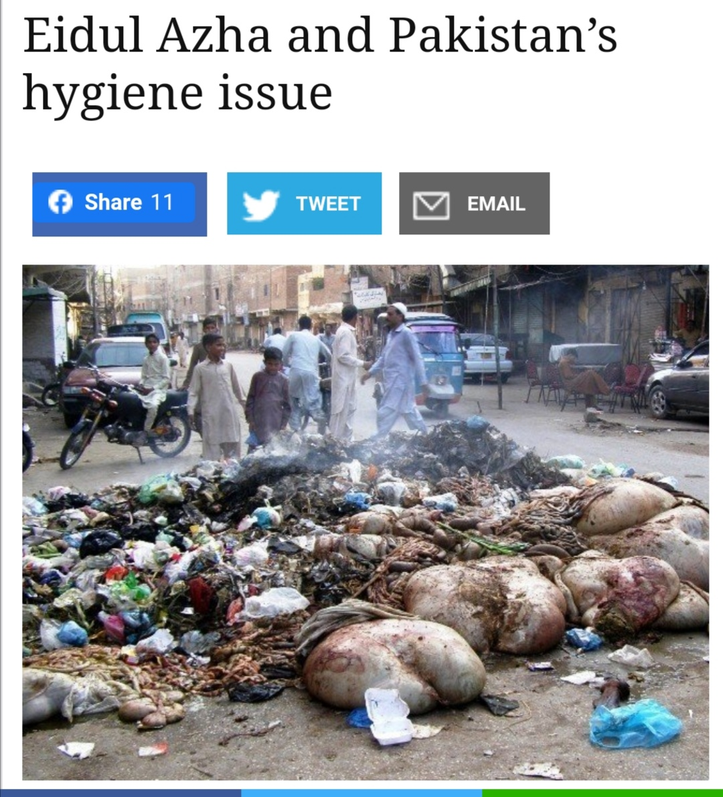

Slide 14
Feed Stocks
BioEthanol
Wheat, Barley,Corn,Rye,Sugar
Waste, Cellulosic Biomass
Bio-Diesel
Rapeseed, Palm Oil, Soybean,Jatropha,Animal Fat, Chicken fat
Waste, Used Cooking Oil(UCO),Poultry waste, Slaughterhouse

Slide 15
Waste Sources
Crop Waste
Poultry Waste
Slaughter house waste
Dairy Waste
Animal Dung
Human Waste
Food waste and MSW
Agro-industrial waste

Slide 16
Crop and agro-industrial Waste
Wheat Straw and Husk
Rice Husk and Stubble
Sugar cane; tops and leaves;bagasse, Press mud; Molasses; Vinasse
Cotton seed; Cotton Stalk etc
Cellulosic crop material
Corn Cob

Slide 17
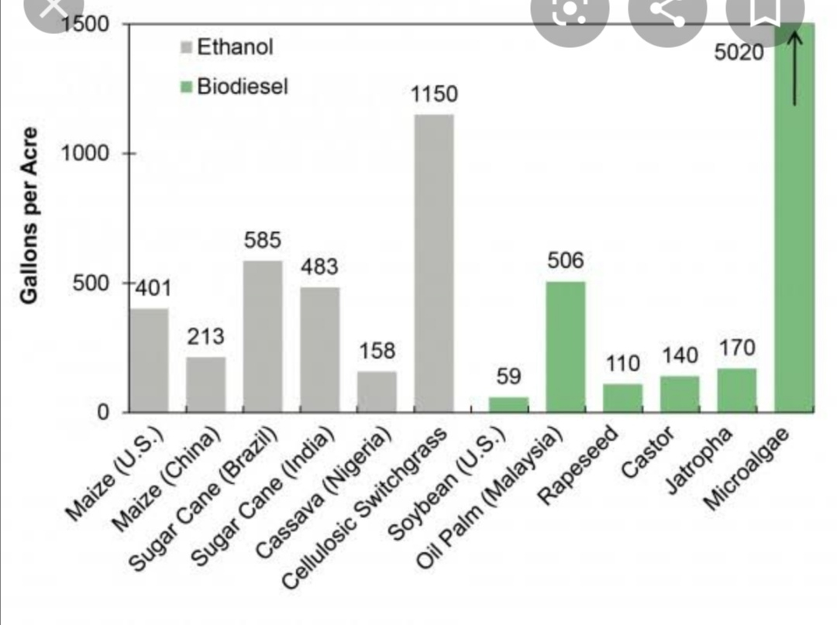

Slide 18
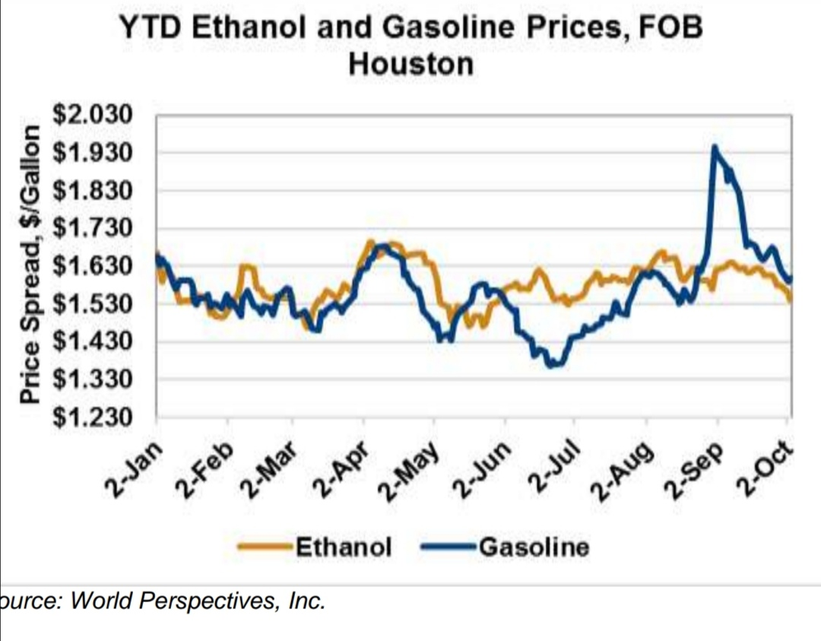

Slide 19
Bio Ethanol Ready Capability
Ethanol Exports=653,443 Tons;425 Mn USD
Gasoline Consumption=7 Mn Tons
% Blend Possible=8.7 %
Immediate Target=5%
Practically no investment requirements except modest adjustments
Blending at Refineries, Terminals or even Ethanol plants

Slide 20
Bio-Ethanol Potential
Cotton stalk-5.039 MT(million tons)
Wheat straw-5.689 MT
Rice Straw-6.534 MT
Sugarcane tash-2.55 MT
Maize stalk-0.68 MT
Total-20.494-MT
Bio-ethanol-yield-250 Liter/ton
Bio-ethanol potential-5 billion Liters Bio-ethanol-7 MT-
Gasoline Consumption-7 million Tons

Slide 21
Bio-Diesel Potential & Possibilities
Limited potential
BD is based on Vegetable Oils and Fats
Pakistan is short of Oil seeds production, could not acquire self sufficiency in cooking Oil
Jatropha potential overstated
Used Cooking Oil-UCO is a possibility
UCO potential-400,000 t/yr-Policy Requirements
Chicken Feather Meal-100,000 t/yr-Total 500,000 t
Diesel Consumption -7 Mn tons- BD 7%

Slide 22
Biogas is not small any more
Smallness is Biogas strength-Household
Community Biogas-isolated grid
Injection to normal gas grid
Electricity generation
Bio-CNG
CAPEX-200 USD for household plant to 20 Mn USD for Utility grade

Slide 23
Bio-Gas End uses
Household uses
Community Gas network
Bio-CNG(Karachi Cattle Colony Landhi Green Bus Project on Bio-CNG)
Utility Gas Injection
Large Biogas multi-purpose
CHP-Electricity Generation(Solar has made biogas electricity uncompetitive)
CHP-Cold Storage Plants

Slide 24
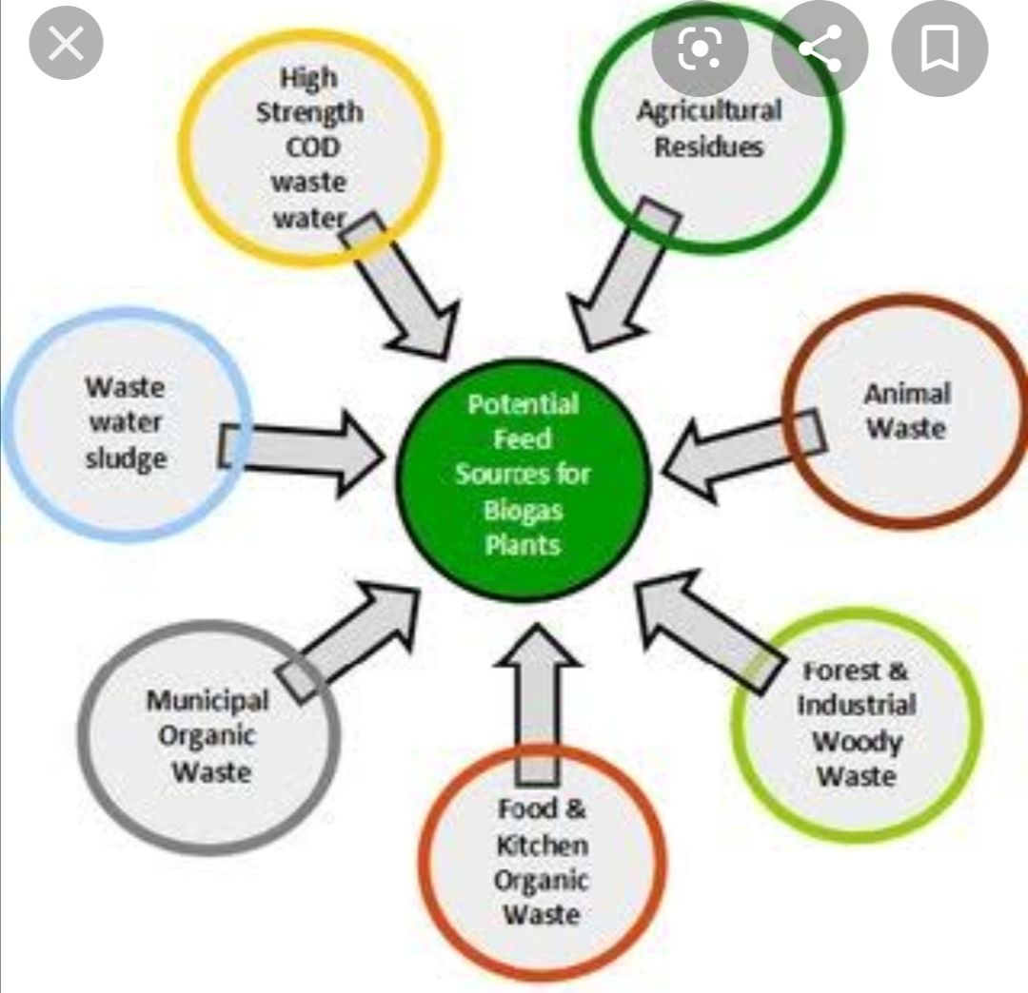

Slide 26
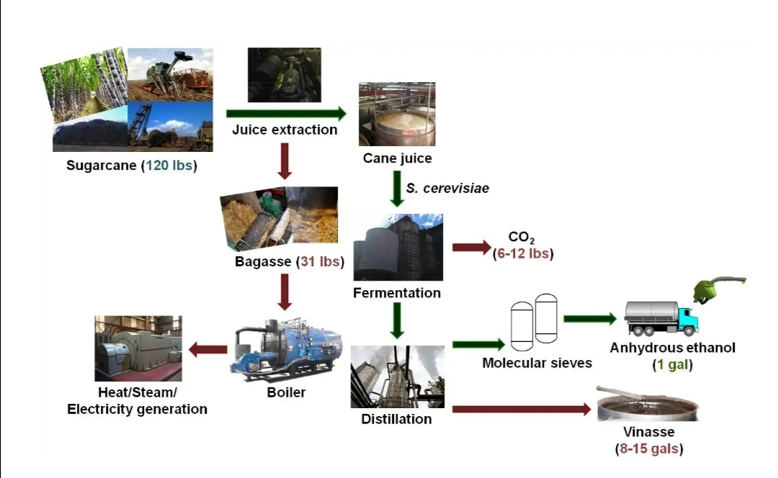

Slide 27
Pakistan Biogas Achievement
China-1.367 bn population-43 Mn plants, 1 bio-plant for 9.4 HH
India-1.21 Bn pop-4.75 Mn plants,1 bio-plant for 52.5 HH
Pakistan-207 Mn pop,5360 bio plants,1 bio-plants for 6000 house holds
Pakistan Rural households=20 Million
Pakistan Biogas Plant demand(1/50)=400,000

Slide 28
Biogas Potential
Poultry Waste=649/ mmcfd(300 mmcfd)
MSW-khi=55 mmcfd
MSW –lhr=33 mmcfd
Gobar Gas=530 mmcfd(250) mmcfd
o/w Landhi Colony=22
Sugar Industry=76 mmcfd
Crop Waste=600 mmcfd
Slaughter Waste=?
Total=1336 mmcfd-Perpetual
=30% of local conventional gas production

Slide 29
Potential Feasible targets
Household Bio-Plants-400,000
Community Plants-200
Bio-CNG-1200-46% of CNG Demand

Slide 30
BIO-DIESEL

Slide 31
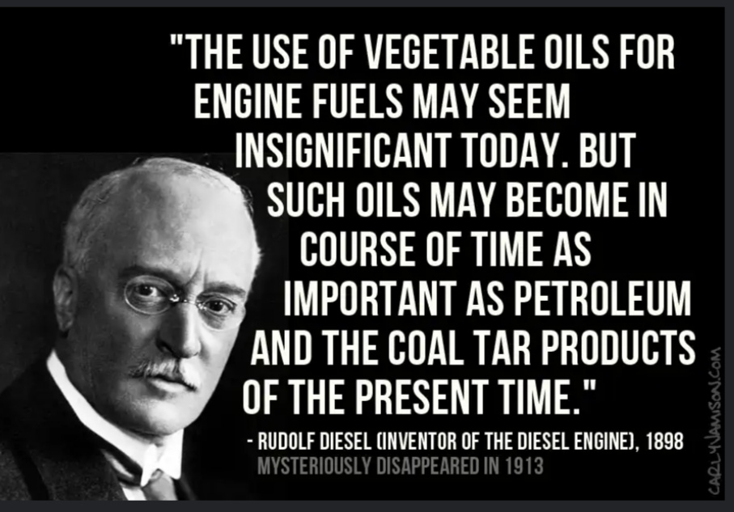

Slide 34
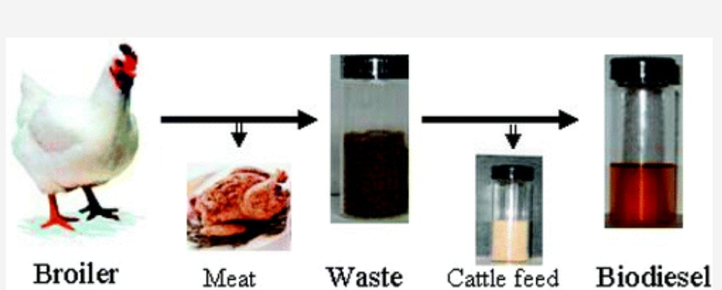

Slide 35
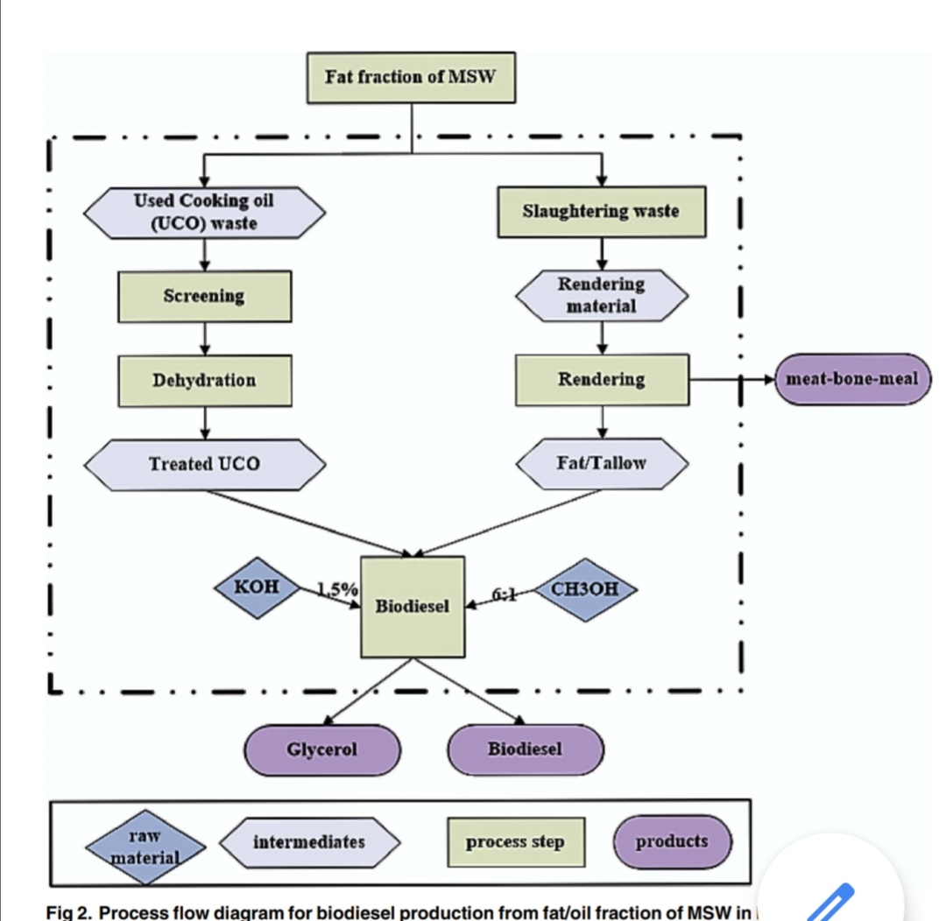

Slide 36
BioETHANOL

Slide 38
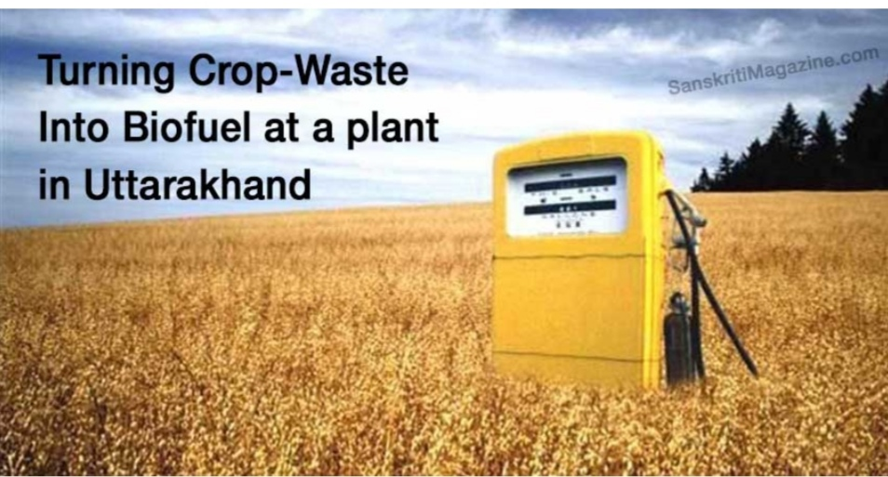

Slide 39
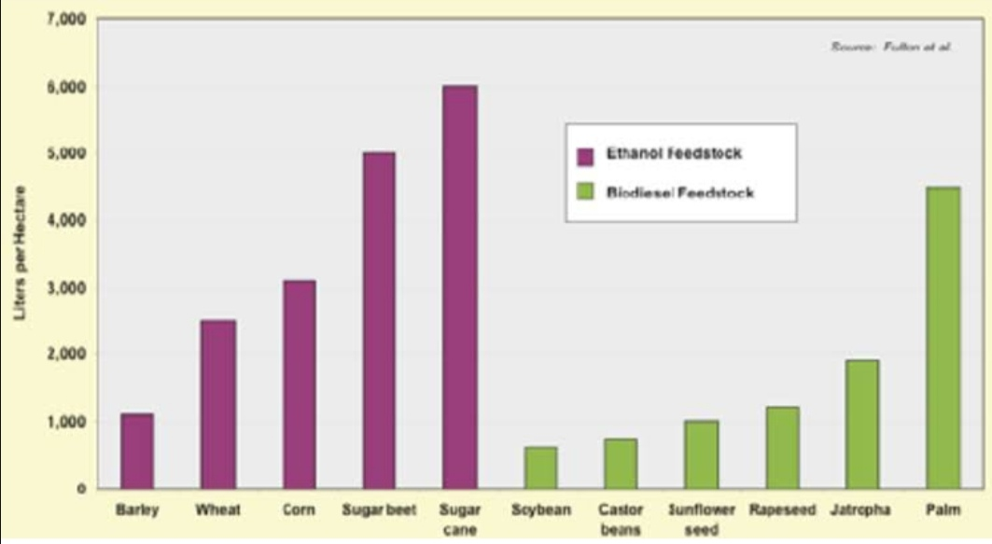

Slide 40
BioGas-BIOCNG
BioGas

Slide 42
Raw and Clean Biogas
Raw Biogas for cooking
Also in direct burning applcations; furnaces,brick kilns etc
Clean Biogas after upgradation;
In biocng,gas grid and electricity
EU original target 20% Biogas in Grid by 2020-30

Slide 43
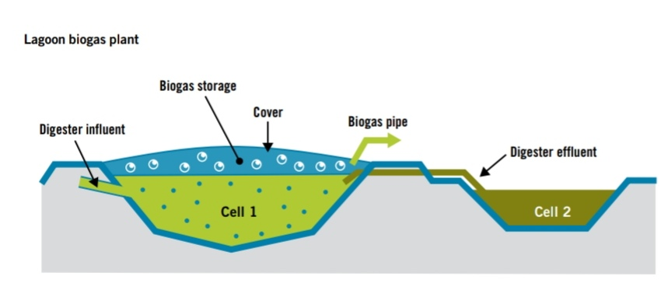

Slide 44
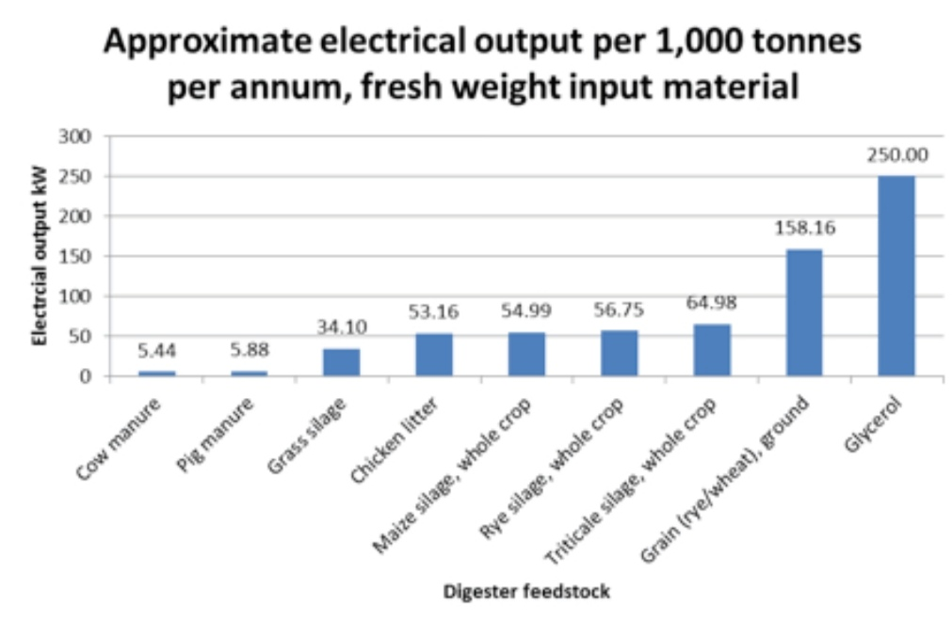

Slide 45
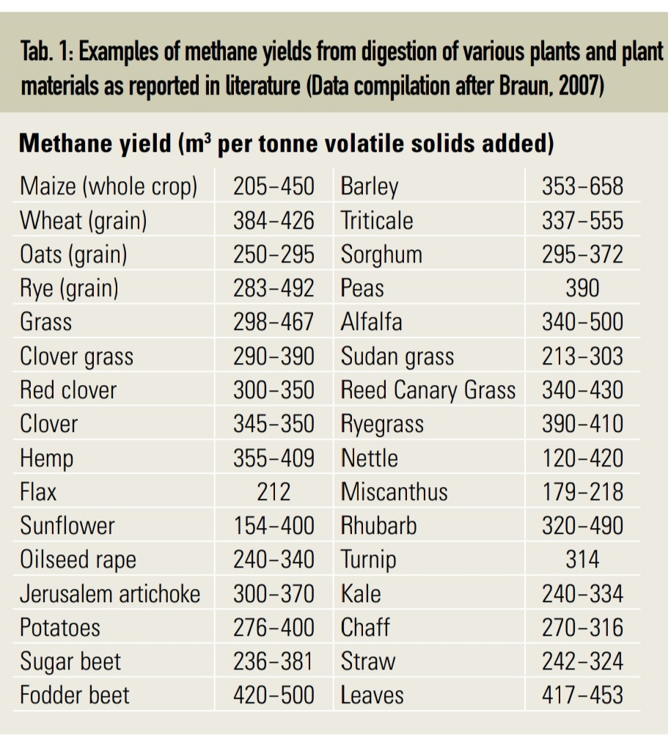

Slide 46
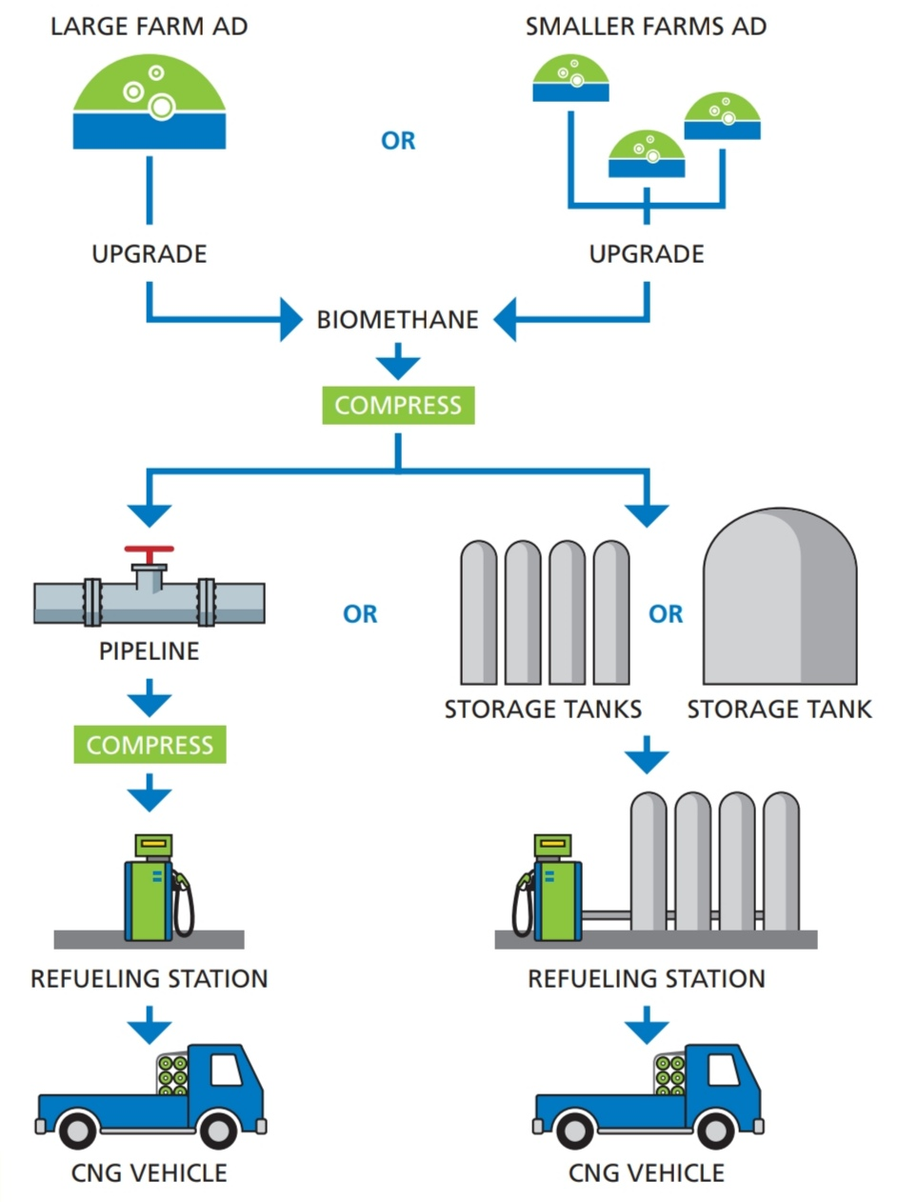

Slide 48
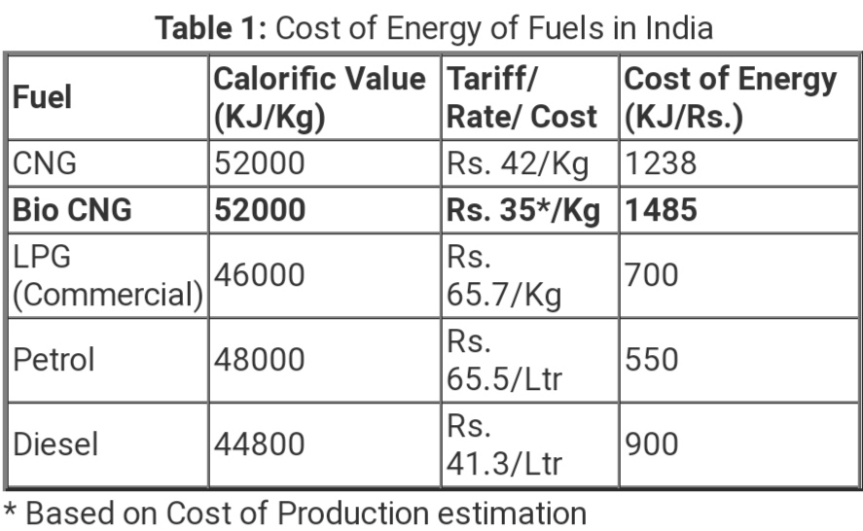

Slide 49
India- Rice Stubble to Bio-CNG
Rice straw from 20,000 acre farm area(Karnal,Haryana)
40,000 t/yr feedstock
Bio-cng out put 10,000 kg/day-IGL gas company
Target 5000 plants by 2023
15 million tonnes pe year of bio-cng by 2023
Similar plant inaugurated in Philippines recently
Pakistan, Lahore ?

Slide 50
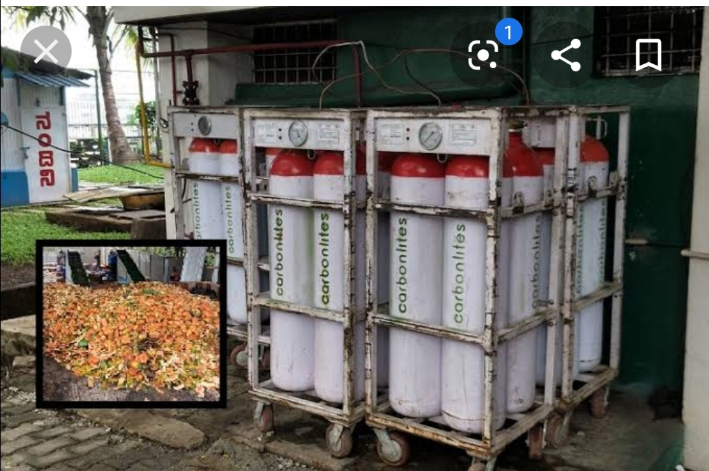

Slide 51
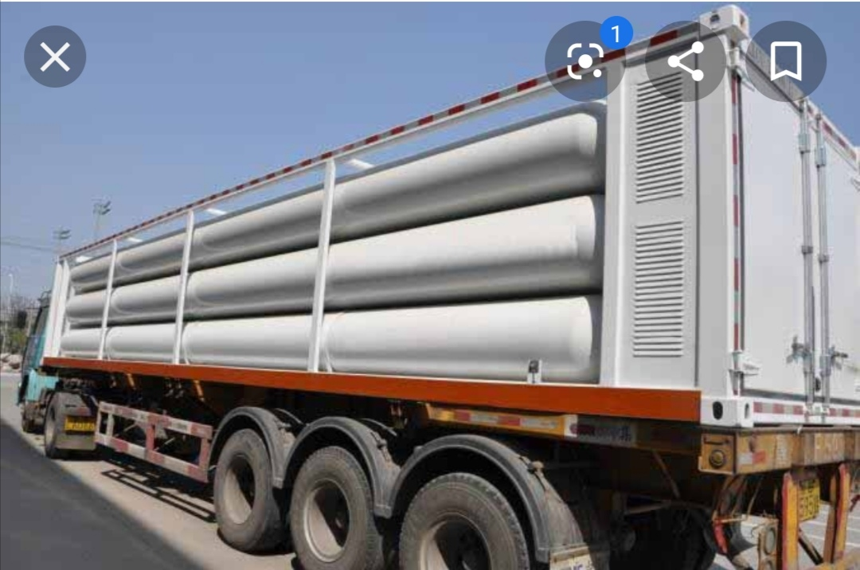

Slide 52
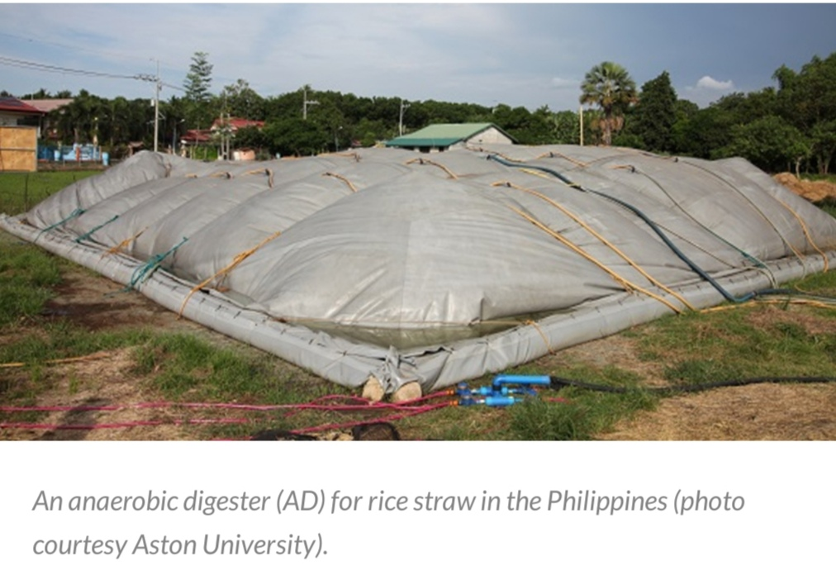

Slide 53
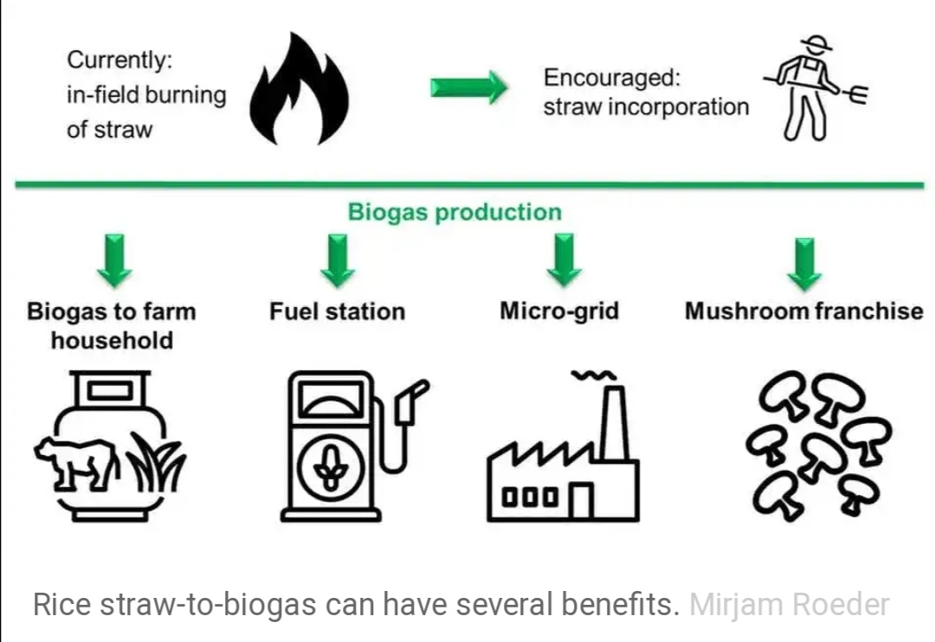

Slide 54
Biogas-Potential-Cow Dung
63 million cattles
15 kg poop per day
35 million tons per year
Biogas yield-160 m3/ton
Biogas potential-5.6 billion m3/year-530 mmcfd
50% realisation-265 mmcfd
Karachi landhi cattle colony potential-30 mmcfd

Slide 55
Biogas Demand Rural
Number of Households(HH)Urban=11.966 Mn
Total Number of Gas consumers=8.45 Mn
% Urban HH having Gas=70
Number of Rural Households=19.387 Mn
Gas consumption per Rural HH=3000 cft
Total Biogas demand-rural=697.932 Bcft/yr=1912 mmcfd=31.86%
Total Biogas Potential=530 mmcfd-Cow dung

Slide 56
Biogas Potential from MSW
 | Karachi | Lahore | Landhi Cattle Colon
Daily MSW-tons | 10000 | 6000 | 6000
o/w Food Waste-% | 50 | 50
Daily Food Waste-tons | 5000 | 3000
Biogas Yield-M3/ton | 450 | 450 | 150
Daily Biogas output-M3 | 2250000 | 1350000 | 900000
Daily Biogas output-MMCFD | 78.75 | 47.25 | 31.5
Methane Content-% | 70 | 70 | 70
Daily Methane output-MMCFD | 55.125 | 33.075 | 22.05
Cattle Population |  |  | 400000
Manure per cow-kg |  |  | 15
Daily Manure Production-tons |  |  | 6000
Source:Author

Slide 57
Methane per Hour-M3 | 65625 | 39375 | 26250
Typical output AD-Digester-M3 | 1000-2000 | 1000-2000 | 1000-2000
Per Plant CAPEX-MnUSD | 15 | 15 | 15
Noof Plants | 30 | 20 | 13
Total CAPEX-MnUSD | 450 | 300 | 195
Unit Gas Value-USD/000 cft | 8 | 8 | 8
Daily Gas Sales-MnUSD | 441000 | 264600 | 176400
Annual Sales-MnUSD | 154,350,000 | 92,610,000 | 61,740,000
GP-Margin % | 15 | 15 | 15
Annnual Gross Profit-MnUSD | 23,152,500 | 13,891,500 | 9,261,000
Pay-back yrs | 19.44 | 21.60 | 21.06
Tipping Fee-USD/t | 20 | 20 | 20
Tipping Revenue | 73,000,000 | 43,800,000 | 43,800,000
Total Revenue Tipping+Gas | 96,152,500 | 57,691,500 | 53,061,000
Pay Back-yrs | 4.68 | 5.20 | 3.68

Slide 58
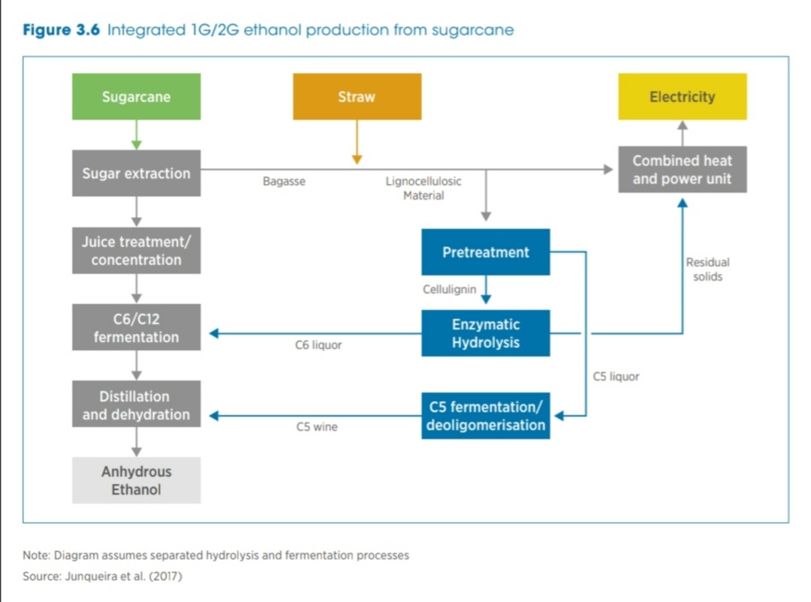

Slide 59
Sugar Plants Biogas Potential-Vinaasse+Pressmud
 | Rate |  |  |  | All Plants
Capacity-TPD sugar cane |  | 3000 | 6000 | 10000 | 178082
Sugar-TPD-Recovery % | 10 | 300 | 600 | 1000 | 17808.2
Vinasse
Ethanol-L/t | 90 | 270000 | 540000 | 900000 | 16027380
Ethanol-t | 790 | 342 | 684 | 1139 | 20288
Vinasse-L/L of Ethanol | 10 | 2700000 | 5400000 | 9000000 | 1.6E+08
Methane-L/L of Vinasse-L | 7 | 18900000 | 37800000 | 63000000 | 1.12E+09
Methane -M3 |  | 18900 | 37800 | 63000 | 1121917
Methane- CFD |  | 661500 | 1323000 | 2205000 | 39267081
Methane-MMCFD |  | 0.6615 | 1.323 | 2.205 | 39.26708
PessMud
Pressmud-TPD(%of SC) | 5 | 150 | 300 | 500 | 8904
Methane-(M3/t)-M3 | 119.6 | 17940 | 35880 | 59800 | 1064930
Methane-CFD | 35 | 627900 | 1255800 | 2093000 | 37272563
METHANE-MMCFD |  | 0.6279 | 1.2558 | 2.093 | 37.27256
Methane-Vinasse+Pressmud | mmcfd | 1.2894 | 2.5788 | 4.298 | 76.53964
No of CNG Stations serviced |  | 21 | 42 | 70 | 1248
CNG Consumption-mmcfd |  | 184
CNG Stations-Total-no |  | 3000
CNG Consumption per station | mmcfd | 0.061333333
% of CNG demand out of Sugar |  | 41.60

Slide 60
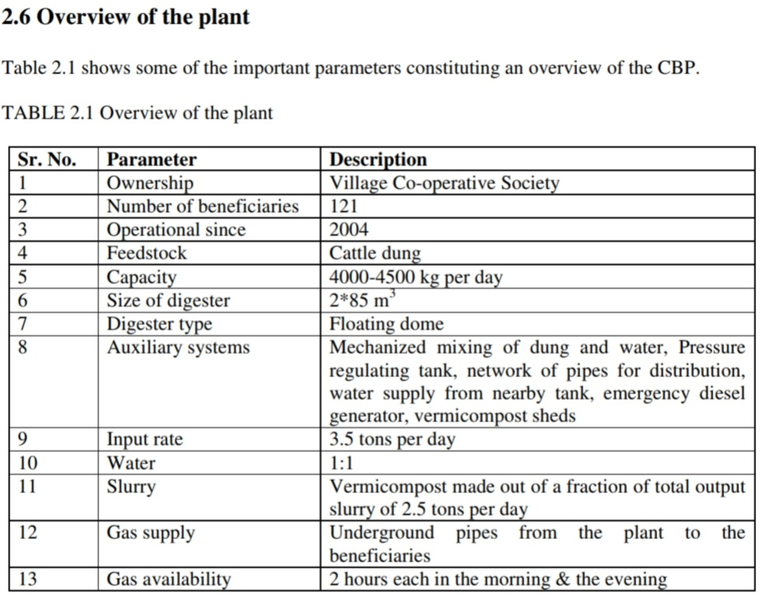

Slide 61
BioGas CAPEX
Household Plants;Rs.50,000/-
Community Level:Rs. 2-5 Million
Bio-CNG:Rs 50 Million
Utility Level : 20 Mn USD

Slide 62
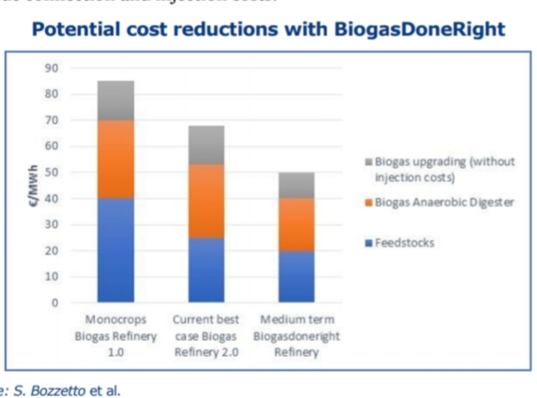

Slide 65
Poultry Sector Profile
15000 Poultry Farms
1.4 Million Tons/yr Broiler Meat
17.5 Billion Eggs
Chicken Population=

Slide 66
Feather Meal
Feathers 7% of chicken weight
10% Fat content in Feathers
1.4 Million Tons Chicken meat
Feather weight=1 Mn Tons/yr
Fat content=100,000 tons/yr
Yied =90%
Bio-diesel potential=90,000 tons

Slide 67
Poultry Litter Biogas
Chicken Population=729 million
Litter=0.7 ounce per chicken per day
Annual Litter=84 Million tons
Biogas yield=80 M3/ton
Biogas Potential=6773 Million M3=237 Billion Cft/yr=649 mmcfd?

Slide 68
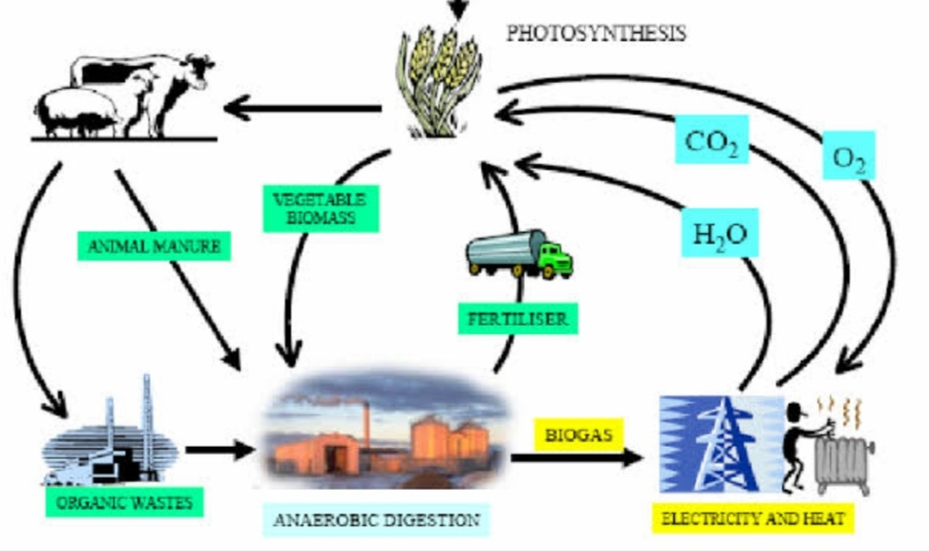

Slide 72
