Slide 1
Investment Opportunities in Khyber Pakhtunkhwa Hydropower Projects
Partnering for Liquid Gold

Slide 2
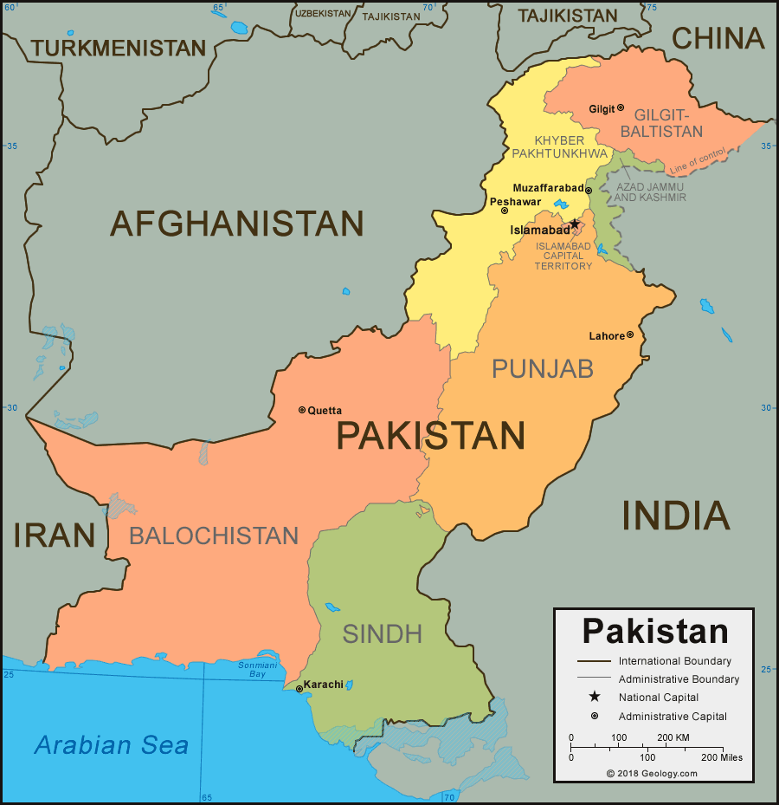
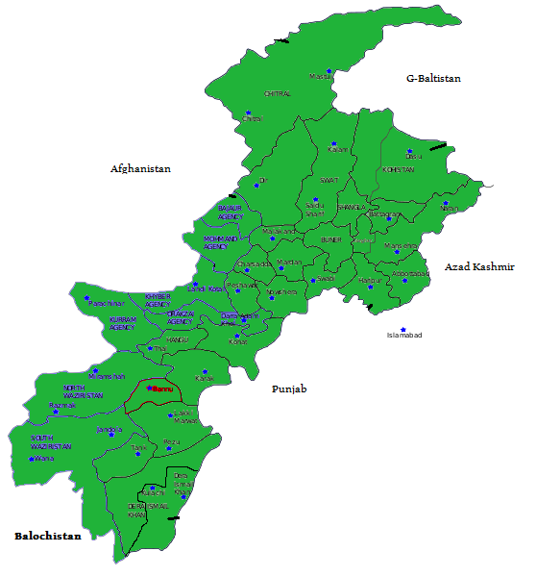
Map of Pakistan & KP

Slide 3
About PEDO
Under the Constitution of Pakistan, Provinces can develop any capacity of project within their boundaries by employing any mode of power generation such as hydropower, Solar, wind and ARE sources through Public, Private and Public-Private partnership.
Established as Small Hydel Development Organization (SHYDO) back in 1986, now became Pakhtunkhwa Energy Development Organization (PEDO) with broader scope to undertake any capacity of power projects.
KP Province has approx: 30,000 MW hydel potential out of which 6,700 MW tapped and 23,300 MW untapped.
Notes:
The northern part of the province has three famous mountain ranges i.e. Himalaya, Karakorum and Hindukush making it a unique place on earth for hydro generation projects of high head.
All the major rivers including Indus and its tributaries originates from these snow covered mountains.
And gives approximately 30,000 MW of hydro potential.
Out of which we have selected 4 projects totaling more than 400 MW to offer for investment.
The tariff regime of hydro generation envisages 20% rate of return on equity thus a project recoup its investment within 5 - 6 years.
Since there is a great market to sell power, thus its make it a good opportunity for establishment of power generation projects to earn a good return.
These projects are high head means the power generation is by utilizing the natural drop in elevation given by nature in our mountain ranges. There is no big dam with reservoir involved and the water is just diverted for few kilometers to a suitable location to generate electricity after which the water is discharged back into the same river.
The government of KPK is committed to provide easy access to every kind of information to its people and extends full facilitation to private investors.
The sale of power is guaranteed as the country has a huge electricity deficit.
The KPK Govt will fully facilitate the purchase of land for the projects.

Slide 4
KEY BUSINESS AREAS
Primary | Hydro Power Solar Other Renewables Thermal
Secondary | Mini-Micro Hydro Units Off-Grid Solar Solutions

Slide 5
PUBLIC SECTOR

Slide 6
Success Stories in Public Sector
Seven (7) hydropower Projects of 161.2 MW are completed and operational which is generating around US$ 30 Millions annually
Five (5) Projects of 215.8 MW are under construction where most of the Projects will be completed in the year 2019.
5 Projects of 636 MW cumulative Capacity are in the final negotiation stages with reputable donor agencies for development.
Feasibility Studies and detail design is in progress for 3 Projects of 965 MW Capacity .
PEDO initiated Access to Clean energy project as off grid solution for the community social uplift through Mini & Micro Hydel Projects and Solarization of Houses, Mosques and Schools. Which is benefiting the communities in far flung areas.
Notes:
For 7 projects (161 MW) see slide No 22
For 5 projects (215 MW) see slide No 23
For 4 projects (479 MW) see slide No 24
For Mini Micro see slide No 25
For solar projects see slide No 26

Slide 7
PRIVATE SECTOR

Slide 8
Success Stories in Private Sector
Processed 2 Feasibility Completed sites of 201 MW to IPPs through Tariff based ICB, wherein Tariff has been approved by NEPRA
Award of 2,024 MW Projects to National and Foreign State Owned Organizations
Award of 860 MW Hydropower Projects to IPPs for which Feasibility Studies are in progress
Approval of 5 Feasibility Studies of Total 249.5 MW Solar Projects in the Private Sector
Notes:
As per the prevailing power policy the investor may use any financial instrument to raise funds, both in terms of partial equity and debt.
Incentives to the investors are given in the policies available on the websites.
PEDO can assist investors with government approvals.
TFCs (Term Financing Certificates)

Slide 9
Why invest in Khyber Pakhtunkhwa?
Spade-work for Investment completed
Sites bearing potential identified
Bankable feasibilities available
Comparative Natural Advantages
Favorable hydrology and natural high heads
Sites with least environmental hazards
Investment-friendly regulatory environment
High Benefit investor friendly Provincial Energy Policy
Unflinching political and administrative backing
Notes:
The Govt of KP established an organization to tap the untapped undocumented hydel potential available in northern districts of province. PEDO, which was called SHYDO at that time, with the technical support of German Govt through GTZ/GIZ, identified the total potential sites in the northern districts and prepared a master plan for development of this potential. At that time a network of gauge stations were established on different stream to measure the available discharge which is a key component for feasibility study. Hydrology is a time consuming activity and for a reliable feasibility at least 20 to 30 years of data is required.
PEDO is developing projects from the master plan in public and private sector.
The northern part of the province has three famous mountain ranges i.e. Himalaya, Karakorum and Hindukush making it a unique place on earth for hydro generation projects of high head. All the major rivers including Indus and its tributaries originates from these snow covered mountains. These projects are high head means the power generation is by utilizing the natural drop in elevation given by nature in our mountain ranges. There is no big dam with reservoir involved and the water is just diverted for few kilometers to a suitable location to generate electricity after which the water is discharged back into the same river. The streams have steep gradient and give more head with less length of diversion (headrace tunnel/channel). The hydrology is also very good as we have two peaks of discharge one due to winter rain and second in moonsoon/snow melt. As these streams are fed by snow melt water therefore the flows are stable. Giving good estimate of energy to be generated.
These sites are located in northern part of the province which is comparatively less populated and since no dams are involved therefore there are no environmental hazards.
The current govt is aggressively developing this potential at every cost- Public and Private sector.

Slide 10
Investor Friendly Policy
Ease of Process
Fiscal Incentives
Attractive Rate of Return
Repatriation of Equity
Support
Land Acquisition
Security
Incentives on Tax and Custom Duties
Coordination with other Departments
Solicited Sites
Unsolicited
(G-to-G)
Semi-Raw Sites
Raw Sites
Notes:
The NEPRA allows 16% RoE (for take & pay case) and 15% RoE (for take or pay).
The investors are allowed to repatriate its return on investment.
The sales tax has been reduced from 16% to 1%. The only other tax is in the form of custom duty of 5% which is also a pass through item.

Slide 11
Advantage to invest in Khyber Pakhtunkhwa
KP Hydropower Policy 2016 allows Foreign State Owned companies to invest in the KP Province through a very simplified process.
GoKP allows projects development in Public Private Partnership (PPP) mode under Provincial PPP Act 2014.
As country’s huge untapped Hydel potential is in KP province, GoKP gives its full support in the land acquisition and security.
Facilitation of the sponsor in getting NOCs from Provincial Environmental Protection Agency (EPA)
KP Hydropower Policy 2016 allow Hydel Projects development in Captive mode.

Slide 12
Scope of KP Hydropower Policy 2016
The scope of this Power Policy entails development and implementation of power generation projects and transmission lines in the province of Khyber Pakhtunkhwa by:
Private Sector;
Public sector under the Independent Power Producer (IPP) model where relevant concessions under Power Policy are applicable
Public Private Partnerships where relevant concessions under Power Policy are applicable; and
Captive Power Plants
Notes:
The northern part of the province has three famous mountain ranges i.e. Himalaya, Karakorum and Hindukush making it a unique place on earth for hydro generation projects of high head.
All the major rivers including Indus and its tributaries originates from these snow covered mountains.
And gives approximately 30,000 MW of hydro potential.
Out of which we have selected 4 projects totaling more than 400 MW to offer for investment.
The tariff regime of hydro generation envisages 20% rate of return on equity thus a project recoup its investment within 5 - 6 years.
Since there is a great market to sell power, thus its make it a good opportunity for establishment of power generation projects to earn a good return.
These projects are high head means the power generation is by utilizing the natural drop in elevation given by nature in our mountain ranges. There is no big dam with reservoir involved and the water is just diverted for few kilometers to a suitable location to generate electricity after which the water is discharged back into the same river.
The government of KPK is committed to provide easy access to every kind of information to its people and extends full facilitation to private investors.
The sale of power is guaranteed as the country has a huge electricity deficit.
The KPK Govt will fully facilitate the purchase of land for the projects.

Slide 13
Security Package of the Policy
LOS between PEDO & sponsors and in case of Tripartite LOS between the PEDO, PPIB / AEDB and the sponsors.
IA between PEDO / PPIB / AEDB and the Sponsors as the case maybe.
PPA between the Power Purchaser and Sponsors.
WUA between Provincial Irrigation and Drainage Authority (PIDA) of GoKP.
GoKP shall facilitate process of obtaining the guarantee of the Federal Government and where the provincial entities are party to any agreement included in the security package documents.
GoKP shall provide protection against specified political and change in law force majeure risks.
Notes:
The northern part of the province has three famous mountain ranges i.e. Himalaya, Karakorum and Hindukush making it a unique place on earth for hydro generation projects of high head.
All the major rivers including Indus and its tributaries originates from these snow covered mountains.
And gives approximately 30,000 MW of hydro potential.
Out of which we have selected 4 projects totaling more than 400 MW to offer for investment.
The tariff regime of hydro generation envisages 20% rate of return on equity thus a project recoup its investment within 5 - 6 years.
Since there is a great market to sell power, thus its make it a good opportunity for establishment of power generation projects to earn a good return.
These projects are high head means the power generation is by utilizing the natural drop in elevation given by nature in our mountain ranges. There is no big dam with reservoir involved and the water is just diverted for few kilometers to a suitable location to generate electricity after which the water is discharged back into the same river.
The government of KPK is committed to provide easy access to every kind of information to its people and extends full facilitation to private investors.
The sale of power is guaranteed as the country has a huge electricity deficit.
The KPK Govt will fully facilitate the purchase of land for the projects.

Slide 14
INVESTMENT OPPORTUNITIES

Slide 15
INVESTMENT OPPORTUNITIES
A. Hydel Projects – Feasibility Studies Completed Projects
S. No. | Name of Scheme | Location | Capacity (MW) | Energy (GWh/a) | Estimated Cost (M US$)
1 | Lower Palas HPP | Kohistan | 665 | 2,590 | 1,104.51
2 | Naran HPP | Mansehra | 188 | 705.46 | 440
3 | Bata Kundi HPP | Mansehra | 96 | 368.7 | 190
4 | Ghorband Khwar HPP | Shangla | 20.6 | 111.4 | 74
5 | Nandihar Khwar HPP | Battagram | 12.3 | 69.84 | 50
6 | Ghrait- Swir Lasht | Chitral | 370 | 1500 | 1811
7 | Istaru Booni | Chitral | 72 | 256 | 276
8 | Mujigram-Shoghore | Chitral | 64.26 | 277.72 | 182
9 | Kari Mashkur HPP | Chitral | 446 | 2036 | 1534
Total |  |  | 1,935 | 7,915 | 5,661

Slide 16
INVESTMENT OPPORTUNITIES
B. Hydel Projects – Semi Raw Sites
S. No. | Name of Project | Location | Capacity (MW) | Est. Cost (M US$)
1 | Middle Spat Gah HPP | Kohistan Upper | 489 | 682
2 | Middle Palas HPP | Kohistan Lower | 398 | 521
3 | Upper Spat Gah HPP | Kohistan Upper | 252 | 863
4 | Upper Palas HPP | Kohistan Lower | 157 | 425
5 | Kedam Khwar HPP | Swat | 17.14 | 20.02
6 | Ayun Gol HPP | Chitral | 15.17 | 30.2
7 | Saiful Maluk Katha HPP | Mansehra | 7.43 | 27.2
Total |  |  | 1,336 | 2,568

Slide 17
INVESTMENT OPPORTUNITIES
S . No. | Name of Project / Location | Capacity* | Estimated Cost (M US$)
1. | 225KM - EHV Transmission Line, Chitral, Khyber Pakhtunkhwa | 500KV | 112.5
2. | Drosh Grid Station, EHV | 500KV | 40
3. | Chakdara Grid Station, EHV | 500KV | 40
Total |  |  | 192.5
EOI called for the Feasibility Studies,
*numbers are tentative; will be finalized after feasibility

Slide 18
THANK YOU!

Slide 19
Completed Projects – Public Sector
S # | Name of Project / Location | Date of Completion | Installed Capacity (MW)
1. | Malakand-III , Dargai | Nov 2008 | 81
2. | Pehur, Swabi | March 2010 | 18
3. | Reshun, Chitral | September 2019 | 4.2
4. | Shishi, Chitral | June 2010 | 1.8
5. | Machai | Oct 2017 | 2.6
6. | Ranolia | Oct 2017 | 17
7. | Daral Khawar | Sept 2018 | 36.6
 | Total |  | 161.2
Back

Slide 20
Projects Under Construction - Public Sector
S. No. | Name of Project | District | Capacity (MW) | Project Cost (USD Million)
1. | Jabori | Mansehra | 10.2 | 38
2. | Karora | Shangla | 11.8 | 46
3. | Koto | Dir Lower | 40.8 | 142
4. | Matiltan | Swat | 84 | 208
5. | Lawi | Chitral | 69 | 201
 | Total |  | 215.8 | 635
Back

Slide 21
Public Sector Projects – Donor Assistance
S. No. | Name of Project | Capacity (MW) | Estimated Cost (US$ million) | Financing
1. | Balakot | 300 | 685 | Asian Development Bank
2. | Gabral- Kalam, Swat | 110 | 331 | World Bank
3. | Patrak-Shringal, Upper Dir | 22 | 83 | World Bank
4. | Barikot Patrak, Upper Dir | 47 | 148 | World Bank
5. | Madian, Swat | 157 | 484 | World Bank
 | TOTAL | 636 | 1,731
Back

Slide 22
Overview of Micro Hydel Project
Project | Capacity (MW) | Total Cost (USD Million) | Features
Construction of Mini-Micro Hydel Projects in Northern Districts of KP | 34.7 MW | 53 | 356 Mini hydel power potential projects in 12 Northern districts of Khyber Pakhtunkhwa.
Access to Clean Energy Program Under ADB Loan | 53.13 MW | 118 | 672 Mini hydel projects will be constructed in Northern areas of KP including 150 on canal falls.
Back

Slide 23
SOLAR PROJECTS – PUBLIC SECTOR
S. No. | Description
1. | Electrification of 100 Villages through Solar/Alternate Energy, Phase-1.
2. | Electrification of Un-Electrified Villages through Solar/Alternate Energy, Phase-II.
3. | Solarization of Chief Minister’s Secretariat/Chief Minister’s House.
4. | Solarization of Civil Secretariat (For Remaining Departments of Civil Secretariat)
5. | Solar Electrification of 4000 Masajid In Khyber Pakhtunkhwa.
6. | Solar Electrification of 440 Masajid in PK-10 (Old) & PK-11 (Old) in District Peshawar.
7. | Solar Electrification of 300 Mosques in Merged Districts in Khyber Pakhtunkhwa
8. | Solarization of 8000 Schools & 187 BHUs in KPK
Back

Slide 24
Solicited Sites
Total Capacity – 201 MW
S No. | Project | District | Capacity (MW) | Sponsor | Status
1 | Shigo Kas HPP | Dir Lower | 102 | Saifo Group | NEPRA Approved Tariff
2 | Arkari Gol HPP | Chitral | 99 | Master Textiles
Back

Slide 25
PSO & State Owned Enterprises Sites
Total Capacity – 2,024 MW
Back
S # | Project | District | Capacity (MW) | Sponsor
1 | Lower Spat Gah HPP | Kohistan | 496 | KHNP, Korea
2 | Laspur Marigram HPP | Chitral | 230 | FWO
3 | Shushgai Zhendoli HPP | Chitral | 144 | FWO
4 | Shogo Sin HPP | Chitral | 132 | FWO
5 | Toren More Kari HPP | Chitral | 350 | Sinohydro, China
6 | Jamshel Toren More HPP | Chitral | 260 | Sinohydro, China
7 | Kalam Asrit HPP | Swat | 197 | KOEN, KOREA
8 | Asrit Kedam HPP | Swat | 215 | KOEN, KOREA

Slide 26
Feasibility Study in Progress Projects
Total Capacity – 860 MW
S # | Project | District | Capacity (MW) | Sponsor
1 | Sharmai HPP | Dir | 150 | Sapphire Electric
2 | Nila Da Katha HPP | Mansehra | 2.47 | Sino-Pak Power
3 | Bhimbal Katha HPP | Mansehra | 7.86 | Multiline Pakistan
4 | Baram Gol HPP | Chitral | 24.93 | Markhor Energy
5 | Chowkel Khwar HPP | Swat | 12.00 | MMP
6 | Mastuj HPP | Chitral | 48.20 | Chinar Power
7 | Balkani HPP | Shangla | 7.75 | Shangla Power
8 | Raw Site Projects | - | 606.86 | -
Back

Slide 27
Solar Projects
Total Capacity – 249.5 MW
S # | Project | District | Capacity (MW) | Sponsor
1 | Kolachi | D.I. Khan | 50 MW | FAS Energy
2 | Kolachi | D.I. Khan | 50 MW | Target Energy
3 | Paharpur | D.I. Khan | 49.5 MW | AASAL Solar Power
4 | Nowshehra | Nowshehra | 50 MW | Siddiqsons Solar
5 | Lachi | Kohat | 50 MW | Siddiqsons Solar
Back

