Slide 1
PAKISTAN HYDROPOWER SECTOR PROSPECTS, CHALLENGES AND FUTURE

Slide 2
INTRODUCTION OF KOEN
Leading Generation Company of South Korea with 10,319MW capacity;
Asset Base is USD 8.1 billion;
100% subsidiary of KEPCO; Rated A3 by Moody’s and A+ by S&P;
Currently major portion of energy mix of KOEN is coal based, however, lately KOEN is committed to become Clean & Smart Energy Leader with focus on eco-friendly and sustainable energy;

Slide 3
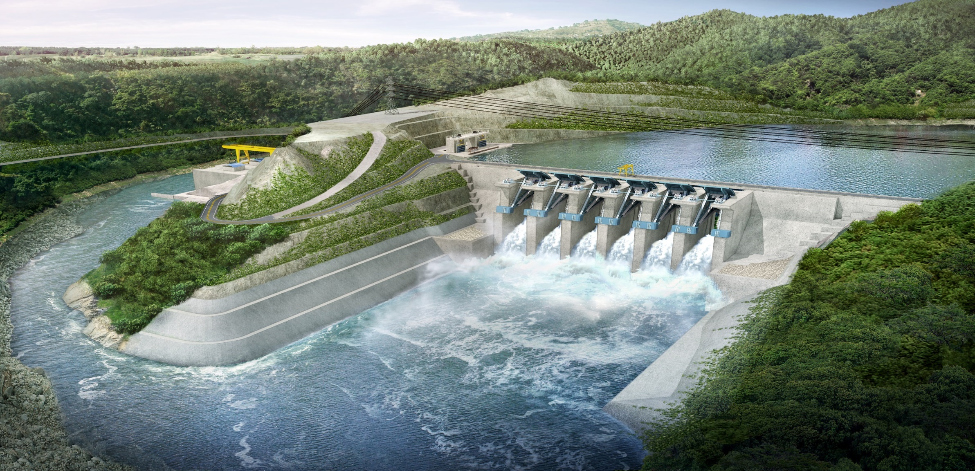
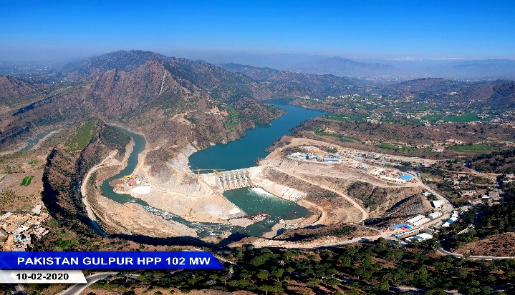
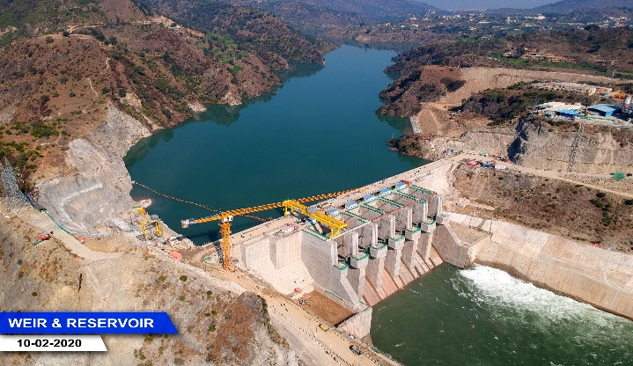
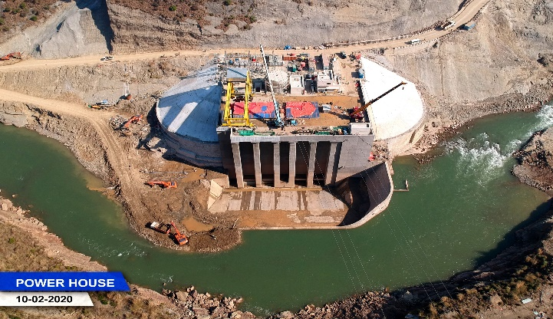
GULPUR HYDROPOWER PROJECT
48 months Construction Period
102MW
Capacity
475 GWh Annual Generation
57.8 m Gross Head
66.5 m Dam
201 cms
Design Flow
Run of River Scheme

Slide 4
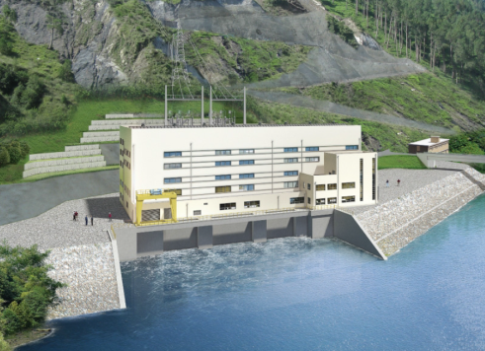
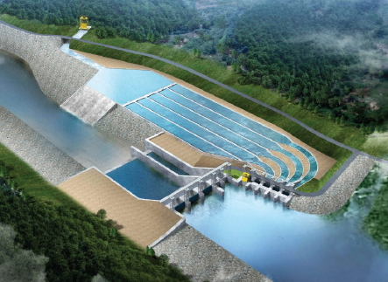
ASRIT – KEDAM HYDROPOWER PROJECT
SPC Name: KOAK Power Co. Ltd.
Location: Swat Valley, Mingora District, KPK
Capacity: 215 MW (3 x 60.9 MW + 1 x 32.2 MW)
Generation: 911.5 GWh
Concession Period: BOOT (30 operational years)
Asrit
Asrit-Kedam HPP
Cost: USD 500 million (125m Equity, 375m Loan)
Kedam
Powerhouse
Financiers: ADB, IFC, K-EXIM etc.
Construction Period: 5 Years
Main Sponsor: KOEN (Korea South-East Power Co.)
EPC Contractor: To be selected (Bidding Process)
Policy: GoP Power Policy 2015 & KPK Policy 2016
Indicative Tariff: 8 Cent / KWh (levelized)
Weir Site

Slide 5
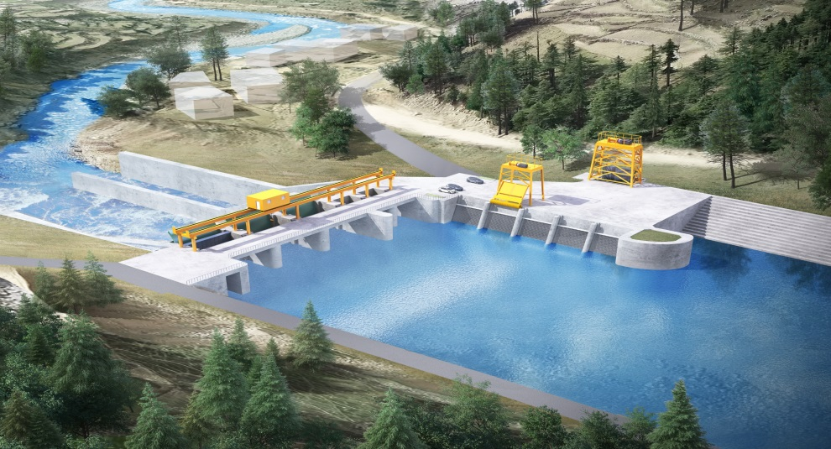
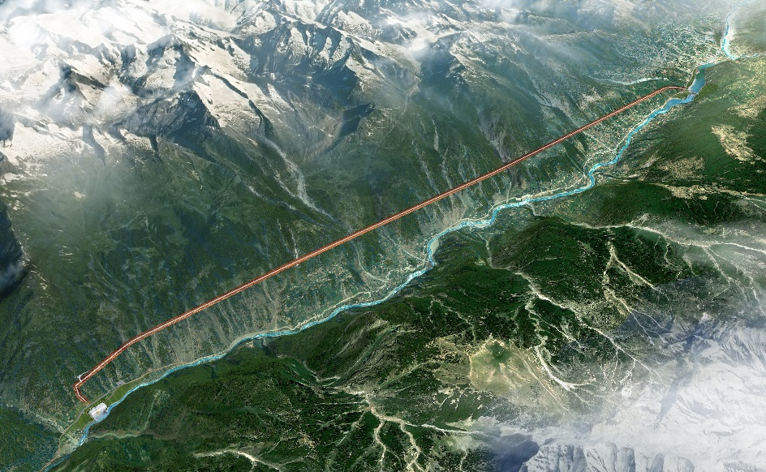
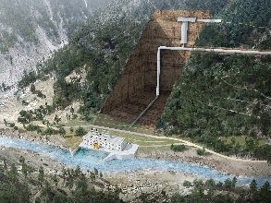
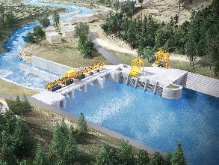
Kalam - Asrit Hydropower Project
Kalam Asrit Project
Project Summary
Project Name | Kalam Asrit HPP
Installed Capacity | 238MW(Estimated)
Annual Generation | 912.9GWh(Plant Factor 45%)
Total Cost | 512.0 Mil.USD
Assumed Tariff | 8.6 Cent/kWh(F/S Stage)
Period | 30 years+5years construction
Project Aerial View
Powerhouse
P/H
Weir
Weir Site
5

Slide 6
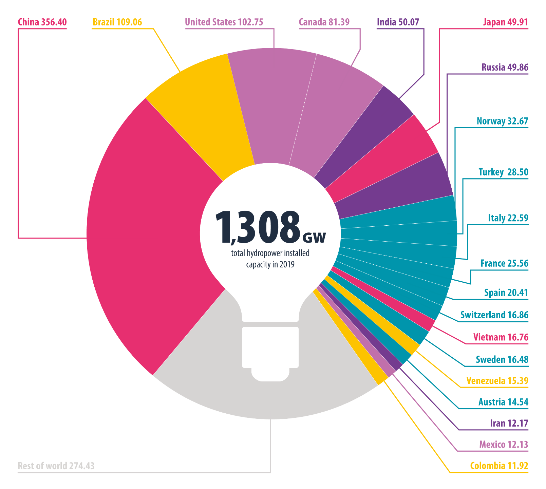
Hydropower Status Report 2020
Global hydropower installed capacity
Total global hydropower installed capacity reached 1,308 gigawatts (GW) in 2019.
This represents an annual rise of 1.2 per cent.
hydropower.org/statusreport

Slide 7
HYDRO POTENTIAL OF PAKISTAN
60,000 MW

Slide 8
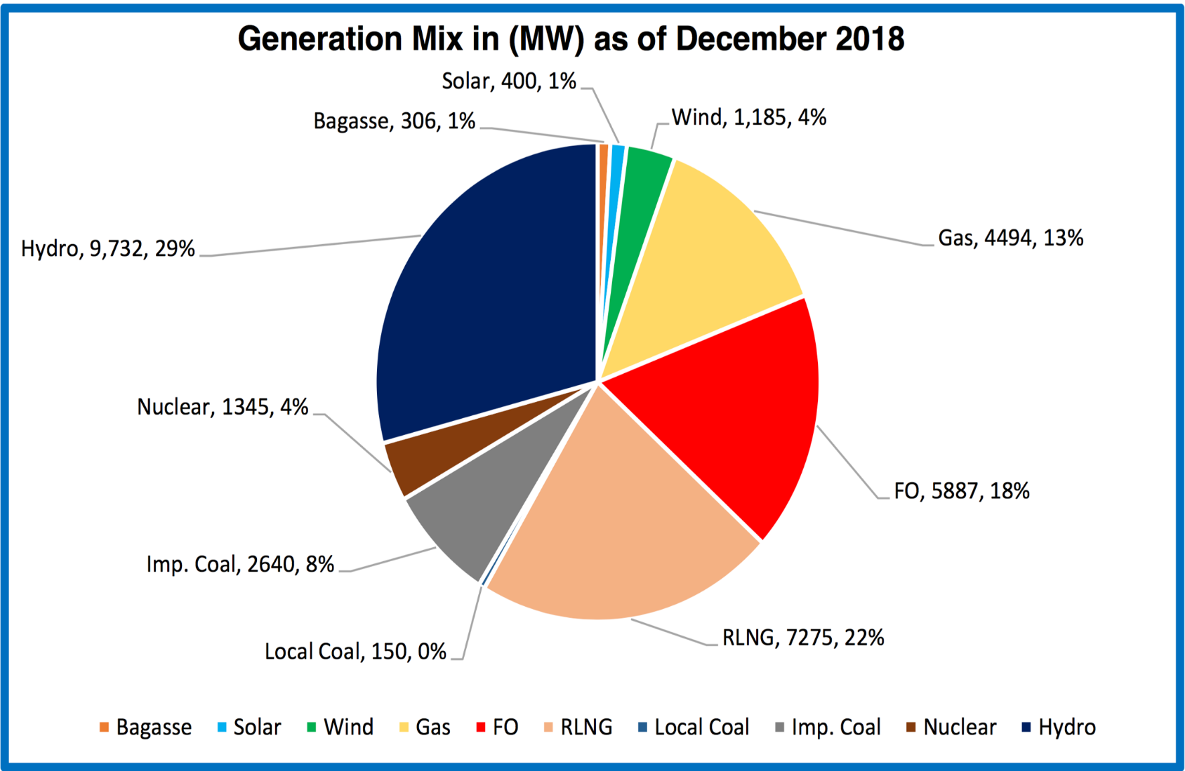
CURRENT GENERATION MIX OF PAKISTAN – 33,414 MW
HYDRO: 29%
RENEWABLE: 6%
THERMAL: 65%
Lack of Planning and Forecasting
Quick Fixes
Political Reasons
Misunderstanding of energy market
Inherent issues in Hydro development

Slide 9
STRENGTHS OF POWER SECTOR
Attractive & Balanced Pakistan Power Policy:
Fair and equitable allocation of risks;
Key risk like exchange risk, hydrological risk, political risk, change in laws & taxes risk, interest rate risk, limited geological risks are borne by the Government;
Attractive set of fiscal concessions like tax holidays, free repatriations of investment, guaranteed availability of foreign exchange;
Sovereign Guarantee to cover payment obligations and bail-out opportunity in case of termination;
Attractive USD IRR for renewable projects;
Well defined Tariff Structure
Capacity Payments to cover debt servicing, IRR, O&M and Insurance costs;
Cost Plus Tariff Regime whereby legitimate costs prudently incurred for the benefit of the projects are allowed; Upfront Tariffs are also based on reasonable assumptions;

Slide 10
STRENGTHS OF POWER SECTOR
Strong and Experienced Institutions
One Window Facility of PPIB with highly professional and experienced team gives huge comfort to the investors and saves lots of processing time;
High powered, competent and independent Regulator (NEPRA) to oversee the tariff and licensing matters to balance the interests of consumers and the investors;
Mature IPP Market
With the experience of 22 years and more than 40 operational IPPs, the IPP market is very mature and stable. With this experience a standard and balanced set of key project documents (including PPA, IA, FSA) has evolved boosting the confidence;
Huge Demand of Electricity
The demand of electricity in Pakistan is expected to remain high in coming decades creating at attractive market for investment.

Slide 11
KEY CHALLENGES FOR HYDROPOWER IN PAKISTAN
HYDROPOWER DEVELOPMENT
A MISUNDERSTOOD CONCEPT IN PAKISTAN

Slide 12
KEY CHALLENGES FOR HYDROPOWER IN PAKISTAN
Recently issued IGCEP ranks hydropower (specifically private sector) based on capital cost while completely ignoring the economic and ancillary benefits of hydropower;
In IGCEP, Public Sector Hydropower has been given priority on private sector hydropower completely ignoring the inherent inefficiencies and availability of financing for public sector projects;
Inherent issues of Power Sector like Circular Debt, Payment Delays, availability of grid and transitional phase of power sector is also effecting the decisions of international investors;

Slide 13
PROPOSED POLICY CHANGES – a recipe of disaster
Despite issuance of various policies and good incentives, Government was unable to attract much investment in hydropower sector, however, in a surprise move, decision makers are considering to withdraw certain incentives (listed below) which will not only effect the hydropower development but also deprive the country with this cheapest source of electricity.
Shift of PPAs to “Take and Pay” regime;
Reduction in term of PPA;
Reduction in IRR;
Unilateral fixation of tariff ceilings;
Imposition of additional taxes like income tax on offshore contracts, sales tax on construction services;
Increase in water use charges;

Slide 14
Way Forward for the Decision Makers
for Hydropower Development in Pakistan

Slide 15
HYDROPOWER AND CAPACITY TRAP
Hydropower does not create capacity trap but compliments peak demand curve of the country.

Slide 16
Hydropower is Cheapest Source of Electricity
Hydropower is cheapest source of energy if following factors are given due consideration
Long life of around 80-100 years – Mangla & Tarbela are producing energy @ less than PKR 1 after fifty years. No other technology can compete with hydropower in this respect;
Hydropower provide most valuable peaking energy which essentially reduces the tariff of hydropower by 10%;
Hydropower is the only source of technology which provides reactive power for grid stability (In USA, reactive power is valued at US Cent 7 per Kvarh) which essentially reduces the nominal hydropower tariff by further 20%;
Compared with any other technology, almost 10% of Capital Cost (On-Shore) of hydropower is paid back to Government in terms of taxes
3-4% of total tariff is paid back to Government in form of Water Use Charges
A hydropower project with a nominal tariff of US Cent 8 per KWh will cost not more than US Cent 5 per KWh to the Government which concludes hydropower as cheapest source

Slide 17
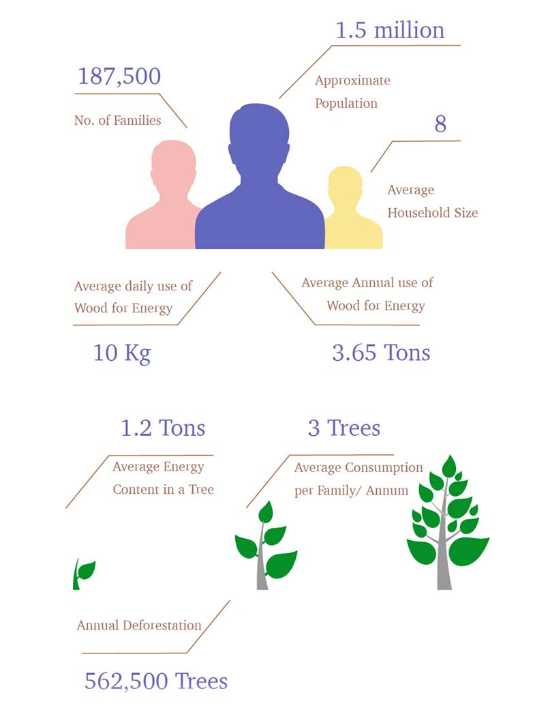
Hydropower is the economic engine
70% of Capital Cost is consumed locally which gives significant boost to economy and GDP while supporting 50 ancillary industries
Long Term energy security (Reliance on imported fuel is reduced) – 10 MW of hydropower saves around US$ 1 million per annum in term of fuel cost. Only on account of this matter, capital cost of hydropower become irrelevant in decision making
Watershed Management - Only in GB (upper reaches of Indus) annually 562,500 tree are cut for energy use
Hydropower and Dams are one the most effective adoptive measure to control the extreme weather (floods and drought) arising due to Climate Change through regulation of water

Slide 18
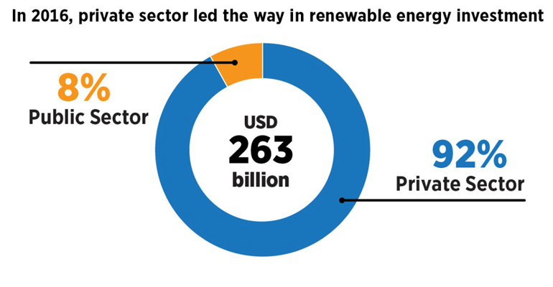
PUBLIC SECTOR HYDRO VS PRIVATE HYDRO
Private Hydropower should not be considered as competing option with Public Hydropower.
While the Public Hydro has inherent efficiencies, delays, cost overruns and lesser access to financing, however if Government decide to move for public sector, it should be for larger and strategic projects in public sector and equally promote private hydropower in which most of the risks are shifted towards sponsors and lenders in non-recourse financing model. A global trend of investment in renewable sector is shown below:

Slide 19
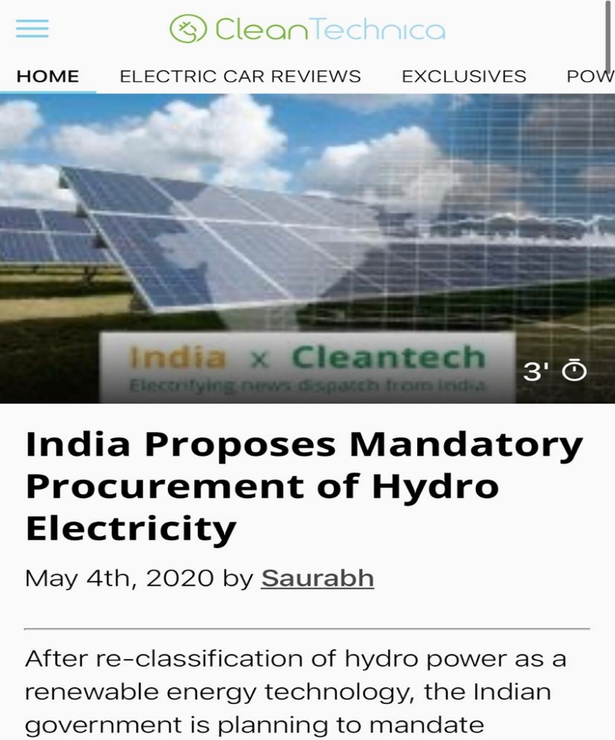
CONCLUSION
Based on aforesaid, we strong conclude that private hydro development is the lifeline for Pakistan and government should decide to include significant percentage of private hydro as mandatory acquisition which should be incorporated in all policies including IGCEP.
Country | Coal | Gas | Oil | Hydro | Renewabl | Nuclear
Paraguay | 0.0 | 0.0 | 0.0 | 100 | 0.0 | 0.0
Tajikistan | 1.5 | 0.0 | 0.0 | 99 | 0.0 | 0.0
Norway | 0.1 | 1.8 | 0.0 | 96 | 1.9 | 0.0
Ethiopia | 0.0 | 0.0 | 0.0 | 93 | 7.3 | 0.0
Georgia | 0.0 | 22.0 | 0.0 | 78 | 0.0 | 0.0
Iceland | 0.0 | 0.0 | 0.0 | 73 | 26.7 | 0.0
Venezuela, | 0.0 | 19.4 | 16.9 | 64 | 0.0 | 0.0
Brazil | 4.7 | 13.7 | 5.0 | 62 | 12.1 | 2.6
Panama | 6.9 | 0.0 | 27.8 | 61 | 4.6 | 0.0
Uruguay | 0.0 | 0.0 | 11.4 | 60 | 28.4 | 0.0
Austria | 8.2 | 12.6 | 1.4 | 60 | 16.5 | 0.0
Switzerland | 0.0 | 1.0 | 0.1 | 58 | 4.3 | 34.9
Croatia | 20.6 | 10.7 | 2.0 | 57 | 10.0 | 0.0
Canada | 9.8 | 10.0 | 1.2 | 57 | 6.3 | 15.5
New Zealand | 4.3 | 15.5 | 0.0 | 56 | 24.6 | 0.0
Pakistan | 8 | 35 | 18 | 29 | 6 | 4

