Slide 1
PAKISTAN HYDRO POWER SECTOR
PROSPECTS, CHALLANGES & FUTURE
Intl. Virtual Conference
DR. MUNAWAR IQBAL
DIRECTOR (Hydropower)
Private Power and Infrastructure Board
Ministry of Energy (Power Division)
25 AUGUST 2020

Slide 2
21125 MW
HYDROPOWER POTENTIAL
24736 MW
6450 MW
7291 MW
1 MW
Total
=59796 MW
193 MW

Slide 3
Hydropower Potential - River
Total
=59796 MW
Say (60000 MW)

Slide 4
GRID AS OF NOW
SHPP 0.3%
Biomass 0.7%
Solar 1%
Wind 3%

Slide 5
HYDROPWER
PROVINCE WISE STATUS
MW
MW
AJ&K
KPK
Punjab

Slide 6
HYDROPOWER
ENTITIES WISE STATUS
70 MW
386 MW
450 MW
Operation
Development
380 MW
390 MW
165 MW
3070 MW
4135MW
333 MW
6446 MW
6779 MW
9389MW
3300 MW
12689 MW
MW

Slide 7
LOCATION OF HPPs
ON JEHLUM RIVER
N
Chakothi
Jhelum River
500 MW Chakothi Hattian HPP
Dam
Hattian Town
Neelum Jhelum HPP
Siran Village
AJ&K
Muzaffarabad
Mahl River
Kohala Bridge
Neelum River
1124 MW Kohala
700 MW Azad Pattan HPP
720 MW Karot HPP
17 km
PH
Mangla
147 MW Patrind HPP
Barsala
Jhelum River
640 MW Mahl HPP
Khyber Pakhtunkhwa
Kunhar River
PUNJAB
Murree
Garhi
Habibullah
7
Notes:
7

Slide 8
NEELUM VALLEY- MAJOR HYDEL SCHEMES
Dudhnial 960 MW Athmuqam 350 MW Ashkot 300 MW N-J 969 MW Total= 2579 MW
AJ&K
Khyber Pakhtunkhwa
Nara
Dudhnial HPP
Janawai
Kaghan
KUNHAR RIVER
NEELUM RIVER
Sharda
Halmat
Dudhnial
Athmuqam
HPP
Toabat
ATHMUQAM
Jagran
Legend
Ashkot HPP
Kundal Shahi
INDIAN OCCUPIED KASHMIR
NEELUM RIVER
Panjgran
TITHWAL
N-J HPP

Slide 9
PROJECTS ON POONCH RIVER IN AJK
Sehra HPP
SEHRA 130 MW KOTLI 100 MW GLPUR 100 MW RAJDHANI 132 MW Total= 462 MW
TATA PANI
KOTLI HPP
KOTLI
Rajdhani HPP
Gulpur HPP
MANGLA
Gulpur

Slide 10
PROJECTS ON
KUNHAR RIVER IN KP
96 MW
Batta Kundi HPP
188 MW
Naran HPP
Allai Khwar
Naran
Kaghan
Bata Kundi 96 MW Naran 188 MW Suki Kinari 870 MW Balakot 300 MW Patrind 147 MW Total= 1601 MW
870 MW
Suki Kinari HPP
Paras
300 MW
Balakot HPP
Balkot
Mansehra
Muzaffarabad
147 MW
Patrind HPP

Slide 11
HYDROPOPWER
IDENTIFIED HPP POTENTIAL
17%
8%
67%
8%

Slide 12
HYDROPOPWER
PROSPECTS
  Fiscal and Financial Incentives
  Hydrological Risk Coverage
  Sovereign Guarantee
  Tri Partite Letter of Support Regime (a bridge b/w province and Federal levels)
  Three Stage Tariff Mechanism
  Indigenous, Renewable and Reliable for Peaking Operations
  Well Tested Security Package
  Confidence of Lenders and Investors:
    Major Lenders: IFC_WB, ADB, IsDB, ICBC, CDB, K-EXIM
    Major Sponsors: CTG_CSAIL, CGGC, HUBCO, K-WATER, KOEN, KHNP,
  Socio-Economic Uplift of Remote Areas plus WUC to provinces
  Much Better Per MW-Output Based CAPEX than other RE Technologies

Slide 13
HYDROPOWER
CHALLENGES
  Per MW Installed Capacity CAPEX Higher than Other Technologies
  Placement in Indicative Generation Capacity Expansion (IGCEP)
  Financing Issues from World Bank and ADB etc. (some Areas)
  Environmental Related Compliances
  Land Acquisition (Gen. Projects as well as T/Lines)
  Provincial Projects when initiated remained out of radar of Federal entities (i.e. CPPAG-NTDC)
  Synchronization of Projects development in each Valley to meet T/Line capacities
  Non Availability of Power Policy for Gilgit Baltistan
  Non Connectivity of National Grid with Gilgit Baltistan Region
Notes:
13
13

Slide 14
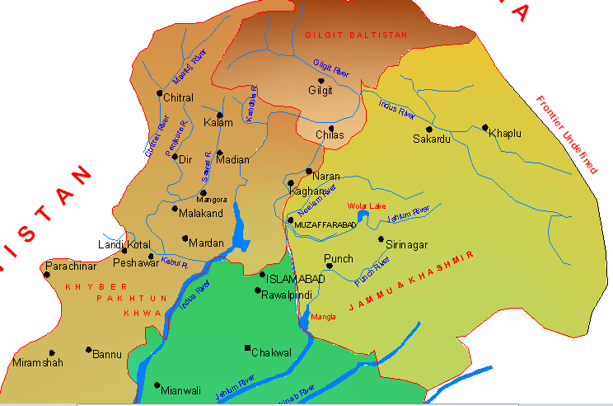
TRANSMISSION
CHALLENGE
22000 MW
3000 MW
2000 MW
10000 MW
1600 MW
P u n j a b
Neelum R.
2500 MW
Jhelum R.
3500 MW
Poonch R.
Size of T/Line
Voltage Level
Projects’ Schedule
IGCEP Merit
B a l o c h i s t a n
S i n d h
BACK

Slide 15
HYDROPOPWER
FUTURE
  Around 40,000 MW Non Committed Potential Available
  IGCEP 2020-2047 includes Development of around 45000 MW Potential up to year 2047
  Transmission Expansion Plan (TEP) being Synchronized with IGCEP
  GOP Determined to Develop Indigenous Sources for Electricity Generation
  GOP Committed to Drastically Increase Share of Renewable Sources in Power Mix with
  Hydropower has Capability to Compensate Technical Limitations of Other RE Plants w.r.t. Lower Capacity Factor, Intermittency of Generation and Grid Stability
  Increasing Interest of Investors in Hydropower

Slide 16
THANKS

