Slide 1

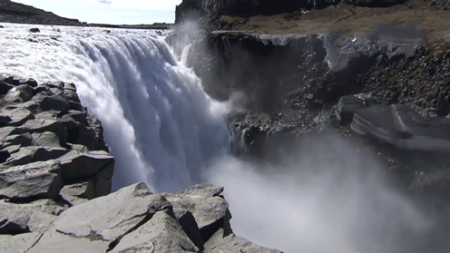
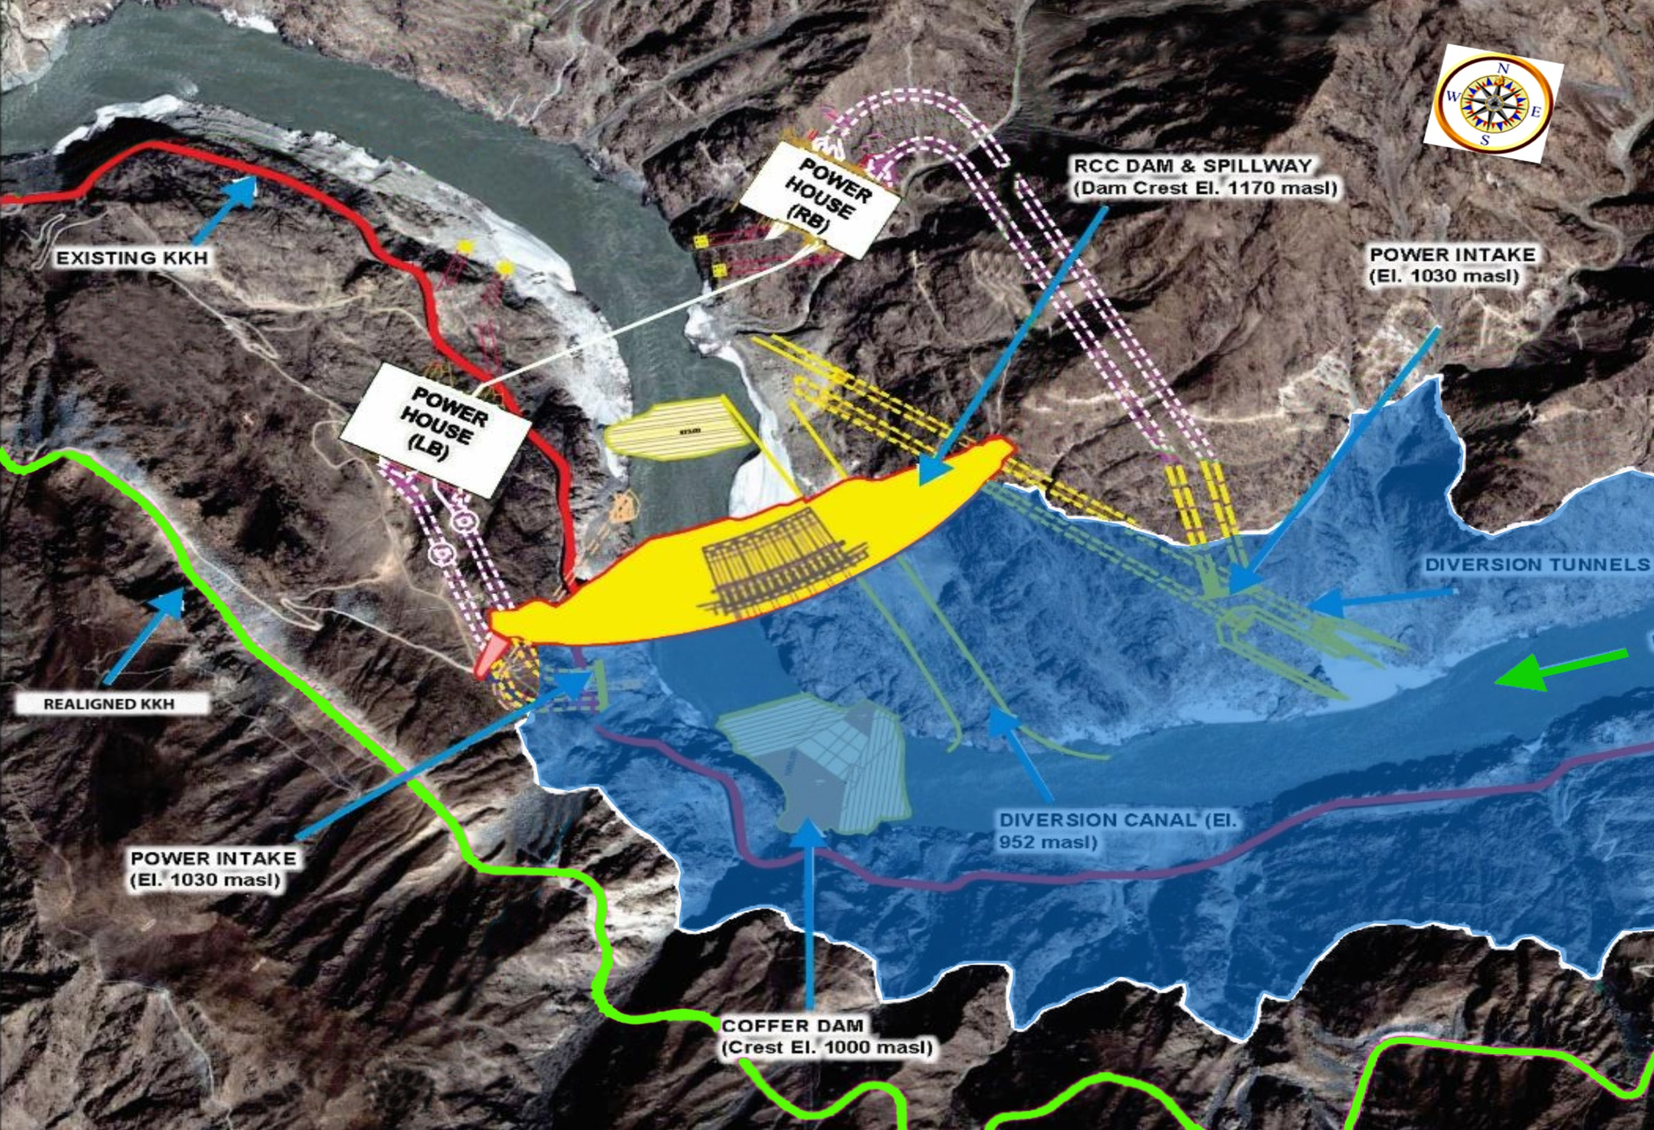
WATER AND POWER DEVELOPMENT AUTHORITY
WATER AND HYDROPOWER DEVELOPMENT - WAPDA
NOVEMBER 27, 2021

Slide 2
HUMAN SECURITY DEPENDENT HOW WE MANAGES FOUR KEY COMPONENTS
POPULATION
HUMAN SECURITY
FOOD
WATER
ENERGY

Slide 3
PER CAPITA AVAILABILITY OF WATER
10000
9000
8000
7000
6000
5000
4000
3000
2000
1000
0
230
220
210
200
190
180
170
160
150
140
130
120
110
100
90
80
70
60
50
40
30
230
220
210
200
190
180
170
160
150
140
130
120
110
100
90
80
70
60
50
40
30
a
248
POPULATION
GROWTH
207
178
5,650 m³
(1951)
PER CAPITA
AVAILABILITY
138
CANAL DIVERSIONS (MAF)
AFTER
TARBELA
PER CAPITA AVAILABILITY (M) ³ / ANNUM
106
POPULATION ( MILLIONS)
POPULATION ( MILLIONS)
104
AFTER
MANGLA
98.6
AFTER
TREATY
WATER SHORT COUNTRY
BEFORE
TREATY
908 m³
2019
1700 m³
1992
550 m³
2025
INDEPENDENCE
1951 1961 1972 1981 1992 2002 2019 2025
2
YEARS
Notes:
2
The Stark facts:
Water stress: Pakistan has already reached water stress situation, a situation which is going to degrade into out-right water scarcity as a result of high population growth.

Slide 5
AVAILABILITY OF RIVER WATER
Reservoirs needed for inter-season and inter-year transfer of Water
Max. Flow 1978-79
Avg. Annual Flow
(1976-2018)
Min. Flow
(2001-02)

Slide 6
CARRY OVER CAPACITY (DAYS)
Notes:
5

Slide 7
STORAGE CAPACITY
RESERVOIR | LIVE STORAGE CAPACITY |  |  | STORAGE LOSS
 | ORIGINAL |  | YEAR 2019 | YEAR 2019
TARBELA | 9.692 |  | 6.047 | 3.645 (38%)
MANGLA | 5.86 | 8.237 | 7. 356 | 0.881 (11%)
CHASHMA | 0.717 |  | 0.278 | 0.439 (61%)
TOTAL | 16.269 | 18.646 | 13.681 | 4.965 (27%)
Notes:
6
Tarbela, Mangla and Chashma are large size reservoirs in Pakistan which directly feed the Indus Basin Irrigation Network. Their original total live storage capacity was 16.27 MAF. This storage capacity was increased to 18.646 MAF in 2012 by raising of Mangla Dam.
By 2017, the total storage capacity has decreased to 13.86 MAF due to deposition of sediments. Up-till now a total storage capacity of 4.78 MAF has been lost to sedimentation, which is about 25% of original total storage capacity of these reservoirs.

Slide 8
PAKISTAN’S WATER SECTOR
Indus Basin vs Other River Basins
RIVER BASINS | AVG. ANNUAL FLOW (MAF) | USABLE STORAGE (MAF) | % STORAGE
COLORADO | 12 | 59.62 | 497
NILE | 47 | 132 | 281
SUTLEJ BEAS & RAVI | 32 | 11.32 | 35
INDUS BASIN | 145 | 14.06 | 10
WORLD AVERAGE | 20,000 | 8,000 | 40

Slide 9
WAPDA
Integrated Development, Operations and Investments for Water and Power Resources of Pakistan

Slide 10
DEVELOPMENT OF WATER & POWER RESOURCES BY WAPDA
1958-2020
Dams
15
20.85 MAF
Rs. 166 Billion
Drainage
62
25,160 KMs
14,322 T/Wells
Rs.70 Billion
Hydropower
22
9,915 MW
Rs.1,292 Billion
Thermal Power
14
6190 MW
Rs. 92 Billion
Grid Station
47,618 Nos
T/Lines
51,425 KMs
Barrages
07
0.72 MAF
Rs.18 Billion
Canals
16
1,454 KMs
Rs. 170 Billion
Distribution Network
11KV/440/220
465,000 KMs
Village Electrified
125,000
Command Area 30 Million Acres
Reclamation of land 22 Million Acres
Drinking Water 324 Million Gallon/day

Slide 11
INSTALLED CAPACITY - 2021
Total Installed Capacity
39,772 MW
1,43,309.67 GW
Total Hydel
9,915 MW 38,800.54 GW
Nuclear
2,475 MW
11,090.05 GW
Wind / Solar/ Biomass
2,047 MW
4,322.13 GW
GENCOs/ IPP’s / SPPs
22,497 MW
75,728,36
KE System
(KE Own / IPPs/ SPPs/ KANUPP/ Wind/ Solar
2838 MW
13,368.59 GW

Slide 12
ENERGY – 2021
Total Generation
121 Billion Units/Year
WAPDA’s Contribution
37 Billion Units/Year
(31%)

Slide 13
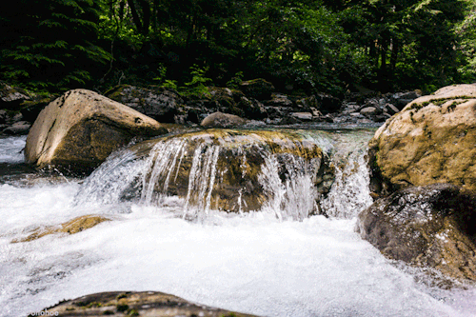
INDUS CASCADE PAKISTAN’S MOST PRECIOUS ASSET
Indus enters Pakistan
Altitude 8,430 ft
5.5 MAF
Shyok
640 MW
3.0 MAF
Skardu
1,200 MW
Tungus
2,200 MW
Yulbo
2,800 MW
Bunji
7,100 MW
6.4 MAF
Diamer Basha
4,500 MW
Drop of 7,840 feet
Dasu
4,320 MW
Pattan
2,400 MW
Thakot
4,866 MW
42,387 MW
6.05 MAF
Tarbela/GB
7,748 MW
6.0 MAF
Akhori
600 MW
33 MAF
Kalabagh
3,600 MW
6.0 MAF
Jinnah
96 MW
0.28 MAF
Chashma
184 MW
Taunsa
135 MW
Multiple Sites along this stretch
Altitude 590 ft
12
Notes:
Upper Indus Basin has a drop of more than 7,000 feet in a stretch of 500 Km length which is ideal for hydropower generation and can serve as engine of growth for economy of the country. Studies carried out by WAPDA identified potential sites for hydropower development projects with more than 42,000 MW generation capacities. The important sites includes Bunji - 7,100 MW, Tungus - 2,200 MW, Yulbo - 2,800 MW, Basha - 4,500 MW, Dasu 4,320 MW, Tarbela/Ghazi Barotha - 7,748 MW, Kalabagh - 3600 MW etc.

Slide 14
Where Do We Go ?
Water Demand
Population 2019
207 million
Population 2050
312 million
Increase in Demand
Water
Food
Energy
Additional Irrigation Water Required
2050
60 MAF
Additional Urban Water Required
2050
10 MAF
Hydel Thermal Mix
2020
30 %
2030
40 %
2050
50 %

Slide 15
WAY FORWARD
SHORT TERM - 2025
5 MAF / 4,600 MW
Nai Gaj (Sindh)
MEDIUM TERM - 2030
8 MAF / 16,000 MW
DBD (GB)
Chiniot (Punjab)
LONG TERM - 2050
28 MAF / 18,400 MW
Kurram Tangi-II (KP)
Skardu (GB)
Mid Ranjha (Punjab)
Akhori (Punjab)
Rohtas (Punjab)
Naulong (Balochistan)
Kurram Tangi-I (KP)
Mohmand (KP)
Bara (KP)
Tank Zam (KP)
KBD (Punjab)
Dhok Abbaki (Punjab)
Hingol (Balochistan)
Murunj (Punjab)
Dudhnial (AJK)
Shyok (GB)
Keyal Khwar (GB)
Tarbela 5th Ext. (KP)
Harpo HPP (GB)
Dasu (Stage-I) (KP)
Thakot (KP)
Patan (KP)
Dasu (Stage-II) (KP)
Lower Palas (KP)
Phandar (GB)
Basho (GB)
Bunji (GB)
Yulbo (GB)
Tangus (GB)
Sindh Barrage (Sindh)

Slide 16
10 PROJECTS UNDER EXECUTION BY WAPDA
Mohmand Dam
(1.29 MAF, 800 MW and Water Supply 300 MGD)
Dassu Hydropower
(4320 MW, 2160 MW Ph 1)
Diamer Basha Dam
(8.1 MAF, 4500 MW)
Tarbela 5th Ext HP
(1530 MW)
Kurram Tangi Dam
(18.9 MW, 16000 Acres CCA)
Harpo HPP
(34.5 MW)
Nai Gaj Dam
(0.3 MAF)
Kachhi Canal
(30,000 Acres Land)
IMPACT
Gross Water Storage - 11.7 MAF
Power / Annual Energy- 9025 MW / 34.5 Bn Unit
Urban Water Supply - 950 MGD
Jobs Created - More than 35,000
Sindh Barrage
(2 MAF)
K – IV Project
(Water Supply 650 MGD)

Slide 17
HYDEL GENERATION
81 Billion Units
MW
54 Billion Units
37 Billion Units
MW
MW
MW

Slide 18
FINANCIAL STRUCTURE FOR MEGA PROJECT
2019-2028
Diamer Basha Dam
$ 14 Billion
Dassu Hydropower Project
$ 8 Billion
Mohmand Dam
$ 3 Billion

Slide 19
DIAMER BASHA DAM (DBD)
Gross Storage | 8.1 MAF
Installed capacity | 4,500 MW
Annual Generation | 18,027 GWh
Dam Part Cost | Rs 474 Billion (US$4,501 Million)
Power Part Cost | Rs 505 Billion (US$4,795 Million)
Land Acquisition and Resettlement | Rs 160 Billion (US$1,519 Million)
IDC Cost | Rs 307 Billion (US$2,915 Million)
Total Project Cost | Rs 1,446 Billion (US$13,731 Million)
Construction Period | 09 Years
Completion Year | FY 2028
Project Site

Slide 20
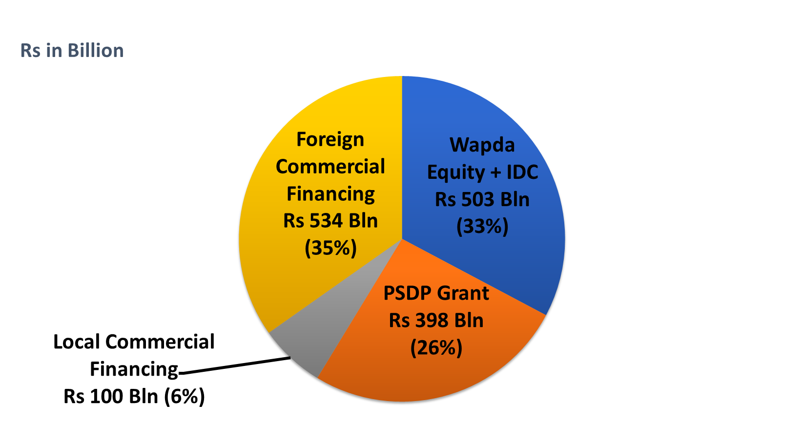
FINANCING STRUCTURE FOR DIAMER BASHA DAM
WAPDA OWN EFFORTS
19

Slide 21
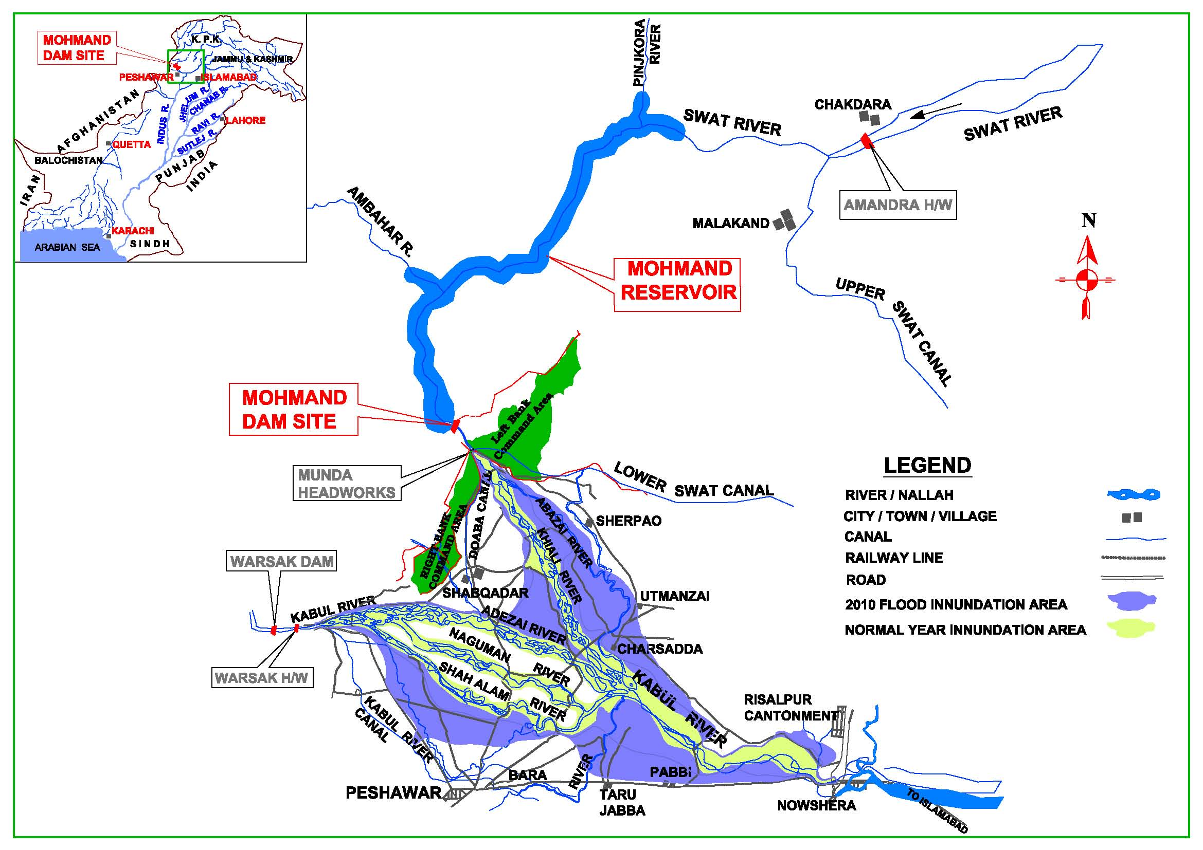
MOHMAND DAM (MDHP)
Gross Storage | 1.2 MAF
Installed capacity | 800 MW
Annual Generation | 2,864 GWh
Dam Part Cost | Rs 114 Billion (US$1,088 Million)
Power Part Cost | Rs 145 Billion (US$1,381 Million)
IDC Cost | Rs 50 Billion (US$479 Million)
Total Project Cost | Rs 309 Billion (US$2,948 Million)
Construction Period | 06 Years
Completion Year | FY 2026
Project Site
MOHMAND DAM SITE

Slide 22
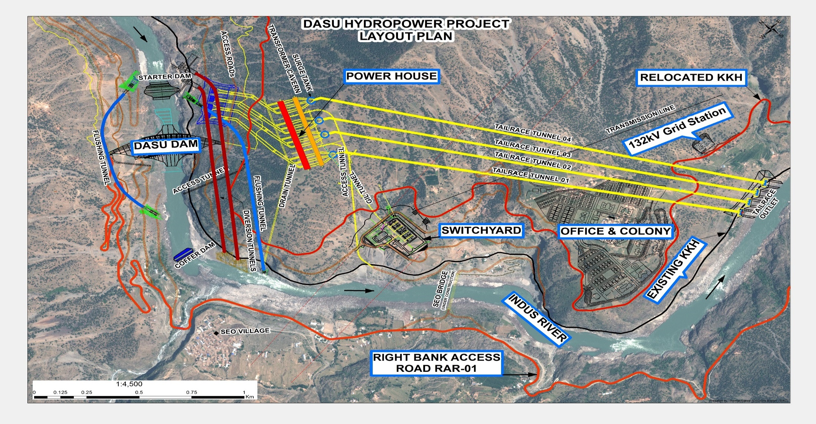
DASU HYDROPOWER PROJECT
Installed Capacity | 4320 MW
Installed capacity (Phase-I) | 2160 MW
Annual Generation | 21,485 GWh
Annual Generation (Phase-I) | 12,220 GWh
Project Cost (Phase-I) | Rs 511 Billion
Completion Year | FY 2024
Project Layout

Slide 23
FINANCING STRUCTURE FOR MOHMAND DAM
WAPDA OWN EFFORTS

Slide 24





WAPDA debut $500 Million Green Eurobond Issuance
A major step towards financial self reliance – unshackled from financial trap
Equalization with GoP by all three major rating agencies – Moody’s, Fitch and S&P
Recognition of WAPDA’s credibility and healthy financial outlook
Participation of major Global Financial Institutions to act as Mandated Lead Arranger

Slide 25
SOCIO-ECONOMIC UPLIFT
Name of Project | Confidence Building Measures (CBMs) | Job Opportunities | Engineers
Mohmand Dam | Rs. 4.5 Billion | 6,000 | 400
Diamer Basha Dam | Rs. 10.8 Billion | 13,000 | 750
Dasu HPP | Rs. 4.8 Billion | 8,000 | 500
Total: | Rs. 20.1 Billion | 27,000 | 1,650

Slide 26
PUNCH LINE
WAPDA is committed to develop Water Storages for food and energy security
Innovative financing strategies are in place
Institutional robustness, research and capacity building
Capacity building of local Consultants/Engineers
Policy, technology, entrepreneur interface

Slide 27

THANKS
Notes:
26

