Slide 1
INTERNATIONAL CONFERENCE ON
HYDROPOWER
PAKISTAN
PPIB – PPIB’ Role in Hydropower Development in Pakistan
DR. MUNAWAR IQBAL
DIRECTOR GENERAL (HYDROPOWER)
PRIVATE POWER & INFRASTRUCTURE BOARD (PPIB)
MINISTRY OF ENERGY (POWER DIVISION)
GOVERNMENT OF PAKISTAN
27th October 2021

Slide 2
PPIB - A ONE WINDOW FACILITATOR
Created in August 1994 as a one-window facilitator on behalf of GOP, its Ministries/ Departments to promote private investments in power sector
Received statutory status on 6th March 2012 through an Act of the Parliament
Coordinates/ Liaisons with local and international multilateral development/ Financial Institutions
Execute IA and issue GOP Guarantee to IPP
POE Members for FS of Provinces
Facilitation Agreements between PPIB and Provinces/AJ&K for
Agent of AJ&K
Issuance of TLOS for provincial/AJ&K projects
Providing technical/legal facilitation to GB for Policy formulation etc.
Notes:
2
2

Slide 3
IPP MODEL BEING EXECUTED BY PPIB
CSA: Coal Supply Agreement
GSA: Gas Supply Agreement
PPA: Power Purchase Agreement
IA: Implementation Agreement
DIA: Direct Implementation Agreement
GoP
Provincial Govt./ AJ&K
Tripartite LOS
PPIB
DIA
Lenders
WUA/ CSA
LOI/ LOS/ IA
Financing
IPPs
NTDC
Gas/ Fuel Supplier
GSA/ FSA
Transmission Line
Fuel Price
Tariff/ Generation Licence
Transmission Licence
PPA
EPC /O&M Contracts
OGRA
NEPRA
CPPAG
EPC/ O&M Contractors

Slide 4
EVOLUTION OF POWER GENERATION MODELS IN PAKISTAN
1958 1994 1995 1998 2002 2006 2012 2015 2021
PUBLIC SECTOR (WAPDA)
Private Sector (PPIB)
Power Policy 1994 (Thermal friendly)
PPP (KP)
Hydel Policy 1995 with Up-front tariff regime
Provincial Policies
ARE Policy
Power Policy 1998
Power Policy 2002
Power Policy 2015
National Elect. Policy 2021
CTBCM

Slide 5
PPIB’s PORTFOLIO – SUMMARY OF OPERATIONAL IPPs
Number of Capacity Investment
Projects (MW) (Million US$)
Project prior to 1994 Power Policy 1 1,292 1,608
Projects under 1994 Power Policy 15 3,100 3,490
Project privatized from public sector 1 1,638 1,583
Project under 1995 Hydel Policy 1 84 215
Projects under 2002 Power Policy 15 3,183 3,927
Projects under 2015 Power Policy 7 8,253 9,153
Total 40 17,551 19,976
Notes:
5
5

Slide 6
PPIB’s PORTFOLIO SUMMARY
Attracted international lenders and investors to invest in country’s power sector
Inducted 40 IPPs of 17,551 MW with cumulative investment of US$ 20 billion
Twelve multiple fuel based IPPs of 9,002 MW commissioned during last six to eight years including Three hydropower Projects of 333 MW
+ 660 kV HVDC Transmission Line commissioned on 1st Sep 2021
More than 50% electricity is supplied to the National Grid by IPPs
Currently processing portfolio of 22 new multiple fuel based IPPs of 12,028 MW including Hydropower Projects of about 4948 MW
Notes:
6
6

Slide 7
HPPs IMPLEMENTATION SUCCESS RATE
Policy | LOI Issued | Dropped | LOS | FC | COD | %Success
1995 | 41 | 40 | 2 | 1 | 1 | 2.4%
2002 | 17 | 11 | 5 | 4 | 2 | 30%
2015 | 4 | - | 2 | - | - | 50%
Numbers
Back Bencher
Major Factors of failure
Long Gestation Period
Initially issues with Tariff determinations
Perception that hydropower is very cheap
Initially un availability of Bankable Security Package
Law and Order Situation
Lack of Capacity of various sectors in the past

Slide 8
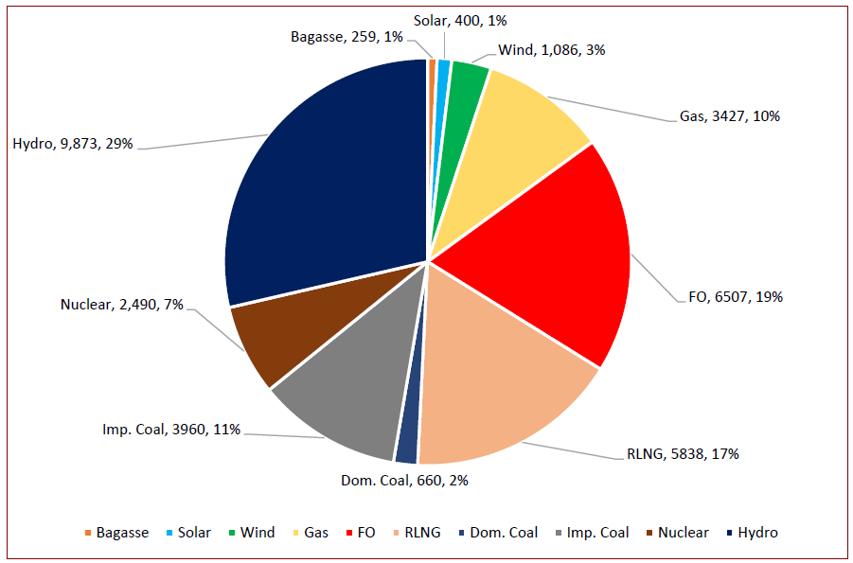
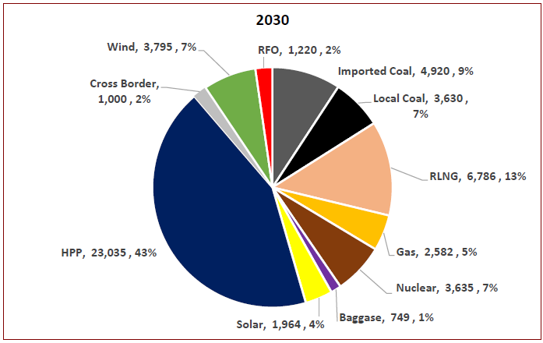
2021 TO 2030
INDICATIVE GENERATION CAPACITY EXPANSION PLAN 2021-30
TARGETS
34,776 MW (HPP: 9873 MW) Indigenization: 60% | 61,112 MW (HPP: 23035 MW) Indigenization: 91%
2030
2021
9873 MW
23035 MW
60 yrs
9 yrs

Slide 9
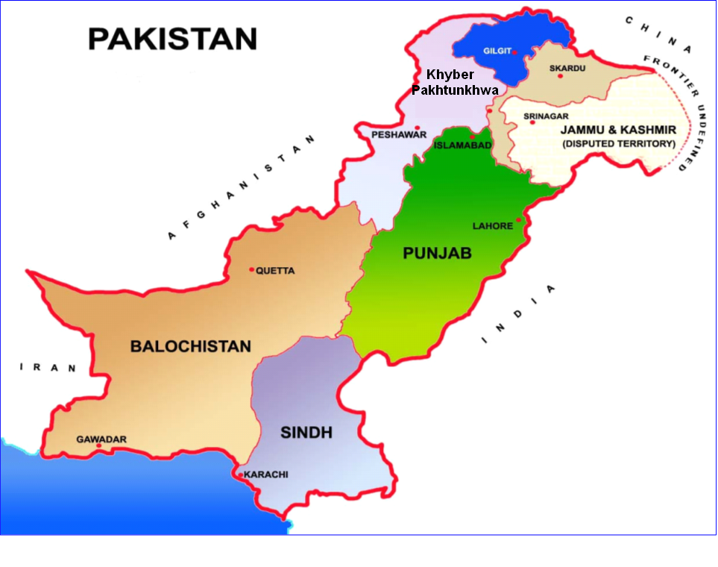
HYDROPOWER POTENTIAL
20000
MW
21161 MW
27012 MW
25000
8296 MW
20000
15000
7316 MW
10000
1 MW
5000
Total
=63,994 MW
0
KP
Pb
208 MW
GB
Sindh
AJ&K
Balochistan

Slide 10
POTENTIAL & STATUS OF HYDROPOWER
DEVELOPMENT IN PAKISTAN
TOTAL =63994 MW
------------------------
OPERATION=9873 MW
National Grid
260 MW Off Grid
Under Process (IPP)
Un-Tapped
17%
27%
Under Process (Public)
Under Process (PPP)
1%
Operational
16%
39%

Slide 11
CONCENTRATION OF HYDROPOWER
POTENTIAL
Gilgit-Baltistan
AJ&K
K. Pakhtunkhwa
P u n j a b
B a l o c h i s t a n
S i n d h

Slide 12
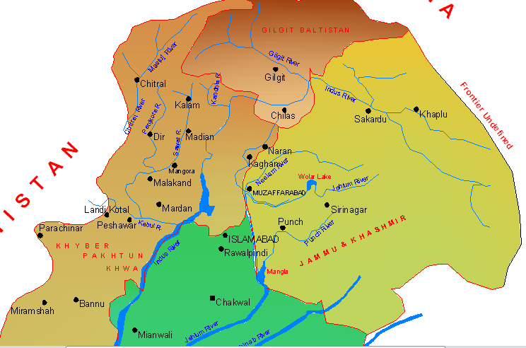
HYDROPOWER
POTENTIAL
NEXT
P u n j a b
Neelum R.
Jhelum R.
Poonch R.
B a l o c h i s t a n
S i n d h
BACK

Slide 13
PROJECTS ON POONCH RIVER IN AJK
130 MW Sehra HPP
TATA PANI
SEHRA 130 MW KOTLI 100 MW GLPUR 102 MW RAJDHANI 132 MW Total= 464 MW
100 MW Kotli HPP
KOTLI Town
132 MW Rajdhani HPP
102 MW Gulpur HPP
Ban Nullah
MANGLA
Gulpur
Previous

Slide 14
LOCATION OF HPPs
ON JEHLUM RIVER
Chakothi
Jhelum River
N
500 MW Chakothi Hattian HPP
969 MW Neelum Jhelum HPP
Hattian Town
Dam
Siran Village
AJ&K
Mahl River
Kohala Bridge
700 MW Azad Pattan HPP
Muzaffarabad
1124 MW Kohala
Neelum River
720 MW Karot HPP
17 km
PH
Mangla
Barsala
Jhelum River
640 MW Mahl HPP
Garhi
Habibullah
147 MW Patrind HPP
Khyber Pakhtunkhwa
Kunhar River
PUNJAB
Previous
14
Murree
Notes:
14

Slide 15
NEELUM VALLEY- MAJOR HYDEL SCHEMES
AJ&K
Khyber Pakhtunkhwa
Nara
Dudhnial HPP
Janawai
Kaghan
KUNHAR RIVER
NEELUM RIVER
Sharda
Halmat
Dudhnial
Athmuqam
HPP
Toabat
ATHMUQAM
Jagran
Legend
Ashkot HPP
Kundal Shahi
INDIAN OCCUPIED KASHMIR
Dudhnial 800 MW Athmuqam 350 MW Ashkot 300 MW N-J 969 MW Total= 2419 MW
NEELUM RIVER
Panjgran
TITHWAL
N-J HPP

Slide 16
KUNHAR RIVER IN KP/AJ&K
102 MW
Batta Kundi HPP
188 MW
Naran HPP
Allai Khwar
Naran
Bata Kundi 102 MW Naran 188 MW Suki Kinari 884 MW Balakot 300 MW Patrind 147 MW Total= 1621 MW
Kaghan
884 MW
Suki Kinari HPP
Paras
300 MW
Balakot HPP
Balakot
Mansehra
147 MW
Patrind HPP
Muzaffarabad
Previous
16

Slide 17
LOCATION MAP RIVER INDUS TRIBUTARIES
Gilgit
TANGUS
2100 MW
Yulbo
3000 MW
Diamer Basha
4500 MW
Jaglot
KAIGAH 548 MW
Bunji
7100 MW
Dasu
4000 MW
Dasu
Chalas
SPATGAH
496 MW
Duber Khwar 130 MW
Patan HPP
665MW
Khan Khwar 72 MW
PALAS VALLEY
665MW
Besham
THAKOT I to III
4900 MW
Allai Khwar 121 MW
BACK
Tarbela

Slide 18
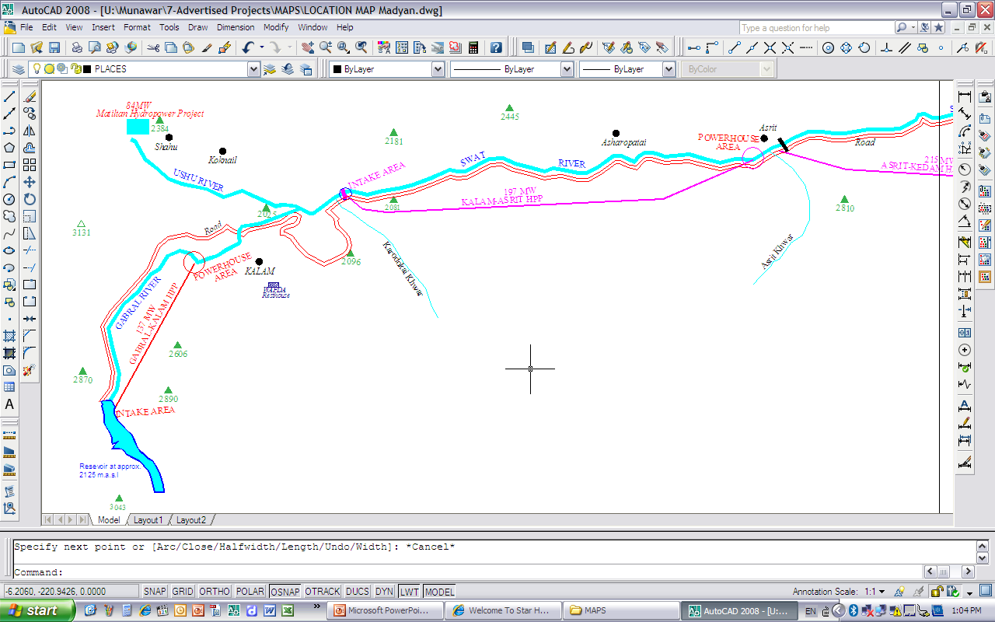
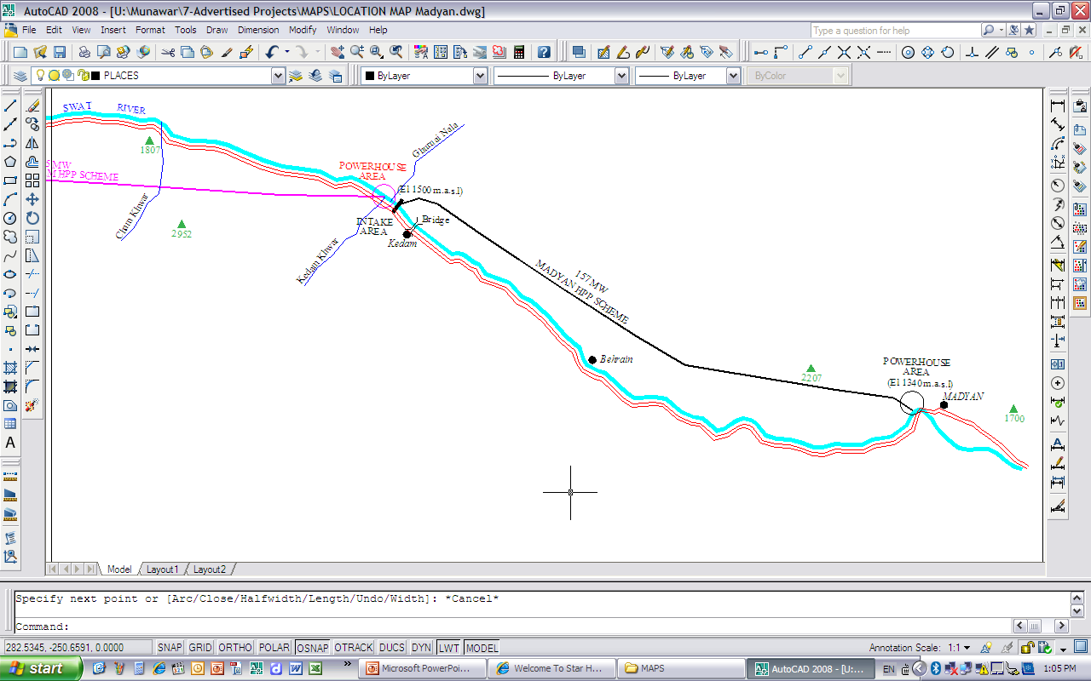
Asrit Kedam HPP
P=215 MW
H=214 m
Kalam Asrit HPP
P=197 MW
H=210 m
PH
Madain Town
PH
PH
Kalam Town
PH
SWAT VALLEY HPPs
Madain HPP
P=157 MW
H=150 m
Gabral Kalam HPP
P=137 MW
H=205 m
BACK

Slide 19
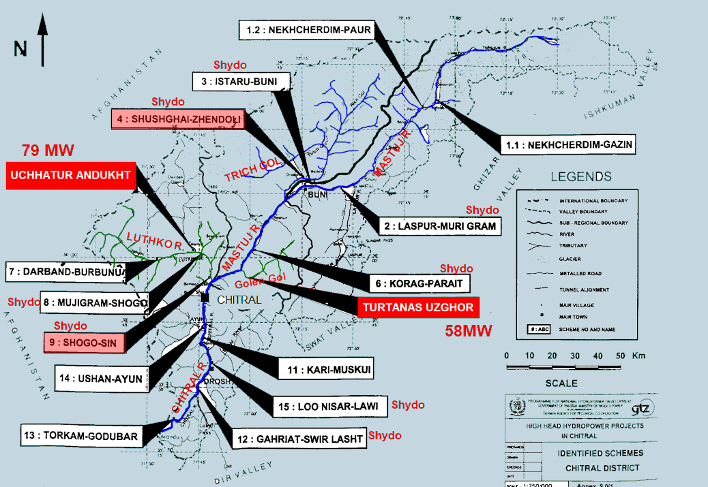
BACK
BACK

Slide 20
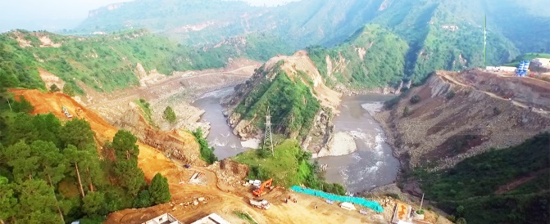
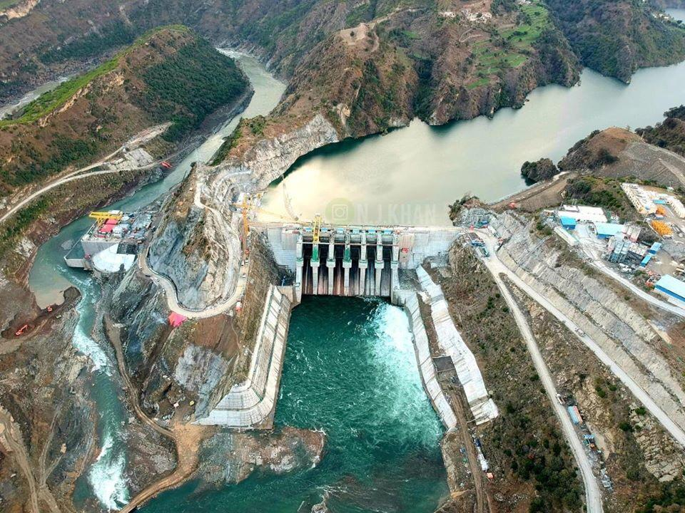
102 MW Gulpur Hydropwer Project
Company : Mira Power Pvt. Limited
Main Sponsor : KOEN From Korea
Capacity : 102 MW
Mobilization in 2015
Completion in 2020

Slide 21
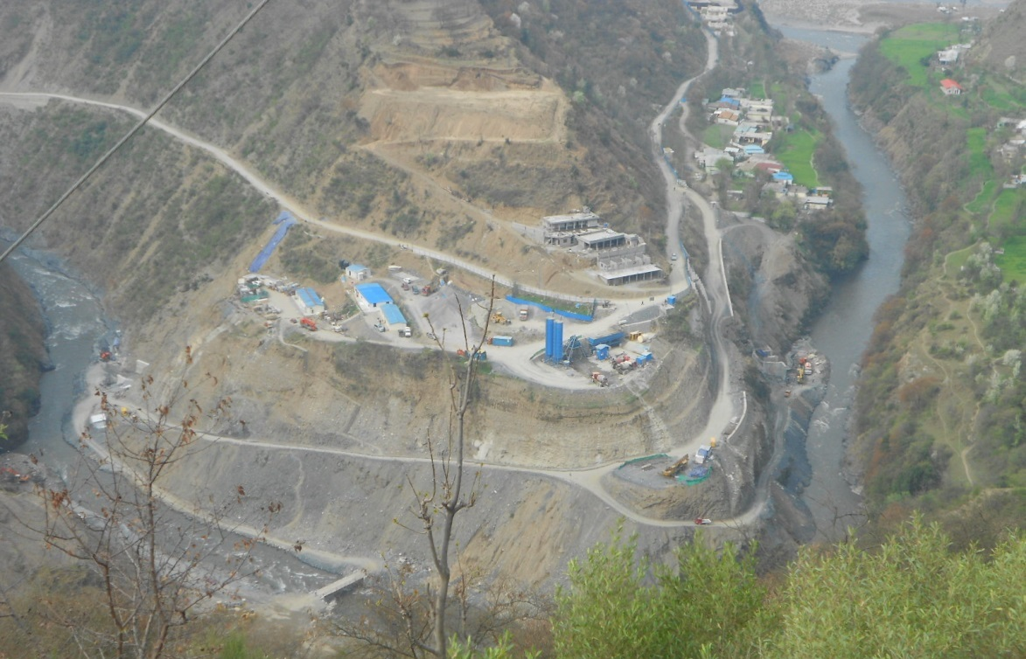
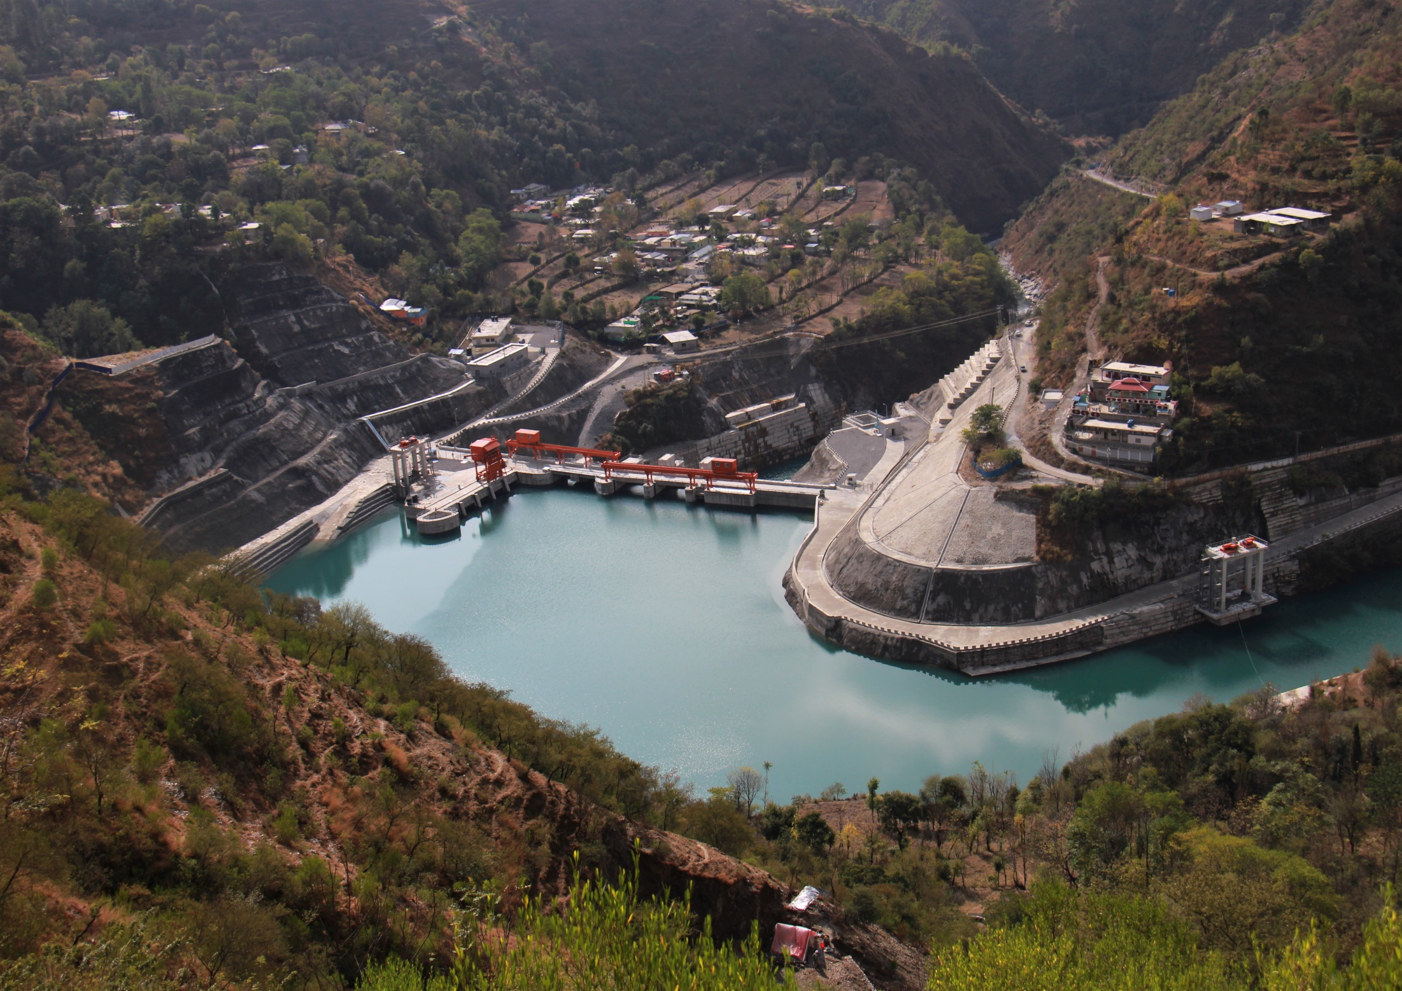
147 MW Patrind Hydropwer Project
Company : Star Hydro Pvt. Limited
Main Sponsor : K-Water Korea from Korea
Capacity : 147 MW
Mobilization in 2013
Completion in 2017

Slide 22
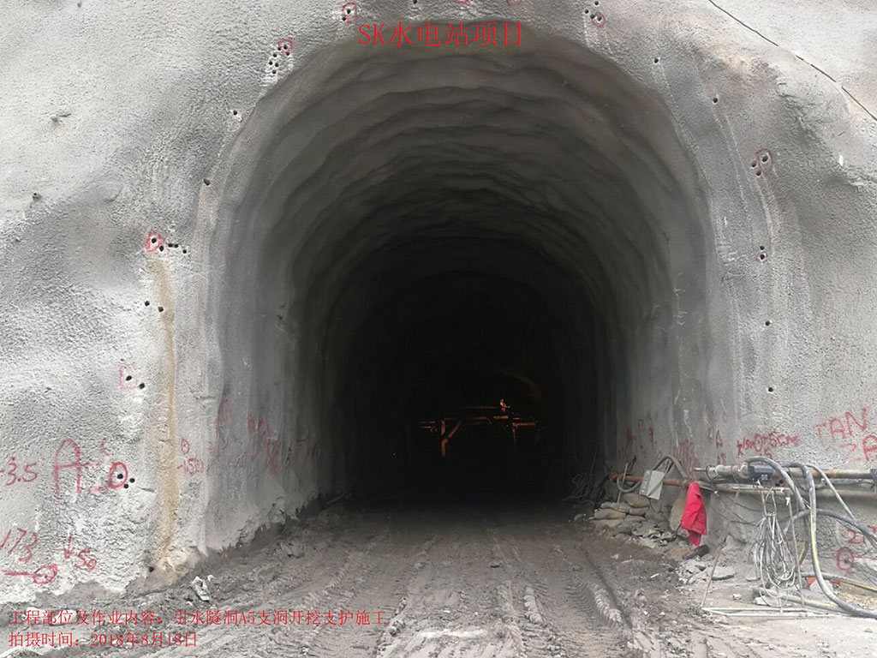
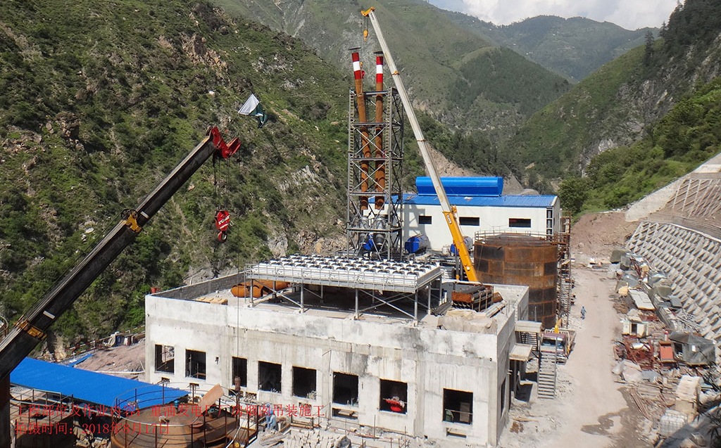
884 MW Suki Kinari Hydropwer Project
Company : SK Hydro Pvt. Limited
Main Sponsor : CGGC-China
Capacity :884 MW
Current Status

Slide 23
HYDROPOWER PROJECTS UDDER PPIB
 | Project | MW | Location | POLICY | Prog-ress | Status
1 | New Bong Escape | 84 | River Jhelum, Punjab | 1995 | 100 % | Commissioned
2 | Patrind HPP | 147 | River Kunhar, AJK | 2002 | 100 % | Commissioned
3 | Gulpur HPP | 102 | River Punch, AJK | 2002 | 100 % | Commissioned
4 | Karot HPP | 720 | River Jhelum, AJK | 2002 | 92% | Under construction; COD Dec 2021
5 | Suki Kinari HPP | 884 | River Kunhar, KP | 2002 | 65% | Under construction; COD Dec 2022
6 | Kohala HPP | 1124 | River Jhelum, AJK | 2002 | - | Under FC; deadline June 2022
7 | Azad Pattan HPP | 700 | River Jhelum, AJK | 2002 | - | Under FC; deadline December 2021
8 | Mahl HPP | 640 | River Jhelum, AJK | 2002 | - | FS Tariff. Waiting inclusion in IGCEP
9 | Athmuqam HP | 450 | River Neelum AJK | 2015 | - | FS done. Waiting inclusion into IGCEP
10 | Turtonas Uzghor | 82 | River Golengol KP | 2015 | - | Under FS Tariff. Waiting incl.into IGCEP
TOTAL HYDEL |  | 4933 | MW

Slide 24
HYDROPOWER PROJECTS UDDER CPEC REGIME
 | Project | MW | Location | Cost | Prog-ress | COD | Status
1 | Karot Hydropower Project | 720 | River Jhelum, Punjab | 1698 | 92% | Dec- 21 | Under construction; COD Dec 2021
2 | Suki Kinari Hydropower Project | 884 | Kagan, River Kunhar, KP | 1963 | 65% | Dec-22 | Under construction; COD Dec 2022
3 | Kohala Hydropower Project | 1124 | River Jhelum, AJK | 2408 | - | Dec-27 | Under FC; deadline June 2022
4 | Azad Pattan Hydropower Project | 700 | River Jhelum, AJK | 1351 | - | Sep-27 | Under FC; deadline December 2021
TOTAL HYDEL |  | 3,428 | MW | $7,420 M

Slide 25
HPPs UNDER TLOS REGIME
 | Project | MW | Location | COD | Status
1 | Riali-II HPP | 8 | AJ&K | - | Under construction; waiting Sec.Docs
2 | Kathai-II HPP | 7 | AJ&K | - | Waiting Sec. Docs
TOTAL SHPPs |  | 15 | MW

Slide 26
KEY CHALLENGES TO HPPs PLAYERS
Non Celerity about Inclusion of HPP in IGCEP
Timely interconnection of projects to meet the COD deadlines
Financing Issues- Circular Debt , Location in AJ&K
Approx. 20000 MW Hydropower in Chitral KP, GB and AJK regions awaiting Power Evacuation Commitments
Non-existence of Power Regulatory regime in Gilgit-Baltistan
Shift of Market Regime-Behaviour unknown
Land Acquisition Issues
Socio-Environmental Challenges
Lack of synergy among different stakeholders
Notes:
26
26

Slide 27
FUTURE INITIATIVE OF PPIB
Pumped Storage
PPIB is in process of considering for a Cooperation Agreement with a Consultant for identification of suitable potential sites suitable for pumped storage.
Initially an area of about 200 km x 200 km north if Islamabad is envisaged for the study.
Notes:
27
27

