Slide 1
HYDRO PUMPED STORAGE& Others
Syed Akhtar Ali
Energyupdate Conference
Islamabad

Slide 3
Electricity Storage
Fly-Wheel
Compressed Air
Super-Capacitor
Pumped Storage
Batteries(Li-Ion)

Slide 4
Pumped Storage-Types
Conventional Hydro
Storage + Desalination
Hill-sea
Special Liquid –R19

Slide 5
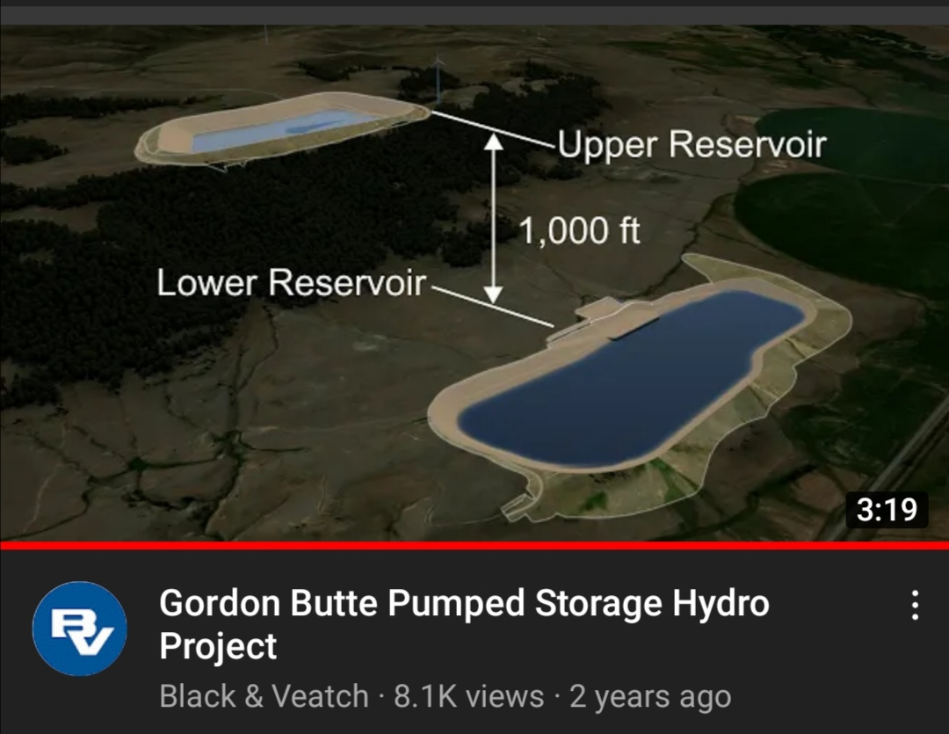

Slide 6
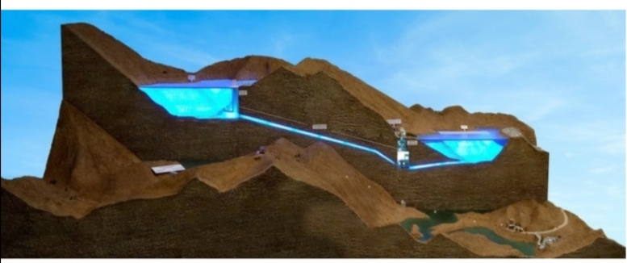

Slide 7
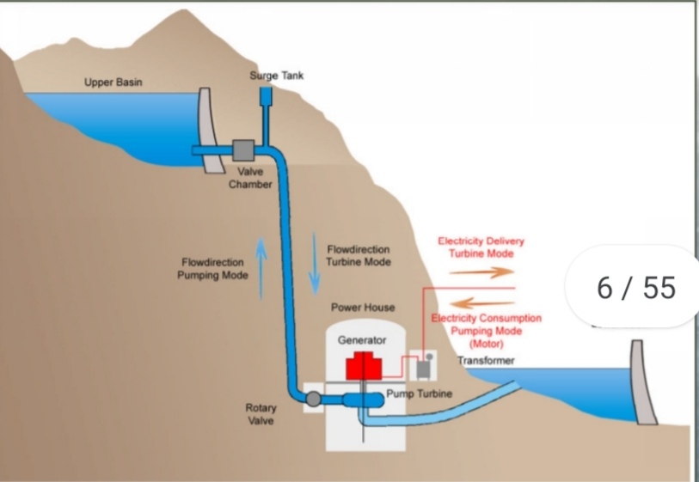

Slide 11
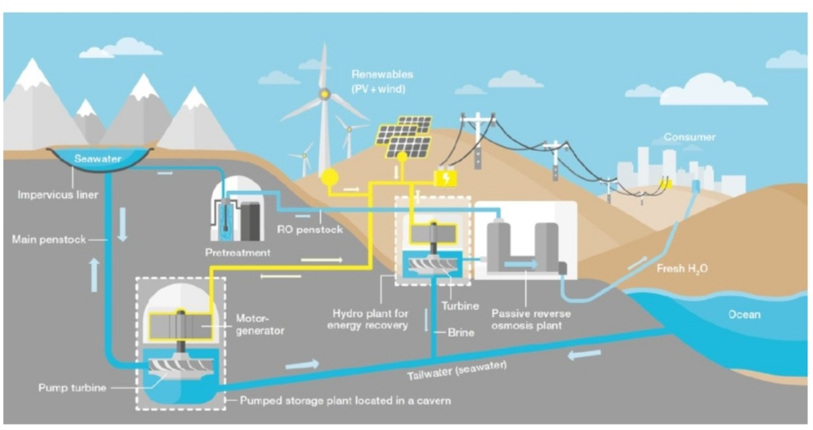

Slide 13
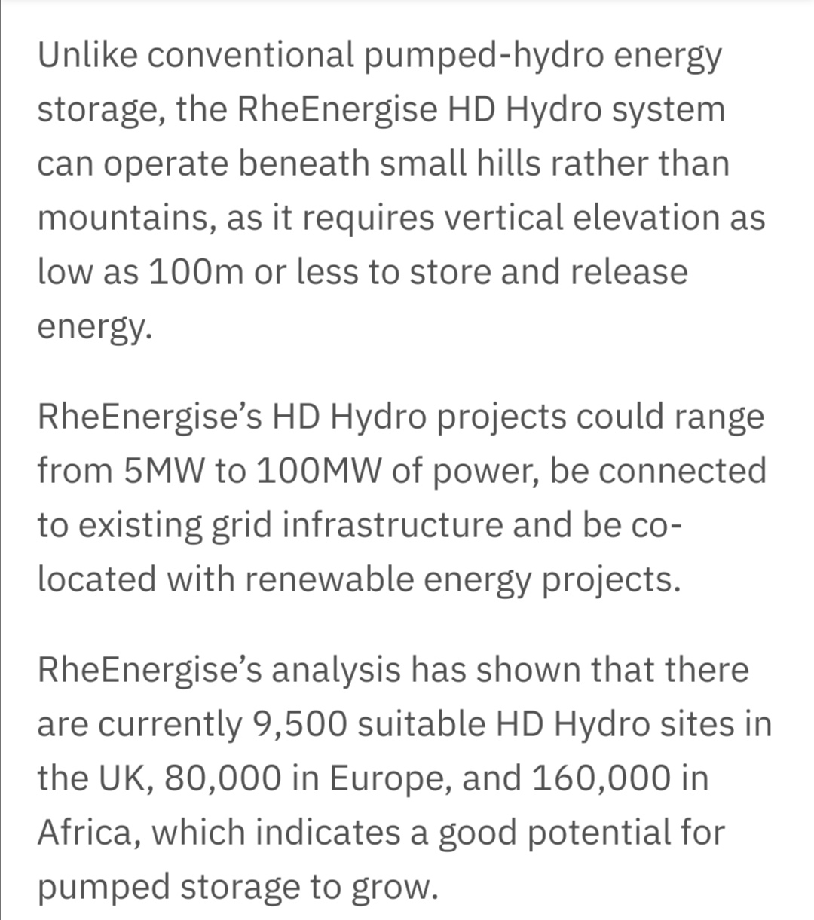

Slide 14
Hatta UAE Pumped Hydro
200 MW-6 hours
Height=150 Meters
Water Discharge= 200 m3/s
Being built above existing Reservoir

Slide 15
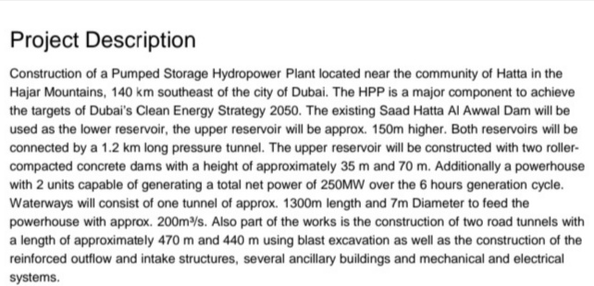

Slide 18
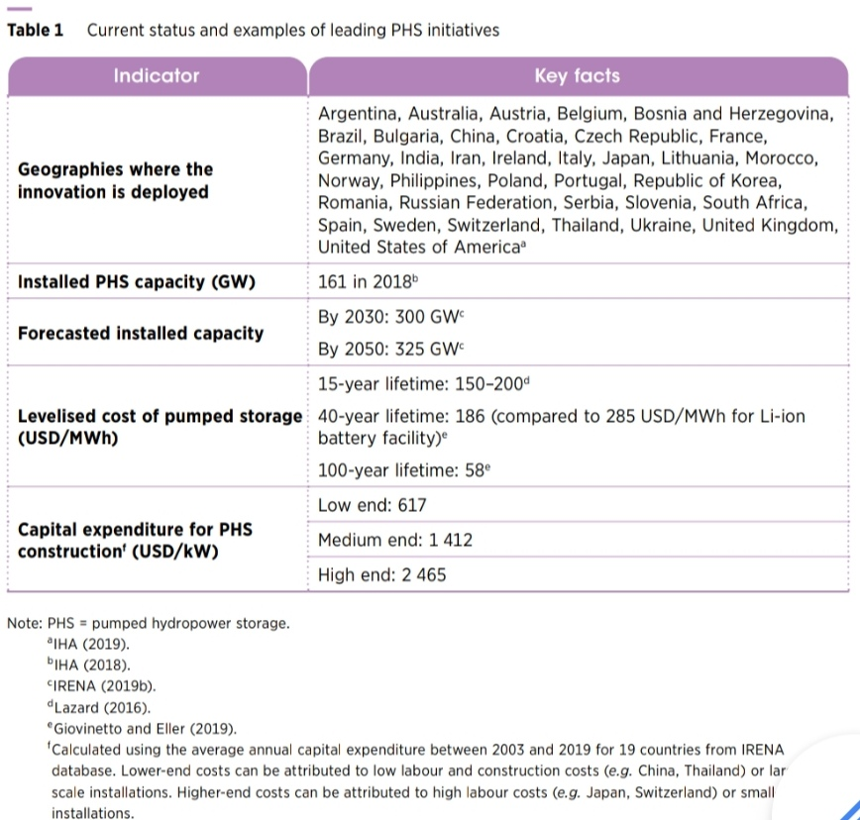

Slide 19
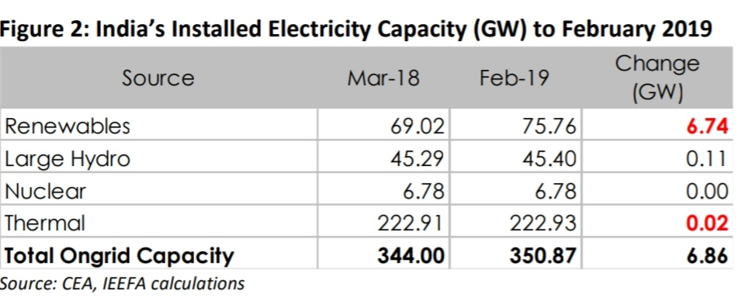

Slide 20
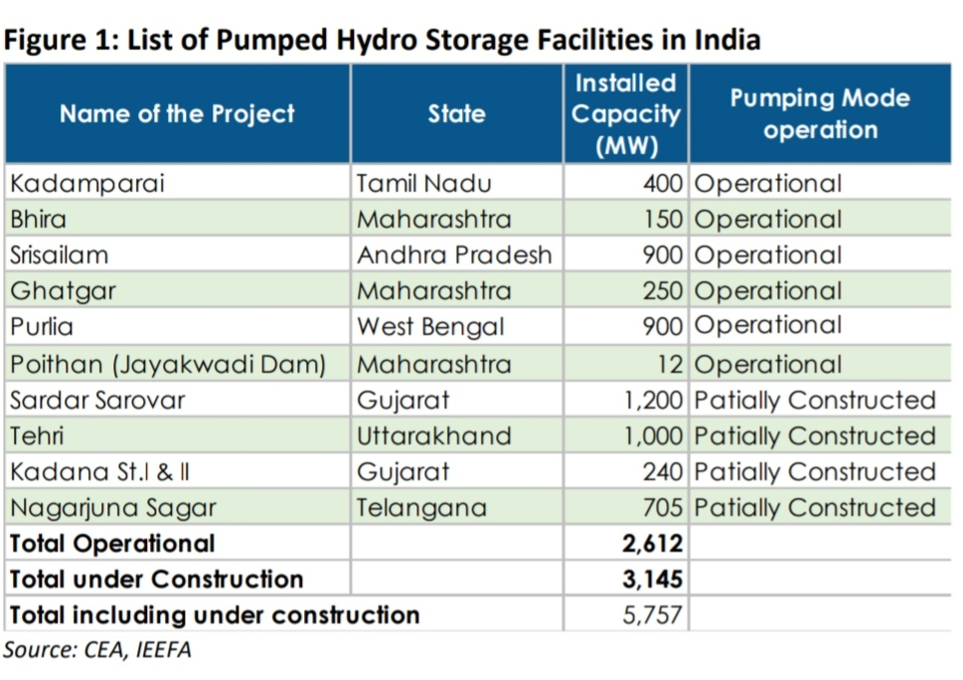

Slide 21
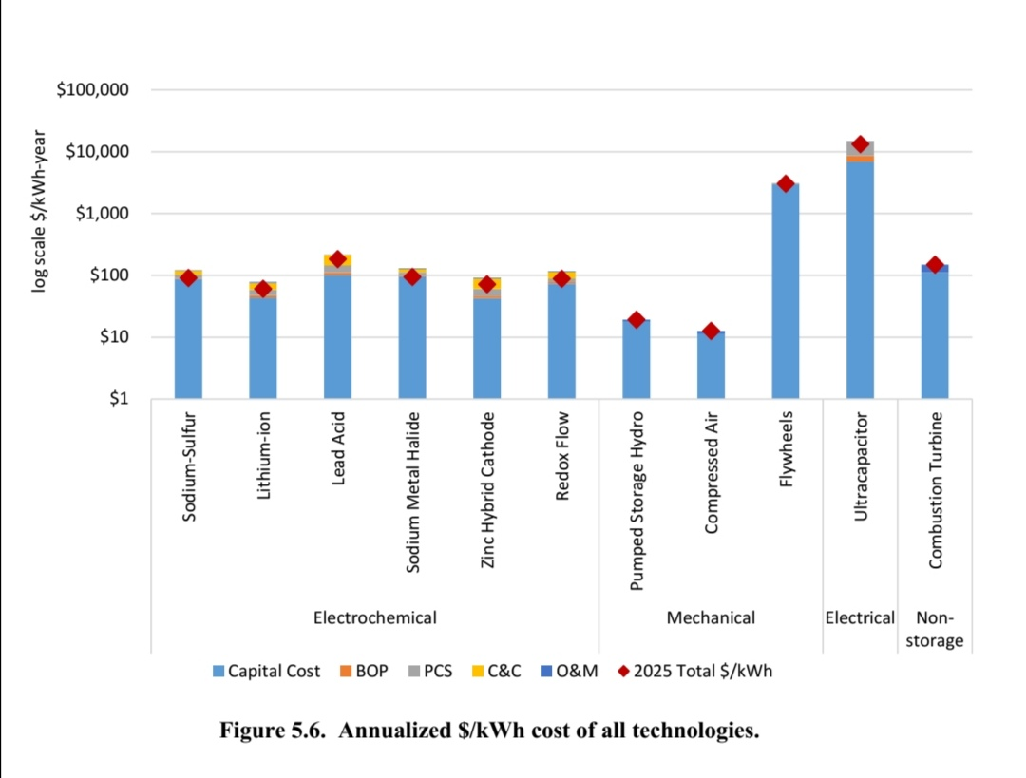

Slide 22
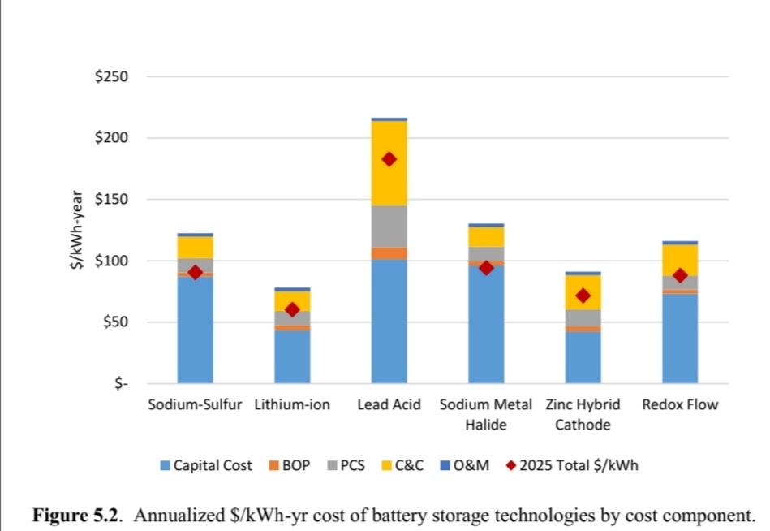

Slide 23
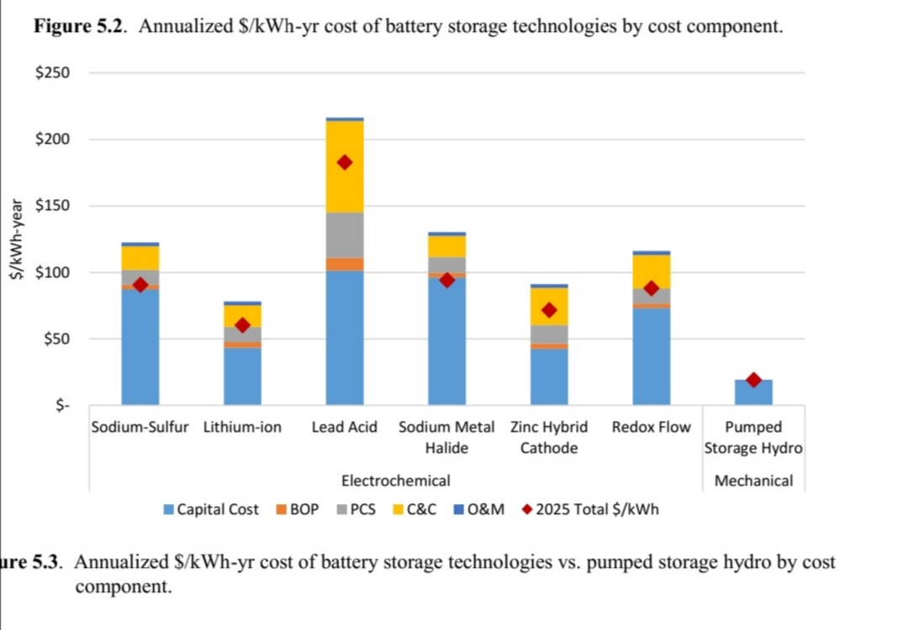

Slide 24
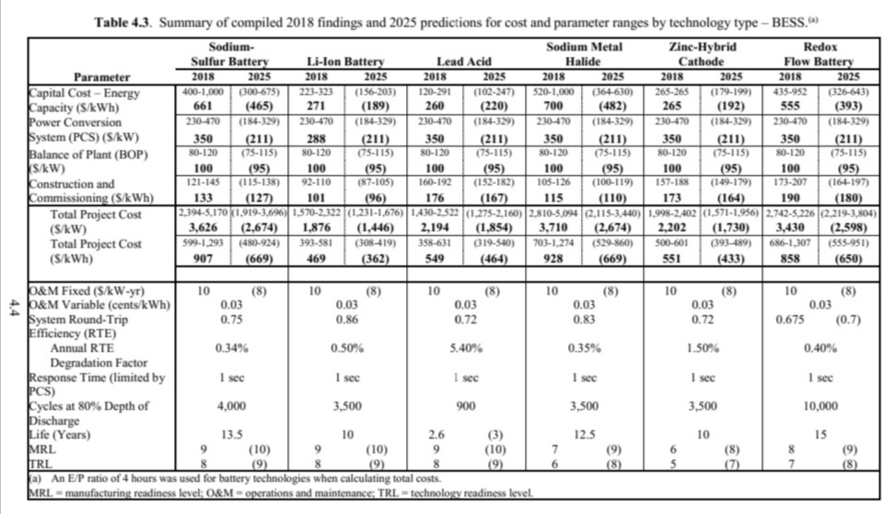

Slide 25
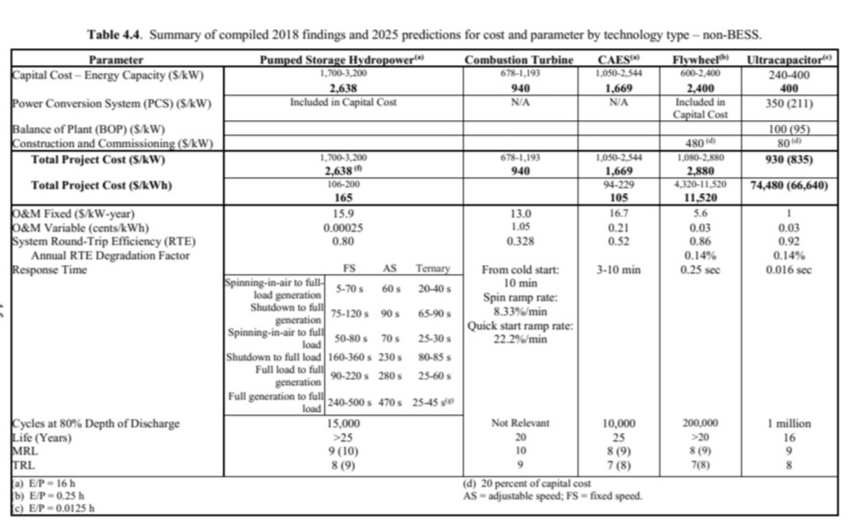

Slide 26
PHS vs Battery-India
Fixed price 25 yrs
 | Hydro Pumped Storage | Battery Storage
Capacity-MW | 900 | 300
Average Tariff-Irs/kWh | 4.04(5.6111USc) | 4.3(5.9722 USc)
Peak-Tariff-Irs/kWh | 6.12(8.5 USc) | 6.85(9.5139 USc)
Off-Peak-Irs/kWh |  | 2.88(4 USc)
CAPEX-USD/kW –USD/kWh 2638$kW -165$kWh USD/kWh |  | 1876/1446 $kW- 469-362 $kWh

