Slide 1
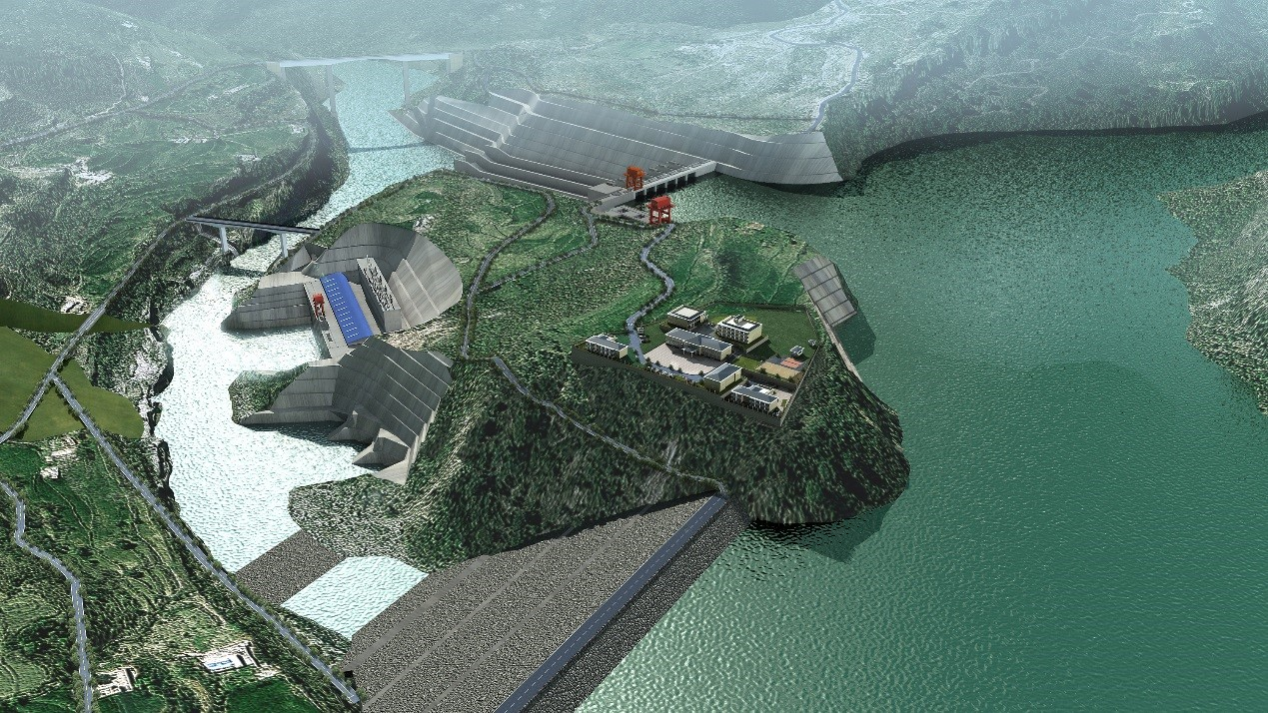

Int’l Conference on Hydropower Pakistan 2021
CSAIL Hydro Power Projects in Pakistan - 720 MW KAROT Hydro Power Project – Success Story
Oct 27, 2021

Slide 2
Contents
CTG- CSAIL
CSAIL Hydro ower Projects in Pakistan
Karot Hydro Power Project
  Key Features, Major Milestones
  Major Benefits
  Project Updates
  Construction Progress- Pictures
  Success Story
Conclusion

Slide 3
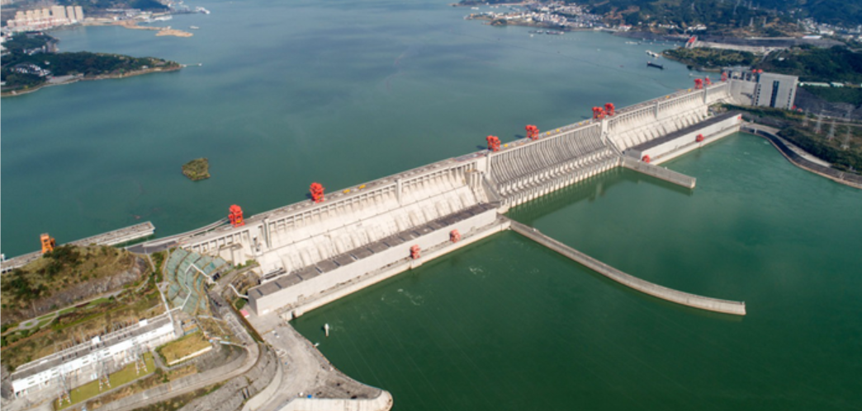
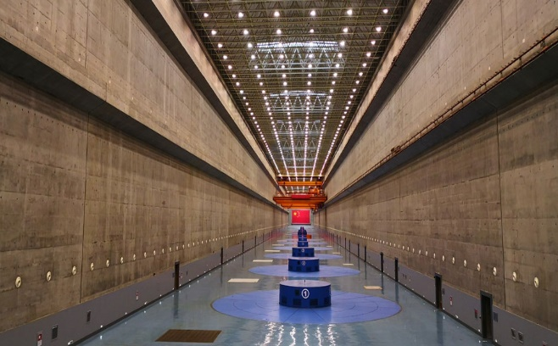
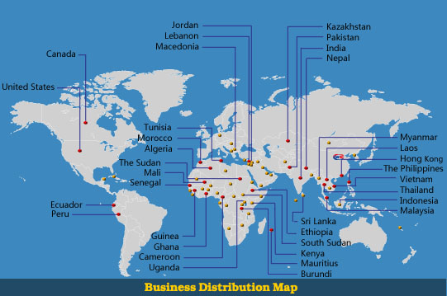
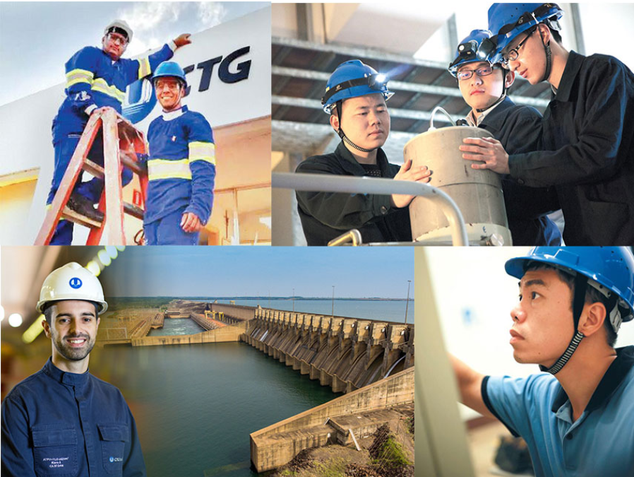
China Three Gorges Corporation (CTG)
A World-Class Clean Energy Group
Owner, developer and operator of world largest Three Gorges Dam (22,500 MW installed capacity).
The world’s largest hydropower developer with installed and under construction capacity of over 139,000 MW, Annual Energy Generation of over 290 TWh
A wholly state-owned enterprise with operation in over 40 countries.
Total Assets of over US$ 100 Billion and Annual Profit of around US $ 5 Bln and having more than 37,000 employees around the world.

Slide 4




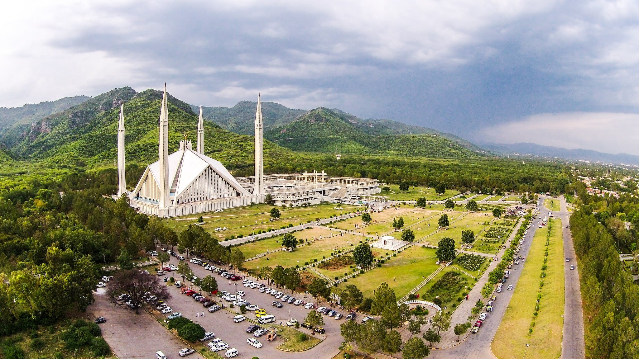
China Three Gorges South Asia Investment Ltd (CSAIL)
Current Ownership & Financing Structure
China Three Gorges Corporation
100%
Beijing
China Three Gorges International Corporation
100%
China Three Gorges International Limited.
100%
Hong Kong
China Three Gorges Hong Kong Investment Company Limited
15%
15%
70%
China Three Gorges South Asia Investment Ltd.
Islamabad
99.99%
99.99%
99.99%
99.99%
97%
99.99%
Pakistan Incorporated Project Companies
TGF
TGS
TGT
KHCL
MPCL
KPCL

Slide 6
CSAIL’s Current Portfolio in Pakistan
Greenfield Hydro, Wind and Solar Power Projects
Sr. No. | Project Name | Capacity (MW) | Project Cost (US$ million) | Targeted Completion | Status / Progress
1 | First Wind | 49.5 | 130 | Achieved | Commissioned in Nov 2014
2 | Second & Third Wind | 99 | 224 | Achieved | Commissioned: TGS: Jun 20, 2018 TGT: Jun 9, 2018
3 | Karot HPP | 720 | 1,740 | 2022 | Construction ongoing. Overall construction progress: 92.37%
4 | Kohala HPP | 1,124 | 2,700 | 2028 | All issues of the Project resolved, tax on the offshore contract and matters related to land acquisition are outstanding
5 | Mahl HPP | 640 | 1,478 | 2029 | Feasibility stage Tariff determined by NEPRA. Review petition rejected. MPCL requested PPIB for extension of the LOI.
Total |  | 2,632.5 | 6,272
Recently, CSAIL has acquired a company named Alcazar Energy, which has seven operational Solar and Wind Power Projects of 411 MW in Egypt and Jordan.

Slide 7
Karot Hydro Power Project
Notes:
南亚公司在巴基斯坦共有员工170人，其中巴方员工占比61%，属地化程度高。
其中三峡国际派驻员工27人，借调员工人14人，国内第三方劳务派遣25人。
巴方管理类员工大多数具有多年水电开发管理经验，入职后能有效推进工作开展。
中方大多数员工都很年轻，在巴基斯坦历经不同岗位的锻炼，成长迅速，很多都能独当一面。

Slide 8
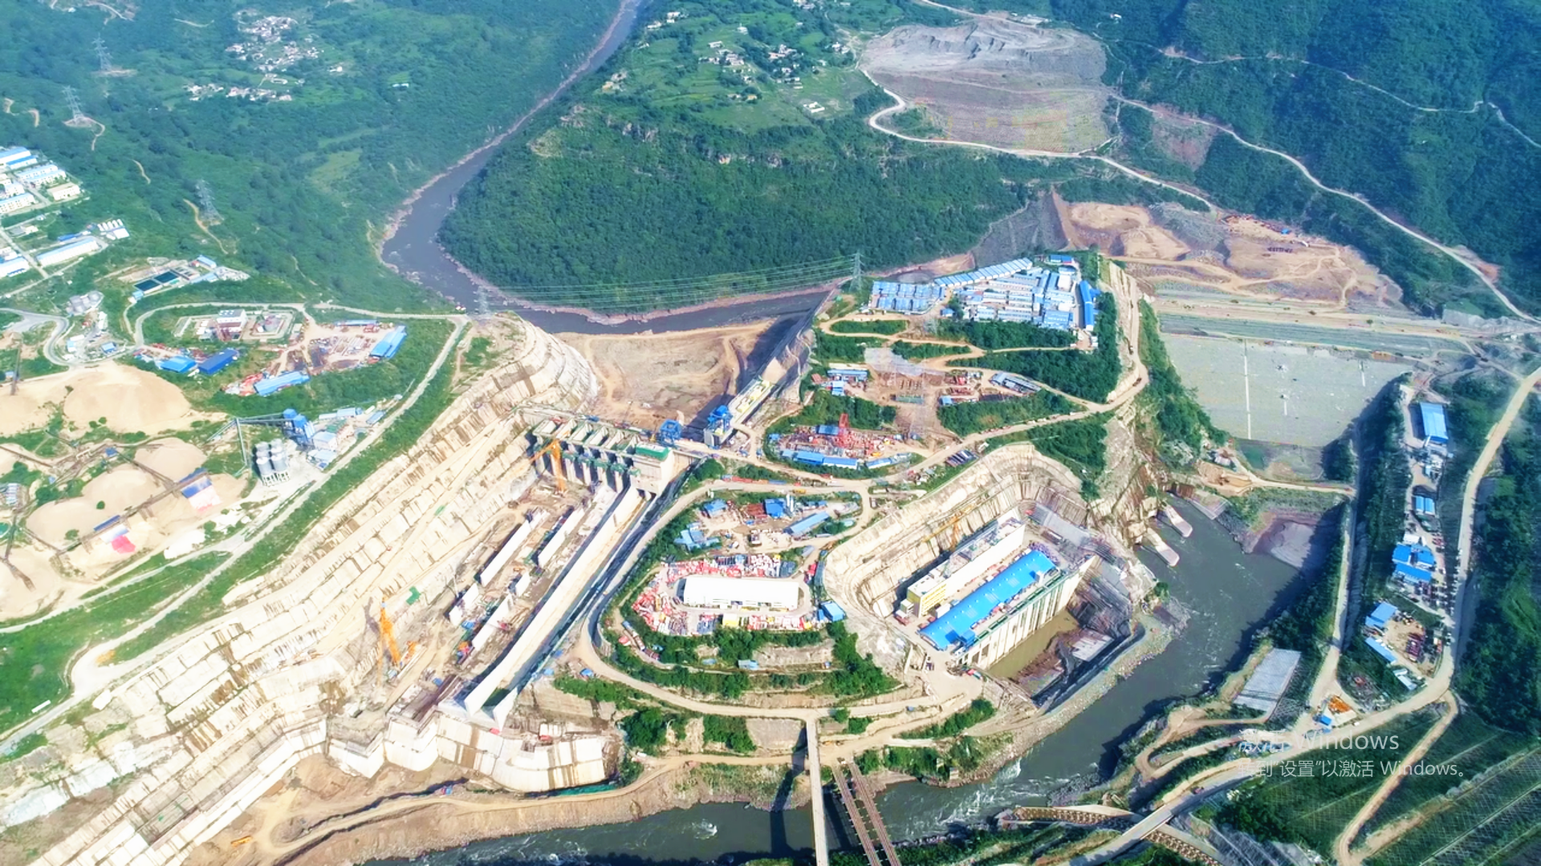
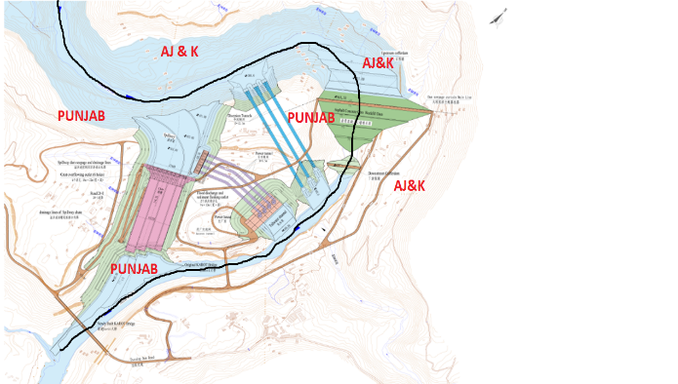
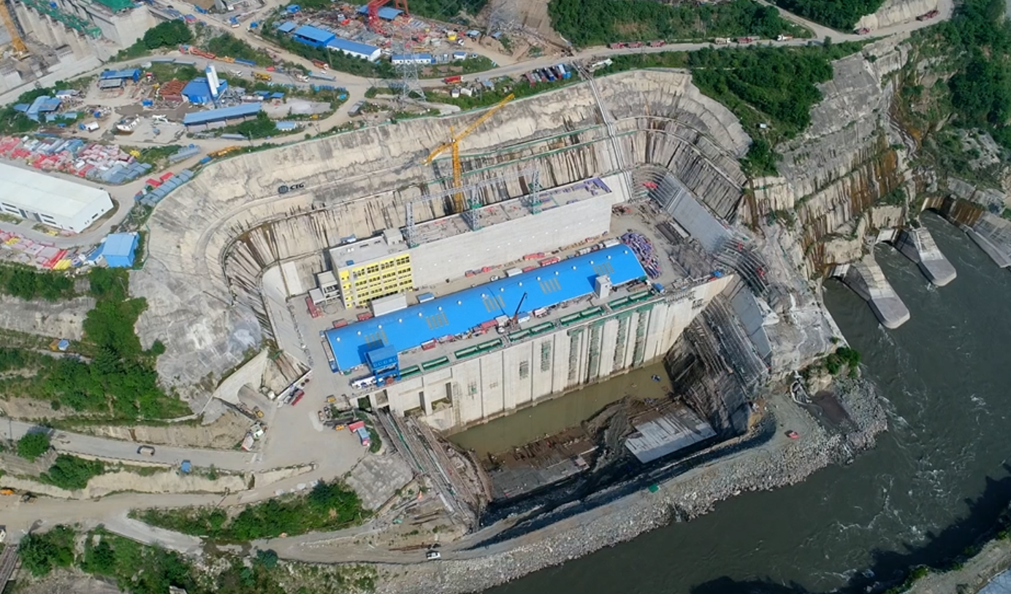
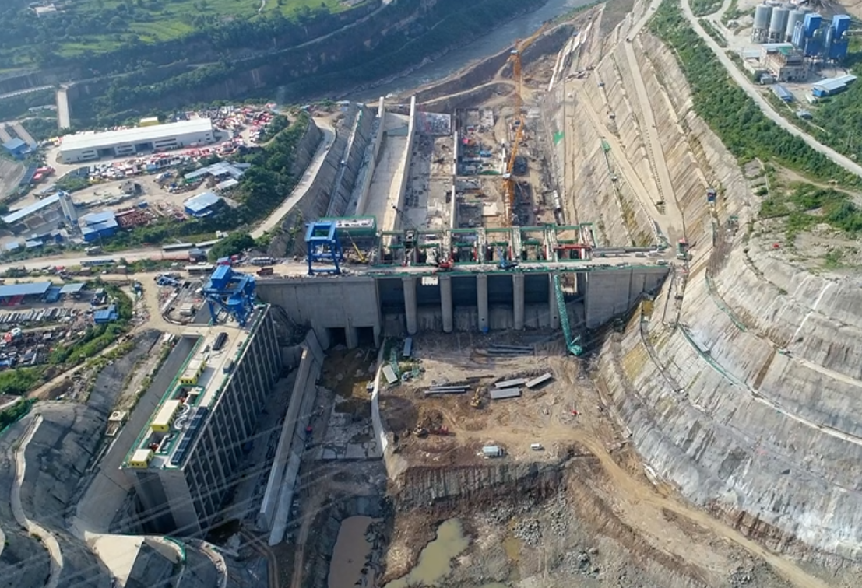
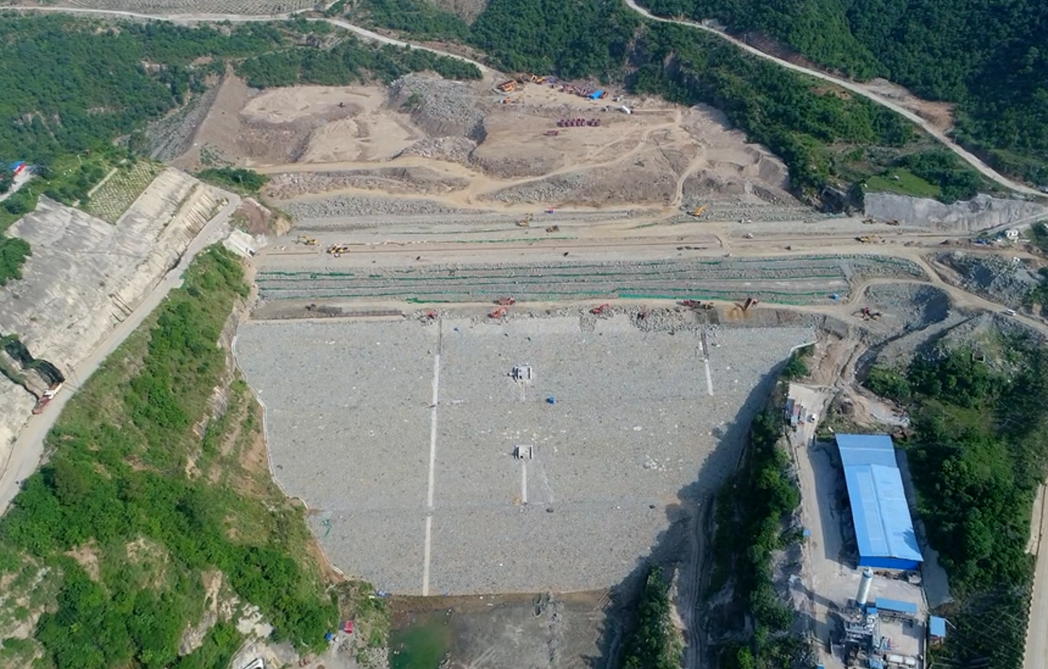
Karot Project Layout
Dam
Spillway
Powerhouse

Slide 9












Karot Project’s Key Stakeholders
Sponsors
中国三峡南亚投资有限公司
China Three Gorges South Asia Investment Ltd.
中國三峽港源投資有限公司
China Three Gorges HongKong Investment Company Limited
Lenders
Employer
卡洛特电力有限责任公司
Karot Power Company (Pvt) Ltd.
Employer’s
Engineer
上海东华工程咨询公司
EPC Contractor
长江三峡技术经济发展有限公司(TGDC)
O&M Contractor

Slide 10
Project Cycle
Project Development, Construction and Operation Stages
The 720 MW Karot HPP has a life of more than 100 years, the Project has different stages and at each stage there are different human categories / resourses
After 30 years of operation the Project will be transferred to Government of Punjab
Project Development
10 years
ATL/KPCL
Project Construction
5.5 years
TGDC
Project Operation 30 years CTGO

Slide 11
Karot Hydropower Project
Strong Sponsors Profile
Reputable EPC contractor
Priority Project of CPEC
Multiple Project Benefits
Karot Project Key Strengths
Notes:
南亚公司在巴基斯坦共有员工170人，其中巴方员工占比61%，属地化程度高。
其中三峡国际派驻员工27人，借调员工人14人，国内第三方劳务派遣25人。
巴方管理类员工大多数具有多年水电开发管理经验，入职后能有效推进工作开展。
中方大多数员工都很年轻，在巴基斯坦历经不同岗位的锻炼，成长迅速，很多都能独当一面。

Slide 12
  Unique and Distinctive Features
  Located in the Province of Punjab and AJK
  Project is under CPEC Framework
  Located very close to Load Center :
    Islamabad 76 km
    Gujar Khan 65 km
  The Project is very close Nation Grid and will require only 3 km of Transmission Line.
  No Environmental Issues
  Project being developed by well experienced company having technical and Financial strength – CTG
  Fool proof security of the Project provided by Pak Army
  Under CSR the Company is constructing hospitals, schools , bridges, roads, and scholarships (Electrical Engineering) are being provided to students of the Project Area
720 MW Karot HPP – Pearl on Jhelum River

Slide 13
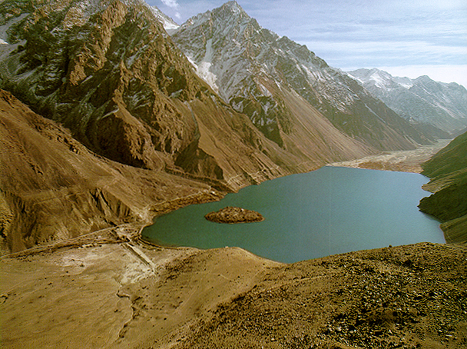


Karot Project a Environmental Friendly Project
Karot HPP complies all Environmental Guidelines, Laws, Rules and Regulations of Federal and Provincial Govts. and Project Lenders.

Slide 14
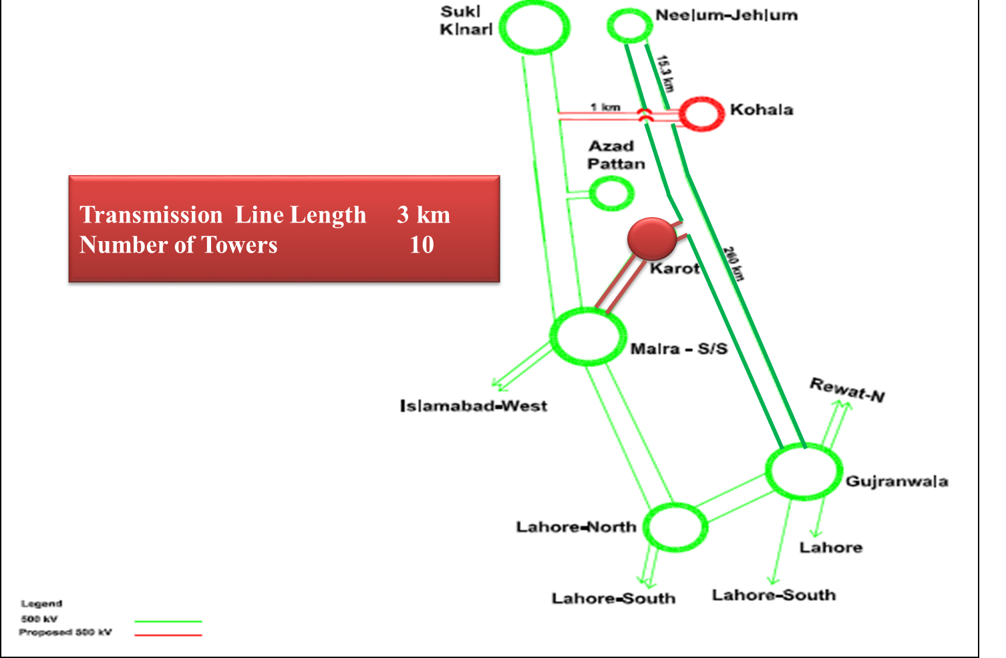
Transmission Line Interconnection Arrangements for Karot HPP

Slide 15
Karot HPP Benefits
Notes:
南亚公司在巴基斯坦共有员工170人，其中巴方员工占比61%，属地化程度高。
其中三峡国际派驻员工27人，借调员工人14人，国内第三方劳务派遣25人。
巴方管理类员工大多数具有多年水电开发管理经验，入职后能有效推进工作开展。
中方大多数员工都很年轻，在巴基斯坦历经不同岗位的锻炼，成长迅速，很多都能独当一面。

Slide 16

Benefits of Karot Project
At the end of the operation period, the Karot Company will transfer the Complex to the Government of Punjab for
Rs. 1
Job opportunities to locals during construction and operation of the Karot Project , about are already working at Karot site.
3,000 people
Notes:
南亚公司在巴基斯坦共有员工170人，其中巴方员工占比61%，属地化程度高。
其中三峡国际派驻员工27人，借调员工人14人，国内第三方劳务派遣25人。
巴方管理类员工大多数具有多年水电开发管理经验，入职后能有效推进工作开展。
中方大多数员工都很年轻，在巴基斯坦历经不同岗位的锻炼，成长迅速，很多都能独当一面。

Slide 17
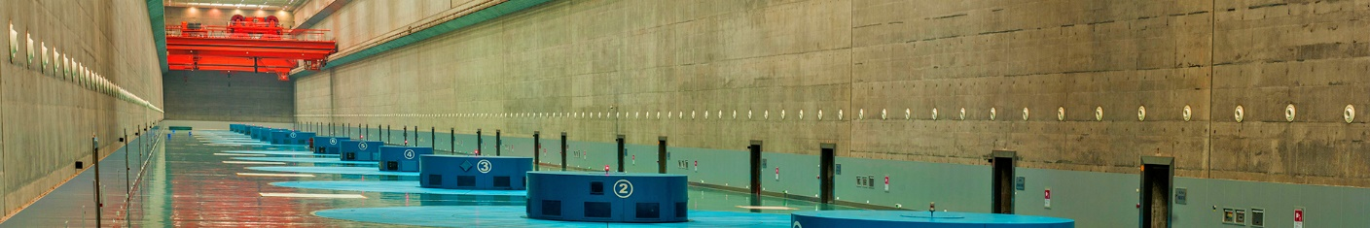
Karot Project benefits to AJK/Punjab
GOAJK/GOPb to receive Rs 20.234 billion in 30 years on account of WUC
GOAJK /GOPb to receive Rs. 675 Million annually for 30 years as WUC
Per day income of around Rs. 1.85 Million to GOAJK /GOPb
Rs. 10.7 billion
Taxes
Rs. 675 Million /year
water revenues GOAJK/GOPb
Notes:
可以从开发原本浪费的当地资源，增加政府收入的角度论述

Slide 18
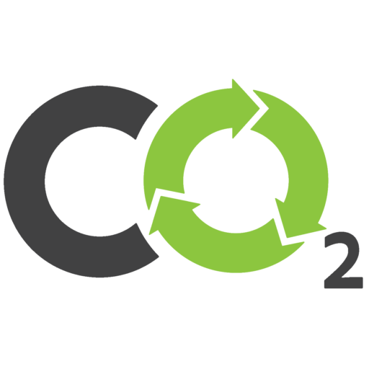
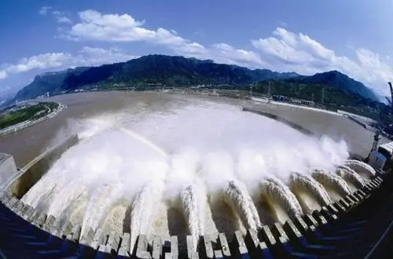
Economical clean energy supply
GWh
3,206
Upon completion of the Karot project, the average annual energy output 3.206 billion kWh
27%
16%
5%
12%
5%
3.5 million
Tons
9%
26%
Upon completion of the Karot project, it is expected to cut annual carbon dioxide emission around 3.5 million tons, uplifting clean energy output mix and optimizing the energy consumption structure.
Notes:
建议介绍内容：1、2025年巴基斯坦电力缺口约110万千瓦，卡洛特项目有效填补电力缺口；2、有效利用当地资源，改善巴基斯坦电力结构；3、水电电价优势，尤其是还贷后优势更为突出，有效解决巴基斯坦的债务问题。（卡洛特EPC阶段均化电价为7.6美分/度，还贷期后为4美分/度）

Slide 19


CSR Activities
US $
Health Facilities
6 million
Drinking water
facilities
KPCL has developed and implemented a community investment plan (CIP) under Corporate Social Responsibility to improve living environment of local community. It will be implemented over the course of construction period.
Educational
Facilities
Infrastructure Improvement
Recreational Facilities

Slide 20
Project Key Features
Notes:
南亚公司在巴基斯坦共有员工170人，其中巴方员工占比61%，属地化程度高。
其中三峡国际派驻员工27人，借调员工人14人，国内第三方劳务派遣25人。
巴方管理类员工大多数具有多年水电开发管理经验，入职后能有效推进工作开展。
中方大多数员工都很年轻，在巴基斯坦历经不同岗位的锻炼，成长迅速，很多都能独当一面。

Slide 21
Project Updates
720 MW Karot Hydropower Project
Project Features
Location : Distt. Rawalpindi, Punjab & AJK
River : Jhelum River
Project Importance : The Project is under CPEC
Capacity : 720 MW
Av. Annual Energy : 3206 GWh
Design Discharge : 1200 m³/s
Gross Head : 79 m
No. and Type of Units : 4 Francis Turbine Units
Project Cost : US$ 1740 million
FS Tariff : US cents 6.5005 kWh (not confirmed)(Term 30 Years) approved by NEPRA
EPC Stage Tariff : US cents7.6152 kWh (Term 30 Years)
EPC Project Cost : US$ 1277.80million
Notes:
南亚公司在巴基斯坦共有员工170人，其中巴方员工占比61%，属地化程度高。
其中三峡国际派驻员工27人，借调员工人14人，国内第三方劳务派遣25人。
巴方管理类员工大多数具有多年水电开发管理经验，入职后能有效推进工作开展。
中方大多数员工都很年轻，在巴基斯坦历经不同岗位的锻炼，成长迅速，很多都能独当一面。

Slide 22
Project Updates
720 MW Karot Hydropower Project
Key Milestones
Issuance of LOI : 2007.05.19
Approval of Feasibility Study : 2009.10.07
Feasibility stage Tariff : 2012.12.12
Issuance of Letter of Support (LOS) : 2013.08.29
Construction Start Date : 2016.04.02
Financial Close : 2017.02.22
Expected COD : By mid of year 2022
Notes:
南亚公司在巴基斯坦共有员工170人，其中巴方员工占比61%，属地化程度高。
其中三峡国际派驻员工27人，借调员工人14人，国内第三方劳务派遣25人。
巴方管理类员工大多数具有多年水电开发管理经验，入职后能有效推进工作开展。
中方大多数员工都很年轻，在巴基斯坦历经不同岗位的锻炼，成长迅速，很多都能独当一面。

Slide 23
Project Updates
720 MW Karot Hydropower Project
Key Events
PPA signed : 2016.08.30
GOP IA and SA signed : 2016.09.08
AJK IA and AJK WUA signed : 2016.09.28
GOPb WUA signed : 2016.10.25
CTA signed : 2016.11.25
Notice to Proceed : 2016.12.01
PPA DA and RAA signed : 2016.12.14
GOPIA DA, AJKIA DA, AJKWUA DA,
GOPBWUA DA signed : 2016.12.15
Financial Closing : 2017.02.22
Notes:
南亚公司在巴基斯坦共有员工170人，其中巴方员工占比61%，属地化程度高。
其中三峡国际派驻员工27人，借调员工人14人，国内第三方劳务派遣25人。
巴方管理类员工大多数具有多年水电开发管理经验，入职后能有效推进工作开展。
中方大多数员工都很年轻，在巴基斯坦历经不同岗位的锻炼，成长迅速，很多都能独当一面。

Slide 24
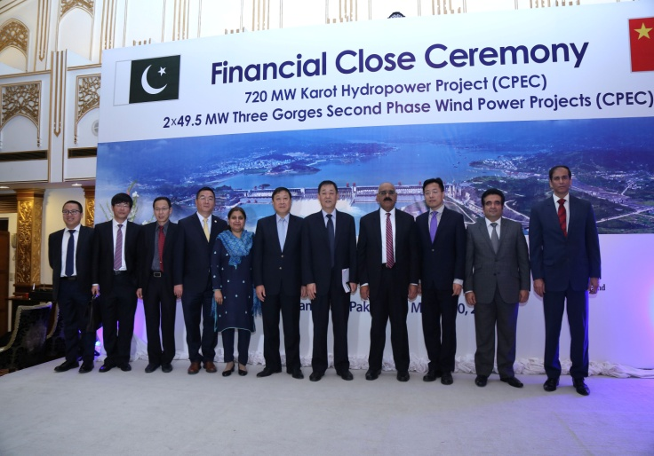
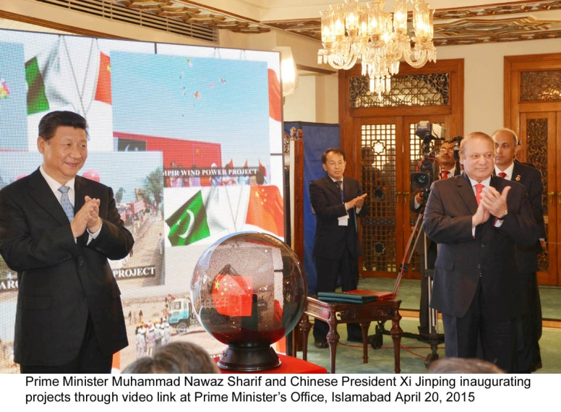
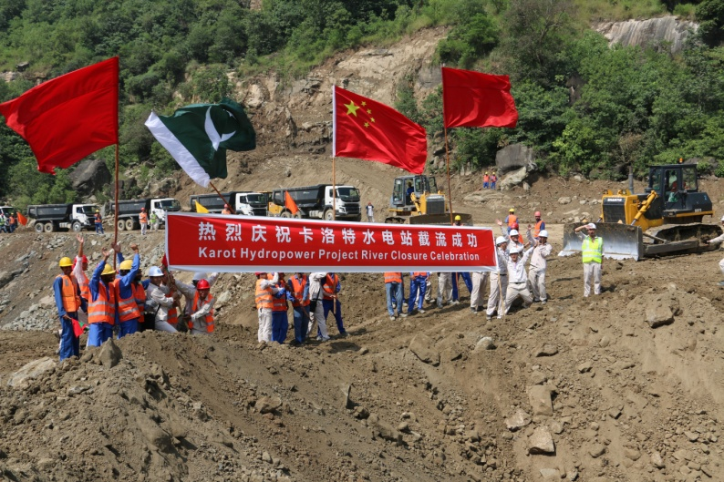
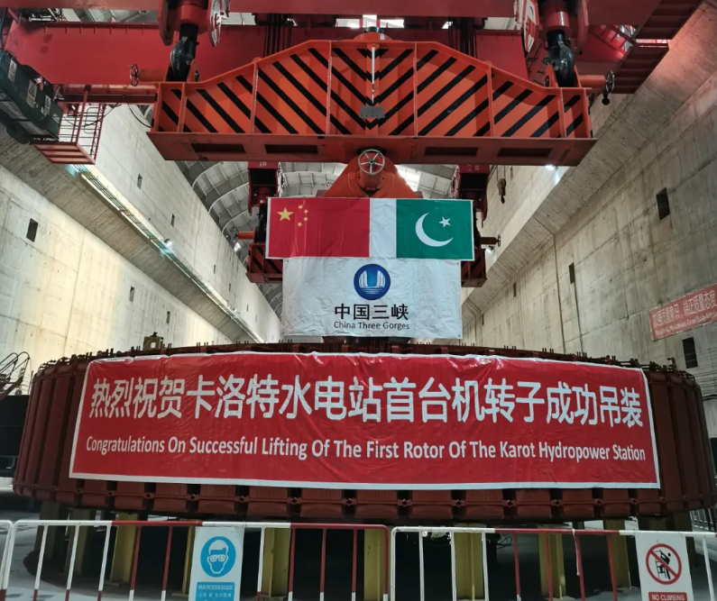
Project Updates
720 MW Karot Hydropower Project
2010.06
2014.04
2015.02
2016.12
2017.02
2018.09
2021.05
2022.06
Incorporation of Karot Power Company (Pvt.) Limited (KPCL)
Chosen as one of the Priority Project under the CPEC
Signing of the EPC contract
Officially started the construction
Financial Close
River Closure
First roter lifted
Expected COD

Slide 25
Project Construction Progress
Notes:
南亚公司在巴基斯坦共有员工170人，其中巴方员工占比61%，属地化程度高。
其中三峡国际派驻员工27人，借调员工人14人，国内第三方劳务派遣25人。
巴方管理类员工大多数具有多年水电开发管理经验，入职后能有效推进工作开展。
中方大多数员工都很年轻，在巴基斯坦历经不同岗位的锻炼，成长迅速，很多都能独当一面。

Slide 26
Overall Construction Progress
Sr. No. | Activity | Progress
1 | Overall Construction | 92.37%
2 | Diversion tunnel | 100%
3 | Rock fill dam | 87.55%
4 | Spillway | 88.27%
5 | Powerhouse | 91.26%
6 | Intake tower | 98.14%
7 | Headrace tunnels | 100%
92.37%
Overall Construction

Slide 27
Pictures on Project Progress
Notes:
南亚公司在巴基斯坦共有员工170人，其中巴方员工占比61%，属地化程度高。
其中三峡国际派驻员工27人，借调员工人14人，国内第三方劳务派遣25人。
巴方管理类员工大多数具有多年水电开发管理经验，入职后能有效推进工作开展。
中方大多数员工都很年轻，在巴基斯坦历经不同岗位的锻炼，成长迅速，很多都能独当一面。

Slide 28
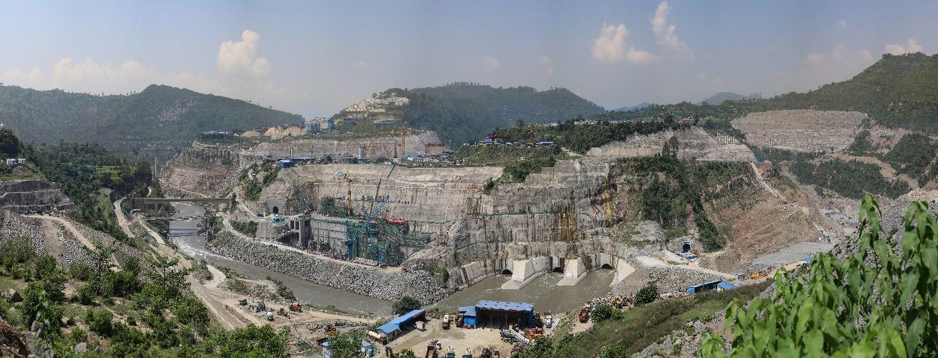
Construction Progress
Project Major Components
No.3 Spoil Disposal Area
Reconstructed Bridge
Dam Left Bank
Access Tunnel
No.1 Spoil Disposal Area
Powerhouse
Diversion Tunnel Outlet
Downstream Cofferdam
Karot Hydropower Project Overall Progress Image 1

Slide 29
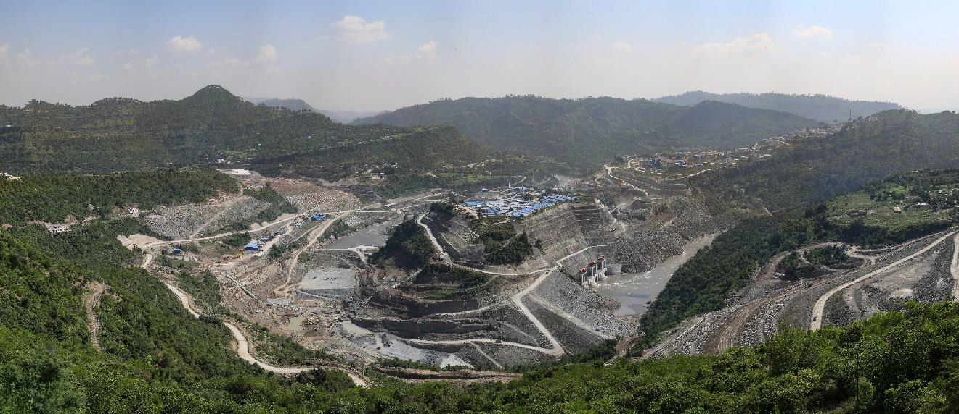
Construction Progress
Project Major Components
Reconstructed Bridge
No.1 Spoil Disposal Area
Spillway
Downstream Cofferdam
Diversion Tunnel Inlet
Dam Right Bank
Upstream Cofferdam
Karot Hydropower Project Overall Progress Image 2

Slide 30
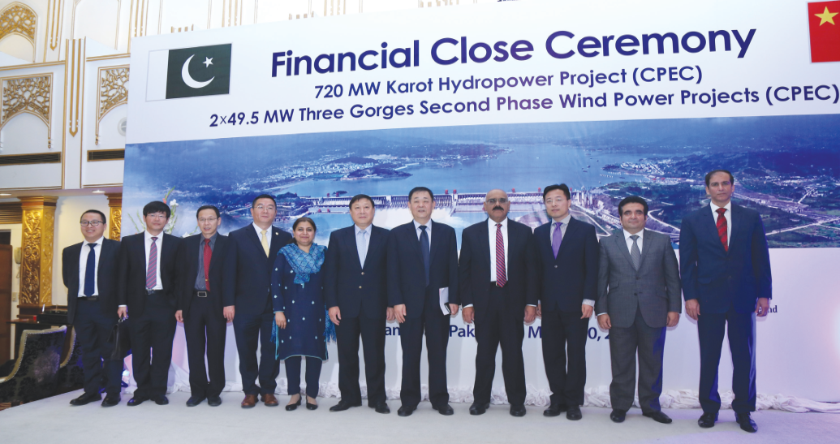
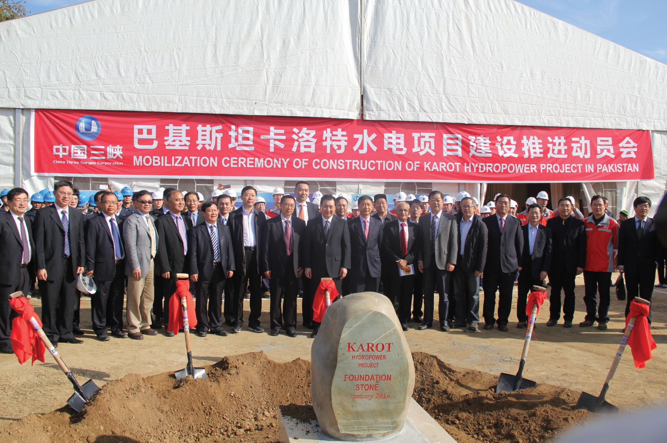
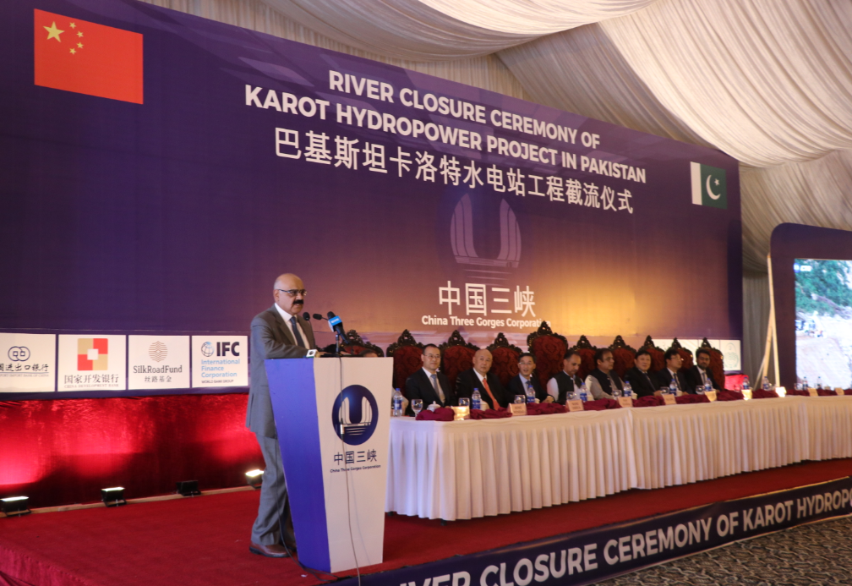
Pictures of Karot Project Activities

Slide 31
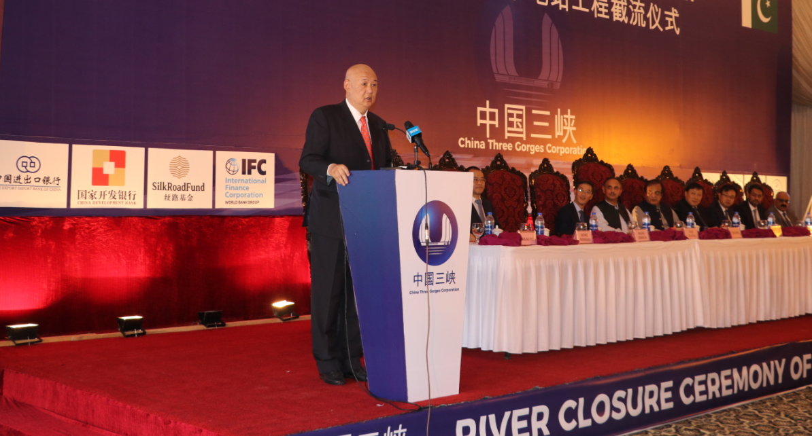
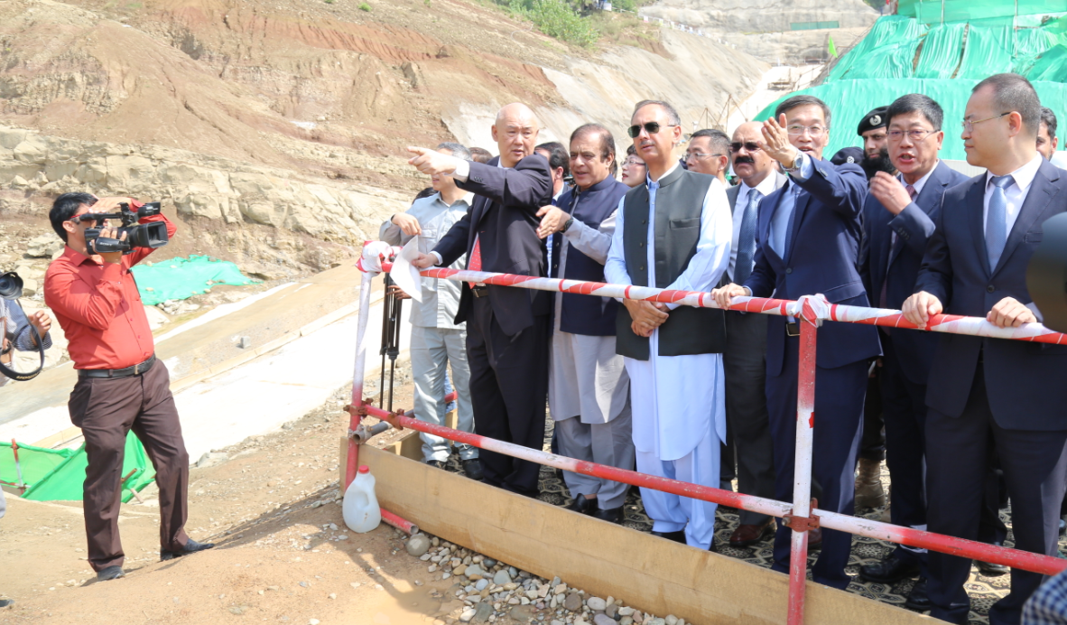
Pictures of Karot Project Activities

Slide 32
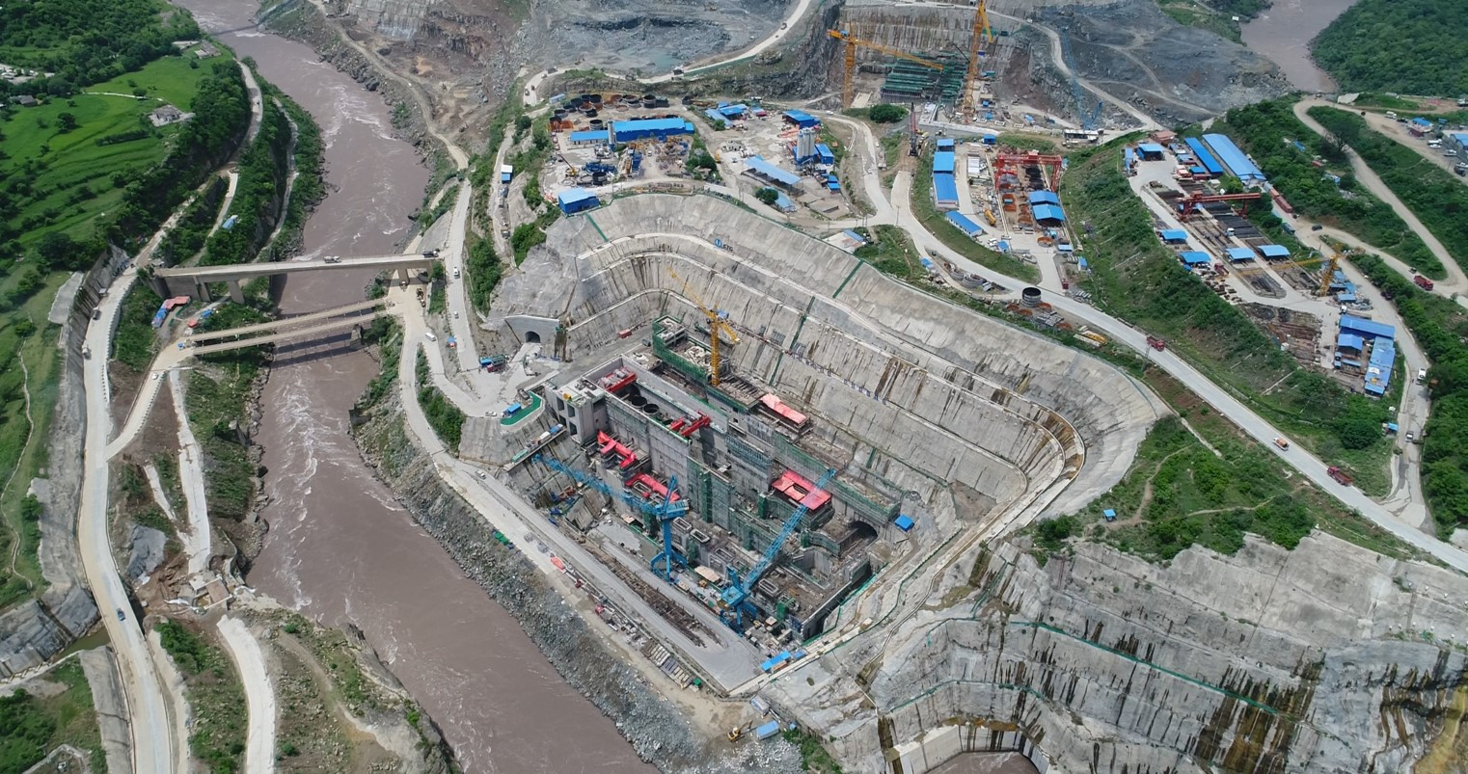
Pictures of Karot Project Activities
Panoramic view of project site for 720MW Karot Hydropower Project

Slide 33
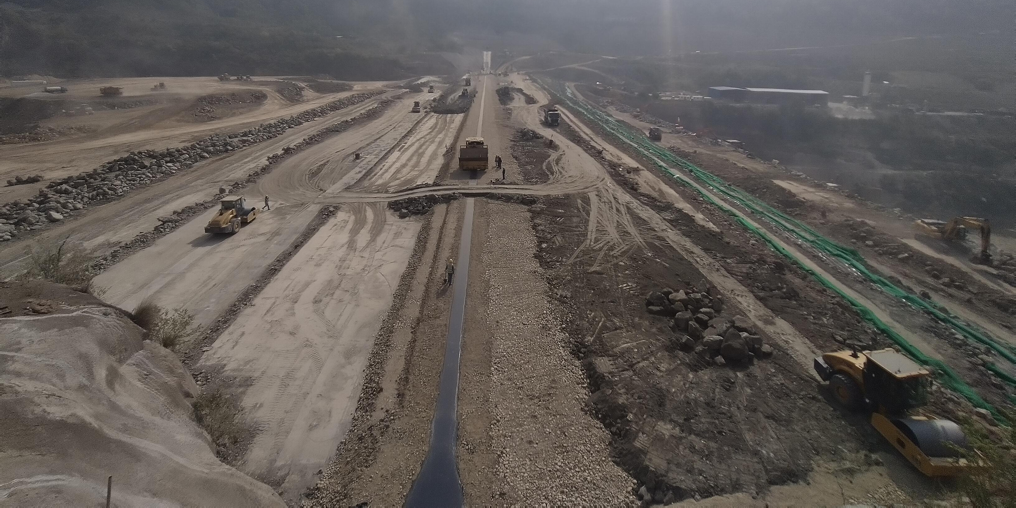
Pictures of Karot Project Activities
  Dam percentage completion 87.55%

Slide 34
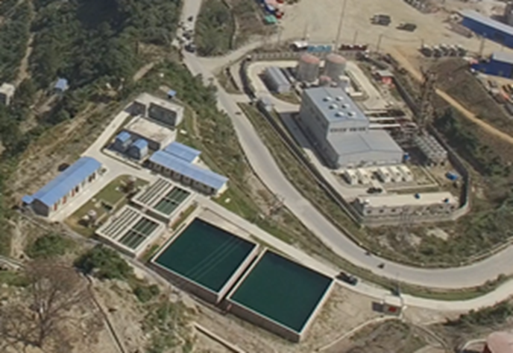
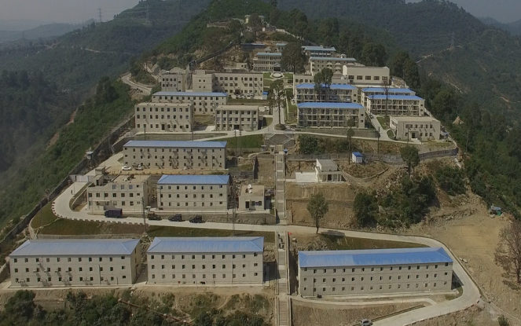
Pictures of Karot Project Activities
Construction management camps
Water storage at site
Notes:
南亚公司在巴基斯坦共有员工170人，其中巴方员工占比61%，属地化程度高。
其中三峡国际派驻员工27人，借调员工人14人，国内第三方劳务派遣25人。
巴方管理类员工大多数具有多年水电开发管理经验，入职后能有效推进工作开展。
中方大多数员工都很年轻，在巴基斯坦历经不同岗位的锻炼，成长迅速，很多都能独当一面。

Slide 35
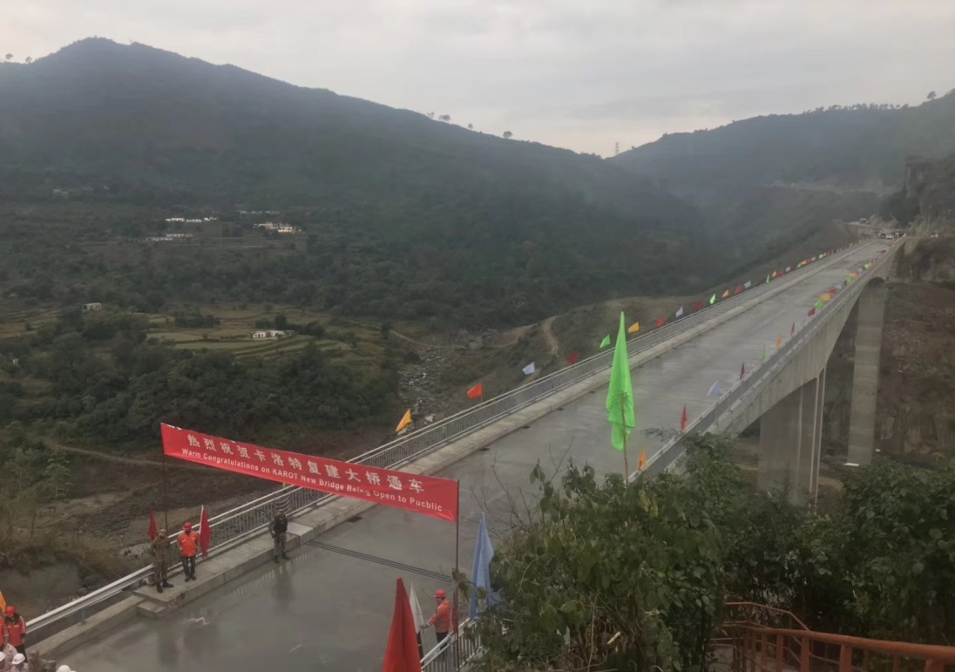
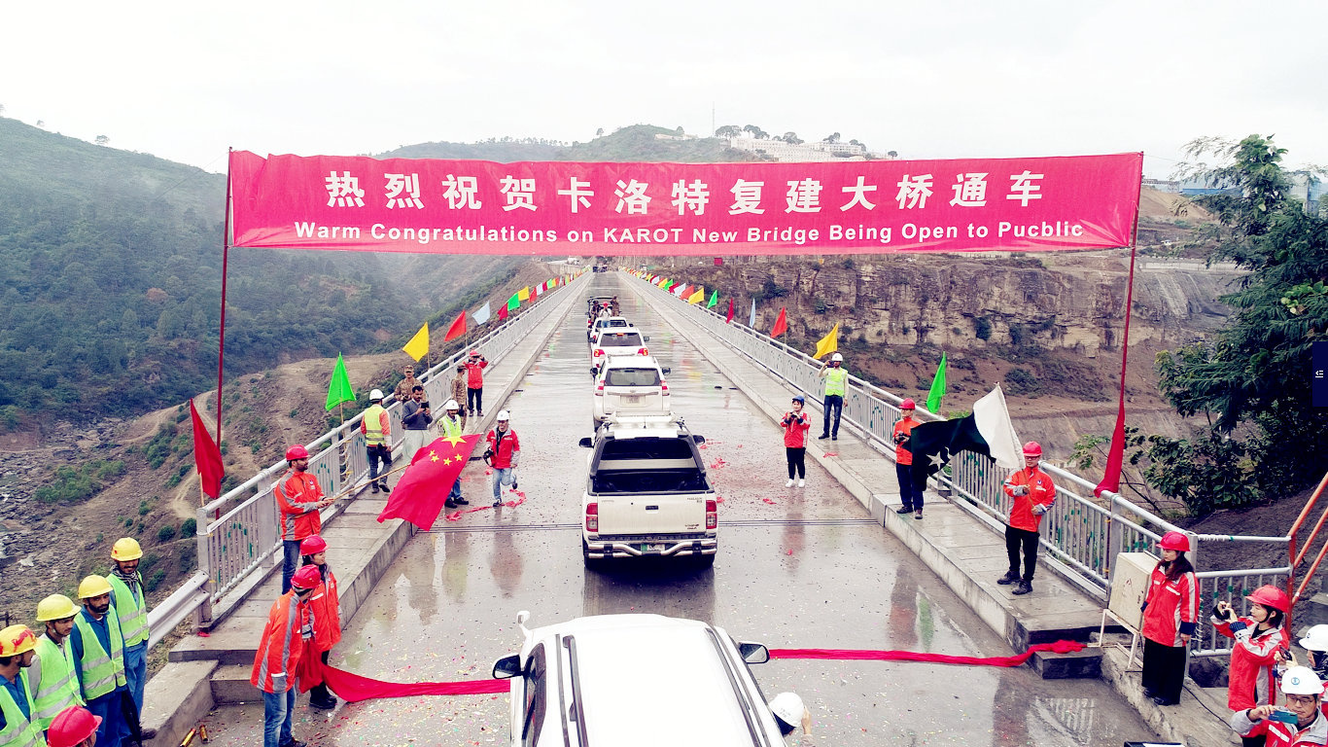
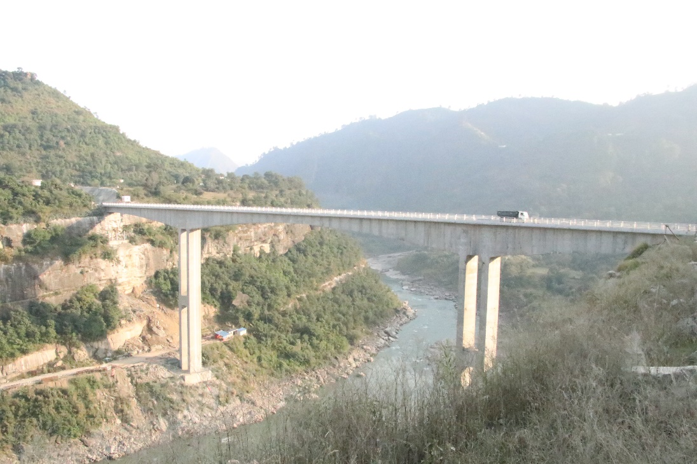
Karot New Bridge

Slide 36
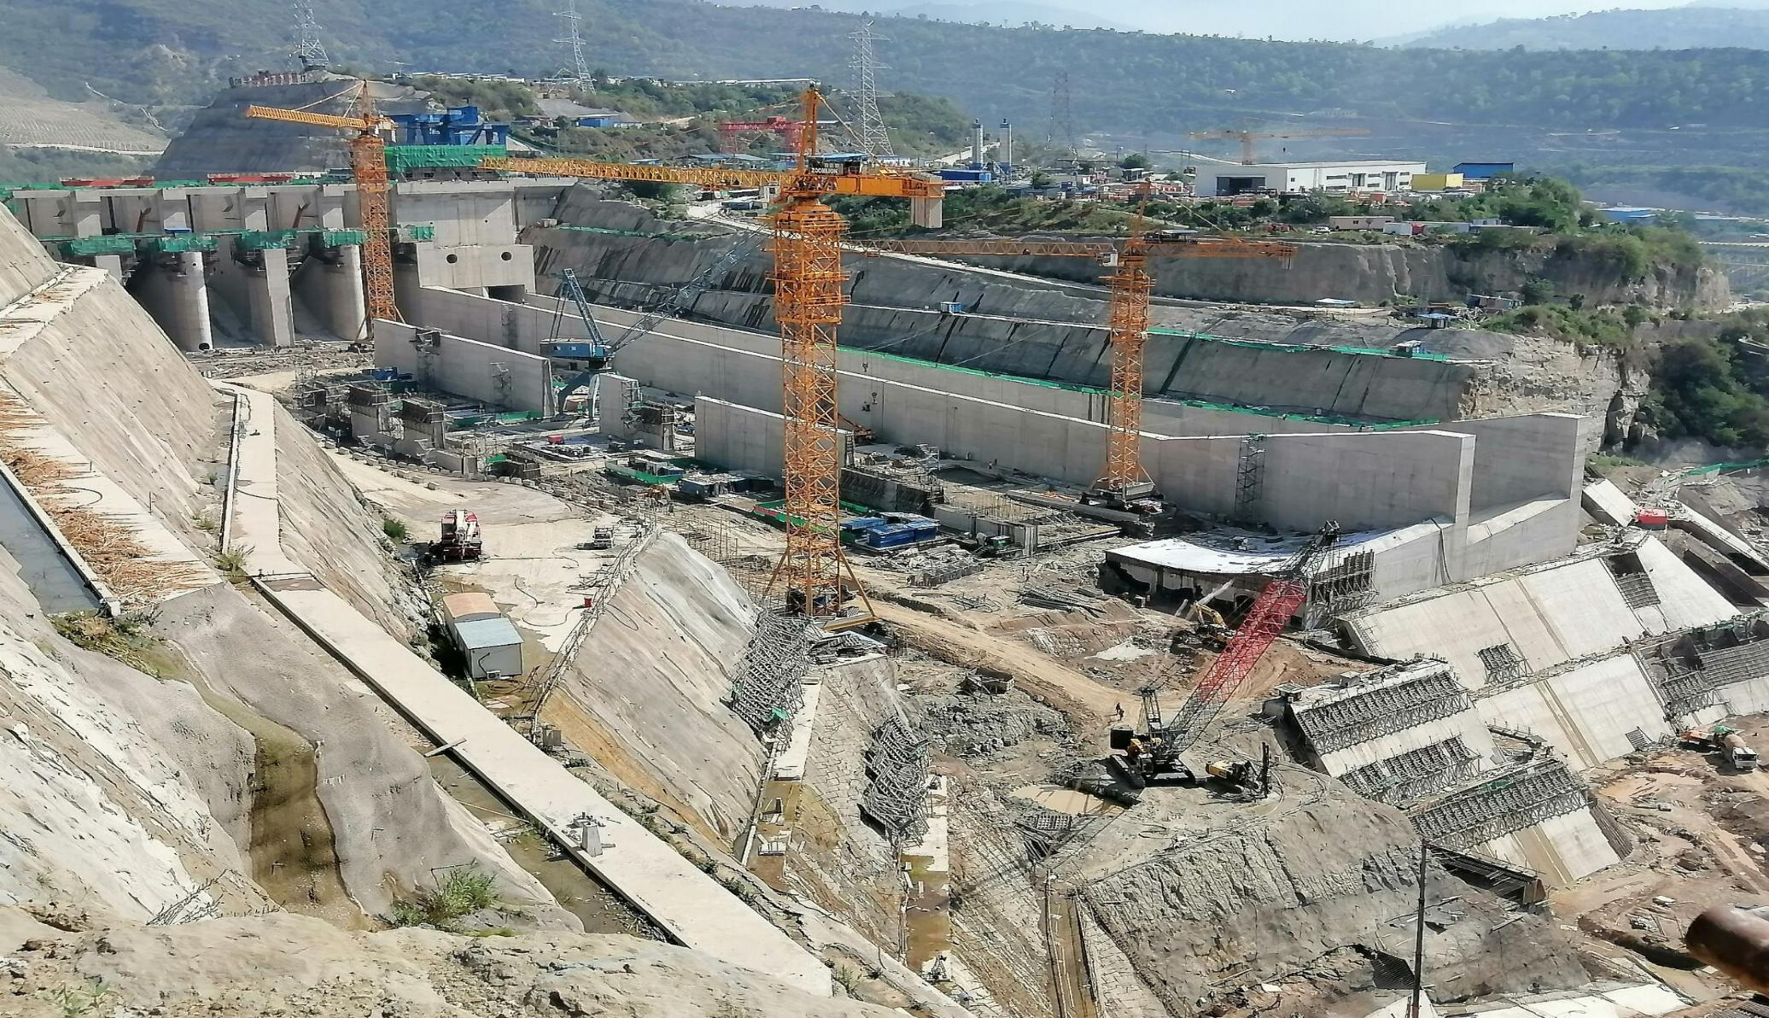
Pictures of Karot Project Activities
  Spillway completion 88.27%

Slide 37
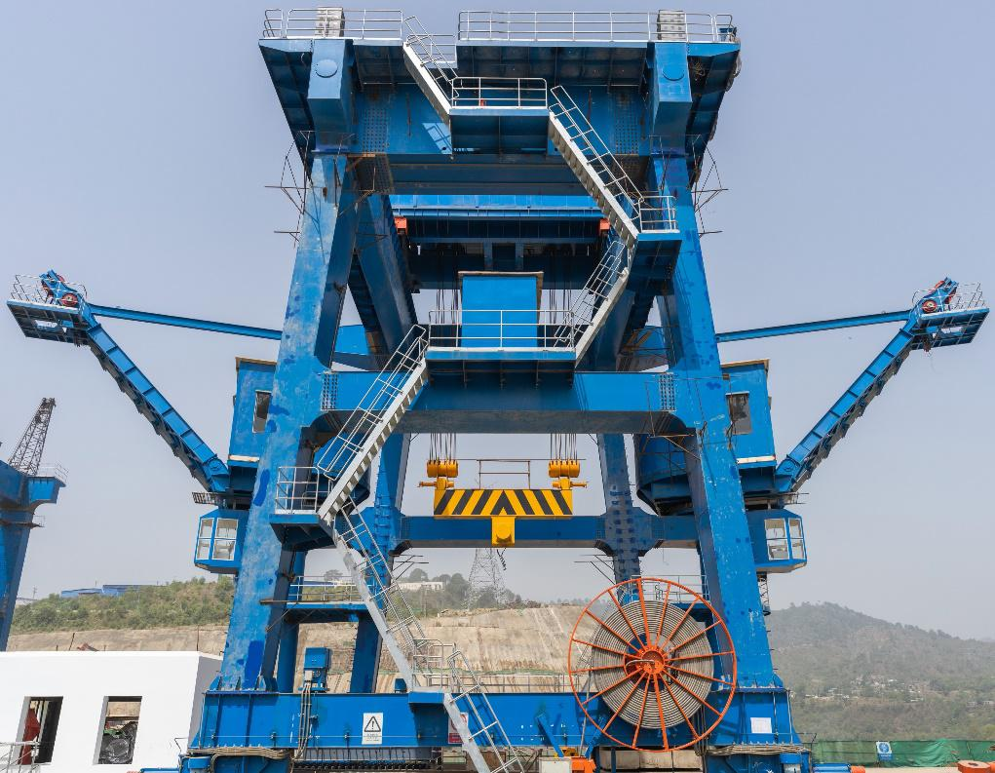
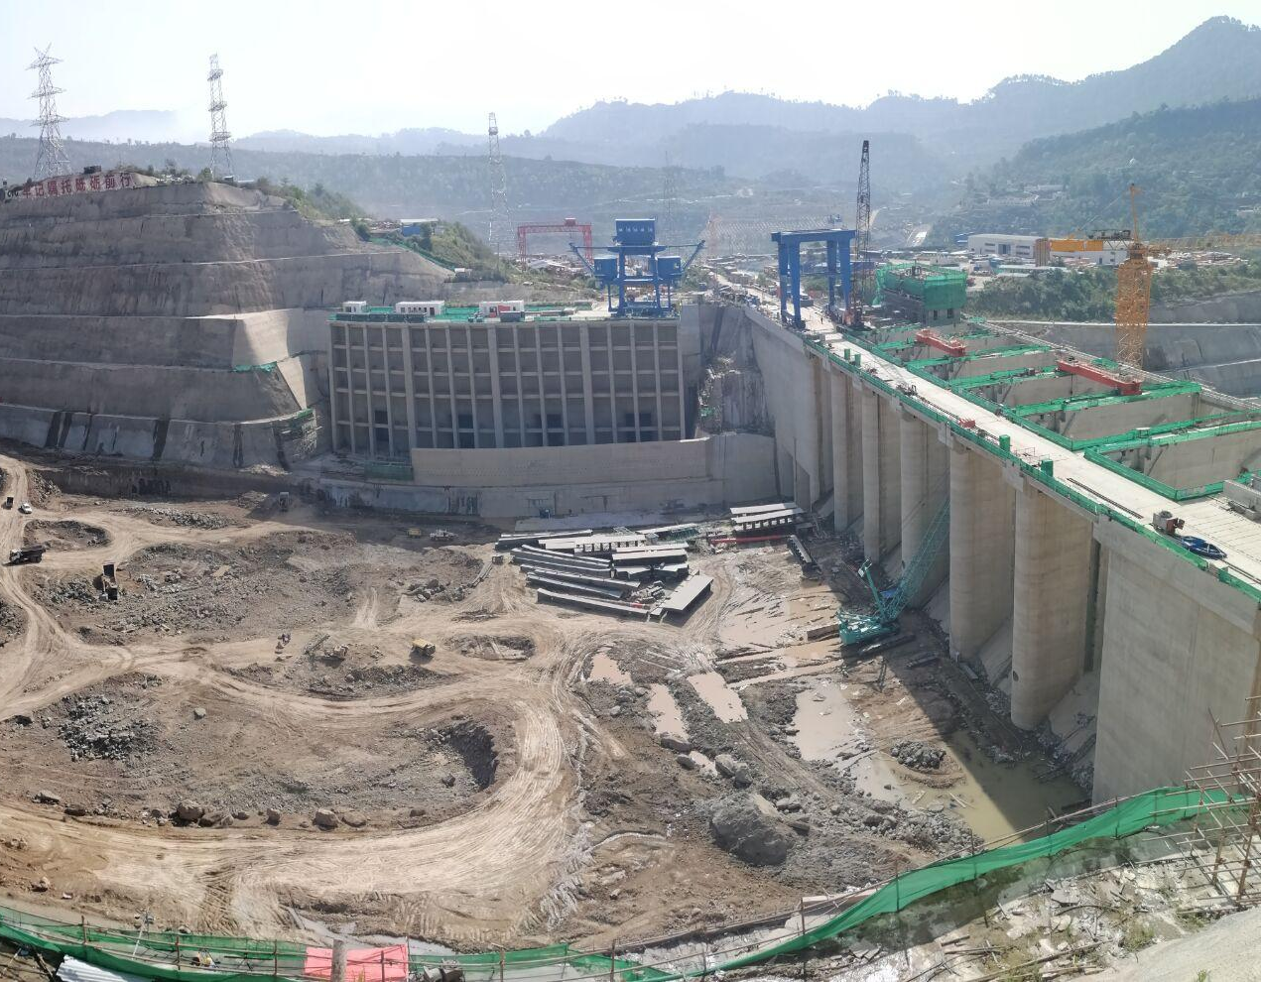
Pictures of Karot Project Activities
  Intake tower completion 98.14%

Slide 38
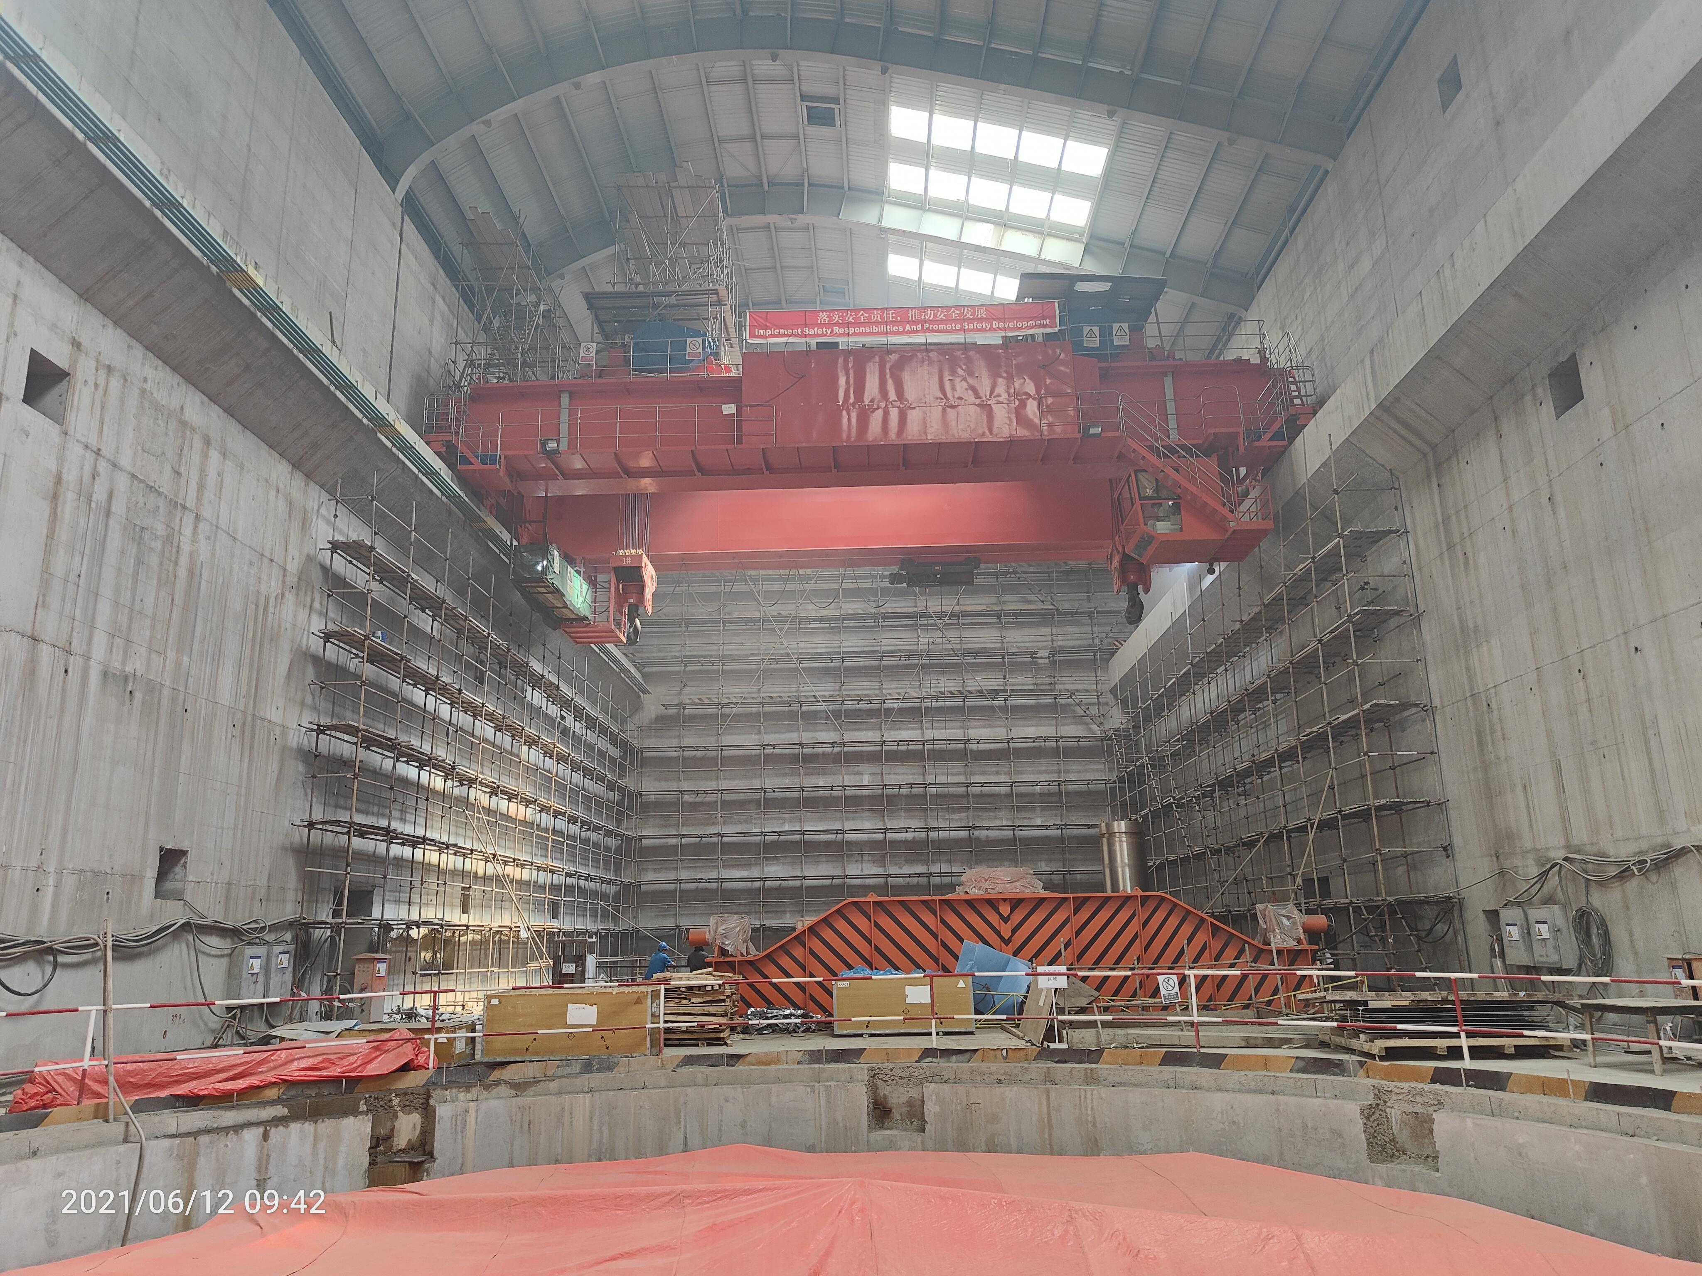
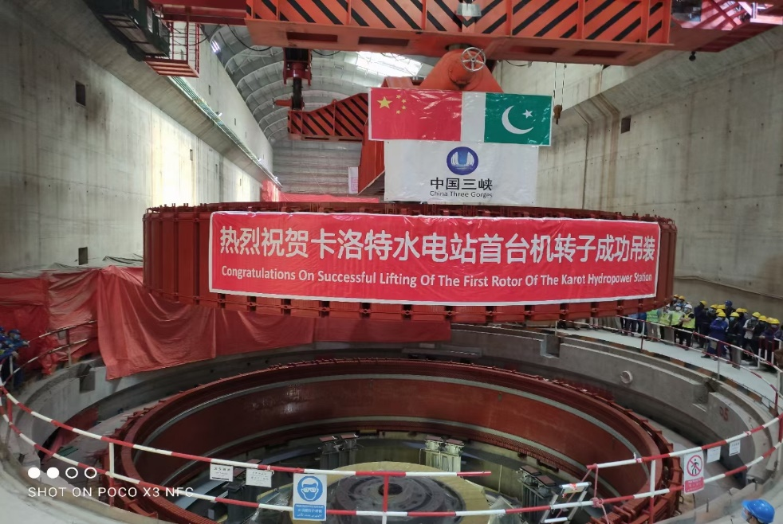
Pictures of Karot Project Activities
  Power house completion 91.26 %

Slide 39
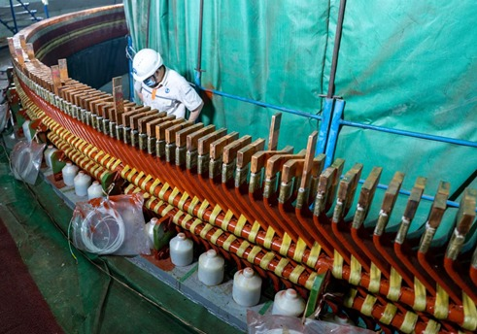
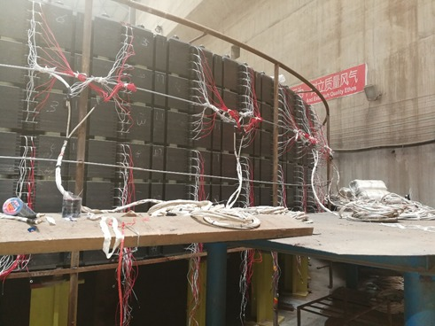
Pictures of Karot Project Activities
  Power house completion 91.26 %

Slide 40
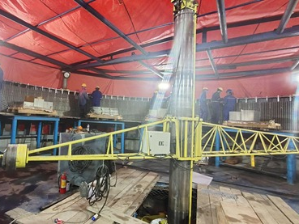
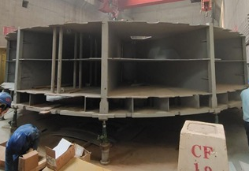
Pictures of Karot Project Activities
  Power house completion 91.26 %

Slide 41
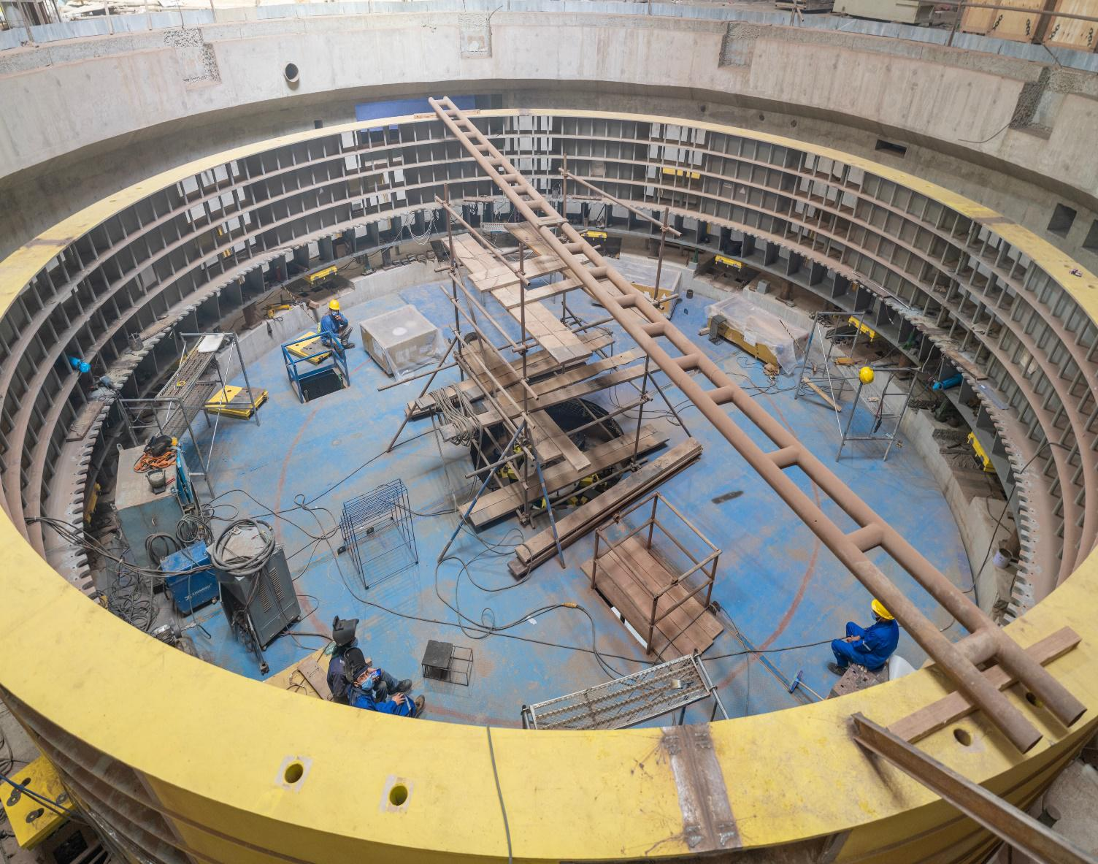
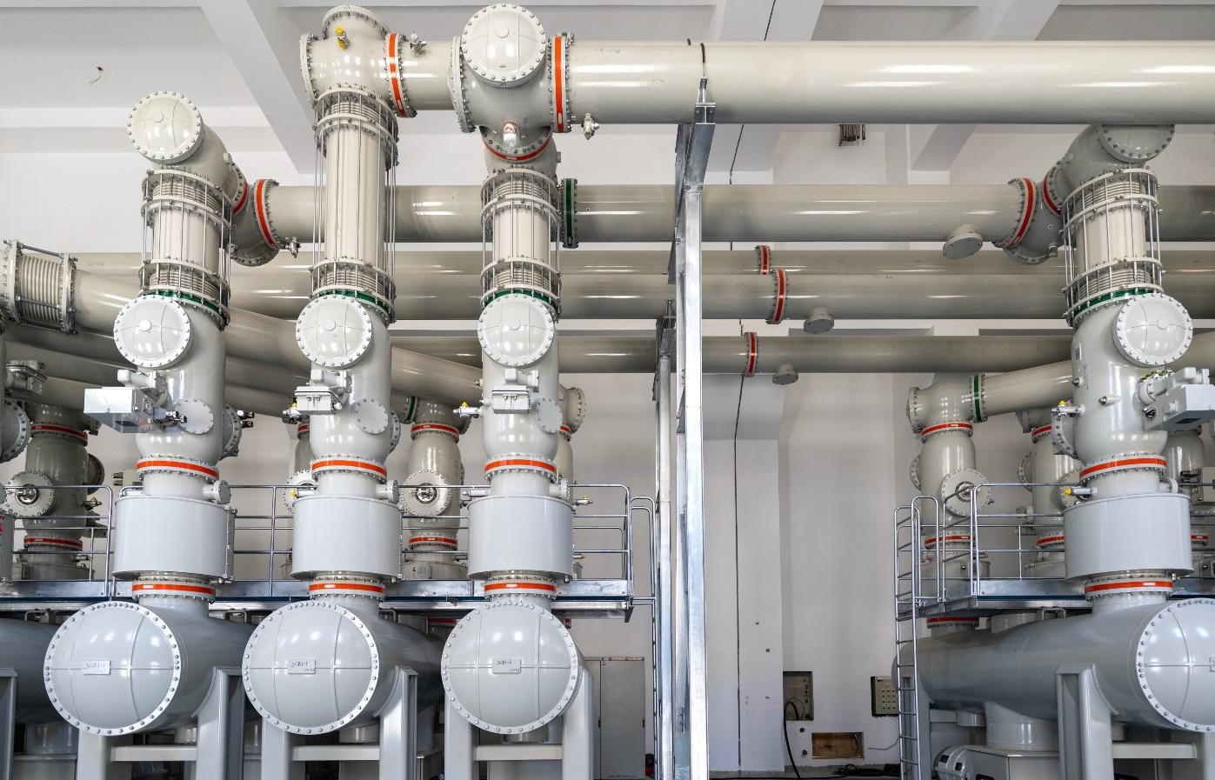
Pictures of Karot Project Activities
  Power house completion 90.38%

Slide 42
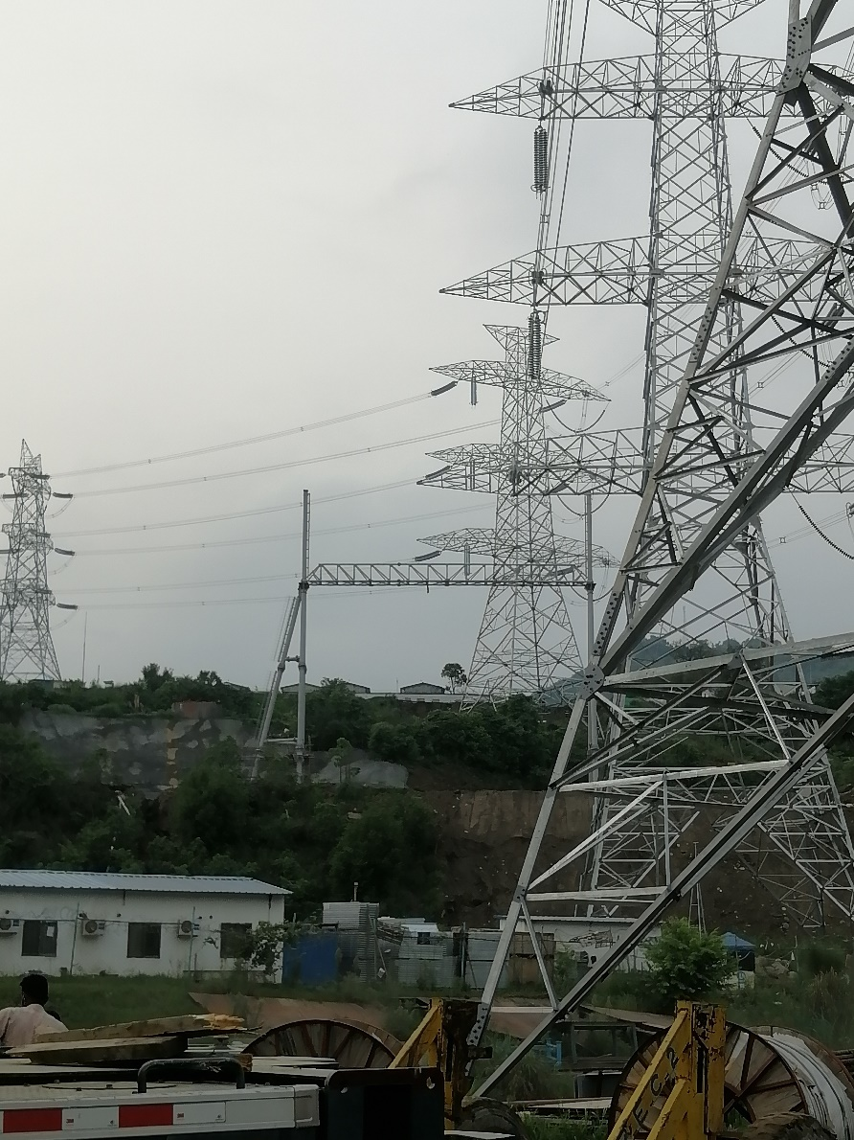
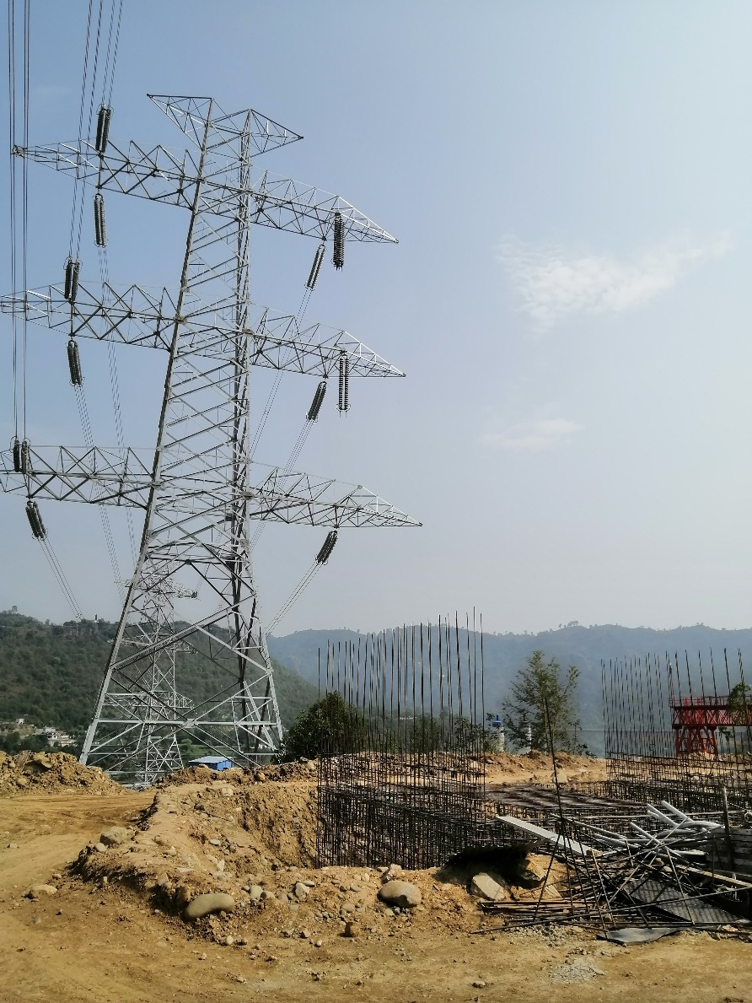
Pictures of Karot Project Activities
  Transmission Line Construction

Slide 43
COVID – 19 Preventive Measures
Notes:
南亚公司在巴基斯坦共有员工170人，其中巴方员工占比61%，属地化程度高。
其中三峡国际派驻员工27人，借调员工人14人，国内第三方劳务派遣25人。
巴方管理类员工大多数具有多年水电开发管理经验，入职后能有效推进工作开展。
中方大多数员工都很年轻，在巴基斯坦历经不同岗位的锻炼，成长迅速，很多都能独当一面。

Slide 44
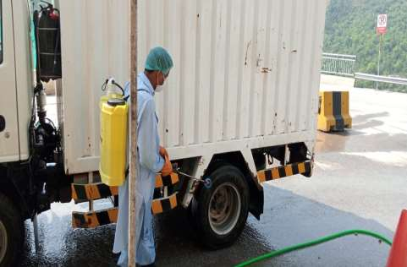
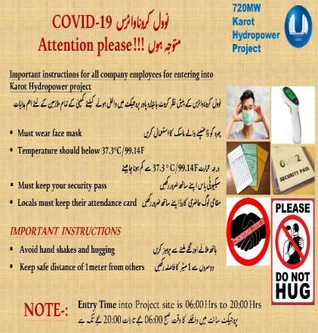
COVID – 19 Preventive Measures
In order to prevent the spread of COVID-19 at the project site, the following actions were taken for health and safety of all workers and employees:
Company provided
  Free COVID-19 testing
  Masks and other PPEs
  PCR testing on weekly basis
Company formulated SOPs to prevent COVID-19 at site which included:
  restriction of wearing masks;
  Washing of all project entering vehicles;
  Following possible social distancing;
  Awareness of workers;
  Disinfectant spry in camps, offices, at working sites and in transportation vehicles;
  Vaccination of all employees (vaccination is ongoing)

Slide 45
Corporate Awards
Notes:
南亚公司在巴基斯坦共有员工170人，其中巴方员工占比61%，属地化程度高。
其中三峡国际派驻员工27人，借调员工人14人，国内第三方劳务派遣25人。
巴方管理类员工大多数具有多年水电开发管理经验，入职后能有效推进工作开展。
中方大多数员工都很年轻，在巴基斯坦历经不同岗位的锻炼，成长迅速，很多都能独当一面。

Slide 46
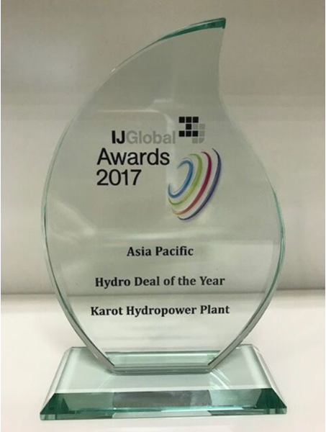

A Pakistani employees of KPCL was awarded the Pakistan excellent employee award of the China-Pakistan Economic Corridor (CPEC) project
720 MW Karot Hydropower Project won the Asia Pacific Hydro Deal of the Year (2017), awarded by IJ Global, the global energy infrastructure authority
Dam left abutment excavation Dam right abutment excavation

Slide 47

Karot project camp won the 2018 China overseas project excellent camp award
Dam left abutment excavation Dam right abutment excavation

Slide 48


Karot Hydropower Project won the "2019 China International Sustainable Infrastructure Project Award", awarded by China International Contractors Association in December 2019 in Changsha, China
Dam left abutment excavation Dam right abutment excavation

Slide 49



CSR Awards Achievement during 2019 for Education and Health
Dam left abutment excavation Dam right abutment excavation

Slide 50
Karot Project Key Successes and Challenges
Notes:
南亚公司在巴基斯坦共有员工170人，其中巴方员工占比61%，属地化程度高。
其中三峡国际派驻员工27人，借调员工人14人，国内第三方劳务派遣25人。
巴方管理类员工大多数具有多年水电开发管理经验，入职后能有效推进工作开展。
中方大多数员工都很年轻，在巴基斯坦历经不同岗位的锻炼，成长迅速，很多都能独当一面。

Slide 51
720 MW Karot HPP – Key Successes
Approvals from relevant Government Departments / Entities
  Acquired total 24,261 Kanals of land in Punjab and AJK without much hassle.
  Sought timely approvals from GOP / GOAJK for IA, PPA and WUA, ESIA Study NOC
  Mechanism for tax sharing between Federal, Punjab and AJK Governments developed with consensus of all.
  Resolved 16 % sales tax on Construction Contractor levied by Government of Punjab and GOAJK amicably.
  KPCL resolved the issue of seeking consent for the design of seven bridges from Governments of Punjab and AJK.

Slide 52
720 MW Karot HPP – Challenges Ahead
  Impoundment of Water after completion of construction of main dam.
  Dry and wet testing of the Karot HPP
  Resolution of the technical issues related to testing and commissioning of the Project
  COD tariff adjustment from NEPRA in a timely manner.
  Dispatch of the Karot Project by NTDC / NPCC
  Getting timely payments by NTDC /CPPA-G

Slide 53
Conclusion
  The success of the Karot Project is the first steps toward development of other mega Hydro Power Projects in Private Sector in Pakistan by CTG Group and has inculcated interest of the investors and lenders in development and implementation of Hydro Power Projects.

Slide 54

Thank you!
Contacts:
N A Zuberi
0300-5317303
zuberippib@gmail.com

