Slide 1
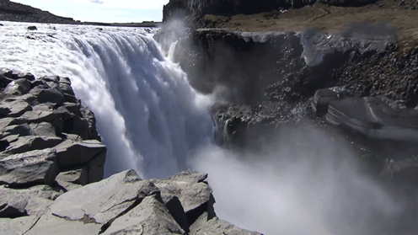
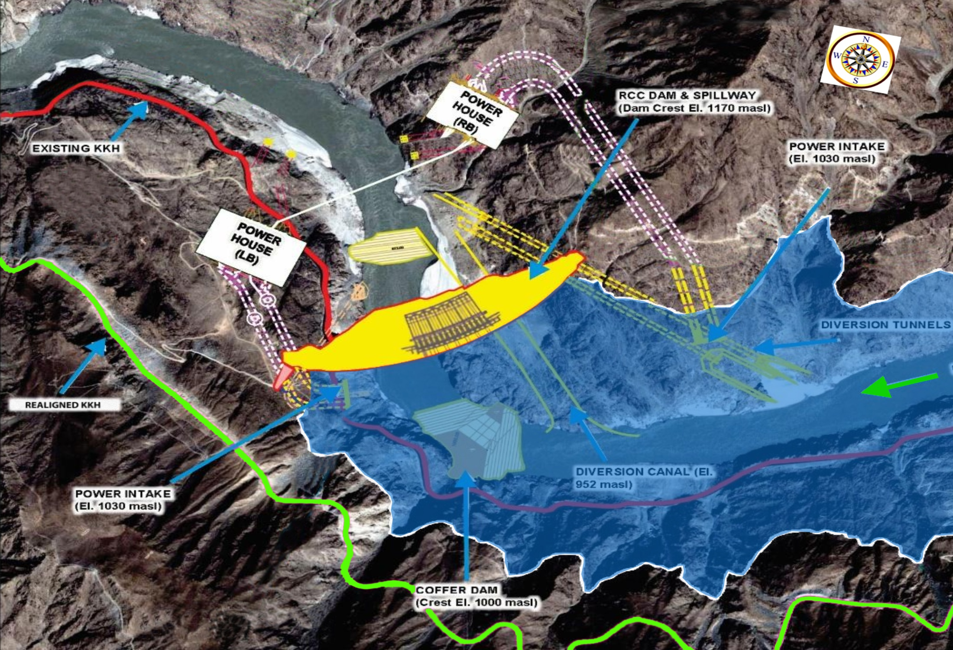
WATER AND POWER DEVELOPMENT AUTHORITY
DIAMER BASHA DAM PROJECT
2nd INTERANTIONAL HYDROPOWER CONFERENCE
DECEMBER 2022

Slide 2
WHY HYDROPOWER
Economic Resource of Energy
Renewable and Clean Resource
Eco Friendly
Flood Mitigation

Slide 3
PAKISTAN WATER RESOURCES
145 MAF
55 MAF
Annual Surface Water Availability
Ground Water
13.5 MAF
26 MAF
Storage Capacity
Water Available for additional Storage

Slide 4
THE ENERGY DYNAMICS OF PAKISTAN
Total Generation 121 Billion Units/Year
WAPDA’s Contribution 37 Billion Units/Year (28.7%)

Slide 5
ENERGY MIX
IDEAL HYDEL THERMAL MIX
70:30
PRESENT HYDEL THERMAL MIX
30:70

Slide 6
PAKISTAN’S HYDROPOWER POTENTIAL
Total Potential= 100,000 MW
Identified Potential= 62,796 MW
Tapped= 9,400 MW
5

Slide 7
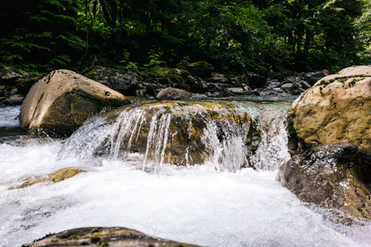
INDUS CASCADE PAKISTAN’S MOST PRECIOUS ASSET
Indus enters Pakistan Altitude 8,430 ft
5.5 MAF
Shyok
640 MW
3.0 MAF
Skardu
1,200 MW
Tungus
2,200 MW
Yulbo
2,800 MW
Bunji
7,100 MW
6.4 MAF
Diamer Basha
4,500 MW
Drop of 7,840 feet
Dasu
4,320 MW
Pattan
2,400 MW
Thakot
4,673 MW
42,196 MW
5.86 MAF
Tarbela/GB
7,748 MW
6.0 MAF
Akhori
600 MW
33 MAF
Kalabagh
3,600 MW
6.0 MAF
Jinnah
96 MW
0.28 MAF
Chashma
184 MW
Taunsa
135 MW
Multiple Sites along this stretch
Altitude 590 ft
6
Notes:
Upper Indus Basin has a drop of more than 7,000 feet in a stretch of 500 Km length which is ideal for hydropower generation and can serve as engine of growth for economy of the country. Studies carried out by WAPDA identified potential sites for hydropower development projects with more than 42,000 MW generation capacities. The important sites includes Bunji - 7,100 MW, Tungus - 2,200 MW, Yulbo - 2,800 MW, Basha - 4,500 MW, Dasu 4,320 MW, Tarbela/Ghazi Barotha - 7,748 MW, Kalabagh - 3600 MW etc.

Slide 8
CARRY OVER CAPACITY (DAYS) – WORLD VS PAKISTAN
Days

Slide 9
STORAGE CAPACITY
RESERVOIR | LIVE STORAGE CAPACITY |  |  | STORAGE LOSS
 | ORIGINAL |  | YEAR 2022 | YEAR 2022
TARBELA | 9.692 |  | 5.862 | 3.866 (40%)
MANGLA | 5.86 | 8.237 | 7. 356 | 0.881 (11%)
CHASHMA | 0.717 |  | 0.278 | 0.439 (61%)
TOTAL | 16.269 | 18.646 | 13.460 | 5.186 (27%)
Notes:
8
Tarbela, Mangla and Chashma are large size reservoirs in Pakistan which directly feed the Indus Basin Irrigation Network. Their original total live storage capacity was 16.27 MAF. This storage capacity was increased to 18.646 MAF in 2012 by raising of Mangla Dam.
By 2017, the total storage capacity has decreased to 13.86 MAF due to deposition of sediments. Up-till now a total storage capacity of 4.78 MAF has been lost to sedimentation, which is about 25% of original total storage capacity of these reservoirs.

Slide 10
PROJECTS UNDER EXECUTION BY WAPDA
Mohmand Dam
(1.29 MAF, 800 MW and Water Supply 300 MGD)
Dassu Hydropower
(4320 MW, 2160 MW Ph 1)
Diamer Basha Dam
(8.1 MAF, 4500 MW)
Tarbela 5th Ext HP
(1530 MW)
Kurram Tangi Dam
(18.9 MW, 16000 Acres CCA)
Harpo HPP
(34.5 MW)
Nai Gaj Dam
(0.3 MAF)
Kachhi Canal
(30,000 Acres Land)
IMPACT
Gross Water Storage - 11.7 MAF
Power / Annual Energy- 9025 MW / 34.5 Billion Unit
Urban Water Supply - 950 MGD
Jobs Created - More than 35,000
Sindh Barrage
(2 MAF)
K – IV Project
(Water Supply 650 MGD)

Slide 11
DIAMER BASHA DAM PROJECT

Slide 12
INTRODUCTION
Diamer Basha Dam Project is one of the most important Indus River Cascade Hydropower Project
The site Is 315 KM upstream of Tarbela Dam Project, 180 KM below Gilgit and 40 KM downstream of Chilas, the Headquarter of District Diamer GB.
It will be the tallest RCC Dam having height of 272 m and largest RCC dam in the world in terms of RCC volume (17.4 MCM).
Upon completion, it will be the 2nd largest power station in Pakistan after Tarbela having installed capacity of 4500 MW.

Slide 13
SALIENT FEATURES
MAIN DAM
MAXIMUM HEIGHT | 272M
TYPE | ROLLER COMPACTED CONCRETE (RCC)
RESERVOIR
GROSS STORAGE | 8.1 MAF
LIVE STORAGE | 6.4 MAF
POWERHOUSE
2 | EACH LEFT & RIGHT BANK
TOTAL INSTALLED CAPACITY | 4500 MW
LOCATION | UNDERGROUND
NO OF UNITS | 12 EACH OF 375 MW
ANNUAL GENERATION | 18,100 GWH/YEAR (18.1 BILLION UNITS ANNUALLY)

Slide 14
BENEFITS OF DIAMER BASHA DAM PROJECT
INSTANT
POST COMPLETION
Jobs upto 16,500
Engineers upto 1,050
Steel 600,000 Tons
Cement 2 Million Tons
Pozzolan 2 Million Tons
Transportation 700-800 veh/day
Development Rs.78 Billion
Energy (at site) 18 billion Units
Increase in energy at existing projects (Tarbela, GBHP, Chashma & Jinnah) 2.5 billion units
Upcoming Projects
(Dasu, Pattan & Thakot)
Tarbela Life 35 Years
Saving US$ 2.5 billion
Agri Land 1.23 MA
7.5 billion units

Slide 15
IMPLEMENTATION STRATEGY
DIAMER BASHA DAM PROJECT IS BEING IMPLEMENTED THROUGH THREE SEPARATE PC-Is AS FOLLOWS:
PC-I | COST IN BILLION PKR | APPROVAL DATES | DESCRIPTION | STATUS
DAM PART | 479.686 | 14.11.2018 | CIVIL AND HYDROMECHANICAL WORKS FOR MAIN DAM AND APPURTENANT STRUCTURE | Commencement of works on 07.08.2020
ACQUISITION OF LAND & RESETTLEMENT (2ND REVISED) | 174.700 | 30.04.2020 | LAND ACQUISTION AND VARIOUS PRELIMINARY WORKS CONTRACTS, CONFIDENCE BUILDING MEASURES (CBM’S) AND CULTURAL HERITAGE MANAGEMENT PLAN (CHMP) | 91.32% Land Acquisition completed CBMs and Resettlement works in progress
POWER GENERATION FACILITIES | 933.584 | Under process | CIVIL, HYDROMECHANICAL AND ELECTROMECHANICAL WORKS FOR LEFT BANK AND RIGHT BANK POWERHOUSES | RECOMMENDED BY CDWP FOR ECNEC

Slide 16
CONSULTANTS & CONTRACTOR
CONSULTANTS
DIAMER BASHA CONSULTANS GROUP COMPRISING OF 12 FIRMS
NESPAK (Lead Firm)
ACE - Pakistan
MMP - Pakistan
MWH (Stantec) - USA
Poyry (AFRY) - Switzerland
DOLSAR - Turkey
In association with
AGES - Pakistan
DMC - Pakistan
MAES - Pakistan
MML - UK
BIDR - China
MWH- Pakistan
Contract Cost: Rs. 27.182 Billion
Commencement: 10.06.2020
CONTRACTOR MW-1 MAIN DAM
M/s Power China-FWO (JV)
Contract Cost Rs. 442.402 Billion.
Commencement : 07.08.2020
Power China Share 70 %
FWO Share 30 %

Slide 17
ENGAGEMENT OF PANEL OF EXPERTS
NAME | AREA OF EXPERTISE | NATIONALITY
MR. BRIAN FORBES | DAM ENGINEERING & RCC TECHNOLOGY | AUSTRALIAN
MR. CARLOS JARAMILLO | GEOLOGICAL & ROCK MECHANICS EXPERT | AMERICAN / COLOMBIAN
MR. JOHN H. GUMMER | ELECTRO-MECHANICAL EQUIPMENT EXPERT | AUSTRALIAN/ BRITISH
MR. ASLAM RASHEED | HYDRAULICS EXPERT | PAKISTANI
MR. KHALIL TAYYAB HASSAN | PROCUREMENT EXPERT
MR. YUSOF GHANAAT | SEISMIC DESIGN EXPERT | AMERICAN
Notes:
Field Verification of existing topographic survey (carried out during feasibility study) was carried out by NESPAK Survey Team to ascertain the credibility of survey and following are the observations:
In the existing survey, NESPAK geodetic survey team observed horizontal and vertical control error in the identified control points. 63cm error in vertical control with respect to Survey of Pakistan (SOP) benchmark erected in the Primary school building in Hanzel village were observed.
Existing survey was insufficient between RD 3+300 to RD 3+700 along the Headrace Channel and along left bank of river at weir and power house site
Topographical changes were observed along the project components
Keeping in view the deficiencies in Topographic Survey, Consultants have mobilized their survey team and they carried out the acquisition of field data .Consultants Survey and GIS Experts are now processing survey data.

Slide 18
FINANCING STRATEGY FOR PC-I: DAM PART
Project Cost
(Dam)
(Rs 480 Billion)
PSDP
(Rs 234 Billion )
Commercial Financing
(Rs 146 Billion)
Syndicate Commercial Financing
WAPDA Equity
Rs. 100 Billion
Green Euro Bond
Int’l Donor Agencies / Development Partners (SFD, IsDB, AIIB, KFD)
REVISED PC-I DAM PART IS UNDER PREPARATION. TENTATIVE COST IS RS. 707 BILLION
Notes:
Field Verification of existing topographic survey (carried out during feasibility study) was carried out by NESPAK Survey Team to ascertain the credibility of survey and following are the observations:
In the existing survey, NESPAK geodetic survey team observed horizontal and vertical control error in the identified control points. 63cm error in vertical control with respect to Survey of Pakistan (SOP) benchmark erected in the Primary school building in Hanzel village were observed.
Existing survey was insufficient between RD 3+300 to RD 3+700 along the Headrace Channel and along left bank of river at weir and power house site
Topographical changes were observed along the project components
Keeping in view the deficiencies in Topographic Survey, Consultants have mobilized their survey team and they carried out the acquisition of field data .Consultants Survey and GIS Experts are now processing survey data.

Slide 19
FINANCING STRATEGY FOR PC-I: POWER GENERATION
Banks
Commercial Financing
(Rs 601 Billion)
Local (Rs 200 Billion)
Sukuk Bonds
Local Bonds
Project Cost
(Power Generation)
(Rs 707 Billion)
PSDP Funding
(Rs.70 Billion)
Supplier’s Credit
Green Euro Bond
Foreign (Rs 401 Billion)
WAPDA Equity
(Rs. 36 Billion)
Panda Bond
Int’l Donor Agencies SFD, AIIB, KFD, IsDB
PC-I AMOUNTING TO RS. 933 BILLION (INCLUDING IDC OF RS. 226 BILLION WHICH SHALL BE RECOVERED THROUGH TARRIF)
Notes:
Field Verification of existing topographic survey (carried out during feasibility study) was carried out by NESPAK Survey Team to ascertain the credibility of survey and following are the observations:
In the existing survey, NESPAK geodetic survey team observed horizontal and vertical control error in the identified control points. 63cm error in vertical control with respect to Survey of Pakistan (SOP) benchmark erected in the Primary school building in Hanzel village were observed.
Existing survey was insufficient between RD 3+300 to RD 3+700 along the Headrace Channel and along left bank of river at weir and power house site
Topographical changes were observed along the project components
Keeping in view the deficiencies in Topographic Survey, Consultants have mobilized their survey team and they carried out the acquisition of field data .Consultants Survey and GIS Experts are now processing survey data.

Slide 20
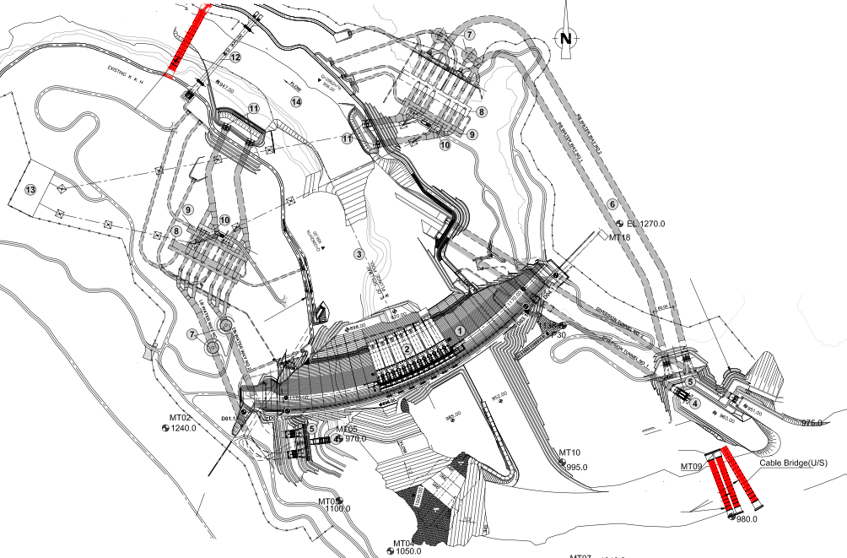
ONGOING SITE ACTIVITIES
Permanent Bridge – Left & Right Abutment & Piers
DT(s) – Outlet Structure
Dam Right Abutment
Guide Wall
Intake Structure DT(s) & Power Waterways
Foundation Pit – Block # 24
Dam Left Abutment
DT - 02
LB Power Intake/Flushing Tunnel Intake
LLO RFO Approach Area
Diversion Canal Middle & U/S Portion
19

Slide 21
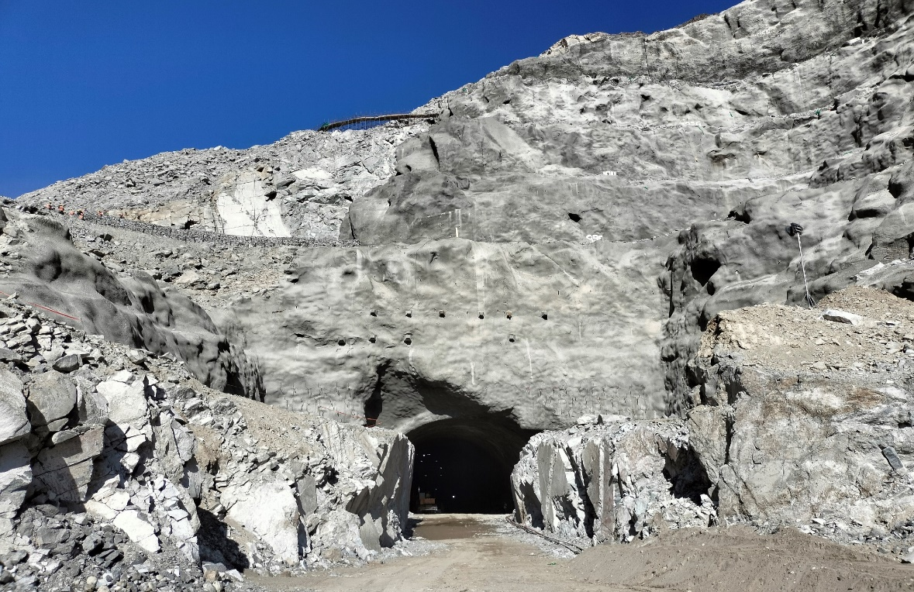
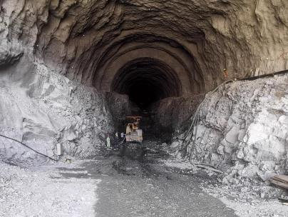
DIVERSION TUNNEL
Inlet
Diversion Tunnel
Outlet

Slide 22
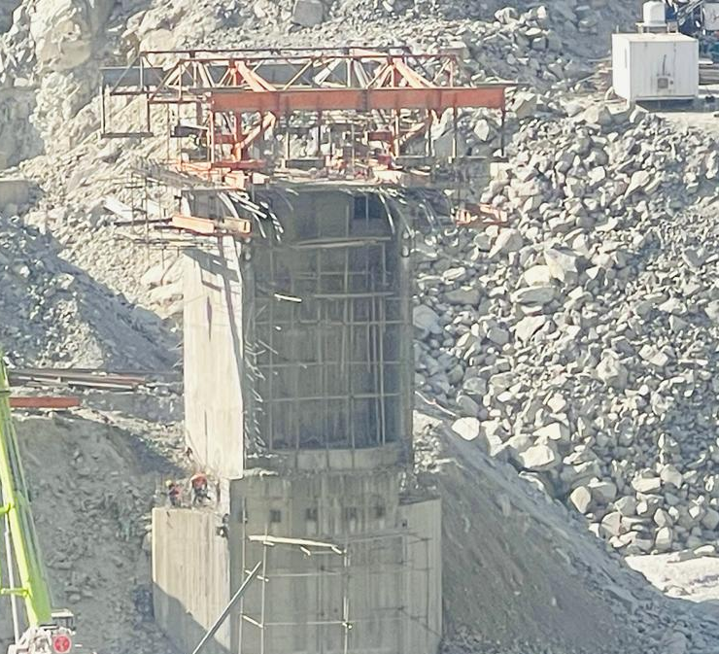
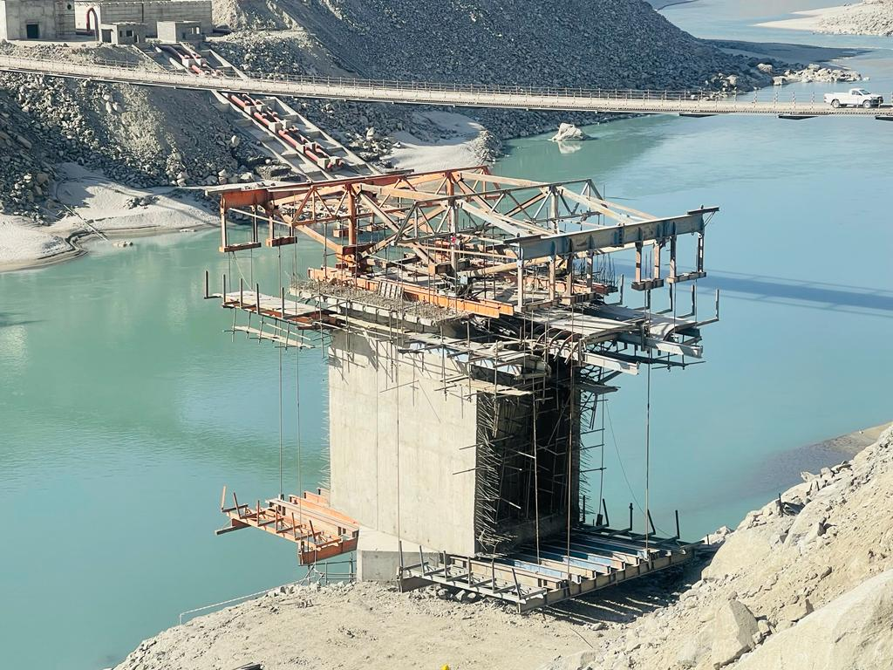
PERMANENET ACCESS BRIDGE

Slide 23
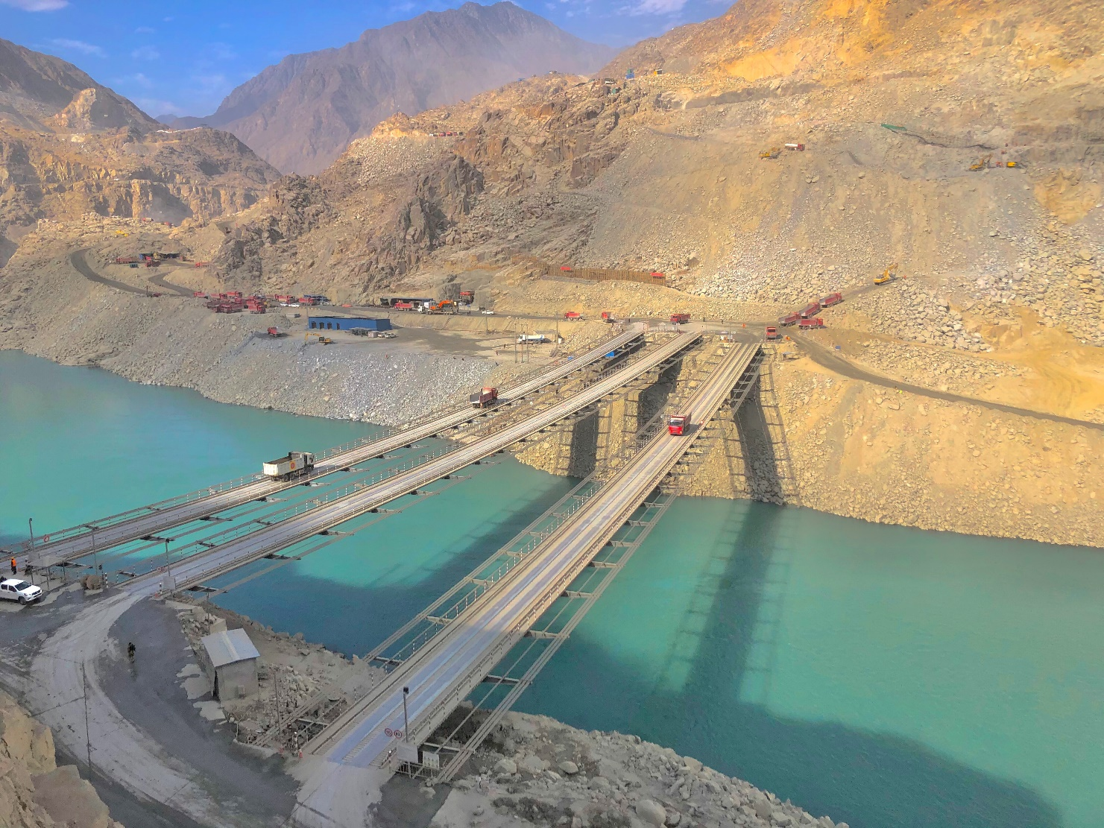
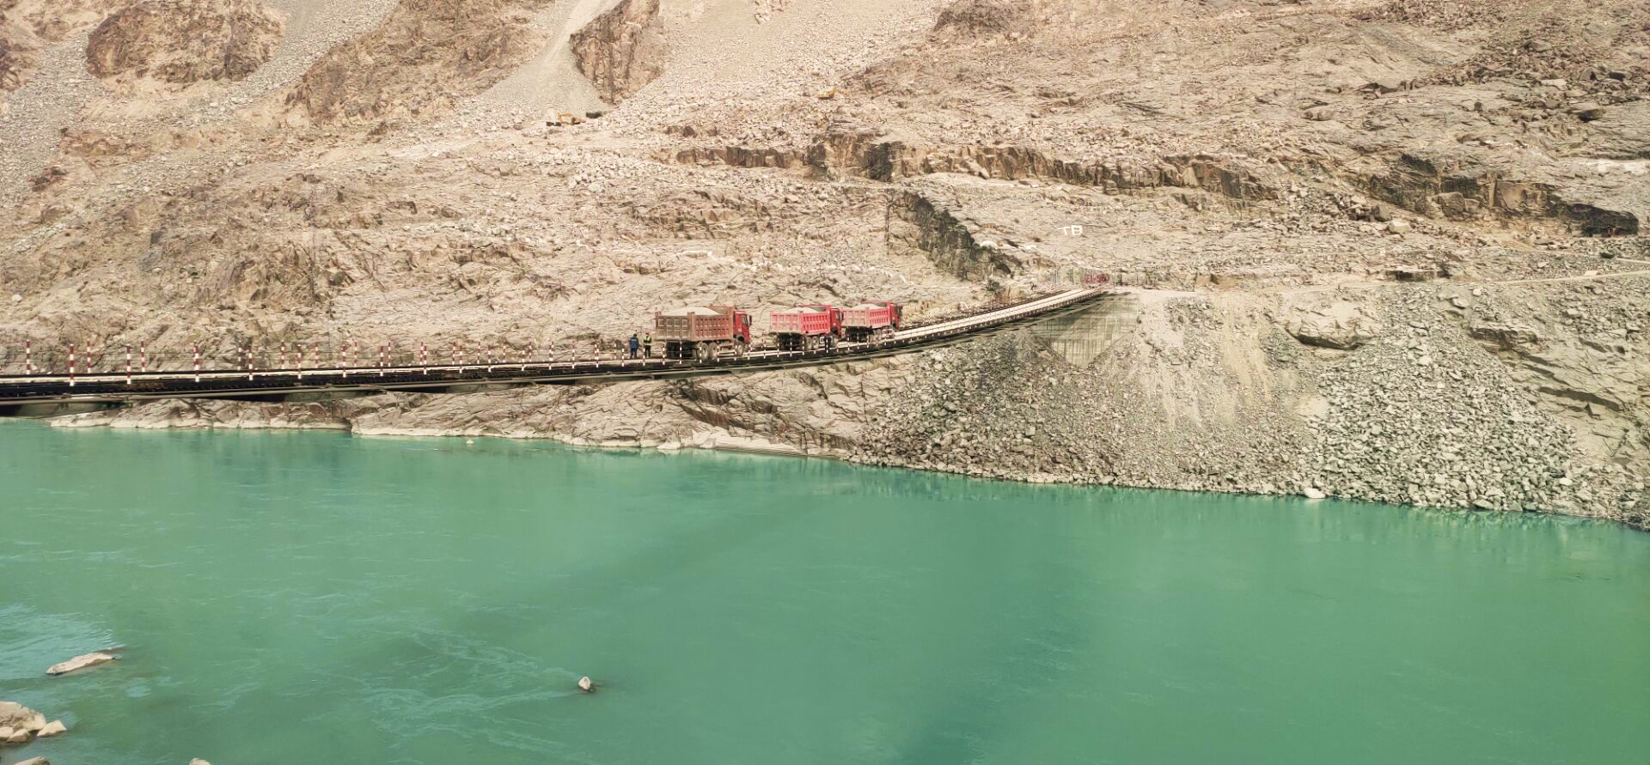
TEMPORARY BRIDGES
UPSTREAM
DOWNSTREAM

Slide 24
Social Uplifting Projects
3.0 MW Hydropower Project in Thak
3.6 MW Hydropower Project in Thor
Cadet College Chilas
WAPDA Army Public School at Thor
44 No. Schemes comprising Education Development Plan, Health Sector Plan and Livelihood interventions(Water Supply, Sewerage System, Bunds etc.) of social safeguards have been completed
Composite Model Village at Harpan Das

Slide 25
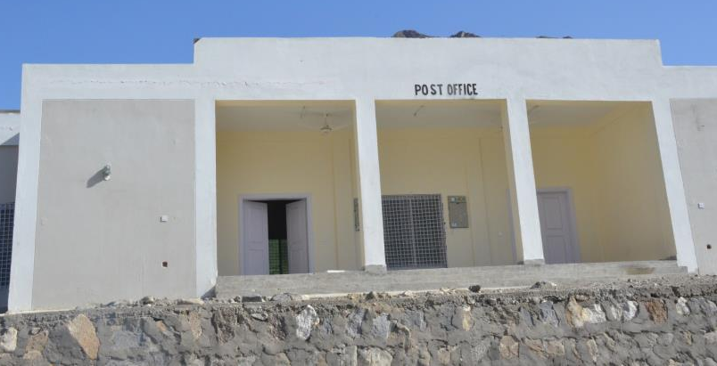
MODEL VILLAGE HARPAN DAS
MAIN MOSQUE
SHOPPING CENTRE
HIGH SCHOOL
POST OFFICE

Slide 26
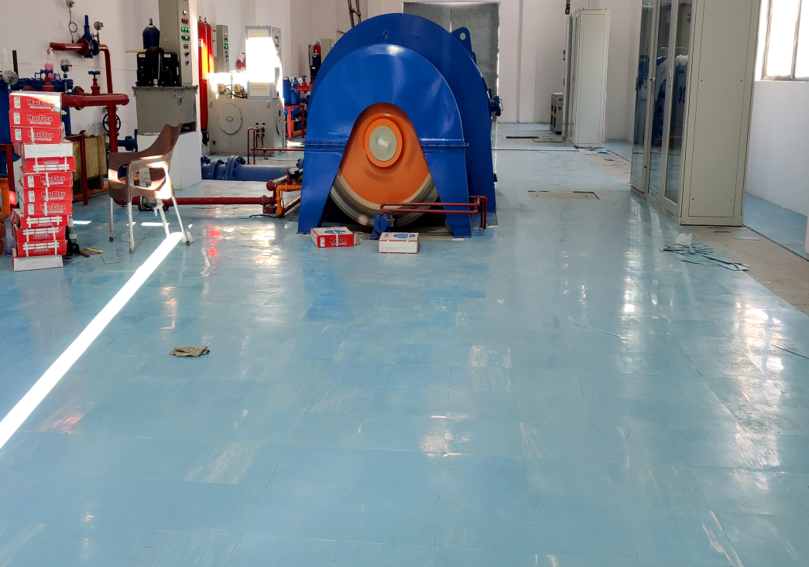
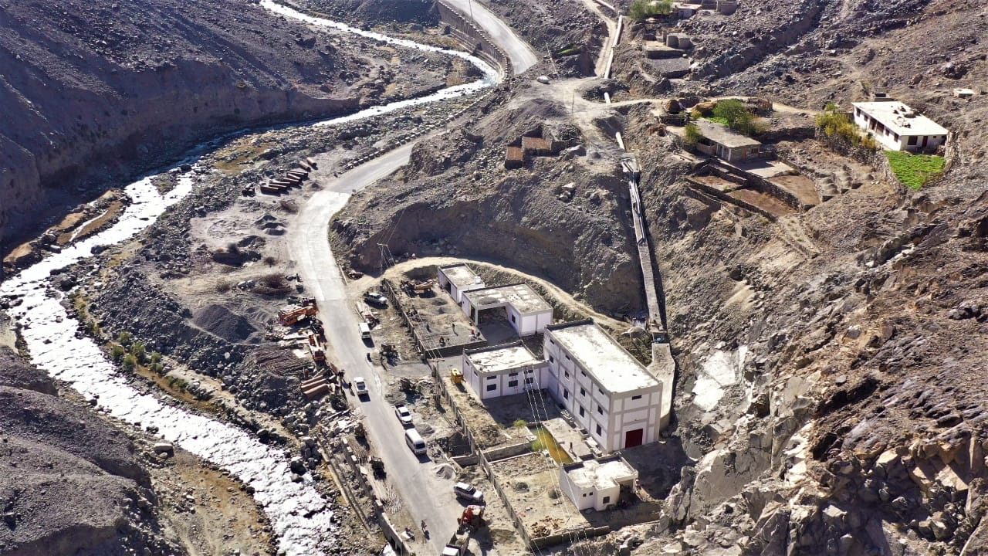
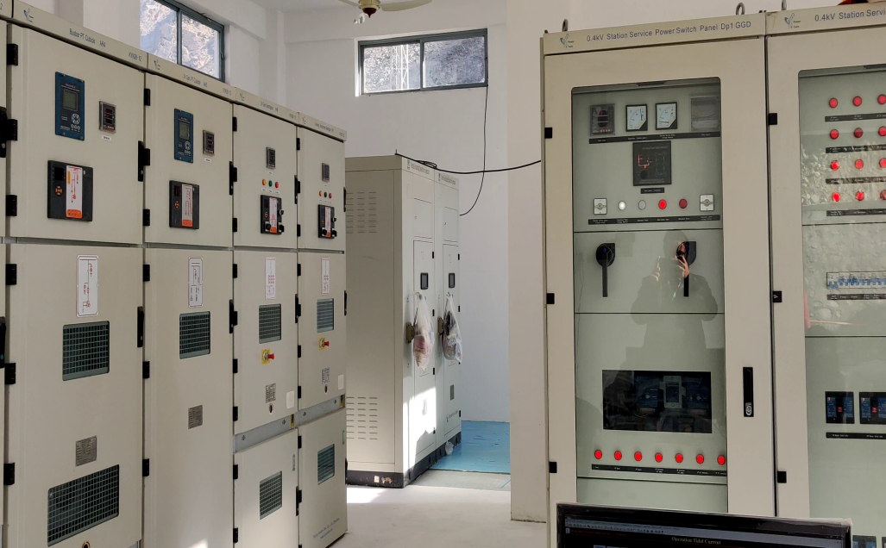
3.0 MW THAK POWERHOUSE

Slide 27
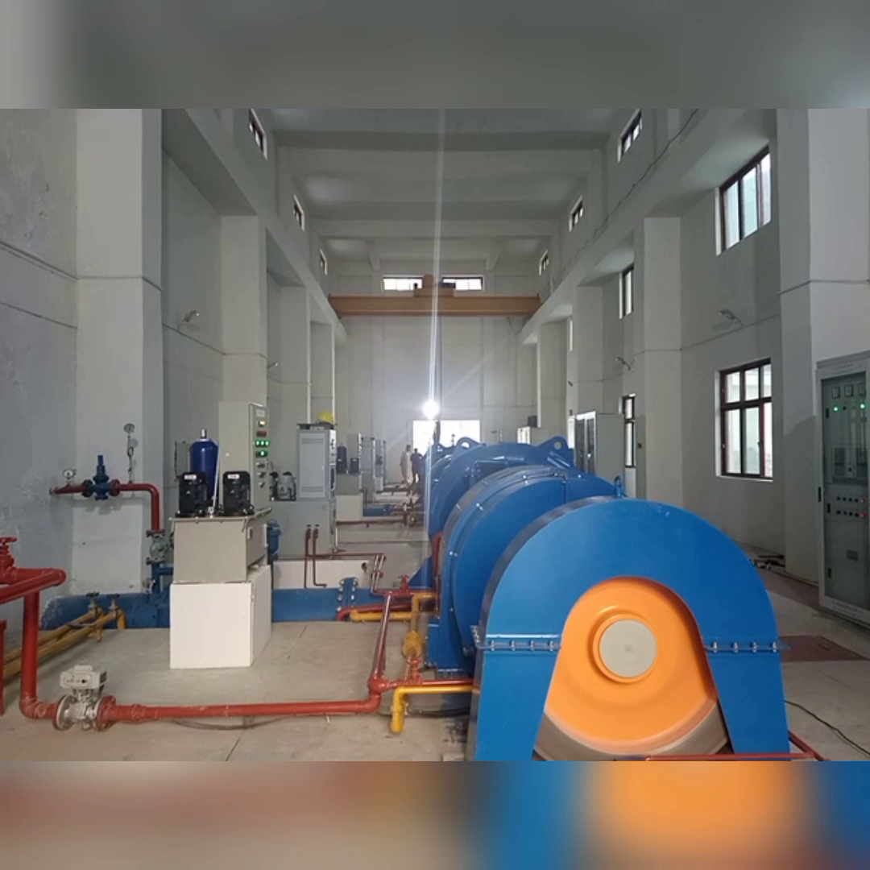
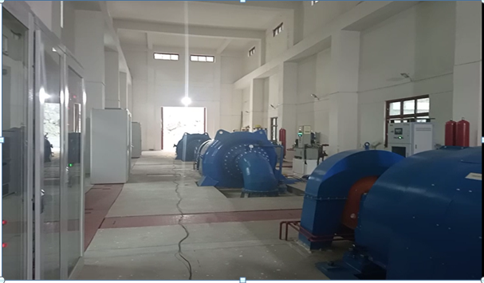
3.6 MW THORE POWERHOUSE

Slide 28
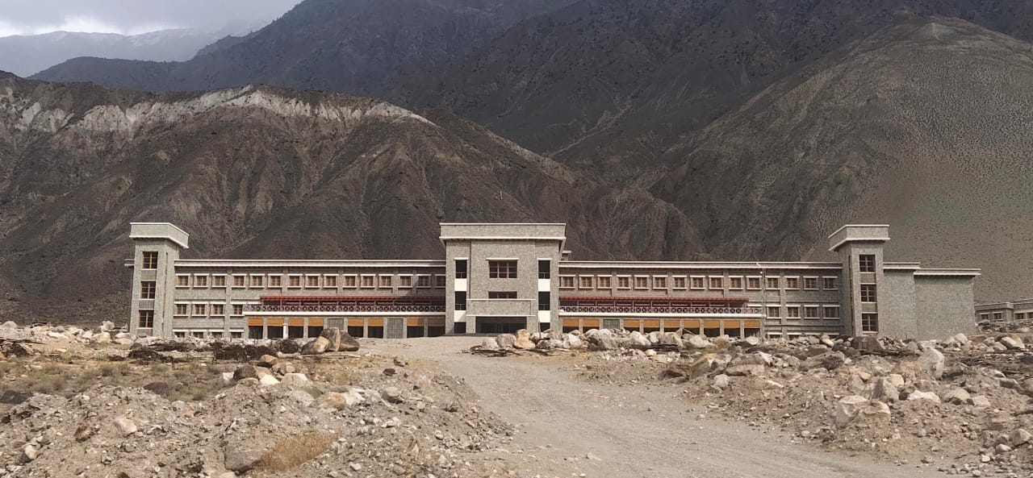
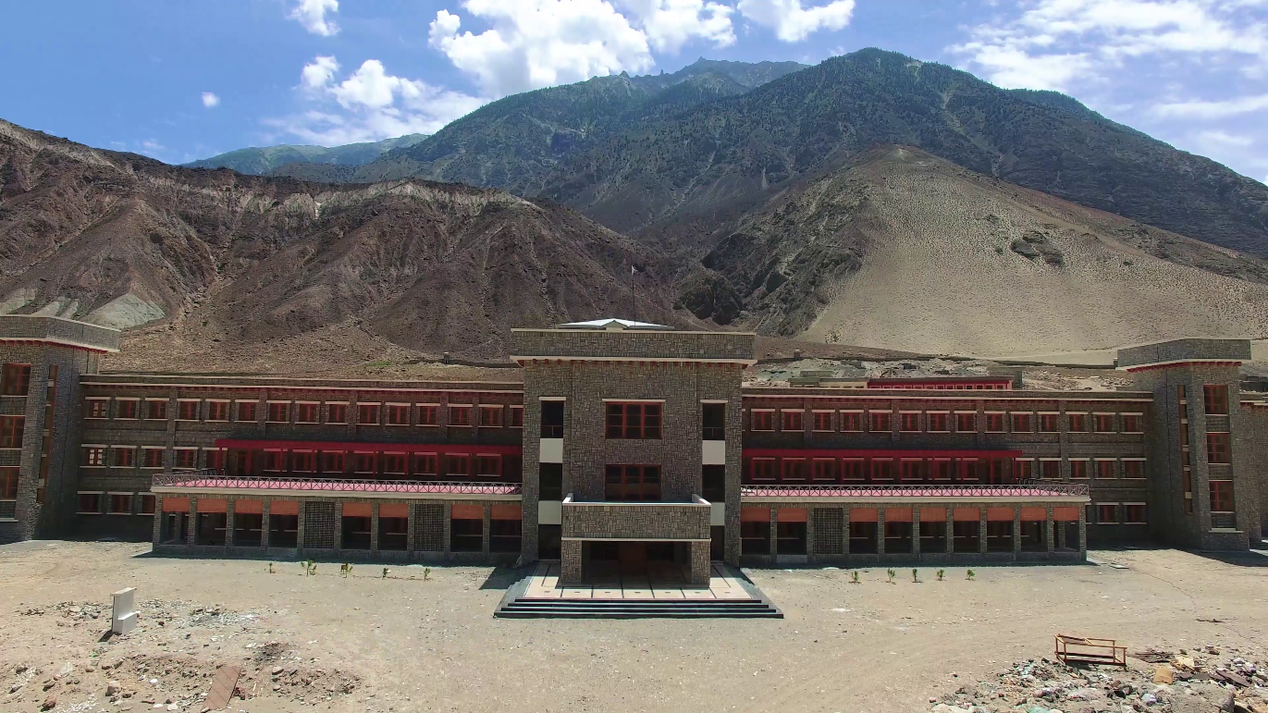
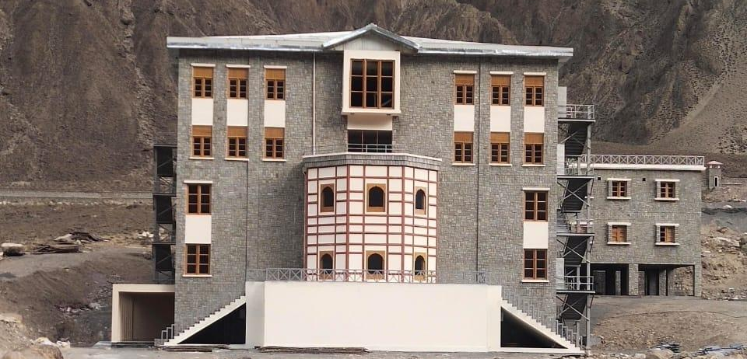
WAPDA CADET COLLEGE

Slide 29
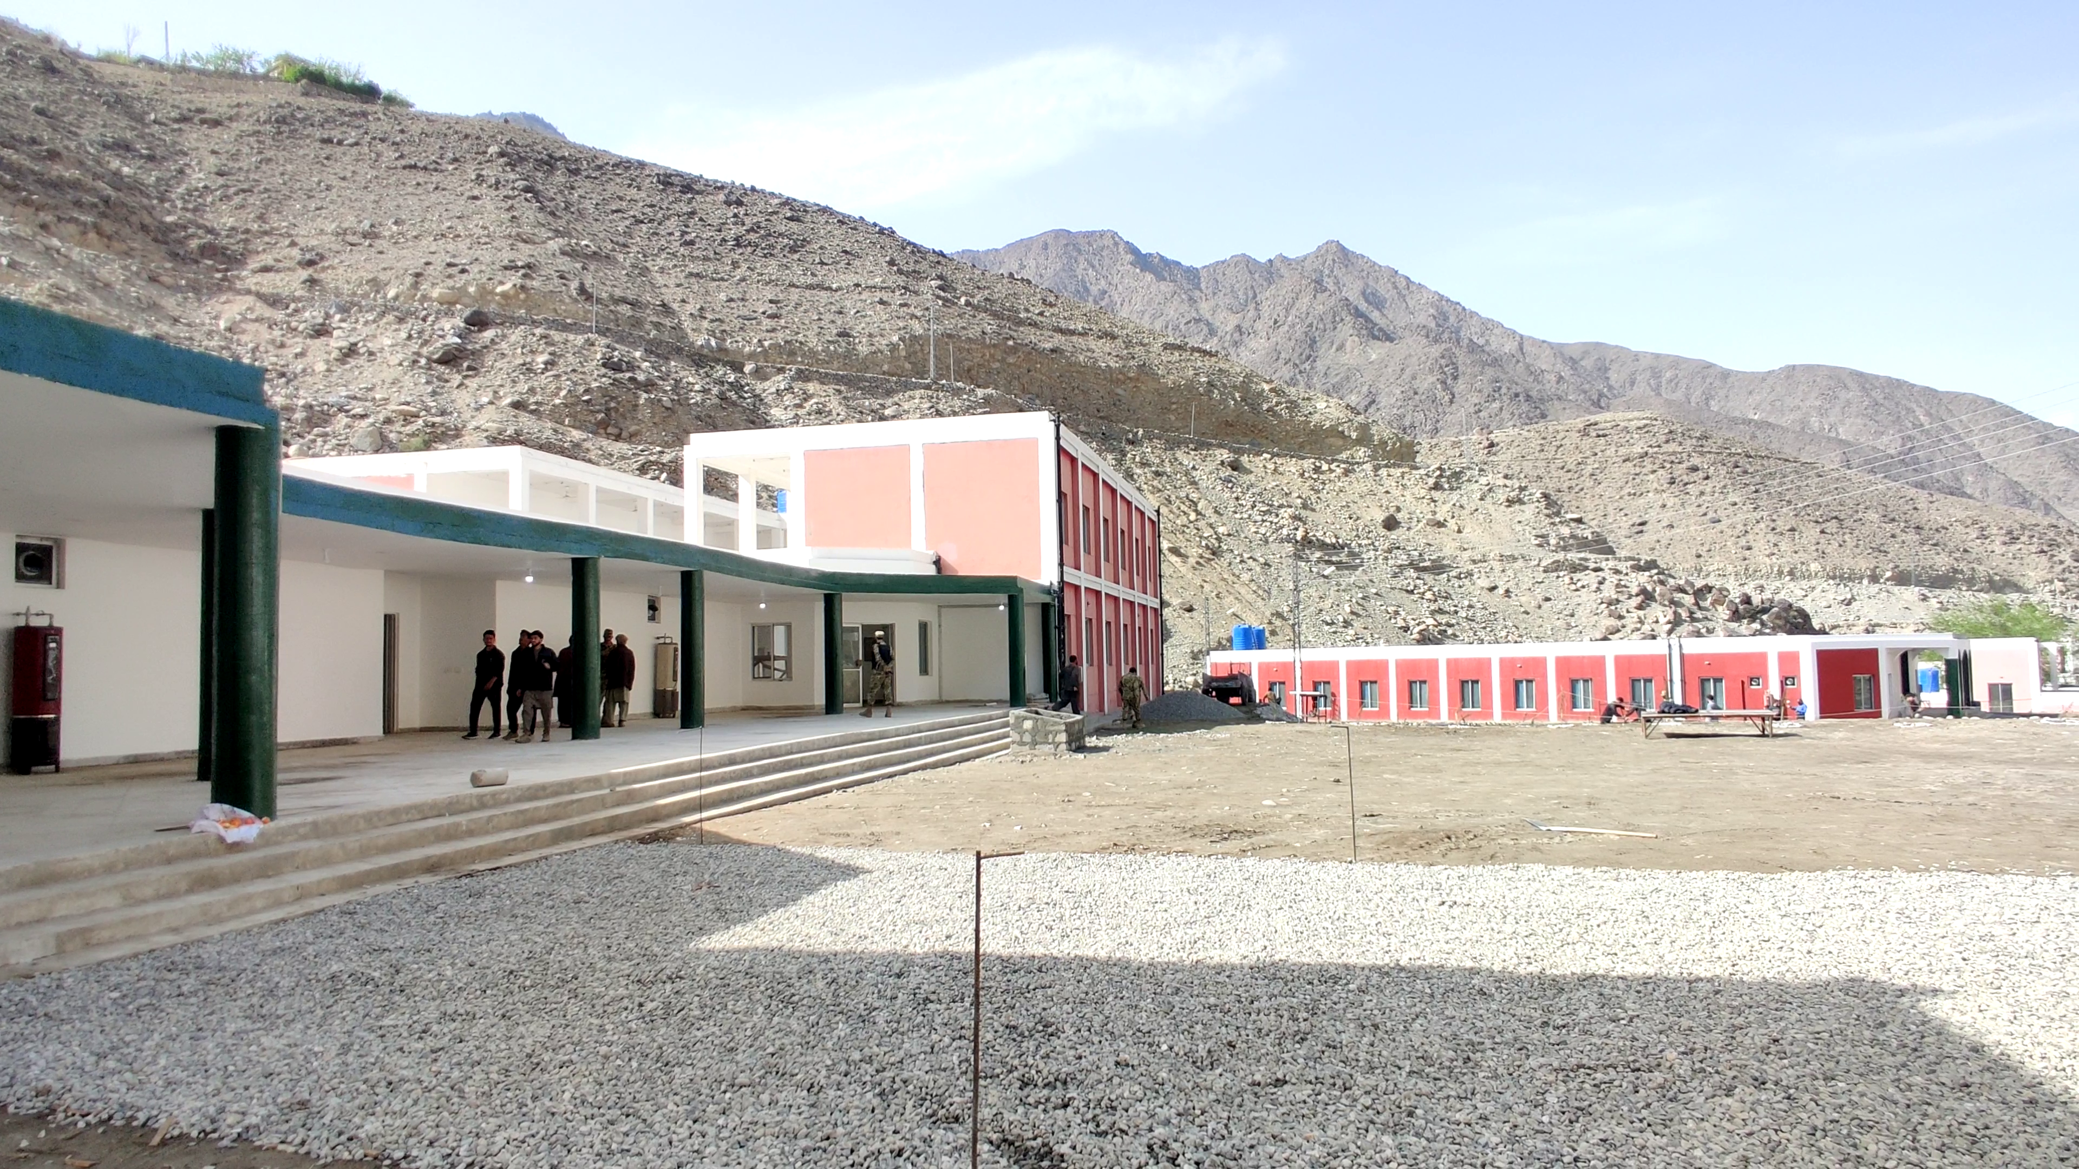
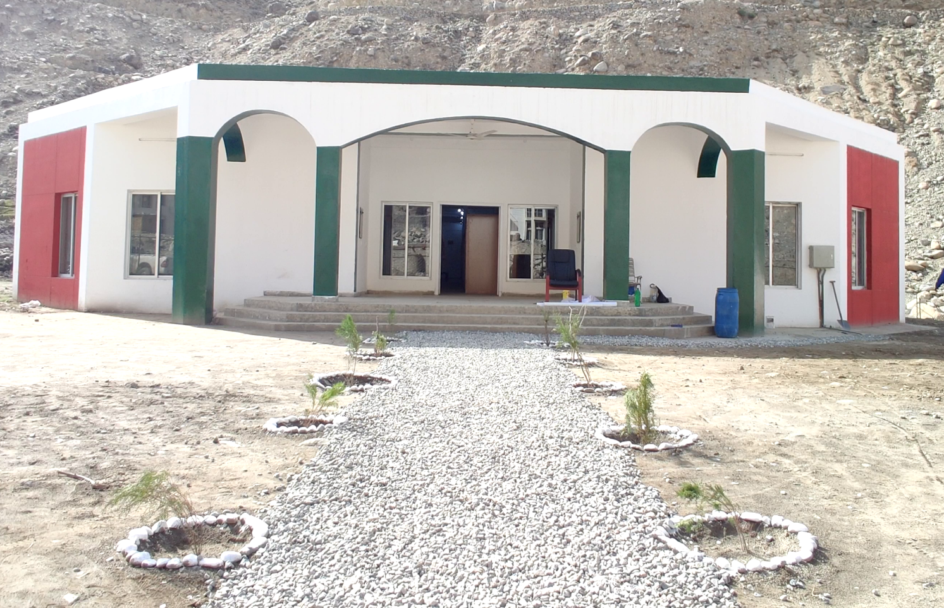
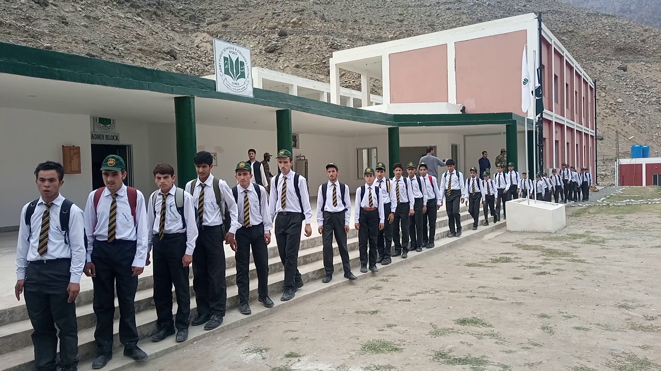
WAPDA ARMY PUBLIC SCHOOL

Slide 30
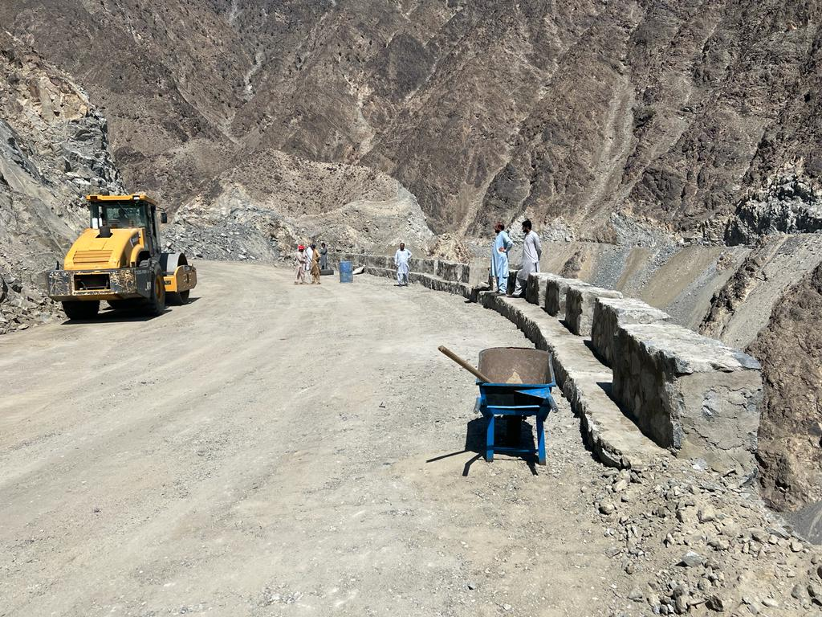
RESETTLEMENT RELATED INFRASTRUCTURE
Right Bank Periphery Road (180.3 km)
Provision of Access to 12 No. Valleys on right bank.
RBPR-01 (27.5Km) 80.18%
RBPR-02 (51.3Km) 62.95%
RBPR-03 (51.95Km) 15.89%
RBPR-04 (24.65km) 13.20%
RBPR-00 (27Km)

Slide 31
THANKS

