Slide 1
2nd INTERNATIONAL CONFERENCE ON
HYDROPOWER
PPIB’s Role in Hydropower Development in Pakistan
DR. MUNAWAR IQBAL
DIRECTOR GENERAL (HYDROPOWER)
PRIVATE POWER & INFRASTRUCTURE BOARD (PPIB)
MINISTRY OF ENERGY (POWER DIVISION)
GOVERNMENT OF PAKISTAN
21st December 2022

Slide 2
OUTLINE
PART-I : POWER PROJECT DEVELOPMENT MODES IN PAKISTAN
Power Project Development Modes in Pakistan
Evolution of Power Generation Models in Pakistan
Role of PPIB – A One Window Facilitator
PPIB’s Portfolio
PART-II : HYDROPOWER DEVELOPMENT
HPPs in Private Sector
Hydropower Potential in Pakistan
PPIB’s Portfolio of Hydropower Projects
Hydropower Projects Under CPEC
PPIB’s Initiative and Achievement in HPP Development
PART-III : FUTURE OVERVIEW
IGCEP 2022-2031
Challenges & Way forward

Slide 3
PART - I
POWER PROJECT DEVELOPMENT
MODES IN PAKISTAN
Notes:
3
3

Slide 4
POWER PROJECT DEVELOPMENT
MODES IN PAKISTAN
WAPDA-Federal Level
PEDO-Khyber Pakhtunkhwa
PPDB-Punjab
PDO-AJ&K
WAPD-Gilgit Baltistan
Public Sector
Private Sector (IPP)
Public Private Partnership (PPP)
PPIB-Federal Level
PEDO-Khyber Pakhtunkhwa
PPDB-Punjab
PPC-AJ&K
P3A-Federal Level
PEDO-Khyber Pakhtunkhwa
Notes:
4
4

Slide 5
EVOLUTION OF POWER GENERATION MODELS IN PAKISTAN
1958 1994 1995 1998 2002 2006 2012 2015 2019 2021
PUBLIC SECTOR (WAPDA)
Private Sector (PPIB)
Power Policy 1994 (Thermal friendly)
Hydel Policy 1995 with Up-front tariff regime
Provincial Policies
ARE Policy
Power Policy 1998
ARE Policy
Power Policy 2002
Power Policy 2015
National Elect. Policy 2021
CTBCM

Slide 6
PPIB - A ONE WINDOW FACILITATOR
Created in August 1994 as a one-window facilitator on behalf of GOP, its Ministries/ Departments to promote private investments in power sector
Received statutory status on 6th March 2012 through an Act of the Parliament
Coordinates/ Liaisons with local and international multilateral development/ Financial Institutions
Execute IA and issue GOP Guarantee to IPP
POE Members for FS of Provinces
Facilitation Agreements between PPIB and Provinces/AJ&K for
Agent of AJ&K
Issuance of TLOS for provincial/AJ&K projects
Providing technical/legal facilitation to GB for Policy formulation etc.
Notes:
6
6

Slide 7
IPP MODEL BEING EXECUTED BY PPIB
CSA: Coal Supply Agreement
GSA: Gas Supply Agreement
PPA: Power Purchase Agreement
IA: Implementation Agreement
DIA: Direct Implementation Agreement
GoP
Provincial Govt./ AJ&K
Tripartite LOS
PPIB
DIA
Lenders
WUA/ CSA
LOI/ LOS/ IA
Financing
IPPs
NTDC
Gas/ Fuel Supplier
GSA/ FSA
Transmission Line
Fuel Price
Tariff/ Generation Licence
Transmission Licence
PPA
EPC /O&M Contracts
OGRA
NEPRA
CPPAG
EPC/ O&M Contractors

Slide 8
TOTAL INSTALLED CAPACITY
PUBLIC SECTOR
Hydel 9,389 MW (22%)
Thermal 5,782 MW * (14%)
Nuclear 2,445 MW ( 6%)
Total 17,616 MW (42%)
22%
PRIVATE SECTOR
IPPs (Thermal) 18,208 MW (44%)
IPPs (Hydel) 1,053 MW (2%)
IPPs (RE) 2,601 MW (6%)
KE 2,579 MW (6%)
Total 24,441 MW (58%)
2%
Total Installed Capacity 42,057 MW
IPPs (RE) includes (Wind 1585MW, Solar 500 MW, Biomass 364MW and SHPP 152 MW )
NTDC System Capacity 38,425 MW
Data Source: NEPRA, PPIB, NTDC, AEDB, KE
Notes:
8
8

Slide 9
PART- II
HYDROPOWER DEVELOPMENT
Notes:
9
9

Slide 10
CONCENTRATION OF HYDROPOWER
POTENTIAL
Gilgit-Baltistan
AJ&K
K. Pakhtunkhwa
P u n j a b
B a l o c h i s t a n
S i n d h

Slide 11
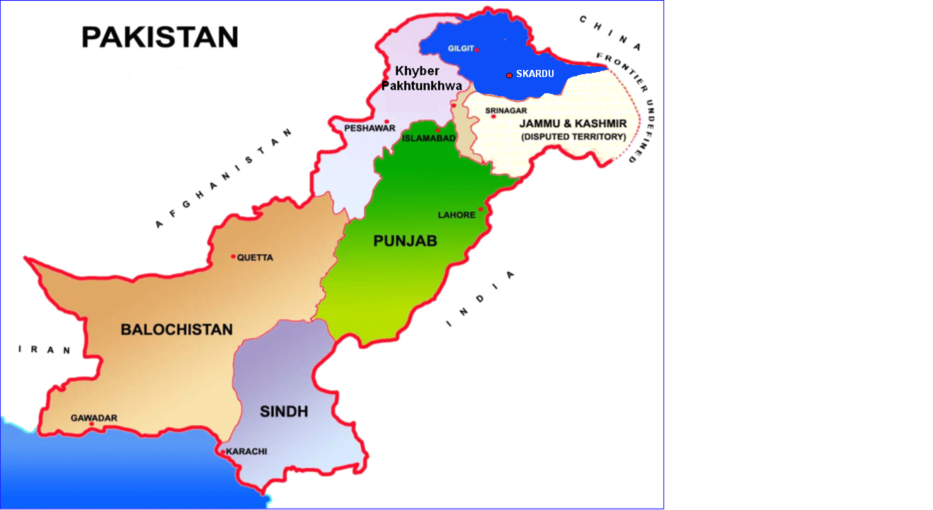
HYDROPOWER POTENTIAL
21162 MW
20000
MW
27013 MW
25000
8296 MW
20000
15000
7316 MW
10000
5 MW
5000
Total
=64,000 MW
0
208 MW
KP
GB
Pb
Sindh
AJ&K
Balochistan

Slide 12
HYDROPOWER RESOURCES OF PAKISTAN - SUMMARY
Province/ Territory | Projects in Operation (MW) | Projects under Implementation |  |  | Raw Sites Identified Projects (MW) | Solicited Projects (MW) | Total Hydel Resources (MW)
 |  | Public Sector (MW) | Private Sector (MW)
 |  |  | Province | Federal
Khyber Pakhtunkhwa | 5789.22 | 12569.56 | 4513.16 | 1514 | 2425.87 | 201 | 27012.81
Gilgit-Baltistan | 169.35 | 11876 | 40 | - | 8543 | 534 | 21162.35
Punjab | 2524.06 | 609.42 | 373.78 | - | 208.87 | 3600 | 7316.13
Azad Jammu and Kashmir | 2370.22 | 215.6 | 208.89 | 3230.08 | 1509 | 762 | 8295.79
Sindh | - | - | 15 | - | 126 | 67 | 208
Balochistan | - | - | - | - | - | 5.2 | 5.2
TOTAL | 10852.85 | 25270.58 | 5150.83 | 4744.08 | 12812.74 | 5169.2 | 64000.28

Slide 13
Hydropower Potential – River Wise Detail
Total
=64,000 MW

Slide 14
PROCESSING OF HPPs IN PRIVATE SECTOR
1 | Sponsor Selection | Through Competition
2 | LOI | Feasibility Study (Raw Sites/ FS Updating)
3 | Tariff | NEPRA’s Tariff Determination
4 | LOS or TLOS issuance and FC declaration | Env. NOC, EPCC, Project Agreements, Land Acquisition, Financing Arrangements, Term Sheets, CPs etc. and Financial Closing
5 | COD | Construction, Installation, testing, Commissioning

Slide 15
PROJECTS ON POONCH RIVER IN AJK
130 MW Sehra HPP
TATA PANI
SEHRA 130 MW KOTLI 100 MW GULPUR 102 MW RAJDHANI 132 MW Total= 464 MW
100 MW Kotli HPP
KOTLI Town
132 MW Rajdhani HPP
102 MW Gulpur HPP
Ban Nullah
MANGLA
Gulpur

Slide 16
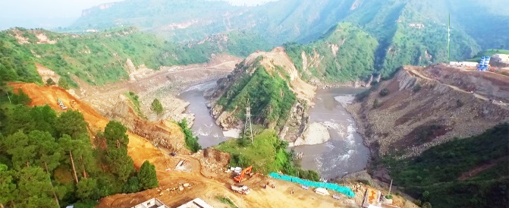
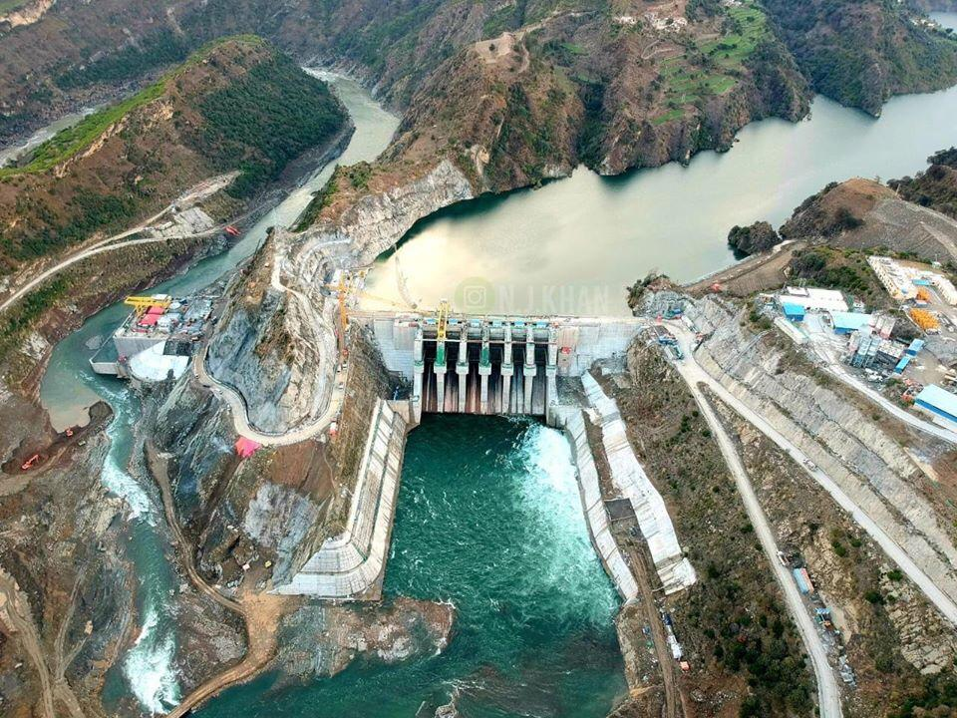
102 MW Gulpur Hydropwer Project
Company : Mira Power Pvt. Limited
Main Sponsor : KOEN From Korea
Capacity : 102 MW
Mobilization in 2015
Completion in 2020

Slide 17
LOCATION OF HPPs
ON JEHLUM RIVER
Chakothi
Karot 720 MW Azad Pattan 700 MW Mahl 640 MW Kohala 1124 MW Chakothi Hattian 500 MW Total= 3664 MW
N
Jhelum River
500 MW Chakothi Hattian HPP
969 MW Neelum Jhelum HPP
Hattian Town
Dam
Siran Village
AJ&K
Mahl River
Kohala Bridge
700 MW Azad Pattan HPP
Muzaffarabad
1124 MW Kohala
Neelum River
720 MW Karot HPP
17 km
PH
Mangla
Barsala
Jhelum River
640 MW Mahl HPP
Garhi
Habibullah
147 MW Patrind HPP
Khyber Pakhtunkhwa
Kunhar River
PUNJAB
Murree
Notes:
17

Slide 18
720 MW Karot Hydropwer Project
Company : Karot Power Company Pvt. Limited
Main Sponsor : China Three Gorges from China
Capacity : 720 MW
Commissioned June 2022

Slide 19
NEELUM VALLEY- MAJOR HYDEL SCHEMES
AJ&K
Khyber Pakhtunkhwa
Nara
Dudhnial HPP
Janawai
Kaghan
KUNHAR RIVER
NEELUM RIVER
Sharda
Halmat
Dudhnial
Athmuqam
HPP
Toabat
ATHMUQAM
Jagran
Legend
Ashkot HPP
Kundal Shahi
INDIAN OCCUPIED KASHMIR
Dudhnial 800 MW Athmuqam 450 MW Ashkot 300 MW N-J 969 MW Total= 2519 MW
NEELUM RIVER
Panjgran
TITHWAL
N-J HPP

Slide 20
KUNHAR RIVER IN KP/AJ&K
102 MW
Batta Kundi HPP
188 MW
Naran HPP
Allai Khwar
Naran
Bata Kundi 102 MW Naran 188 MW Suki Kinari 884 MW Balakot 300 MW Patrind 147 MW Total= 1621 MW
Kaghan
884 MW
Suki Kinari HPP
Paras
300 MW
Balakot HPP
Balakot
Mansehra
147 MW
Patrind HPP
Muzaffarabad
20

Slide 21
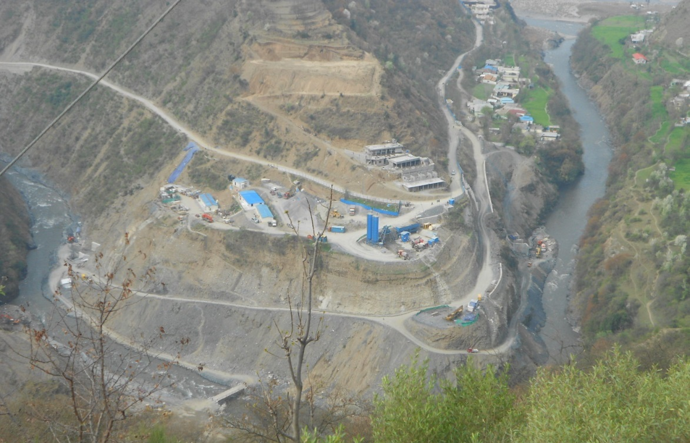
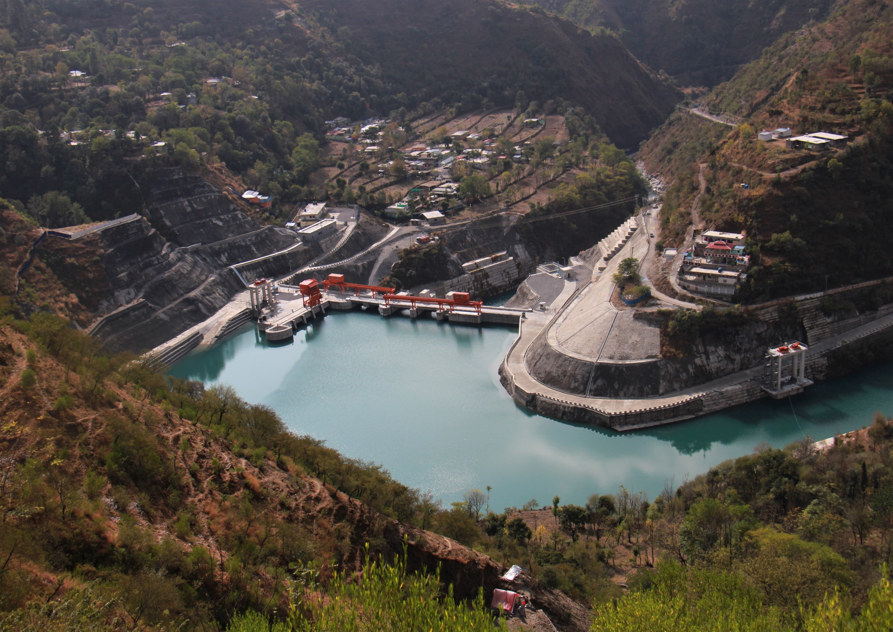
147 MW Patrind Hydropwer Project
Company : Star Hydro Pvt. Limited
Main Sponsor : K-Water Korea from Korea
Capacity : 147 MW
Mobilization in 2013
Completion in 2017

Slide 22
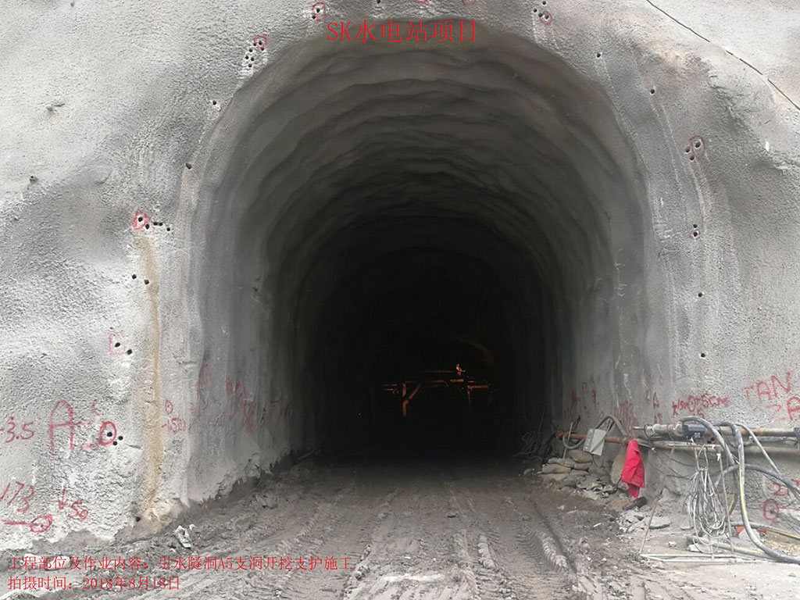
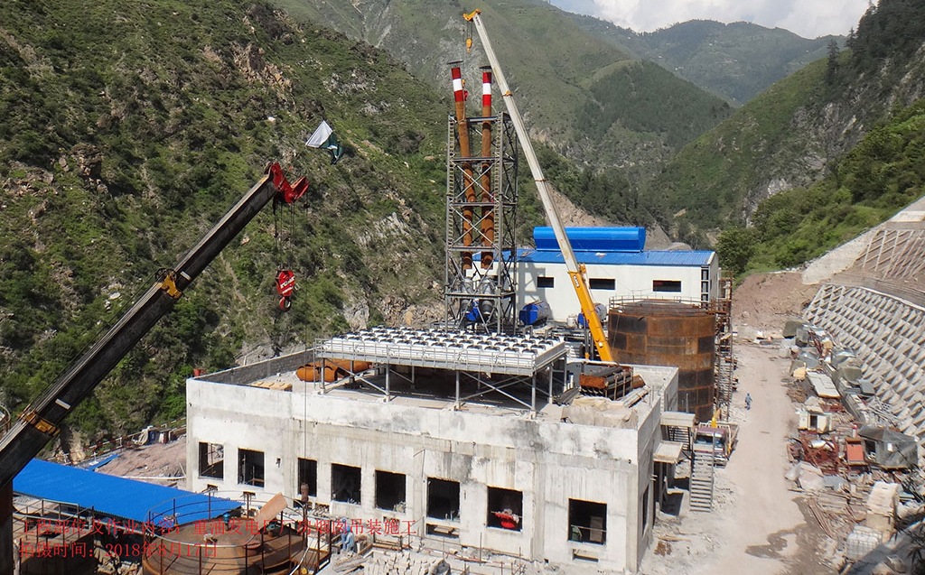
884 MW Suki Kinari Hydropwer Project
Company : SK Hydro Pvt. Limited
Main Sponsor : CGGC-China
Capacity :884 MW
Current Status = Progress Achieved 85%

Slide 23
LOCATION MAP RIVER INDUS TRIBUTARIES
Gilgit
TANGUS
2100 MW
Yulbo
3000 MW
Diamer Basha
4500 MW
Jaglot
KAIGAH 548 MW
Bunji
7100 MW
Dasu
4000 MW
Dasu
Chalas
SPATGAH
496 MW
Duber Khwar 130 MW
Patan HPP
665MW
Khan Khwar 72 MW
PALAS VALLEY
665MW
Besham
THAKOT I to III
4900 MW
Allai Khwar 121 MW
Tarbela

Slide 24
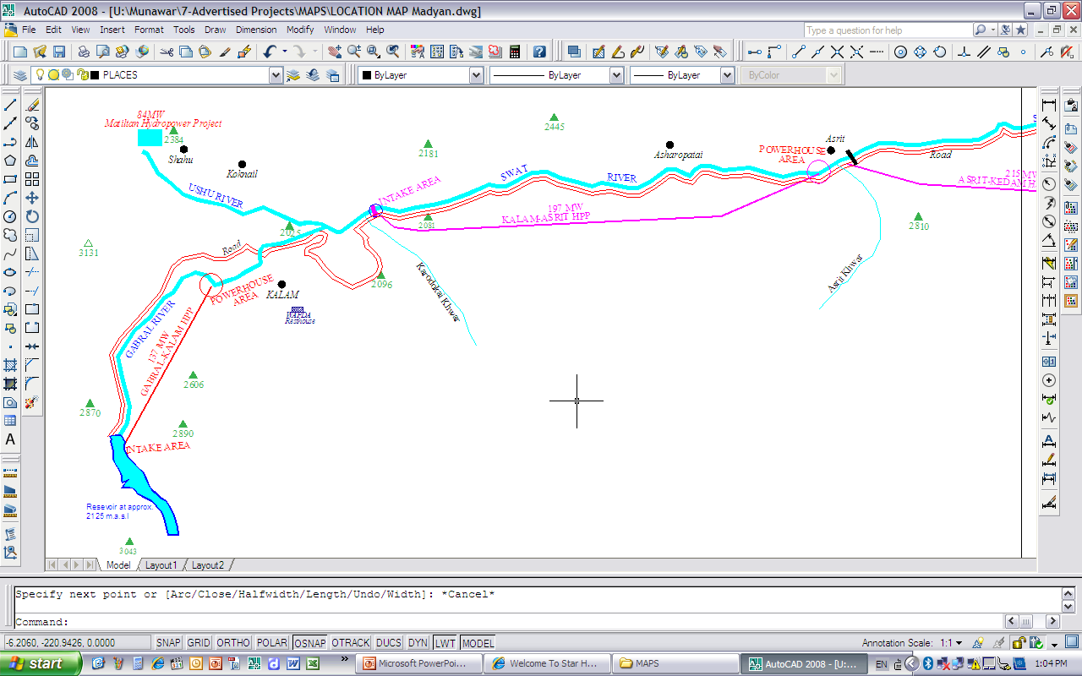
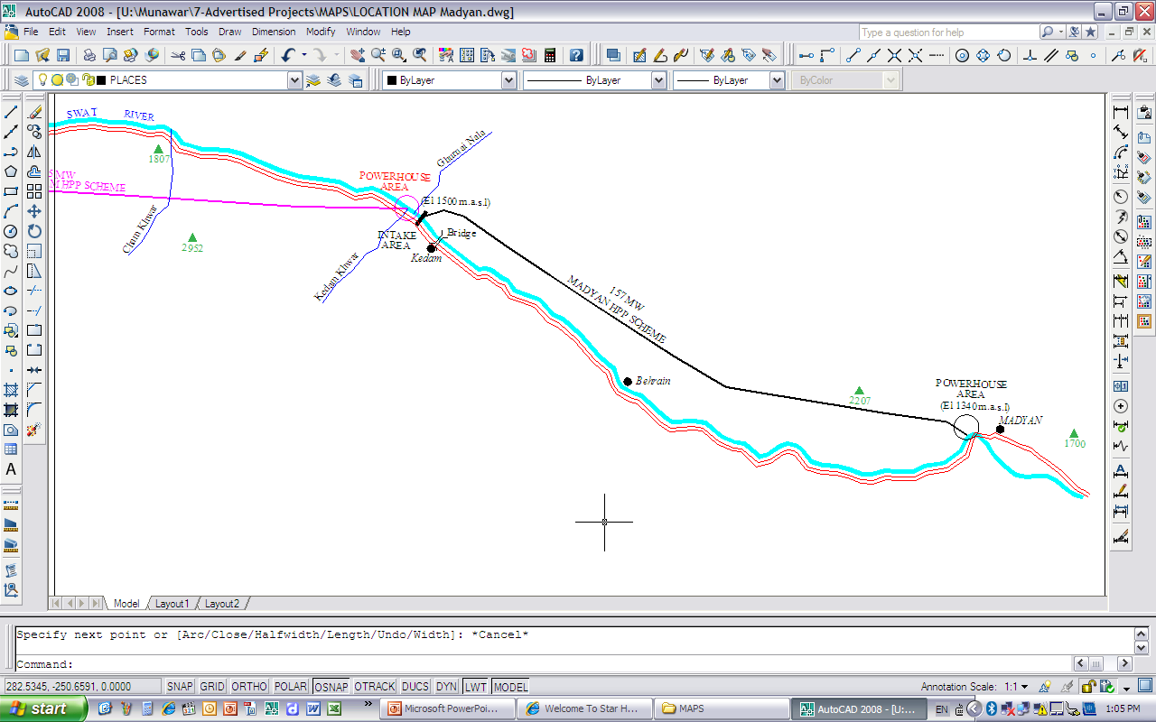
Asrit Kedam HPP
P=215 MW
H=214 m
Kalam Asrit HPP
P=197 MW
H=210 m
PH
Madain Town
PH
PH
Kalam Town
PH
SWAT VALLEY HPPs
Madain HPP
P=157 MW
H=150 m
Gabral Kalam HPP
P=88 MW

Slide 25
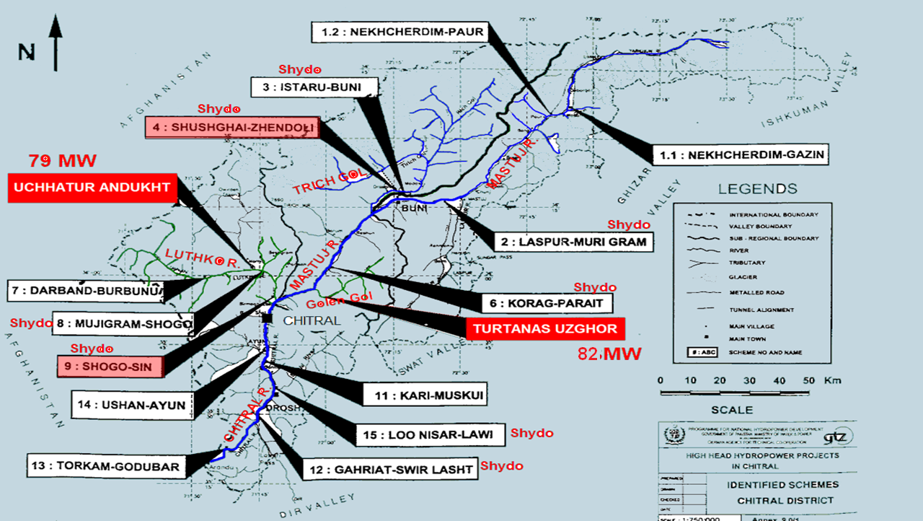

Slide 26
PPIB’s Current Portfolio of Hydropower Projects (1/2)
Sr. # | Project | Sponsor/ Company | Location | Capacity (MW) | Status
1 | New Bong Escape HPP | Laraib Energy Pvt Ltd | Upper Jhelum River D/s of Mangla Dam, AJK | 84 | Commissioned
2 | Patrind HPP | Star Hydro Pvt Ltd | Kunhar River, Muzaffarabad | 147 | Commissioned
3 | Gulpur HPP | Mira Power Pvt Ltd | Poonch River, Kotli AJK | 102 | Commissioned
4 | Karot HPP | Karot Power Co. Pvt Ltd | Jehlum River, Distt. Rawalpindi, Punjab | 720 | Commissioned
5 | Suki Kinari HPP | S.K Hydro Pvt Ltd | Kunhar River, Mansehra, KP | 884 | Under construction Nov-24
6 | Azad Pattan HPP | Azad Pattan Power (Pvt) Ltd. | Jehlum River, Sudhnoti, AJ&K | 700.7 | LOS issued FC in progress Sep-30
7 | Kohala HPP | Kohala Hydro Company Limited | Jehlum River/ Kohala, AJ&K | 1124 | LOS issued FC in Progress Mar-31

Slide 27
PPIB’s Current Portfolio of Hydropower Projects (2/2)
Sr. # | Project | Sponsor/ Company | Location | Capacity (MW) | Status
8 | Athmuqam HPP | Korea Hydro and Nuclear Company | Neelum River, AJ&K | 450 | FS Completed. Waiting for inclusion in IGCEP
9 | Turtonas-Uzghor HPP | Sinohydro-Sachal Consortium | Golen Gol River, Chitral Valley KP | 82 | -do-
10 | Mahl HPP | CWE Investment Corporation/ China Three Gorges & Trans Tech Pakistan | Jehlum River AJ&K/ Punjab | 640 | -do-
11 | Ashkot HPP | Ashkot Energy (Pvt) Ltd. | Neelum River, AJ&K | 300 | The Project has been transferred by GoAJK to PPIB for further processing
SMALL HYDROPOWER PROJECTS (Under TLOS Regime)
16 | Kathai-II Hydropower Project | Kathai-II Hydro (Pvt) Ltd. | Kathai Nullah, Hattian, AJ&K | 8 | LOS issued FC in Progress Aug-26
17 | Riali-II Hydropower Project | Riali Hydro Power Co. | Muzaffarabad AJ&K | 7.08 | LOS issued Under Construction Dec-24
Total |  |  |  | 6508.78 | MW

Slide 28
HPPs UDDER CPEC REGIME
 | Project | MW | Location | Cost (mill $) | Progress | COD | Status
1 | Karot | 720 | River Jhelum, Punjab | 1698 | 100% | Jun- 22 | Commissioned
2 | Suki Kinari | 884 | Kagan, River Kunhar, KP | 1707 | 85% | Nov-24 | Under construction
3 | Kohala | 1124 | River Jhelum, AJK | 2408 | - | Mar-31 | Under Financial Close
4 | Azad Pattan | 700 | River Jhelum, AJK | 1351 | - | Sep-30 | Under Financial Close
TOTAL HYDEL |  | 3,428 | MW | $7164 M

Slide 29
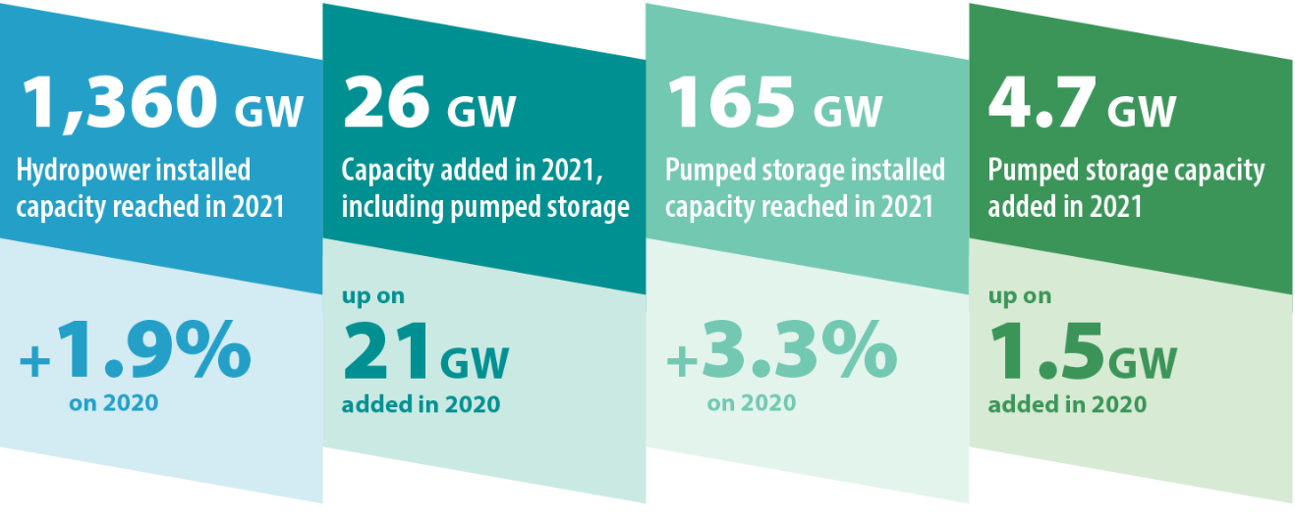
HYDROPOWER WORLDWIDE –Installed Capacity
Pakistan needs to initiate PSH
Source: IHA Status Report 2022

Slide 30
INITIATIVE OF PPIB FOR PUMPED STORAGE HPP
Pumped Storage
PPIB is in process of considering for a Cooperation Agreement with a Consultant for identification of suitable potential sites suitable for pumped storage.
Initially an area of about 300 km x 300 km north of Islamabad is envisaged for the study.
Notes:
30
30

Slide 31
PPIB’s ACHIEVEMENTS REGARDING HYDROPOWER
Successful Commissioning of 84 MW New Bong HPP (1st Hydro IPP) in Jul - 2013
Successful Commissioning of 147 MW Patrind HPP in Nov- 2017
Successful Commissioning of 102 MW Gulpur HPP in Mar-2020
Successful Commissioning of 720 MW Karot HPP, 29 Jun-2022 (1st CPEC PROJECT)
Development of mechanism for processing of Small Hydropower Projects (SHPPs)
Issuance of Tripartite Letter of Support (TLoS) for 2 SHPPs
Development of Security Package (IA, PPA) for SHPPs
Signing of Tripartite Agreement, Tripartite PPA , GoP IA, GoAJK IA and WUA for 1124 MW Kohala HPP. So far the largest investment of US$ 2.4 Billion in any of the IPPs in Pakistan/AJK.
Signing of Tripartite PPA, Water Use Agreement (Punjab) and GOPIA for 700 MW Azad Pattan HPP.
Contribution in finalization of Draft IGCEP.
Role in Development of CTBCM/ Wholesale Electricity Market in Pakistan
Notes:
31
31

Slide 32
HYDROPOWER ENTITIES WISE STATUS
Operation
70 MW
Development
373 MW
443 MW
374 MW
374 MW
163 MW
5690 MW
5852 MW
1053 MW
5506 MW
6559 MW
9389 MW
16573 MW
25962 MW

Slide 33
POTENTIAL & STATUS OF HYDROPOWER
DEVELOPMENT IN PAKISTAN
TOTAL=64000 MW
------------------------
OPERATION / INSTALLED CAPACITY=10852 MW
National Grid
260 MW Off Grid
Under Process (IPP)
Un-Tapped
17%
27%
Under Process (Public)
Under Process (PPP)
1%
Operational
16%
39%

Slide 34
HPPs IMPLEMENTATION SUCCESS RATE IN PRIVATE SECTOR
Policy | LOI Issued | Dropped | LOS | FC | COD | %Success to Reach COD
1995 | 41 | 39 | 2 | 1 | 1 | 2.4%
2002 | 19 | 10 | 6 | 4 | 3 | 16%
2015 | 4 | - | 2 | - | - | 0%
Numbers
Compelled to be Back Bencher
Major Reasons of Slow Progress
Long Gestation Period
Perception that hydropower is very cheap
Previously low cost of competing fuels
Initially issues with Tariff determinations
Initially un availability of Security Package
Law and Order Situation
Capacity issues
HPP

Slide 35
HYDROPOWER Pak Vs. World
World Elect. Energy = 27 mill GWh/a
WORLD ELECT. ENERGY
Country | Mill GWh/yr | Rank
China | 9 | 1st
USA | 4.5 | 2nd
India | 1.9 | 3rd
----- | --- | ---
----- | --- | ---
Pakistan | 0.15 | 32nd
WORLD ELECT. ENERGY
Coal | 36%
Gas | 22%
Hydel | 16%
Nuclear | 9%
Oil | 3%
Bio | 5%
Wind/Solar | 9%
Total Power 42 GW
0.15 Mill GWh
HYDEL
Pakistan
11 GW
25 %
India
50 GW
13 %
Total Power
≈ 403 GW
Source= NEPRA, PPIB, IGCEP 2022-31, Internet including IHA
Notes:
35
35

Slide 36
PART –III
FUTURE OVERVIEW
Notes:
36
36

Slide 37
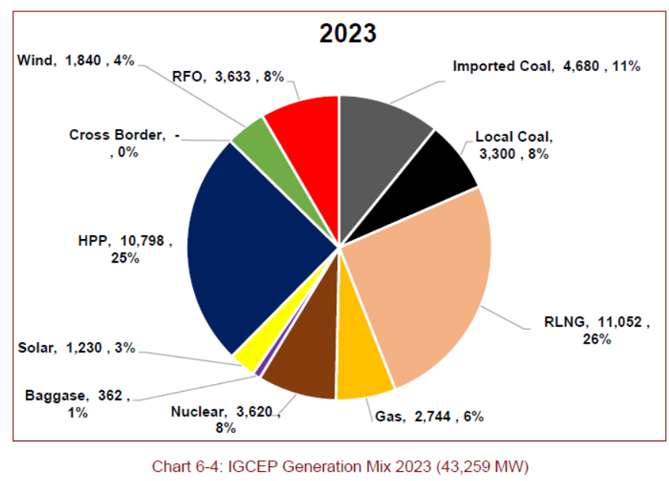
INDICATIVE GENERATION CAPACITY EXPANSION PLAN (IGCEP) 2022-2031
Indigenization = 49%
Indigenization = 75%
Reference: Draft IGCEP PLAN 2022-2031 under approval by NEPRA

Slide 38
KEY CHALLENGES TO HPPs PLAYERS
Non Celerity about Inclusion of HPP in IGCEP
Timely interconnection of projects to meet the COD deadlines
Financing Issues- Circular Debt , Location in AJ&K
Approx. 20000 MW Hydropower in Chitral KP, GB and AJK regions awaiting Power Evacuation Commitments
Non-existence of Power Regulatory regime in Gilgit-Baltistan
Shift of Market Regime-Behaviour unknown
Land Acquisition Issues
Socio-Environmental Challenges
Lack of synergy among different stakeholders
Notes:
38
38

Slide 39
WAY FORWARD
Reduce system losses & leakages
Enhance least cost based power generation
Integrated Generation and Transmission
Regional Trade of Electricity
Overcome intermittency of Wind & Solar plants with Hydropower including PSH
HPPs provide approx. 75% FDI circulation in local economy and WUC for regional dev.
Make HPPs tariff competitive vs other REs by clubbing solar at HPP sites

Slide 40
THANK YOU
https://www.ppib.gov.pk/publications/hydel_resources.pdf

