Slide 1
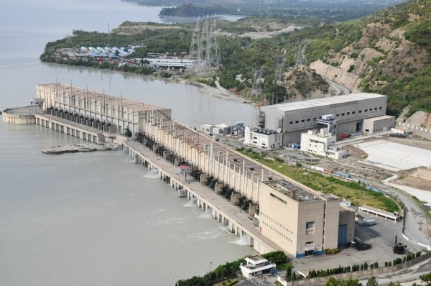
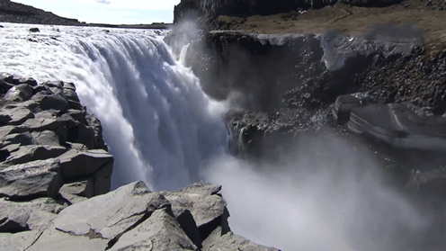
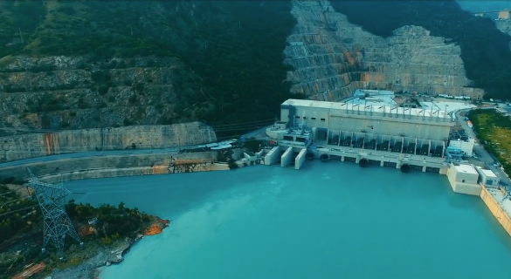
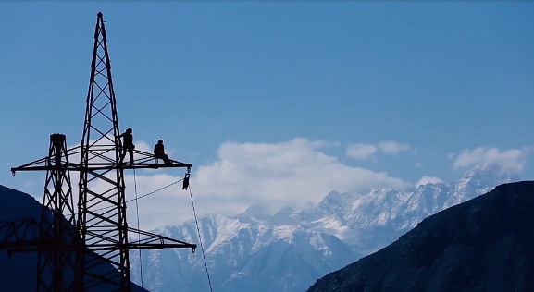
WATER AND POWER DEVELOPMENT AUTHORITY

Slide 2
WAPDA – MANDATE
The Pakistan Water and Power Development Authority (WAPDA) is a statutory body, which was established through an Act of Parliament in February 1958 (WAPDA Act 1958) for development of water and power resources of the country.

Slide 3
WAPDA’s SINCE 2007
WAPDA
POWER WING
Finance &
Common Services
WATER WING
WAPDA Manpower 2007
Before 174,975
After 17,384
Training, Sports & Health services remained with WAPDA
GENERATION
WAPDA
( 22 Hydro )
GENCOs
( Thermal )
TRANSMISSION
N T D C
500/220 kV
DISTRIBUTION
CUSTOMERS
DISCOs
. . . TRANSFORMING THESE ORGANIZATIONAL COMPONENTS
INTO INDEPENDENT CORPORATE ENTITIES

Slide 4
HISTORICAL PROFILE
PRE-INDEPENDENCE:
Sir Ganga Ram Hydel Power Station (1.1 MW) at Renala [1925].
9.6 MW Malakand Hydel Power Station at Jabban [1937].
PRE-WAPDA (1947 ~1958)
22 MW Rasul Hydel Power Station [1952].
20 MW Dargai Hydel Power Station [1952].
10 MW addition at Malakand [1952].
POST WAPDA
17 more Hydel Power Stations installed, total present installed capacity of 21 Hydel Power Stations is 8420 MW.

Slide 5
Installed Capacity of Hydel Power Stations
STATION | WATER WAY (River/Canal) | UNITS NO. | CAPACITY / UNIT (MW) | INSTALLED CAPACITY (MW) | YEAR OF COMMISSIONING
TARBELA & T4 | INDUS (Reservoir) | 1~10 | 175 | 1750 | 1977~1985
 |  | 11~14 | 432 | 1728 | 1993
 |  | 15~17 | 470 | 1410 | 2018
GHAZI BAROTHA | INDUS (D/S Tarbela) | 1~5 | 290 | 1450 | 2003~2004
MANGLA | Jhelum (Reservoir) | 1~10 | 100 U5~6= 135 | 1070 | 1967~1994
WARSAK | Kabul (Reservoir) | 1~6 | 4x40+2x41.48 | 242.96 | 1977 , 1981
CHASHMA | INDUS / Barrage | 1~8 | 23 | 184 | 2000~2001
DUBER KHWAR | Tributaries Of INDUS River | 1~2 | 65 | 130 | 2014
ALLAI KHWAR |  | 1~2 | 60.5 | 121 | 2013
KHAN KHWAR |  | 1~3 | 2x34 & 1x4 | 72 | 2010~2012
JINNAH | INDUS / Barrage | 1~8 | 12 | 96 | 2012~2013
GOLEN GOL | GOLEN | 1~3 | 36 | 108 | 2018
NEELUM JHELUM | NEELUM | 1~4 | 242.25 | 969 | 2017-18

Slide 6
Installed Capacity of Hydel Power Stations
STATION | WATER WAY (River/Canal) | No. of UNITS | CAPACITY OF EACH UNIT (MW) | INSTALLED CAPACITY (MW) | YEAR OF COMMISSIONING
JABBAN | USC | 4 | 5.5 | 22 | Jul-Dec 2013
RASUL | UJC | 1~2 | 11 | 22 | Jul. 1952
DARGAI | USC | 1~4 | 5 | 20 | Dec. 1952
GOMAL ZAM | Gomal Dam | 1~2 | 8.7 | 17.4 | Jan 2014
NANDIPUR | UCC | 1~3 | 4.6 | 13.8 | Mar. 1963
SHADIWAL | UJC | 1~2 | 6.75 | 13.5 | Jan. 1961
CHICHOKI | UCC | 1~3 | 4.4 | 13.2 | Aug. 1959
K/GARHI | KURRAM | 1~4 | 1 | 4 | Feb. 1958
RENALA | LBDC | 1~5 | 0.22 | 1.1 | Mar. 1925
CHITRAL | LUTKO | 1~4 | 0.3 & 0.2 | 0.6+0.4=1 | 1975 & 1982
GRAND TOTAL |  |  |  | 9460

Slide 7
Tarbela Back Bone of Economy
Power
Average Annual Generation 16.7 Billion kWh
Total Generation 547 Billion kWh
Revenue Rs. 547 Billion

Slide 8
Energy – 2021
Total Generation 121 Billion Units/Year
WAPDA’s Contribution 37 Billion Units/Year (31%)

Slide 9
Hydel Generation
81 Billion Units
MW
54 Billion Units
37 Billion Units
MW
MW
MW

Slide 10
Rehabilitation of Old Power Houses

Slide 11
Mangla Refurbishment Project
Objective
Enhancement of capacity from 1,000MW to 1,310 MW by replacing 50 years old/obsolete existing E&M equipment; to avail increased water head (40 ft) and storage (2.9 MAF) after Mangla Dam Raising.
Benefits
Additional Power of 310 MW with Annual Incremental Energy 1,632 GWh
Life Enhancement; 30~40 years
Project Cost
Total PKR 52,224 million ; FEC PKR 31,728 million
PC-I approved on 31.12.2013 by ECNEC

Slide 12
Mangla Refurbishment Project
Financing
US$ 150 million grant provided by USAID.
Euro 90 million loan provided by AFD France
Remaining Finances to be arranged from other donor/loan/WAPDA own resources.

Slide 13
Warsak HEP 2nd Rehabilitation Project
Objectives
Restoring the original installed capacity of 243 MW from existing 193 MW.
Rehabilitation of Civil Structure & Modernization of E&M Equipment to overcome the aging problem.
Benefits
Power 50 MW (additional), Annual Energy=1,144 GWh (169 GWh additional).
To enhance the Power house life for another 30~40 years
Project Cost
Total Rs 22.254 billion (FEC Rs. 11.283 billion & LCC Rs. 10.971 billion)
PC-I Approved on 09-07-2015 by ECNEC.

Slide 14
Warsak HEP 2nd Rehabilitation Project
Financing
Euro 40.0 Million Loan provided by AFD France.
Euro 40.0 Million Loan provided by KfW Germany.
Euro 50 Million Loan Provided by EIB through AFD France
Euro 4.5 Million grant provided by AFD.

Slide 15
Rehabilitation/Up-gradation of Existing Hydel Stations
PC-1 Approved; Consultancy Agreement for Dargai HPS signed on 16.12.2020 with M/s PES Pakistan & M/S K.P USA JV and Consultancy Agreement for Chitral signed on 20.10.2021 with M/s Integration, M/s ELAN Partner & M/S Sanima Hydro JV:
Dargai Hydel Power Station (18 to 22 MW)
Chitral Hydel Power Station (1 to 5 MW)
Following Rehabilitation / Upgradation Schemes of old Small Hydel Power Station are in approval stage:
Renala Hydel Power Station (1.1 to 4.4 MW)
Kurram Garhi Power Station (4 to 5 MW)

Slide 16
Under Construction Projects

Slide 17
10 ONGOING PROJECTS
Diamer Basha Dam
(8.1 MAF, 4500 MW)
Mohmand Dam
(1.29 MAF, 800 MW and Water Supply 300 MGD)
Dasu Hydropower
(4320 MW, 2160 MW Ph 1)
Nai Gaj Dam
(0.3 MAF)
Kurram Tangi Dam
(18.9 MW, 16000 Acres CCA)
Tarbela 5th Ext HP
(1530 MW)
Harpo HPP
(34.5 MW)
Sindh Barrage
(2 MAF)
Kachhi Canal
(30,000 Acres Land)
K – IV Project
(Water Supply 650 MGD)
IMPACT
Gross Water Storage = 11.7 MAF
Power / Annual Energy = 11,369 MW / 44.7 Billion Units
Land to be Irrigated = 3.5 Million Acres
Urban Water Supply = 950 MGD
Jobs Creation = More than 35,000

Slide 18
PROJECTS READY TO KICK OFF
Naulong Dam
(242,163 AF , 4.4 MW)
Keyal Khwar HPP
(128 MW)
Attabad Hydropower
(54 MW)

Slide 19
ONGOING PROJECTS Overview

Slide 20
DIAMER BASHA DAM PROJECT
SALIENT FEATURES
Type Roller Compacted Concrete (RCC)
Maximum Height 272 m (222 m above riverbed)
Gross capacity 8.1 MAF
Live capacity 6.4 MAF
Installed capacity 4,500 MW (Two Power Houses each of 2,250 MW)
Annual Energy 18,100 GWh
Construction period: 8.5 years (Feb. 2029)
PC-I (Dam Part) Rs. 479.686 Billion (i/c 21 MW Tangir HPP)
(approved by ECNEC on 14.11.2018)
2nd Revised PC-I (AL&R) Rs. 174.7 Billion (approved by ECNEC on 10.09.2021)
PC- I (Power Generation) Rs. 933 Billion (Submitted to MoWR on 17.09.2021)
Commencement 07 August 2020 of MW-1

Slide 21
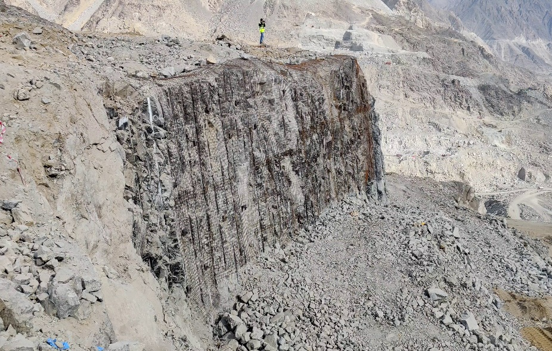
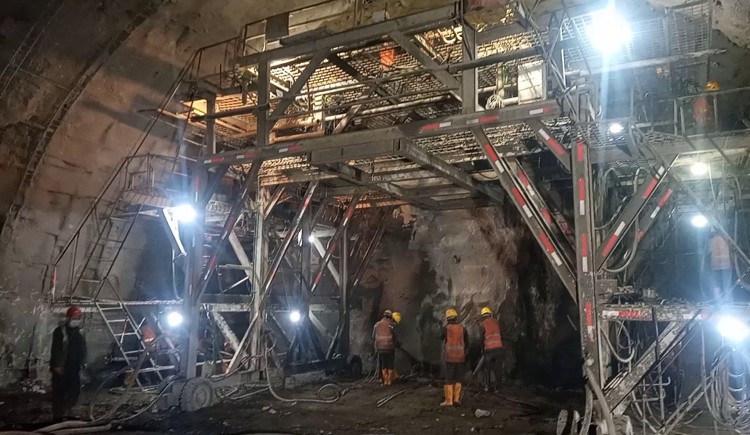
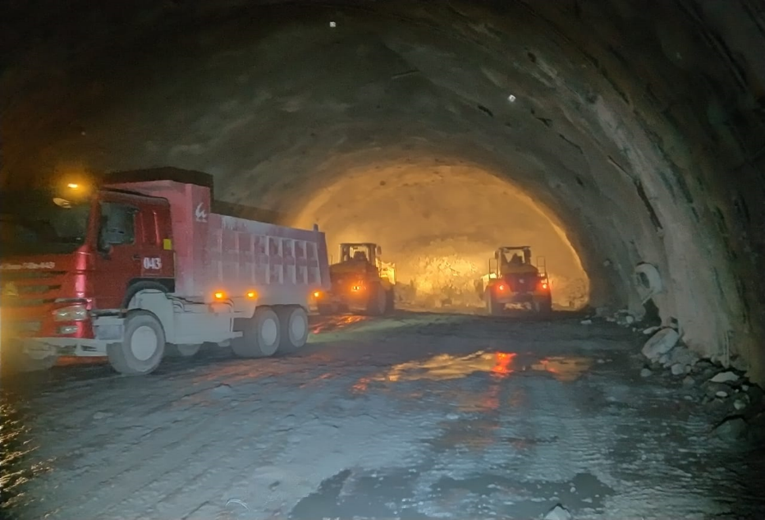
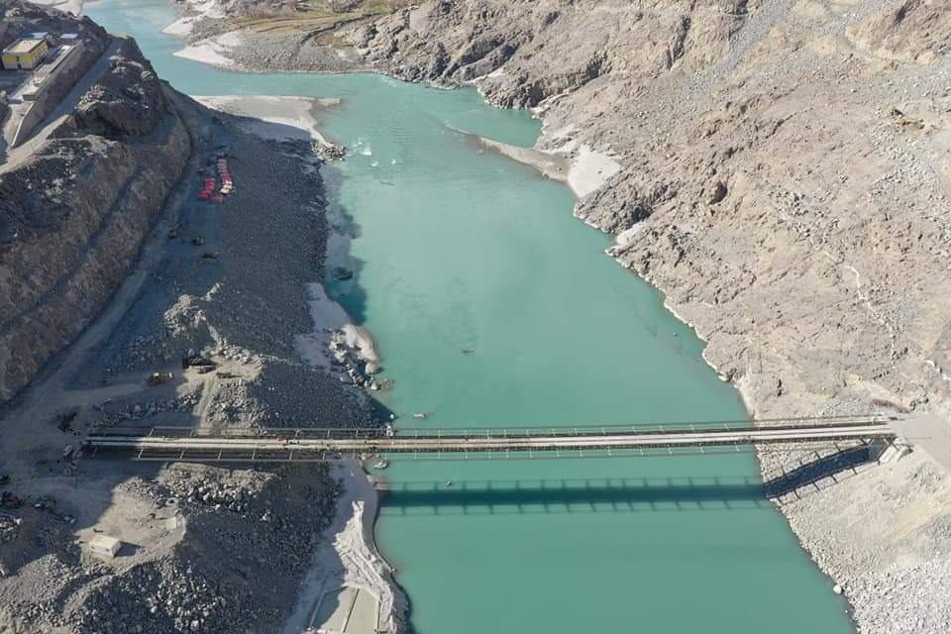
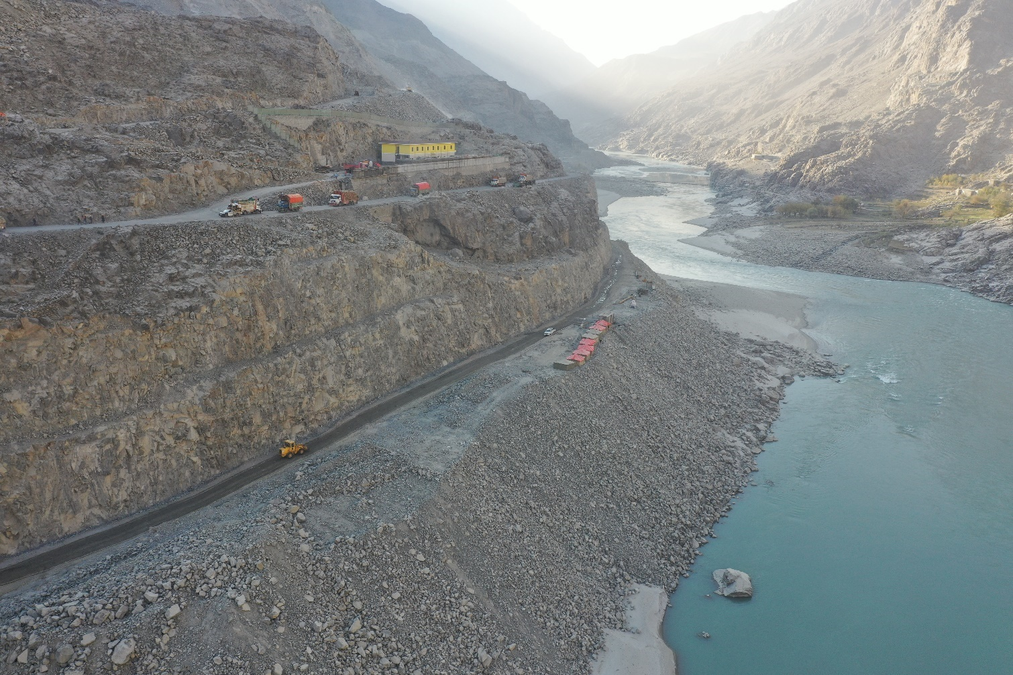
PROJECT IN PICTURES
Dam Left Abutment
Drill for Blast at US face of DT 02
Mucking at D/s Face DT - 02
P01-P02
H/Rock Blasting and is in progress
Downstream Cableway Bridges
Upstream Cableway Bridges

Slide 22
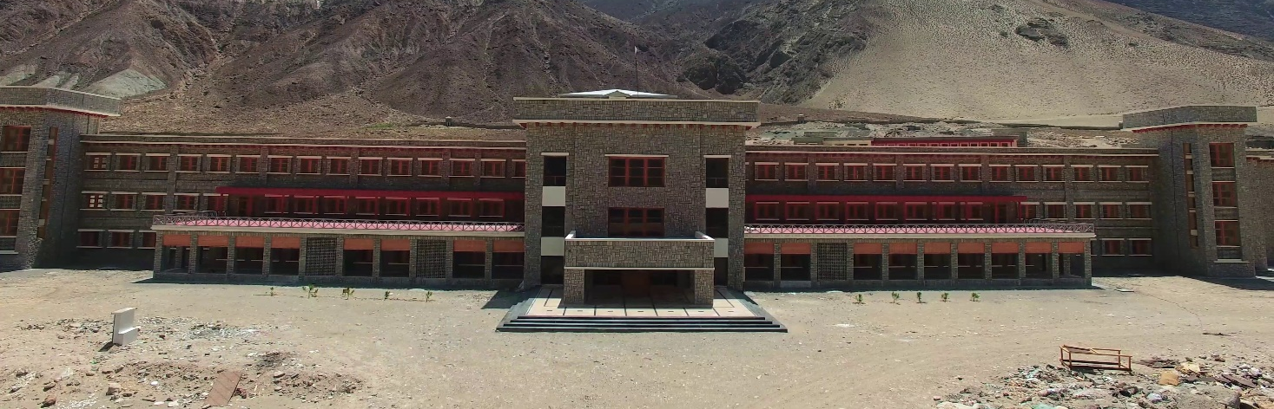
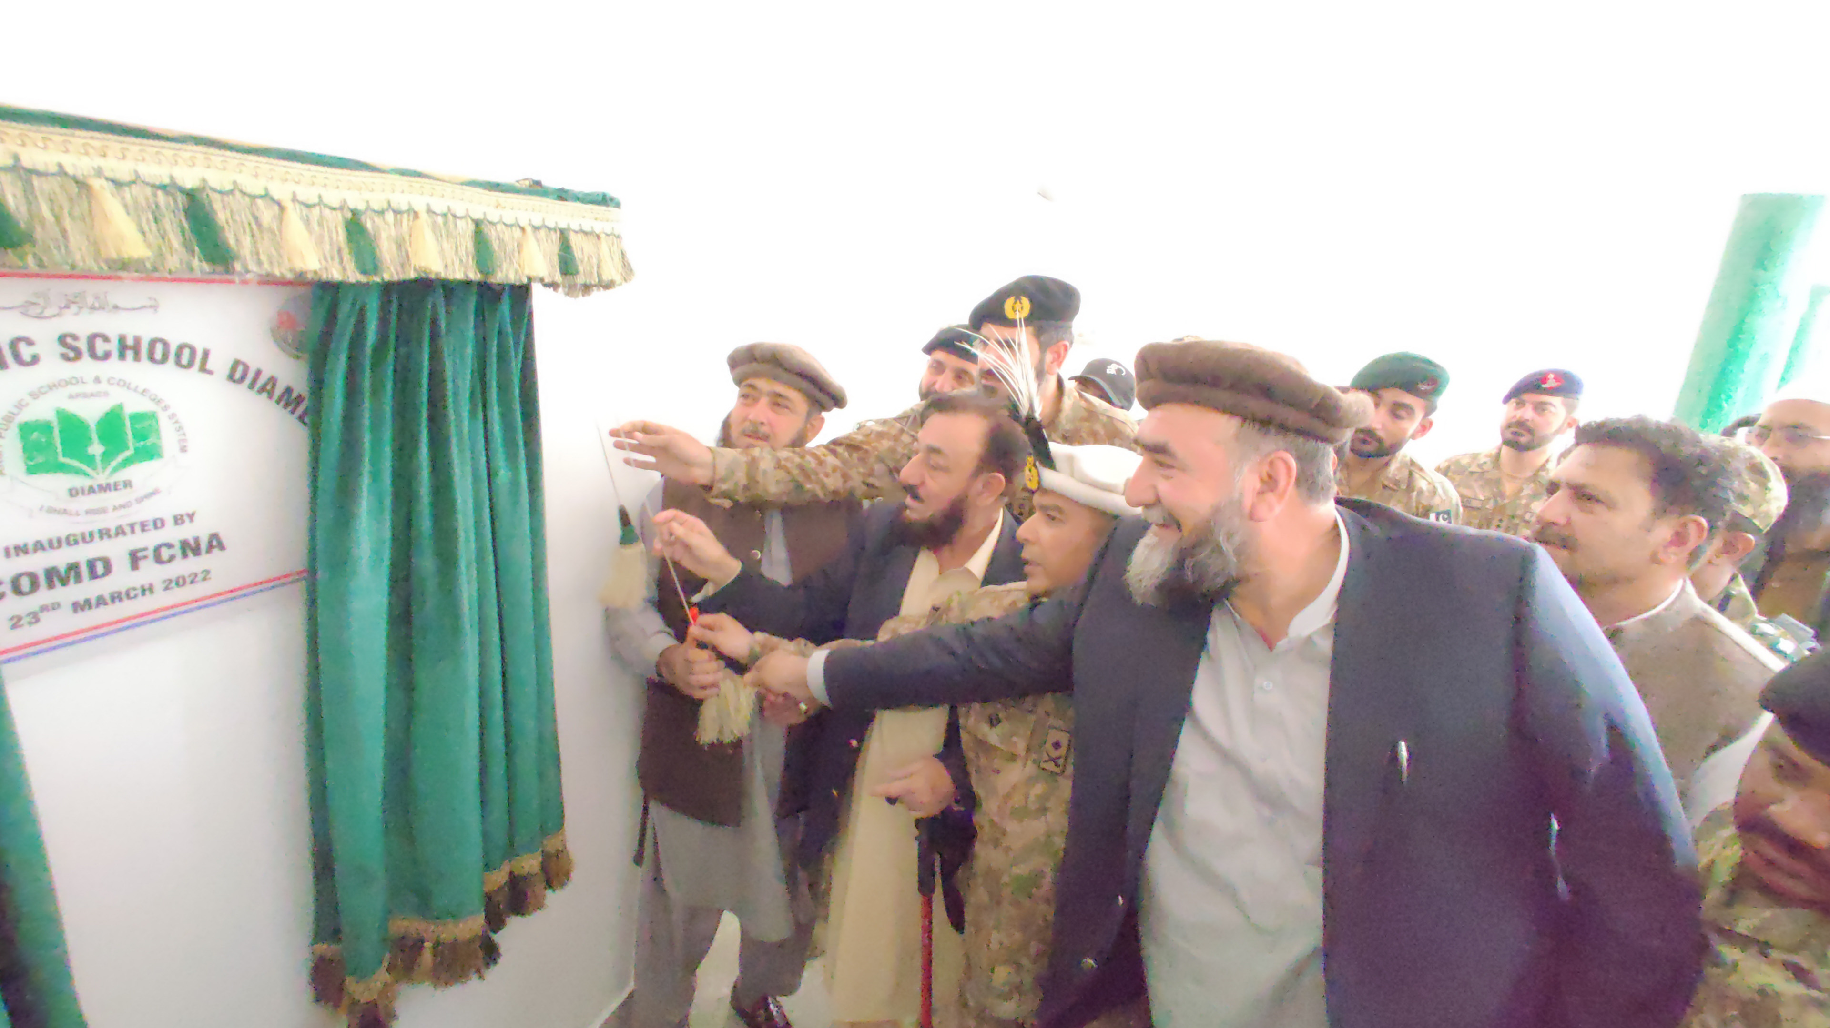
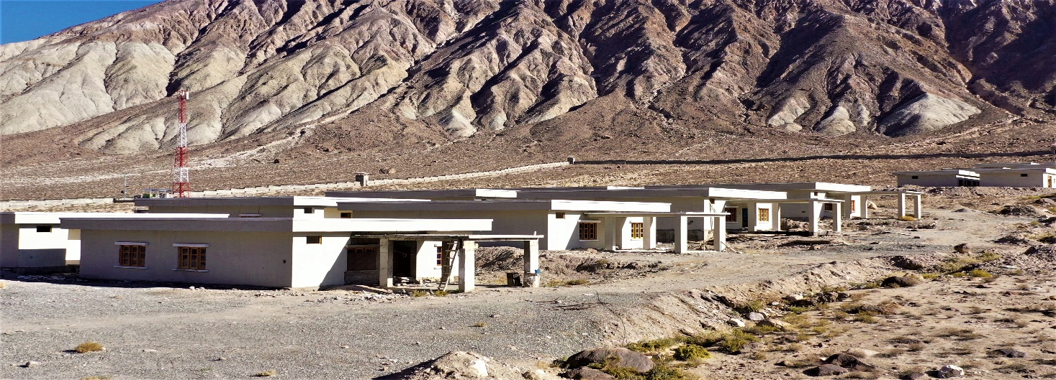
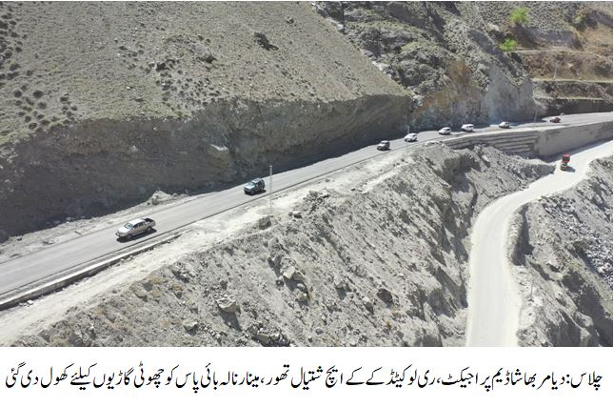
PROJECT IN PICTURES
CADET COLLEGE
WAPDA THORE COLONY
APS THORE INAUGRATION
MODEL VILLAGE HARPAN DAS
RELOCATION OF KKH

Slide 23
MOHMAND DAM PROJECT
SALIENT FEATURES
MAIN DAM
Type Concrete Faced Rockfill Dam (CFRD)
Maximum Height 213 m
RESERVOIR
Gross capacity 1.29 MAF
Live capacity 0.67 MAF
COMMAND AREA
Command Area 18,233 Acres
POWER HOUSE
Total installed capacity 800 MW
Annual Energy 2,862 GWh
CONSTRUCTION PERIOD 6 years 3 months

Slide 24
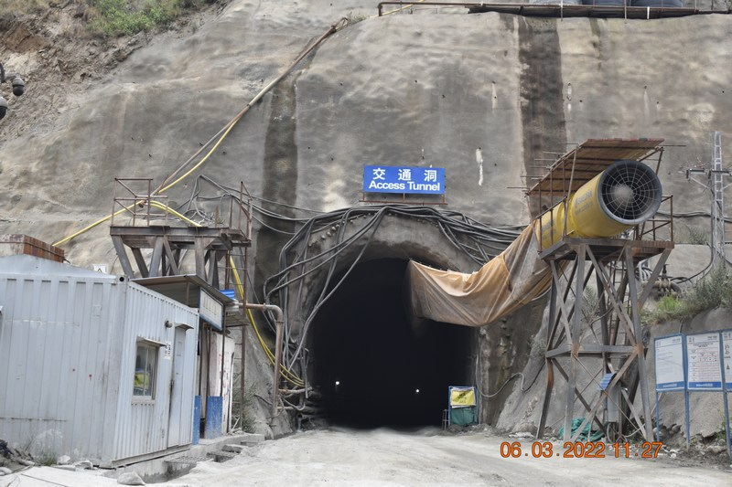
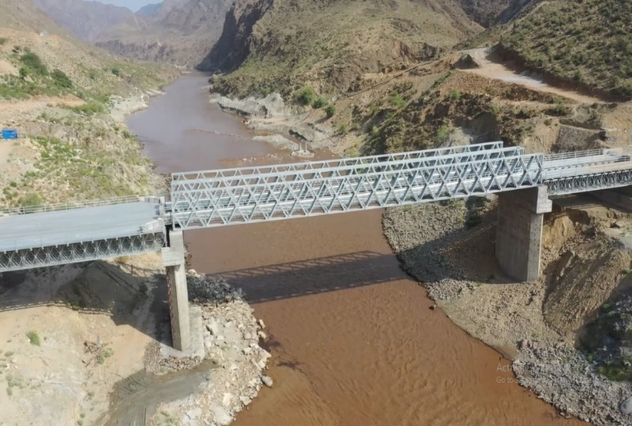
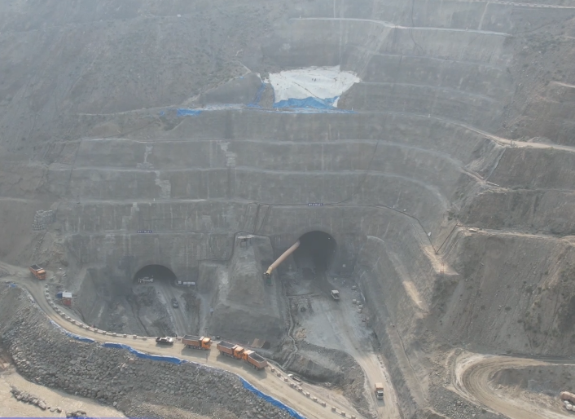
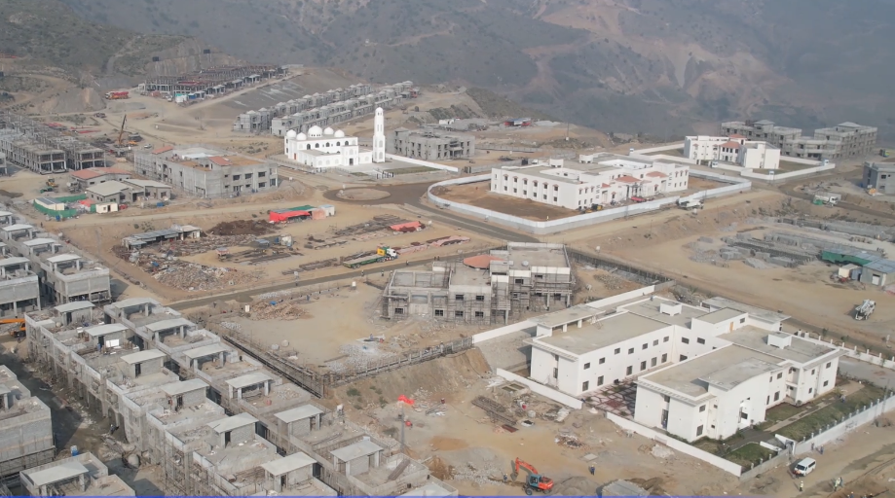
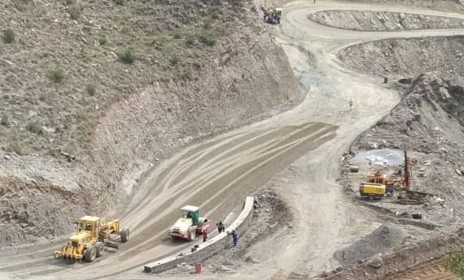
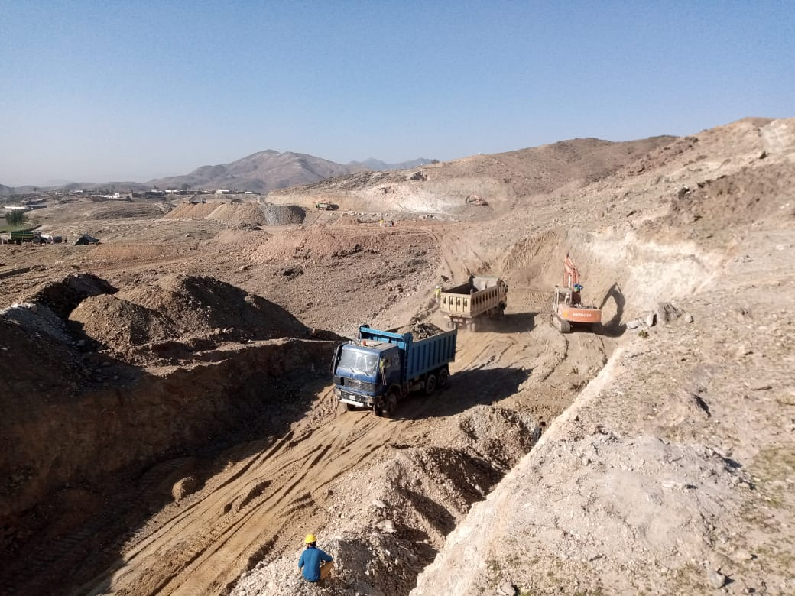
PROJECT PHOTOGRAPHS
Access Tunnel to Diversion Tunnels
Baley Bridge for River Crossing
Inlet Portal of Diversion Tunnel
Project Colony
Sub-base of Access Road
Left Bank Irrigation Canal

Slide 25
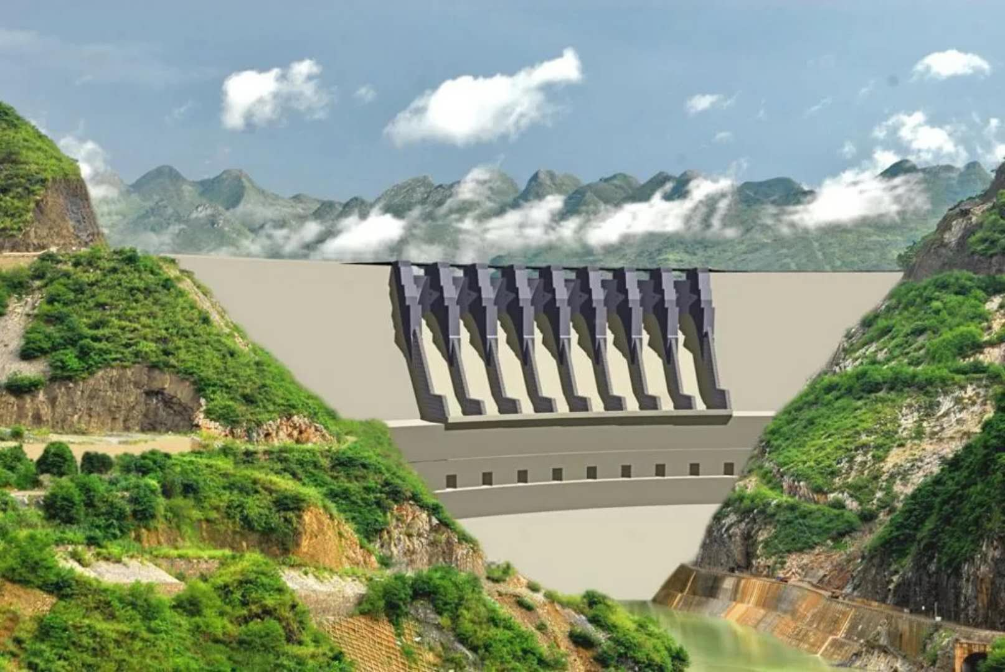
Dasu Hydropower Project

Slide 26
PROJECT PROFILE
Type | Run of the River
Location | Indus River, 7 km u/s of Dasu Town, District Kohistan Upper, Khyber Pakhtunkhwa
Installed Capacity | 4320 MW (Full Project) (12 Units @ 360 MW each) 2160 MW (Stage-I) (6 Units @ 360 MW each)
Annual Energy | 21.485 Billion Units (Full Project) 12.22 Billion Units (Stage-I)
PC-I (Stage-I) | Approved by ECNEC on 28.03.2014
Stage-I Cost | Rs 510,980.2 Million with FEC Rs. 218,547.5 Million
Main Works Contractor | M/s China Geozhouba (CGGC)
Supervision Consultants | M/s DHC: JV of Nippon Koei (Japan) & Dolsar (Turkey) with 03 local sub-consultants (DMC, NDC, PES)
Commencement Date | June 2017
Expected CoD (1st Unit) | May 2026
Source of Financing | World Bank IDA-1 Credit = US$ 588.4 Million Credit Suisse Bank = US$ 350 Million Local Commercial Banks = Rs 144 Billion

Slide 27
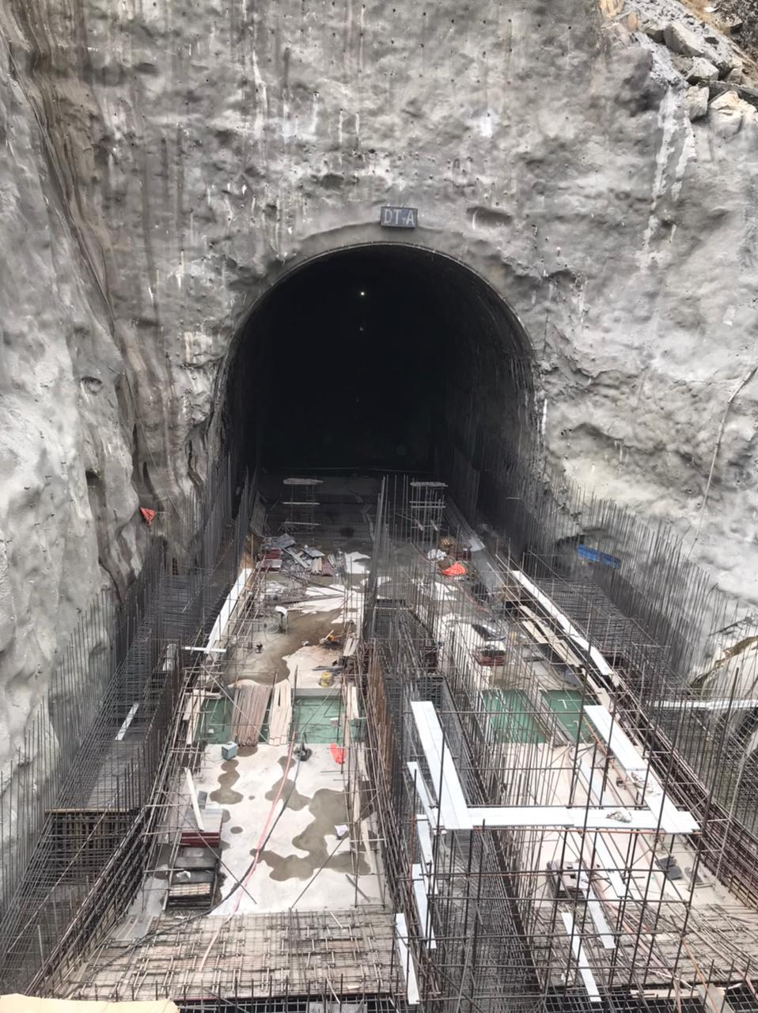
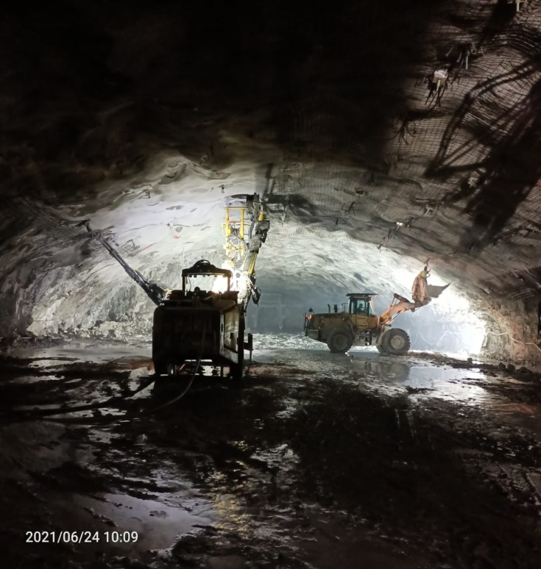
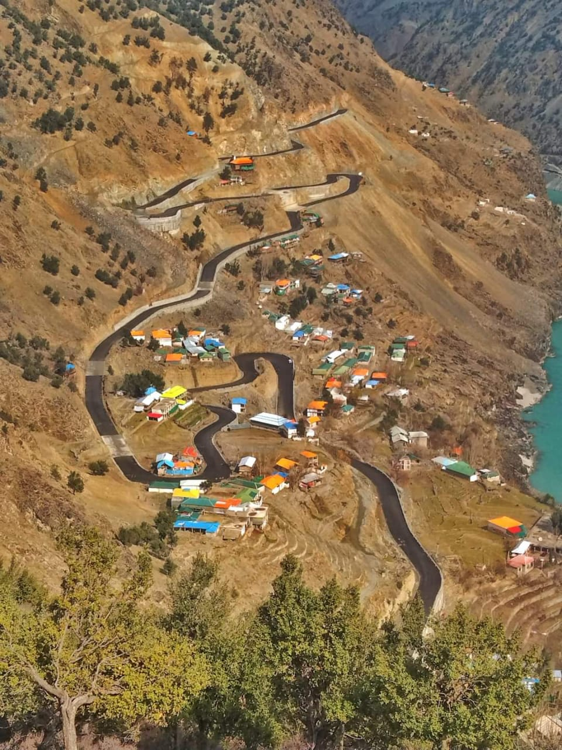
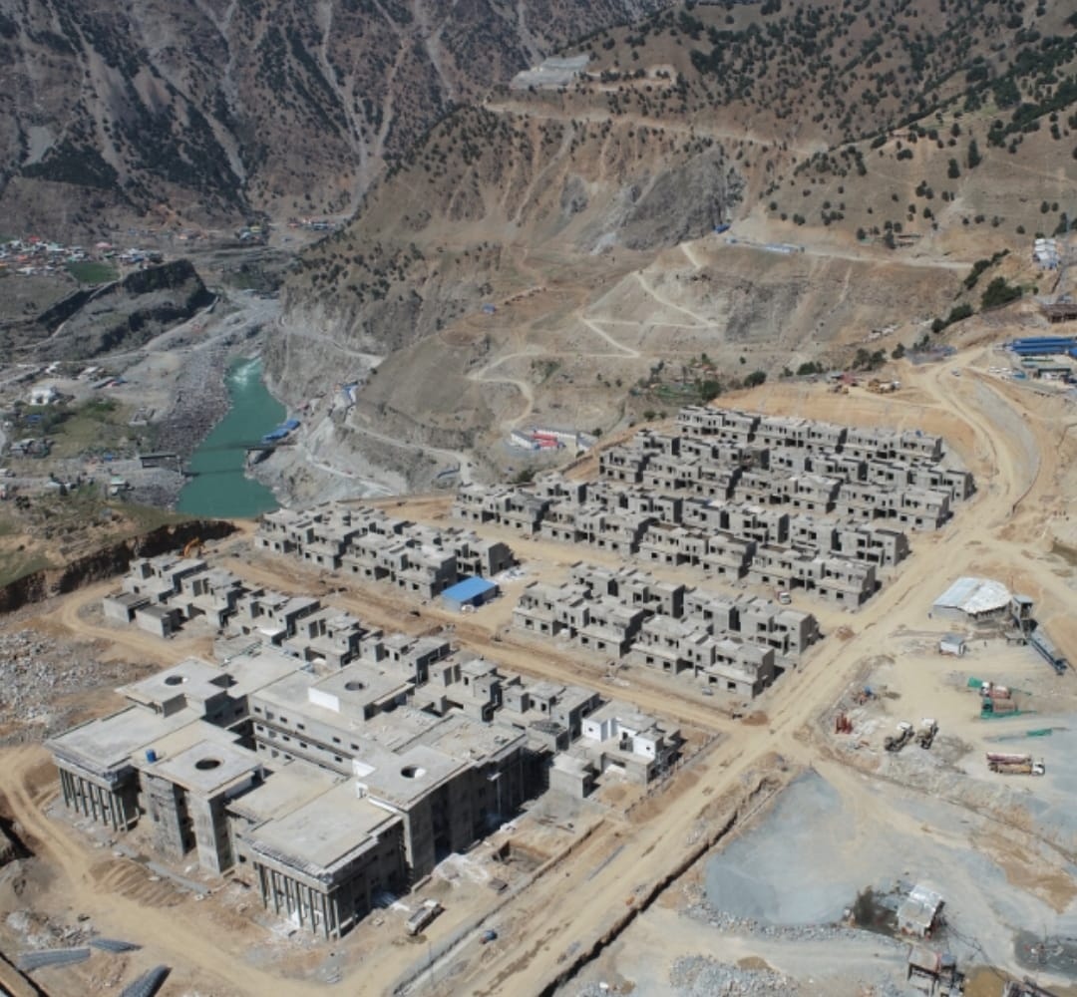
PROJECT PHOTOGRAPHS
Div. Tunnel Inlet
Powerhouse Excavation
Right Bank Access Road
Project Colony

Slide 28
NAI GAJ DAM PROJECT
SALIENT FEATURES
Location On Gaj River in the gorge area at the edge of Kirthar range at about 65 km (40 miles) north-west of Dadu, Sindh
Type of Dam Central Core Earth fill Dam
Dam Height 194 ft
Gross Storage Capacity 300,000 Acre-Ft.
Live Storage Capacity 160,000 Acre-Ft.
Spillways Discharge Capacity 19,094 Cumec (674,353 Cusec)
Reservoir Area 2,023 Ha (5,000 Acres)
Command Area 28,800 Acres
2nd Revised PC-I Rs. 46,980.350 Million (11.03.2021)
Date of Recommencement (Contract) 28.10.2021
Scheduled completion date 27.10.2024
Overall Achieved Physical Progress | 40.25% (As per 2nd revised PC-I)

Slide 29
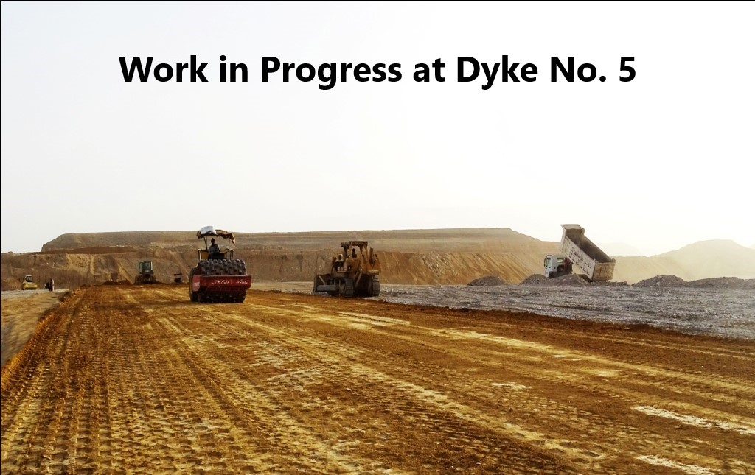
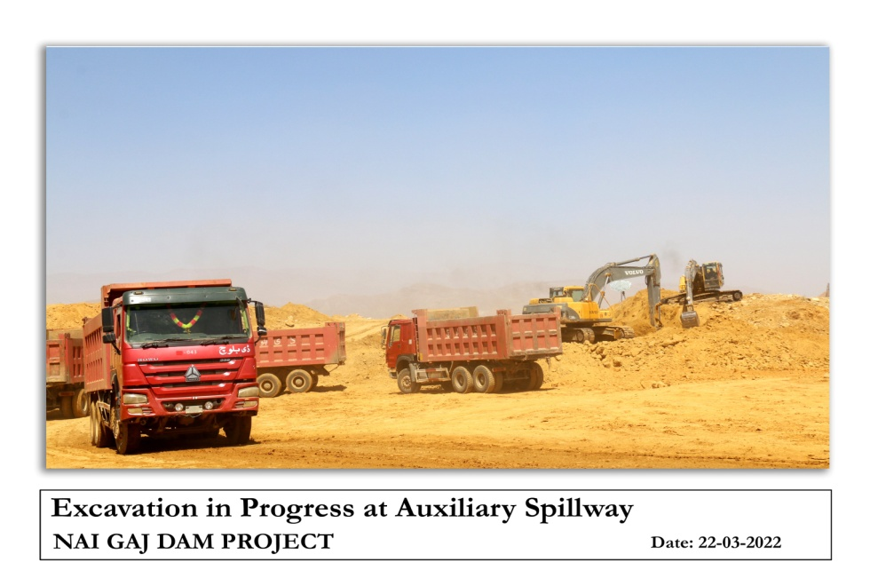
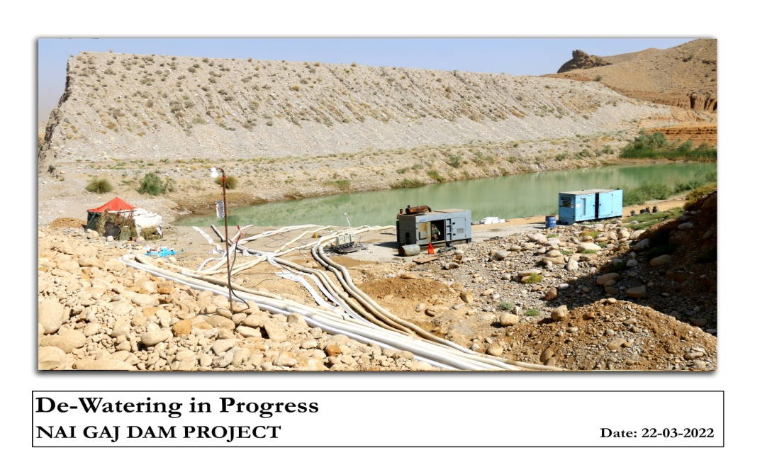
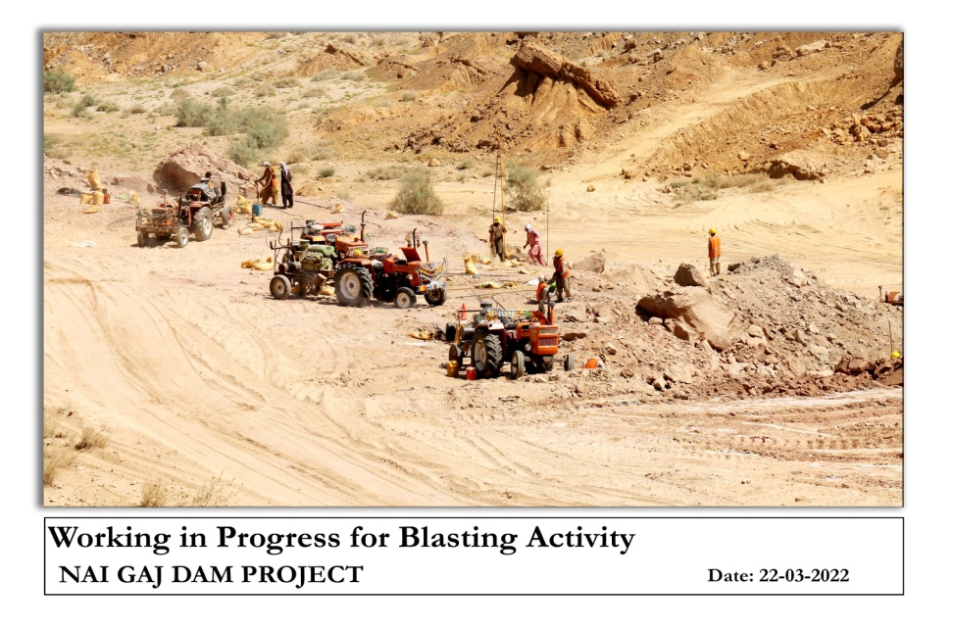
PROJECT PHOTOGRAPHS
Construction of Coffer Dam

Slide 30
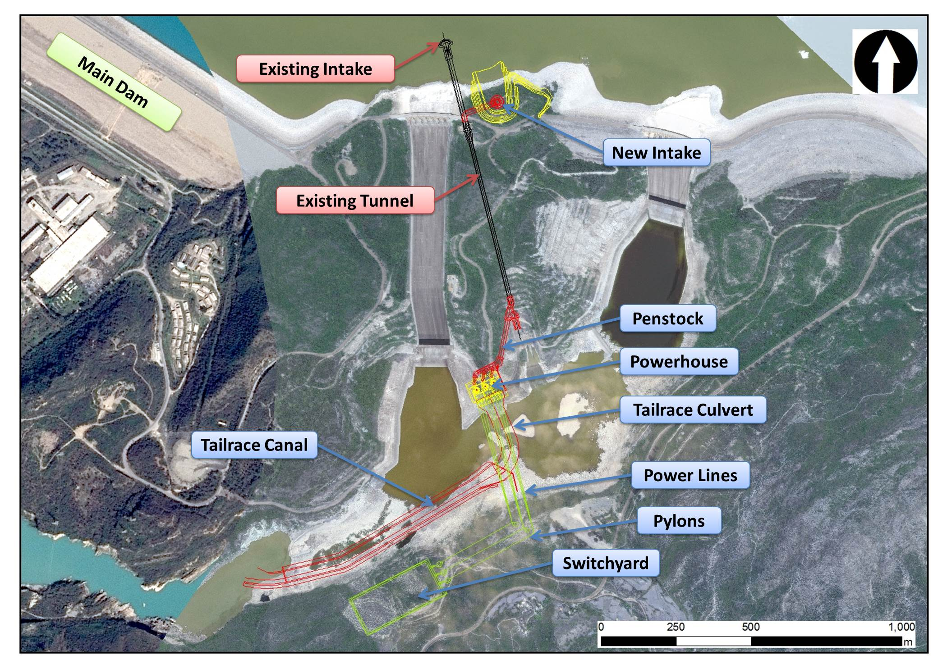
TARBELA 5TH EXTENSION PROJECT
LAYOUT PLAN

Slide 31
STATUS OF PROJECT
Civil Works Contract
SIGNING DATE
06 May 2021
CONTRACTOR
M/s Power Construction Corporation of China Ltd. (PCCCL)
CONTRACT AMOUNT
Eqvl. US$ 354.6 Million
COMMENCEMENT DATE
9 August 2021
DURATION
59 months
E&M Works Contract
SIGNING DATE 25 June 2021
CONTRACTOR JV of M/s Harbin Electric International co. Ltd & M/s Harbin Electric Machinery co. Ltd
CONTRACT AMOUNT
Eqvl. US$ 241.12 Million
EFFECTIVE DATE
23 August 2021
DURATION
37 months

Slide 32
KURRAM TANGI DAM PROJECT (STAGE-I)
The Project comprises of 18 ft high weir, 02 powerhouses, 02 canals for irrigation, Feeder Tunnel, Headrace channel & Transmission Line as its major components
The project aims to provide power and agricultural opportunities in the under-developed area.
Power Generation 18 MW
Annual Generation. 72 GWh
Sheratalla Canal Discharge/ CCA 83 cusecs / 12,300 Acres
Spaira Ragha Discharge/Canal CCA 29cusecs / 4,080 Acres
1st Revised PC-I Rs. 21,059.206 Million

Slide 33
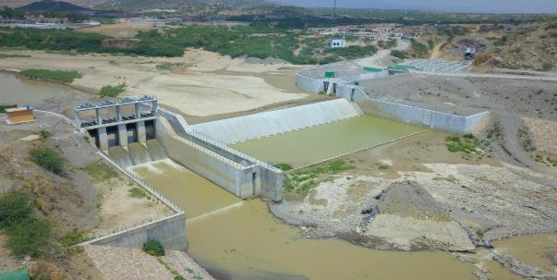
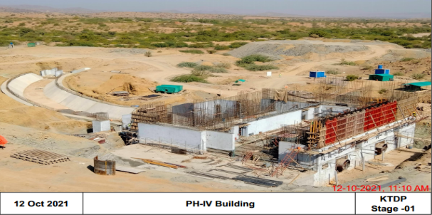
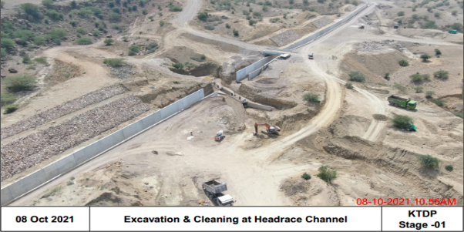
PROJECT PHOTOGRAPHS

Slide 34
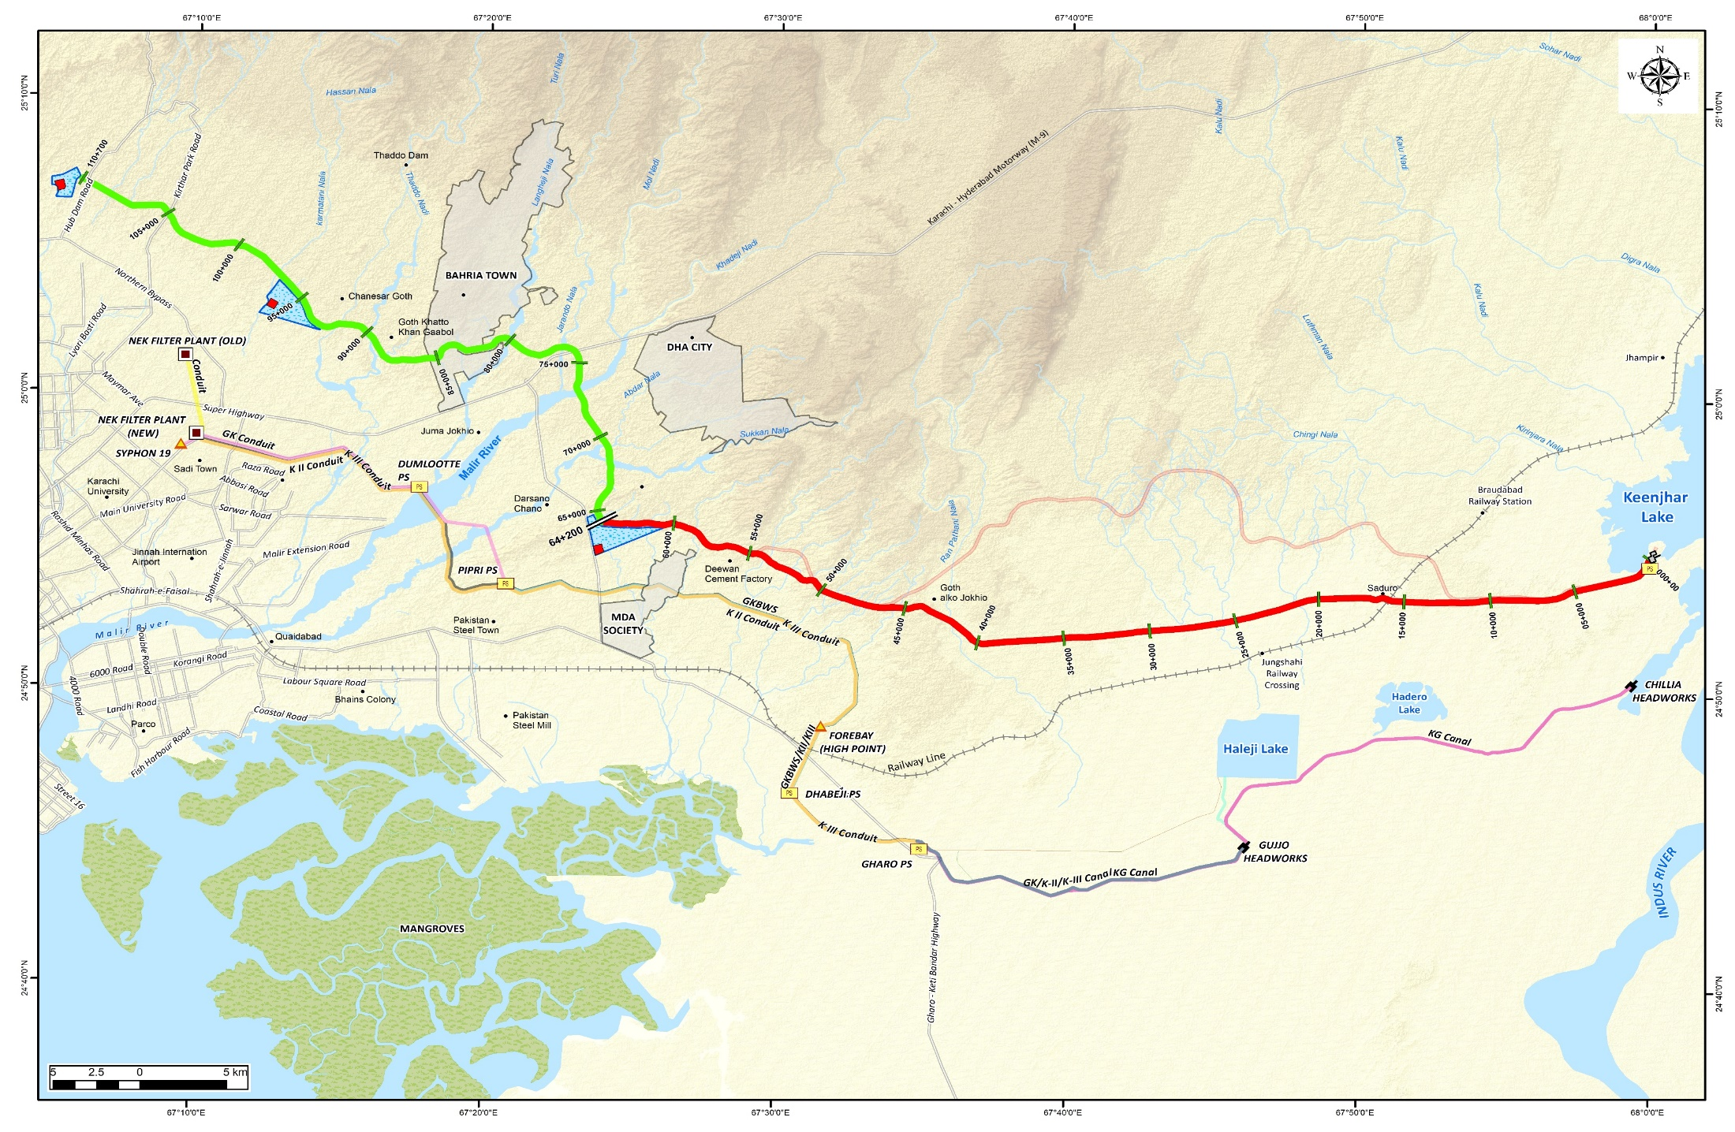
LAYOUT PLAN OF K-IV PROJECT
K-IV PROJECT LAYOUT
K IV PROJECT LAYOUT PLAN
PHASE-1 (260 MGD)
Contract Package KIV-FP3
R3 : 65 MGD
Location : Manghopir Road
Contract Package KIV-PL2
No. of Pipe: 2
Length of Pipe: 32 km (Dia 84”) + 46.5 km (Dia 68”) = 78.5 km
Contract Package KIV-IW
Intake Capacity : 650 MGD
No. of Gates : 4
Size of Gate : 3 x 1.5m
Total Width : 16.5 m
Contract Package KIV-FP2
R2 : 130 MGD
Location : Taiser Town
Contract Package KIV-AW
Access Road : 10 km
Pumping Complex, Staff Colony & PMU Office
Contract Package KIV-PL1
No. of Pipe: 2
Length of Pipe: 64.2+64.2 = 128.4km
Dia: 84”
Contract Package KIV-FP1
R1 : 65 MGD
Location : Pipri
Contract Package KIV-PS
Total Capacity of Pumping Stations : 260
No. of Pumping Station : 2
Capacity of Each PS : 130 MGD
No. of Pumps : 8 Duty & 4 Standby
Capacity of Each Pump : 32.5 MGD

Slide 35
KARACHI GREATER WATER SUPPLY PROJECT (K-IV)
)
K-IV was conceived 15 years ago to meet the critical needs of drinking water to Karachi.
It was marred by poor design including open channel conveyance, alignment and geological issues
FWO abandoned the project in 2018
Karachi still remains short of more than 650 MGD based on the need assessment of 2007
Seeing the issues of the project WAPDA was entrusted to do the project.
WAPDA has hired international consultants and redesigned the conveyance now through pressurized pipes
ECNEC has approved the project and WAPDA is determined to complete by end 2023.

Slide 36
KARACHI GREATER WATER SUPPLY PROJECT (K-IV)
K-IV PROJECT- GREATER KARACHI WATER SUPPLY (PHASE-I 260MGD)
PROJECT COMPONENTS
Intake Structure for 650 MGD at Keenjhar Lake.
Gravity Channel 650 MGD to Keenjhar Pumping Complex
Keenjhar Pumping Complex with 2 Pumping Stations of 130 MGD Each
Pressurized Pipeline (PL-1 and PL-2) flows from two pumping stations to three reservoirs with all appurtenant equipment and structures.
Large capacity Water Reservoirs (3 No)
Filtration Plants at R1, R2 and R3

Slide 37
KEYAL KHWAR HYDROPOWER PROJECT
Location: 128 MW Keyal Khwar Hydropower Project is located in District Kohistan (Lower) KPK, on the right tributary of River Indus.
Project Cost: As per approved PC-I, Project Cost is Rs. 26,084.178 M.
Salient Features:
Consultancy: Project Consultants (KHC) is a Joint Venture of Tractebel Engineering (former Lahmeyer International ) , NDC & EASE-Pak.
Financer: KfW (Germany) Euro 97 Million (Intact)
AFD (France) Euro 120 Million (Under approval).
Timeline: Commencement of Civil Contract : January, 2023.
Completion of Civil Works Contract: December, 2027.
Commencement of E&M Contract : April, 2023.
Completion of E&M Contract : December, 2027
Gross Head 732 m Design Discharge 20 Cumecs Installed Capacity 128 MW | Mean Energy 418 GWh (Annual) Plant Factor 38 % Construction Time 04 Years

Slide 38
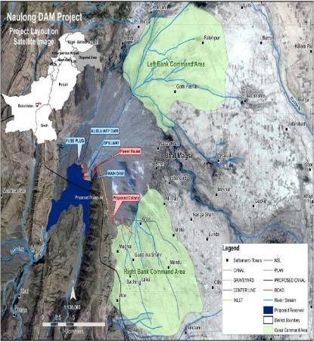
NAULONG MULTIPURPOSE DAM PROJECT
Project Features:-
Location Across Mulla River 30 km from Gandawa City in District Jhal Magsi, Balochistan
Live Storage 242,163 Acre-ft.
Power Generation 4.4 MW
Command Area 47,000 Acres
Approved Updated 2nd Revised PC-I Cost:
Local Rs. 21,538 M
FEC Rs. 6,927 M
Total - Rs. 28,465 M

Slide 39
HARPO HPP
Salient Features
Location | On Harpo Nullah, a left tributary of Indus River about 75 km north west of Skardu District, Gilgit-Baltistan and 670 km North-east of Islamabad.
Gross Head | 723 m
Installed Capacity | 34.5 MW
Energy Generated | 170 GWh
PC-I Approved Cost (Rs.) | Rs. 9,522.801 Million (Approved by ECNEC on 28.03.2014)
Project Consultants | Harpo Consultants (JV of M/s Tractebel, Germany (Former M/s Lahmeyer International) and M/s NDC Pakistan)
Implementation Period | Phase-I (19 December, 2022 (As per latest Project Implementation Time Schedule) Phase-II (20 December, 2026 (48 months after Phase-I ))
Current Status | E&S survey completed within Project Area on 27.10.2021 The Detailed Engineering Design of the Project is under process with Harpo Consultants

Slide 40
300 MW SOLAR FLOATING PHOTOVOLTAIC PROJECT ON WATER BODIES IN TARBELA GHAZI HYDROPOWER GENERATION COMPLEX

Slide 41
SALIENT FEATURES
Total Generation Capacity: 300 MW
Total Project Cost: 345.47 million US$ (As per Previous PC-I)
299 million US$ (Updated)
Source of Financing: As per Previous PC-I
IDA Credit = 171 million US$
IBRD Loan = 170.5 million US$
WAPDA = 5 million US$
Revised as per CDWP directions
IBRD Loan = 294 million US$
WAPDA = 5 million US$
Project life: 25 Years
Average Annual Energy: (GB North Pond + Ghazi Headpond)
(243 GWh + 241 GWh) = 484 GWh

Slide 42
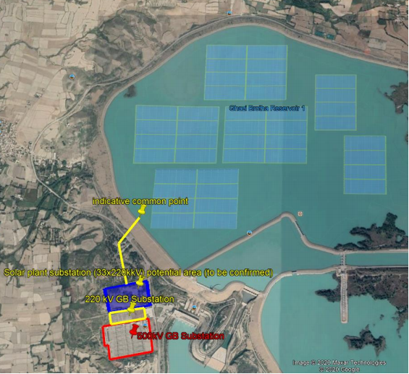
150 MW Solar FPV in Ghazi Barotha North Pond
Generation Capacity: 150 MW
Solar Panel Type: Mono facial Poly Crystalline
Anchoring: Self Weighted Bed Anchoring
Water level variation: 5 – 7 m
Water depth: 19 – 34 m
Water velocity: 0m/s (negligible)
Power Evacuation: 220 KV Mardan or Peshawar
FIRR: 4.29 %
EIRR: 25.4 %
Benefit Cost Ratio: 0.54
Performance Ratio: 81.6 %
Payback Period: 16 Years
Estimated Cost: 139.57 million US$

Slide 43
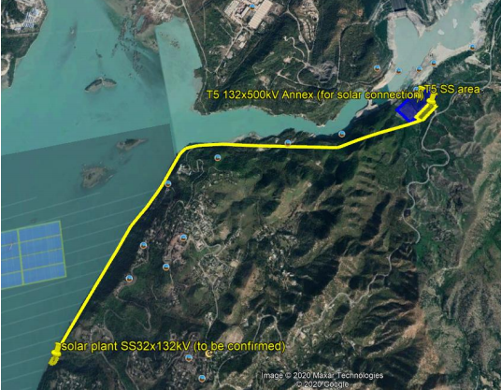
150 MW Solar FPV at Ghazi Headpond
Generation Capacity: 150 MW
Solar Panel Type: Mono facial Poly Crystalline
Anchoring: Self Weighted Bed Anchoring
Water level variation: 3 - 6m
Water depth: 0 - 31.5m
Water velocity: 0 - 4m/s
Power Evacuation: 500KV T5 Switchyard
FIRR: 3.24 %
EIRR: 25.9 %
Benefit Cost Ratio: 0.51
Performance Ratio: 80.9%
Payback Period: 18 Years
Estimated Cost: 156.96 Million US$

Slide 44
THANKS
Notes:
44

