Slide 1

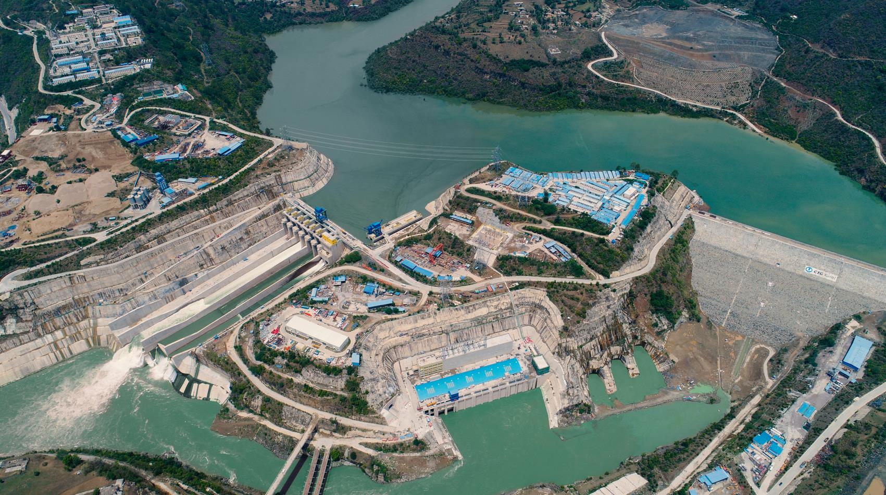
2nd Int’l Hydropower Conference Pakistan 2022
Hydro Power Projects Under CPEC- 720 MW KAROT Hydro Power Project – Success Story
N A Zuberi
China Three Gorges South Asia Investment Ltd
Dec 21, 2022

Slide 2
Contents
CPEC Agreement
CPEC Portfolio of Project
Key Achievement of CPEC Projects
Karot Hydro Power Project
  Key Features, Major Milestones
  Major Benefits
  Construction Progress- Pictures
  Corporate Awards
Karot HPP Successes
Conclusion

Slide 3
CPEC Agreement
  The CPEC Agreement was signed between Government of Pakistan and Government of China on Nov 08, 2014
  The Agreement envisages the development of 17,045 MW of Projects on following energy resources
    Hydro,
    Wind,
    Solar,
    Coal
    Two High Voltage Direct Current (HVDC) transmission lines from South to North and North to South.

Slide 4
CPEC Portfolio of Projects
Sr. No. | Name of Project |  | Capacity (MW) |  | COD
Projects already commissioned
1 | Sahiwal Coal Power | 1,320 |  | Oct-17
2 | Port Qasim Coal Power | 1,320 |  | Apr-18
3 | China-HUB Coal Power | 1,320 |  | Aug-19
4 | Engro Thar Power & Mine | 660 |  | Jun-19
5 | Quaid-e-Azam Solar Park | 400 |  | Aug-16
6 | Hydro China Dawood Wind | 50 |  | Apr-17
7 | UEP Wind Farm | 100 |  | Jun-17
8 | Sachal Wind Farm | 50 |  | Apr-17
9 | Three Gorges Wind Power Projects | 99 |  | Jun-18
10 | Lahore-Matiari 660 HVDC Transmission Line | - |  | Sep-21
11 | Karot HPP | 720 |  | Jun-22
 | Total (MW) | 6,039

Slide 5
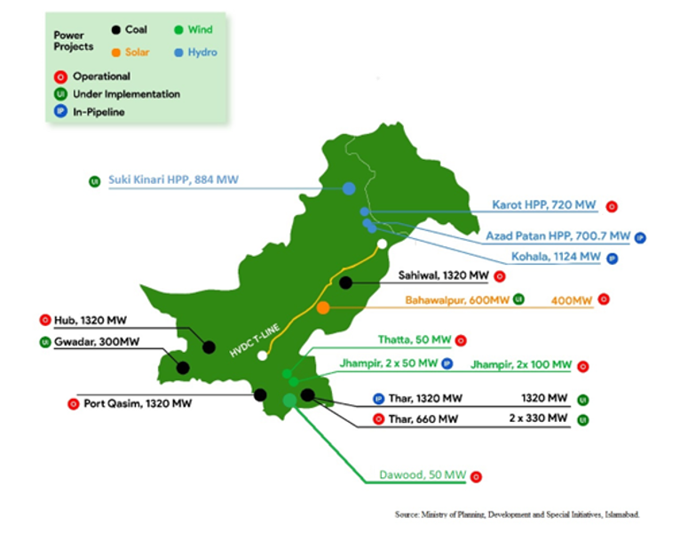
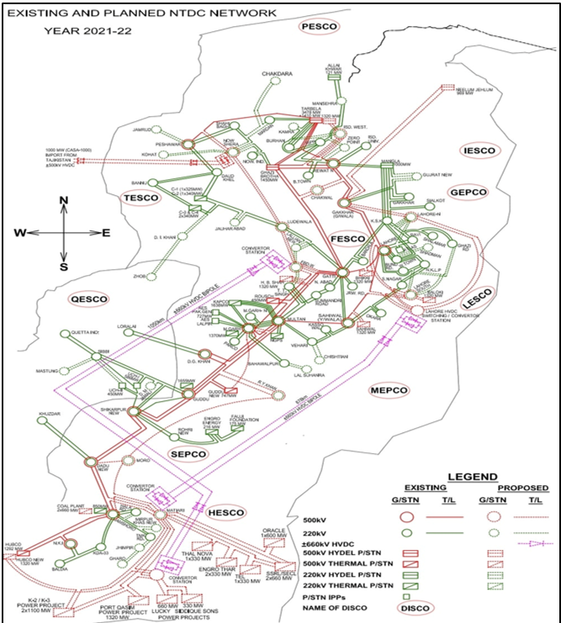
Location of CPEC Projects and NTDC System

Slide 6
CPEC Portfolio of Projects
Projects under construction / under development
1 | Shanghai Electric (TCB-1) & Mine | 1,320 | 2023
2 | HUBCO Thar Power | 330 | 2022
3 | ThalNova Thar Power | 330 | 2022
4 | Suki Kinari HPP | 884 | 2022
5 | Azad Pattan HPP | 700.7 | 2026
6 | Kohala HPP | 1,124 | 2029
7 | Gwadar Coal / Solar Power Plant | 300 | 2023
8 | Thar (Oracle) Coal Plant | 1,320 | 2026
9 | Quaid-e-Azam Solar Park | 600 | 2024
10 | Cacho Wind Power Project | 50 | 2026
11 | Western Energy (Pvt.) Ltd. | 50 | 2026
 | Total (MW) | 7,009

Slide 7
Key Achievements of the CPEC Projects
  Key Achievements of CPEC Projects
  Alleviating Pakistan's energy shortage through addition of more than 6,000 MW of Generation Capacity
  Addition of Pakistan’s first ever HVDC Transmission Line in National Grid.
  Addition of Clean and Green Energy in the National Grid
  CPEC Projects provided immense Employment Opportunities in Pakistan
  Foreign Direct Investment in Pakistan
  Technology and Skill Transfer to Pakistan
  Fast track development of Power Projects in Pakistan
  CPEC Projects providing electricity in Pakistan at Competitive Rates
  CPEC Projects bringing prosperity to the local community

Slide 8
Karot Hydro Power Project
Notes:
南亚公司在巴基斯坦共有员工170人，其中巴方员工占比61%，属地化程度高。
其中三峡国际派驻员工27人，借调员工人14人，国内第三方劳务派遣25人。
巴方管理类员工大多数具有多年水电开发管理经验，入职后能有效推进工作开展。
中方大多数员工都很年轻，在巴基斯坦历经不同岗位的锻炼，成长迅速，很多都能独当一面。

Slide 9
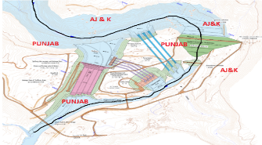
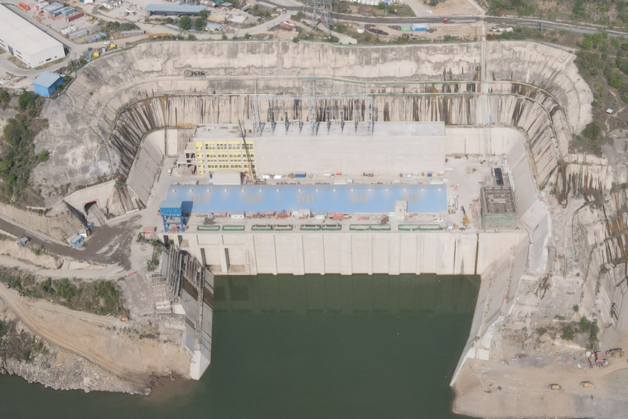
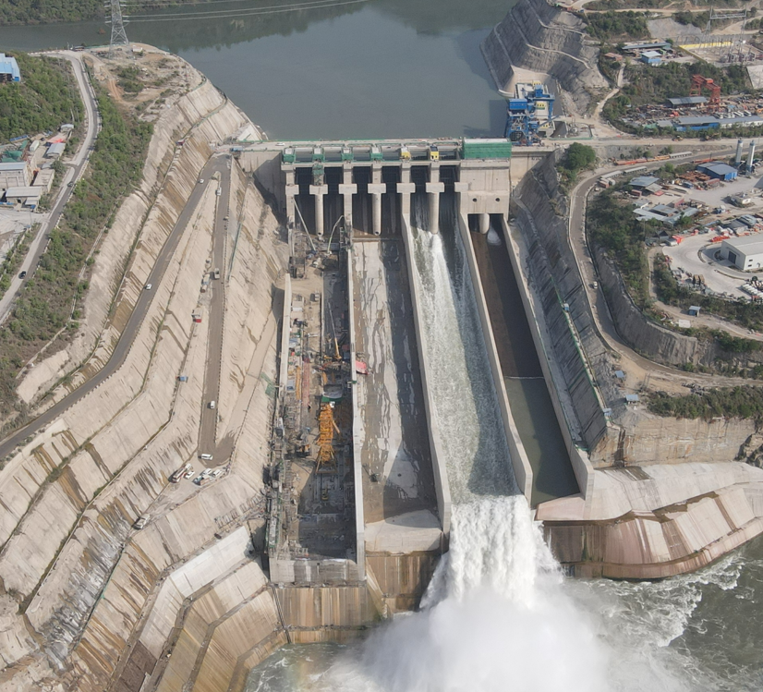
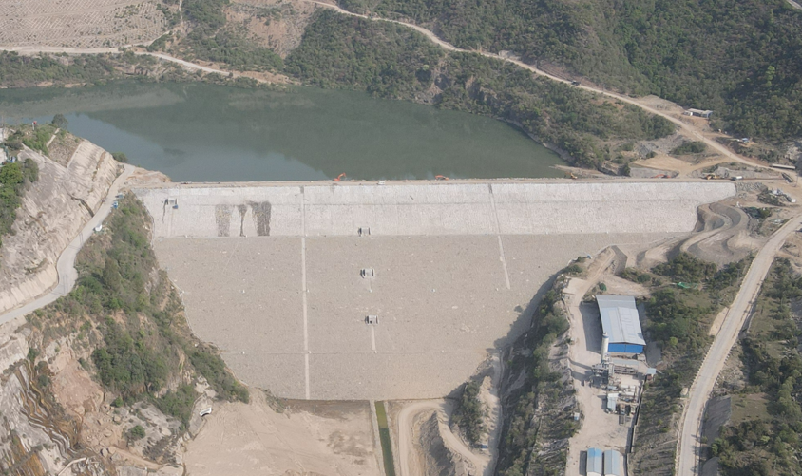
Karot Project Layout
Dam
Spillway
Powerhouse
卡洛特电力有限责任公司
Karot Power Company(Pvt.) Ltd.

Slide 10












Karot Project’s Key Stakeholders
Sponsors
中国三峡南亚投资有限公司
China Three Gorges South Asia Investment Ltd.
中國三峽港源投資有限公司
China Three Gorges HongKong Investment Company Limited
Lenders
Employer
卡洛特电力有限责任公司
Karot Power Company (Pvt) Ltd.
Employer’s
Engineer
上海东华工程咨询公司
EPC Contractor
长江三峡技术经济发展有限公司(TGDC)
O&M Contractor

Slide 11
Project Cycle
Project Development, Construction and Operation Stages
The 720 MW Karot HPP has a life of more than 100 years, the Project has different stages and at each stage there are different human categories / resourses
After 30 years of operation the Project will be transferred to Government of Punjab
Project Development
10 years
ATL/KPCL
Project Construction
5.5 years
TGDC
Project Operation 30 years CTGO

Slide 12
Karot Hydropower Project
Strong Sponsors Profile
Reputable EPC contractor
Priority Project of CPEC
Multiple Project Benefits
Karot Project Key Strengths
Notes:
南亚公司在巴基斯坦共有员工170人，其中巴方员工占比61%，属地化程度高。
其中三峡国际派驻员工27人，借调员工人14人，国内第三方劳务派遣25人。
巴方管理类员工大多数具有多年水电开发管理经验，入职后能有效推进工作开展。
中方大多数员工都很年轻，在巴基斯坦历经不同岗位的锻炼，成长迅速，很多都能独当一面。

Slide 13
  Unique and Distinctive Features
  Projects Developed under Power Policy 2002 as a Private Power Project
  Located in the Province of Punjab and AJK
  Project is under CPEC Framework
  Located very close to Load Center : Islamabad 76 km
  The Project is very close Nation Grid and will require only 3 km of Transmission Line.
  No major Environmental Issues
  Project being developed by well experienced company having technical and Financial strength – CTG
  Fool proof security of the Project provided by Pak Army
  Under CSR the Company is constructing hospitals, schools , bridges, roads, and scholarships
720 MW Karot HPP – Pearl on Jhelum River

Slide 14
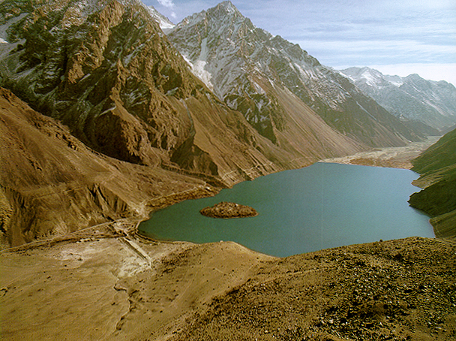


Karot Project a Environmental Friendly Project
Karot HPP complies all Environmental Guidelines, Laws, Rules and Regulations of Federal and Provincial Govts. and Project Lenders.

Slide 15
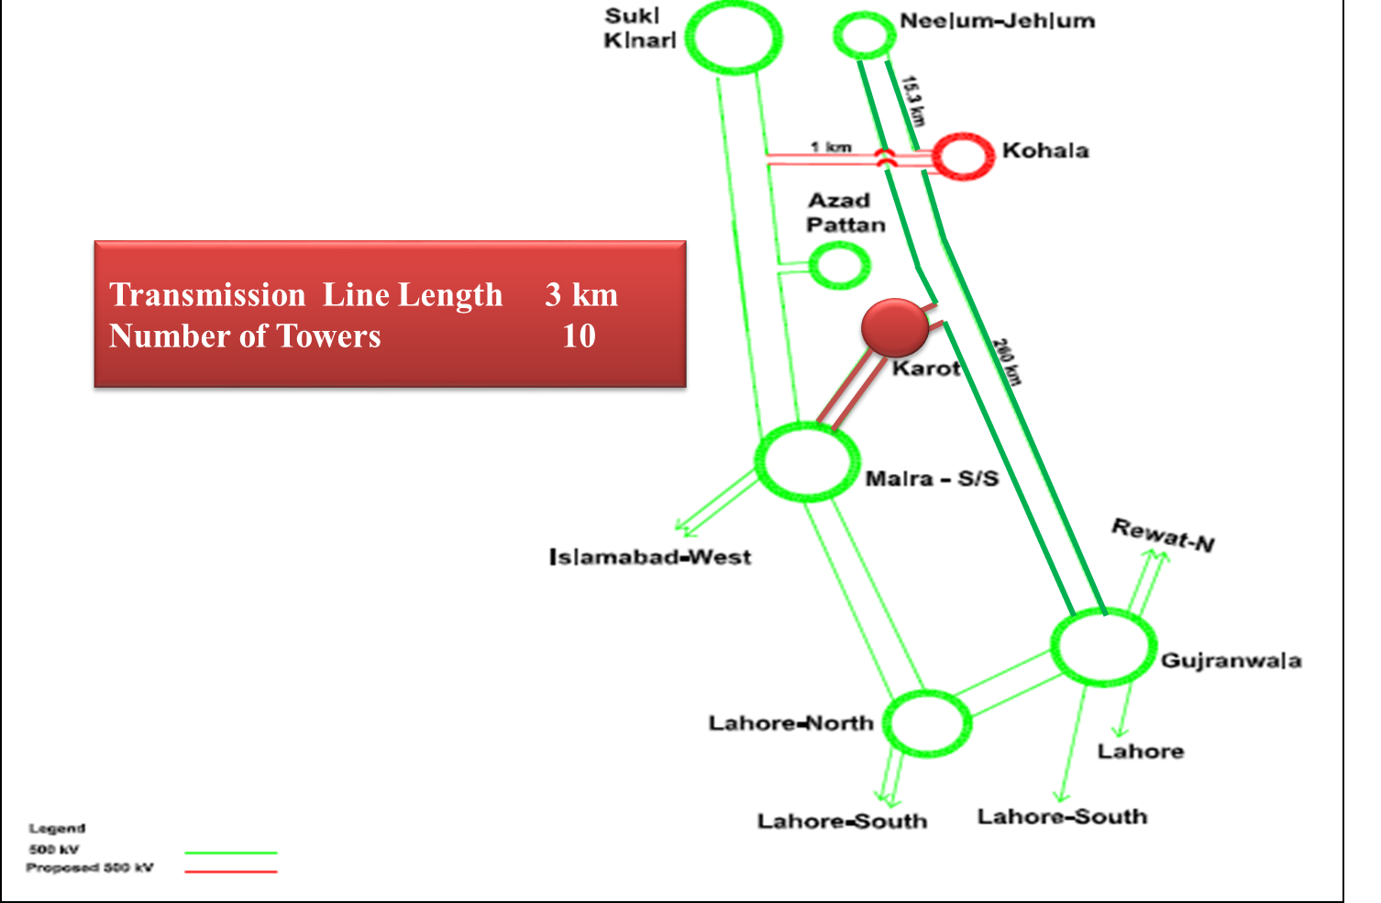
Transmission Line Interconnection Arrangements for Karot HPP

Slide 16
Karot HPP Benefits
Notes:
南亚公司在巴基斯坦共有员工170人，其中巴方员工占比61%，属地化程度高。
其中三峡国际派驻员工27人，借调员工人14人，国内第三方劳务派遣25人。
巴方管理类员工大多数具有多年水电开发管理经验，入职后能有效推进工作开展。
中方大多数员工都很年轻，在巴基斯坦历经不同岗位的锻炼，成长迅速，很多都能独当一面。

Slide 17
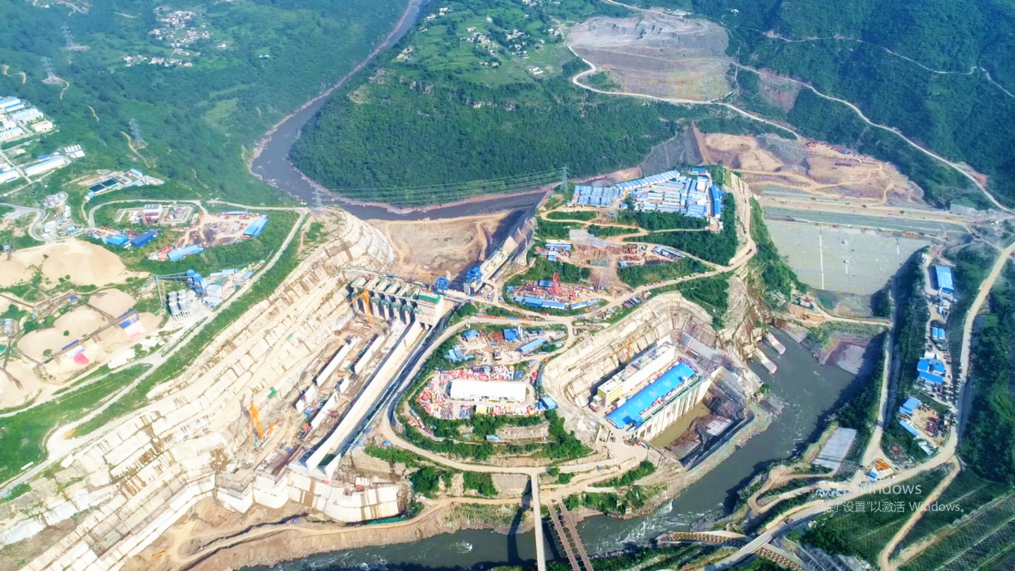
Benefits of Karot Project
At the end of the operation period, the Karot Company will transfer the Complex to the Government of Punjab for
Rs. 1
Job opportunities to locals during construction and operation of the Karot Project , about are already working at Karot site.
3,000 people
Notes:
南亚公司在巴基斯坦共有员工170人，其中巴方员工占比61%，属地化程度高。
其中三峡国际派驻员工27人，借调员工人14人，国内第三方劳务派遣25人。
巴方管理类员工大多数具有多年水电开发管理经验，入职后能有效推进工作开展。
中方大多数员工都很年轻，在巴基斯坦历经不同岗位的锻炼，成长迅速，很多都能独当一面。

Slide 18
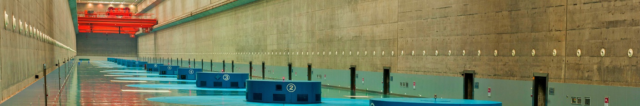
Karot Project benefits to AJK/Punjab
GOAJK/GOPb to receive Rs 20.234 billion in 30 years on account of WUC
GOAJK /GOPb to receive Rs. 675 Million annually for 30 years as WUC
Per day income of around Rs. 1.85 Million to GOAJK /GOPb
Rs. 10.7 billion
Taxes
Rs. 675 Million /year
water revenues GOAJK/GOPb
Notes:
可以从开发原本浪费的当地资源，增加政府收入的角度论述

Slide 19
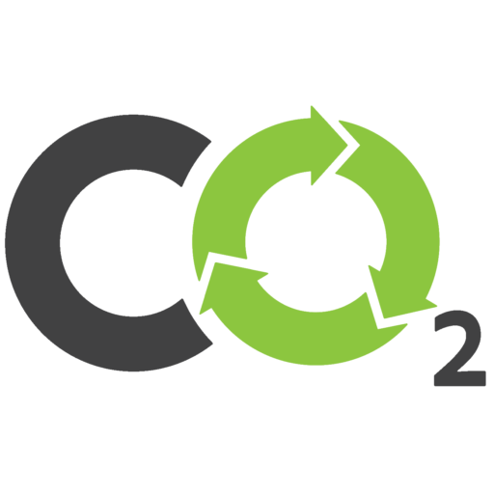
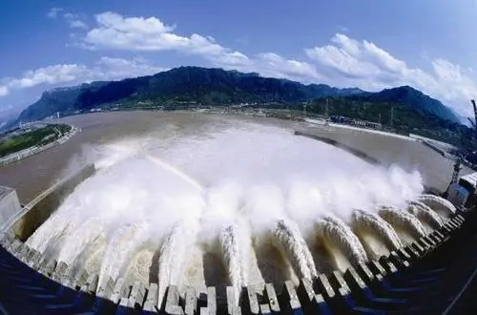
Economical clean energy supply
GWh
3,206
Upon completion of the Karot project, the average annual energy output 3.206 billion kWh
27%
16%
5%
12%
5%
3.5 million
Tons
9%
26%
Upon completion of the Karot project, it is expected to cut annual carbon dioxide emission around 3.5 million tons, uplifting clean energy output mix and optimizing the energy consumption structure.
Notes:
建议介绍内容：1、2025年巴基斯坦电力缺口约110万千瓦，卡洛特项目有效填补电力缺口；2、有效利用当地资源，改善巴基斯坦电力结构；3、水电电价优势，尤其是还贷后优势更为突出，有效解决巴基斯坦的债务问题。（卡洛特EPC阶段均化电价为7.6美分/度，还贷期后为4美分/度）

Slide 20


CSR Activities
RS
Health Facilities
652 million
Drinking water
facilities
KPCL has developed and implemented a community investment plan (CIP) under Corporate Social Responsibility to improve living environment of local community. It will be implemented over the course of construction period.
Educational
Facilities
Infrastructure Improvement
Recreational Facilities

Slide 21
Project Key Features
Notes:
南亚公司在巴基斯坦共有员工170人，其中巴方员工占比61%，属地化程度高。
其中三峡国际派驻员工27人，借调员工人14人，国内第三方劳务派遣25人。
巴方管理类员工大多数具有多年水电开发管理经验，入职后能有效推进工作开展。
中方大多数员工都很年轻，在巴基斯坦历经不同岗位的锻炼，成长迅速，很多都能独当一面。

Slide 22
Project Features
Project Features
Dist. Rawalpindi,
Punjab & AJK
US cents 7.6152/kWh
Location
EPC Stage Tariff
River
Jhelum River
EPC Project Cost
US$ 1277.80million
Project Investment Budget
Capacity
720 MW
US$ 1740 million
Av. Annual Energy
3206 GWh
Construction Period
5.5 Years
Development mode
BOOT
Operation Period
30 Years
Project Importance: Priority Project Under CPEC
卡洛特电力有限责任公司
Karot Power Company(Pvt.) Ltd.

Slide 23
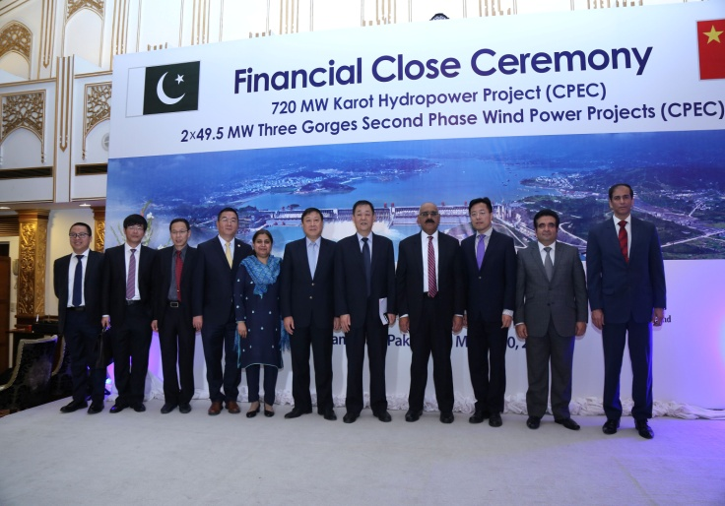
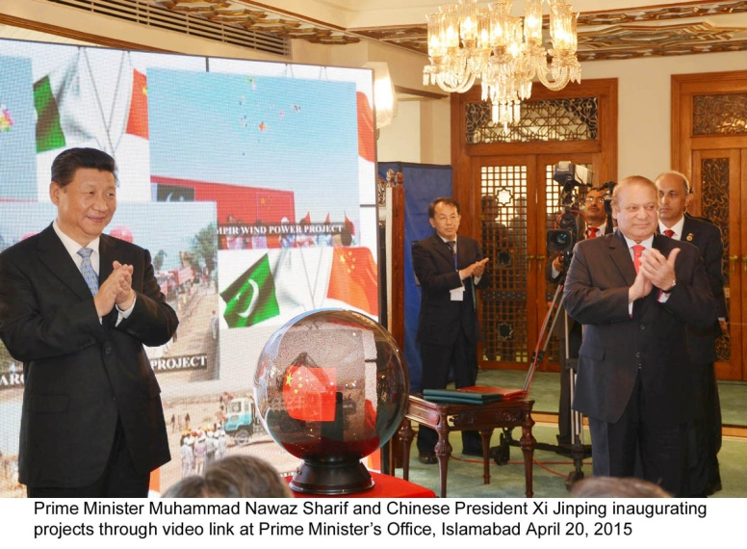
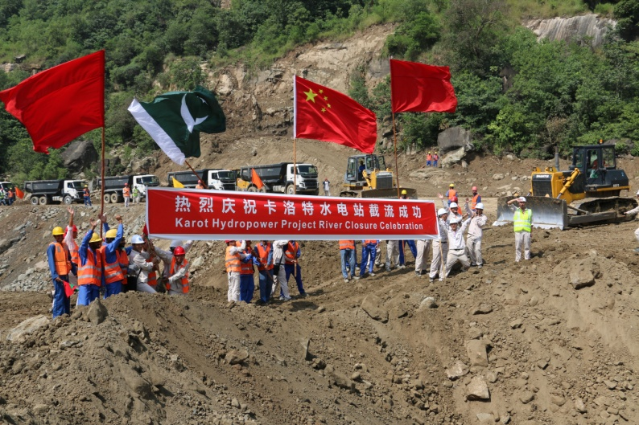
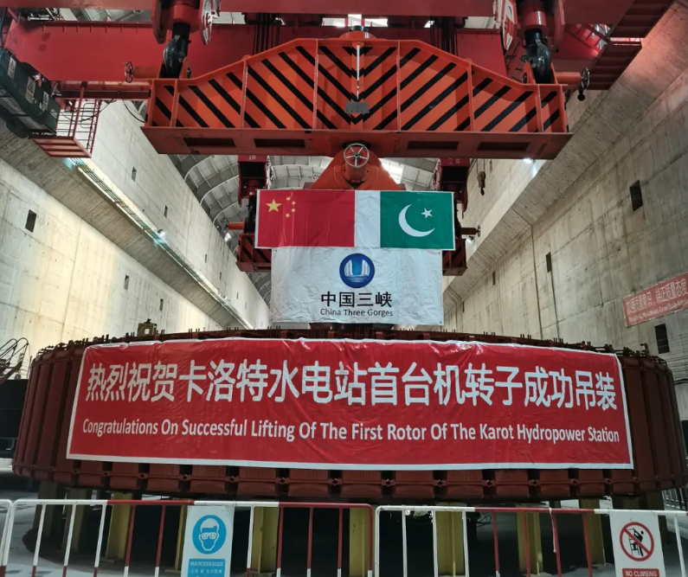
Project Updates
720 MW Karot Hydropower Project
2010.06
2014.04
2015.02
2016.12
2017.02
2018.09
2021.05
2022.06
Incorporation of Karot Power Company (Pvt.) Limited (KPCL)
Chosen as one of the Priority Project under the CPEC
Signing of the EPC contract
Officially started the construction
Financial Close
River Closure
First roter lifted
COD

Slide 24
Project Completion and Support
卡洛特电力有限责任公司
Karot Power Company(Pvt.) Ltd.

Slide 25
Project Completion and Support
The Karot HPP after successfully completing all Commissioning Tests as per provisions of the PPA achieved COD on Jun 29, 2022
The support of following Institutions for timely completion of the Karot is highly acknowledged
  Ministry of Energy (Power Division)
  NEPRA
  PPIB
  CPPA-G
  NTDC
  GOAJK
  GoPunjab
  CPEC Authority
卡洛特电力有限责任公司
Karot Power Company(Pvt.) Ltd.

Slide 26
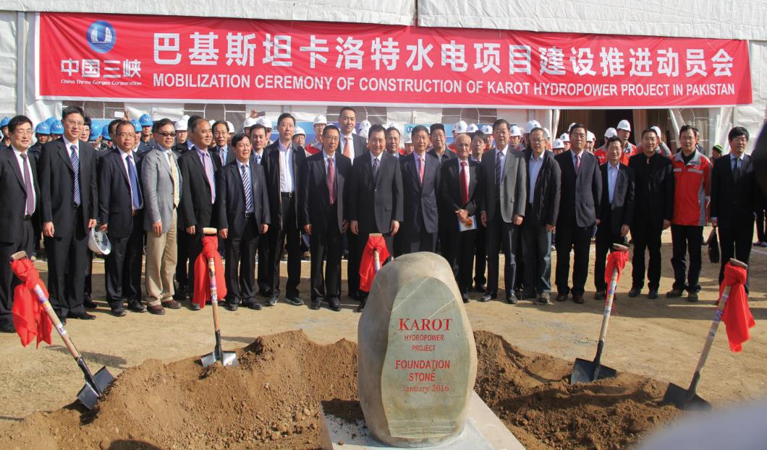
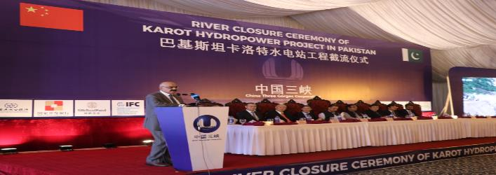
Pictures of Project Activities
Long live China-Pakistan Friendship
卡洛特电力有限责任公司
Karot Power Company (Pvt.) Ltd.

Slide 27
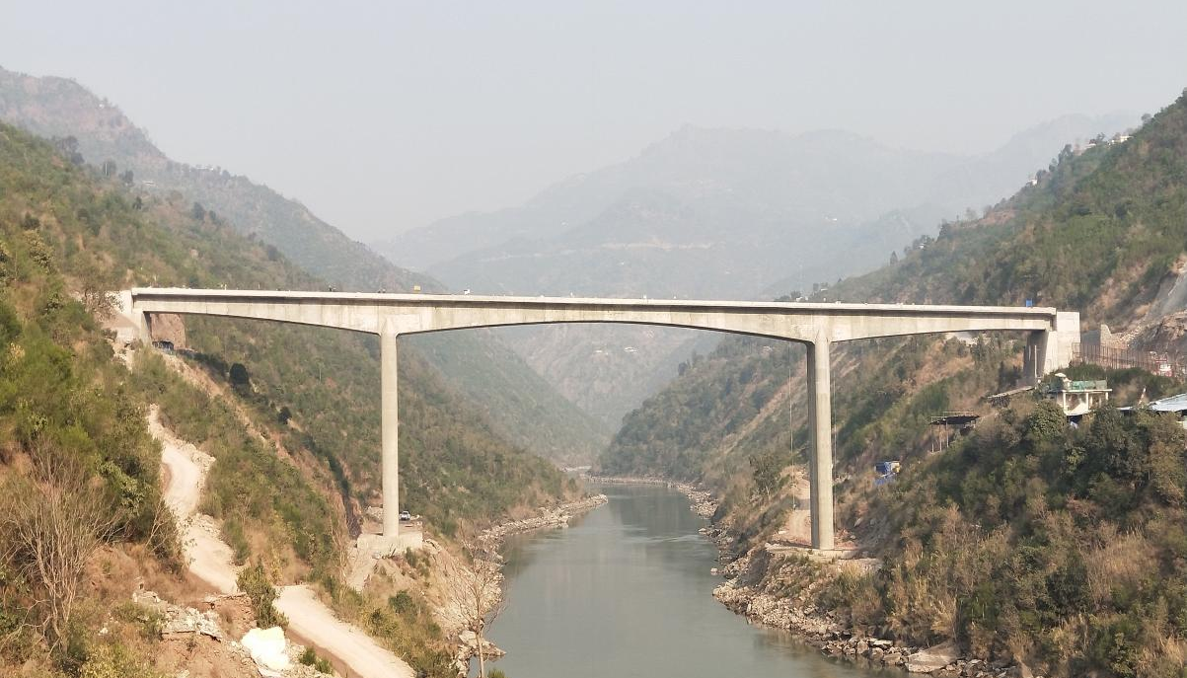
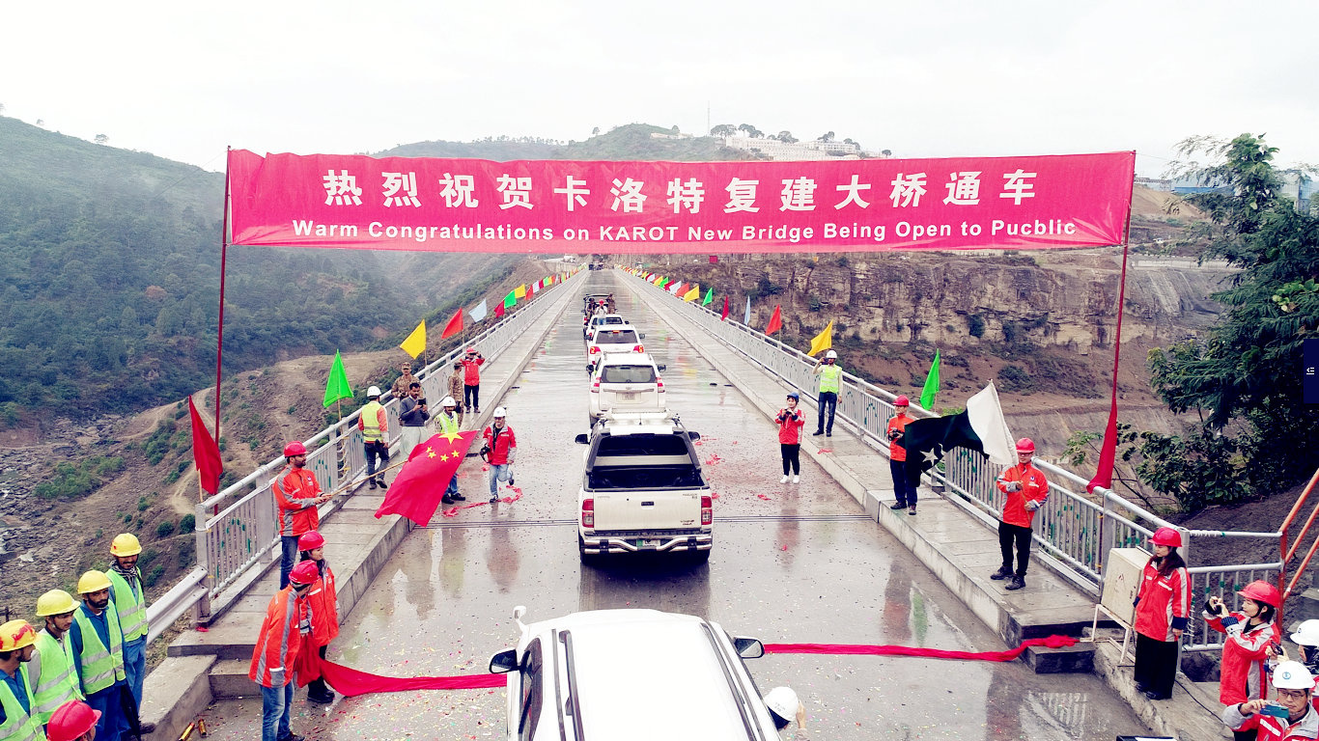
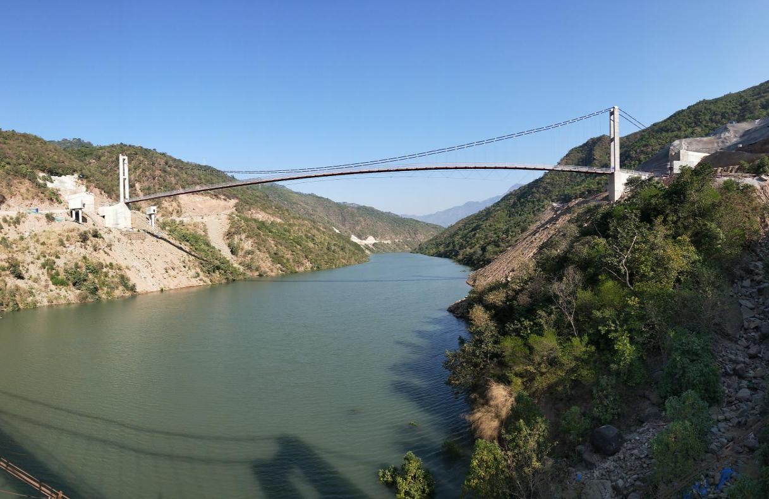
Pictures of Project Activities
Azad Pattan Bridge
Karot New Bridge
Suspension Bridge
卡洛特电力有限责任公司
Karot Power Company (Pvt.) Ltd.

Slide 28
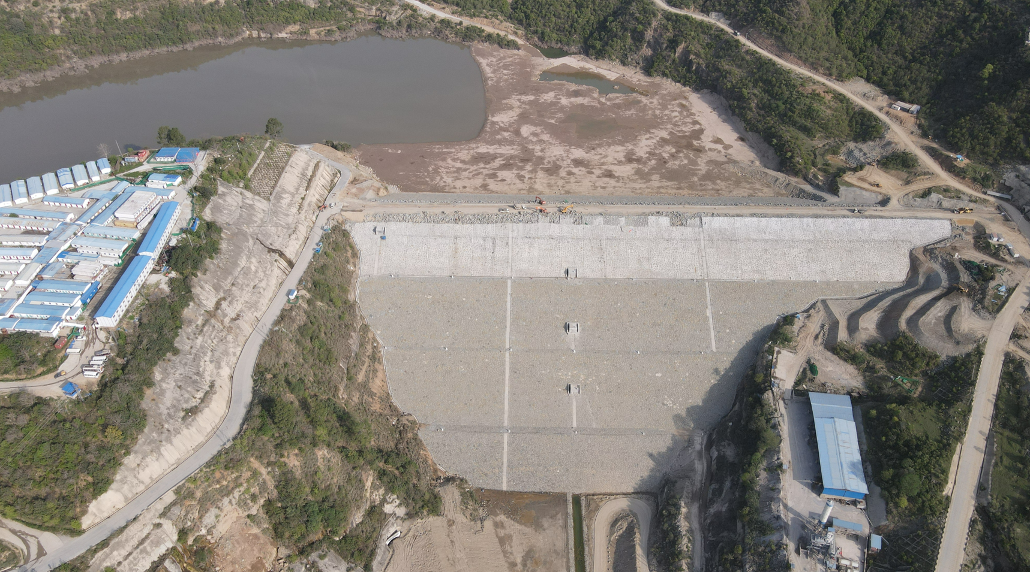
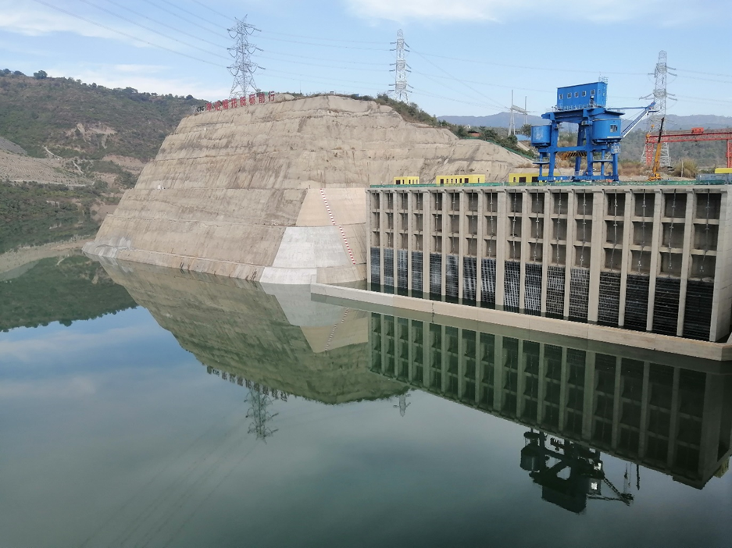
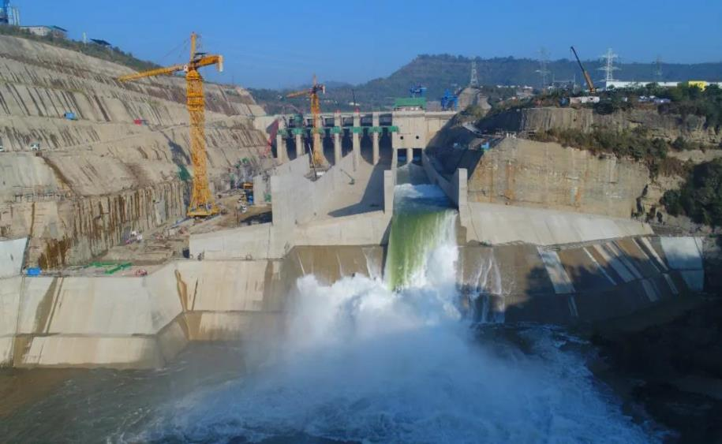
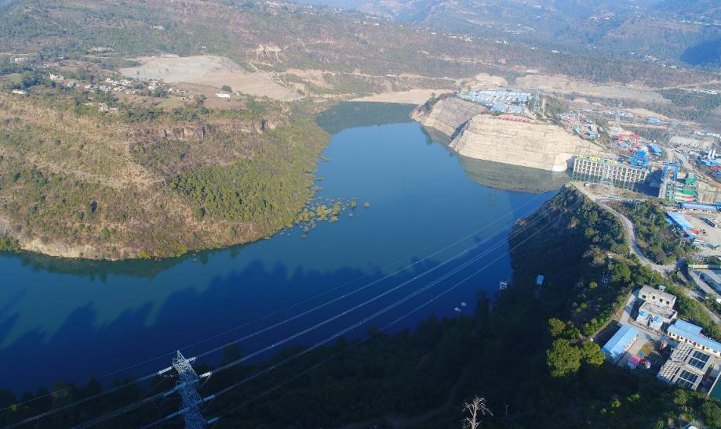
Project Pictures
  Dam
  Intake
  Spillway
  Reservoir
卡洛特电力有限责任公司
Karot Power Company (Pvt.) Ltd.

Slide 29
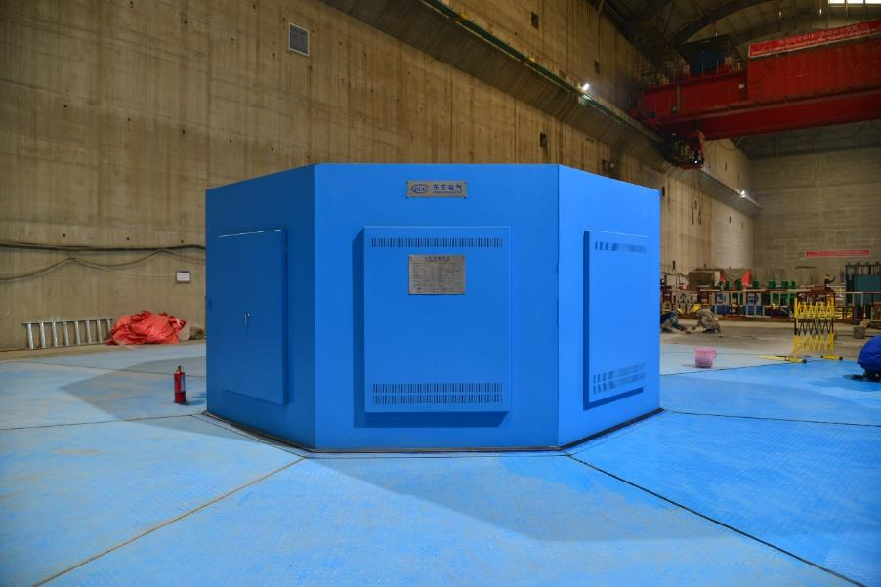
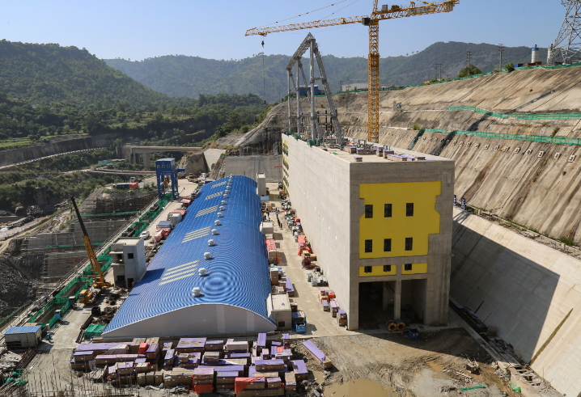
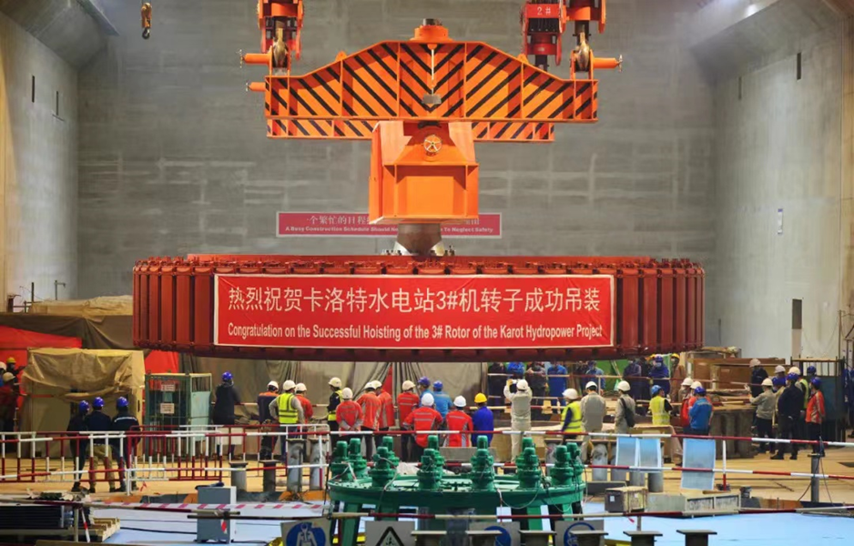
Project Pictures
  Power House
卡洛特电力有限责任公司
Karot Power Company (Pvt.) Ltd.

Slide 30
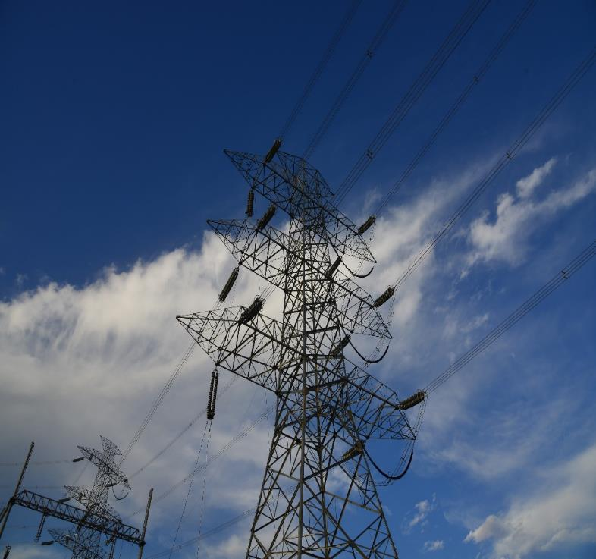
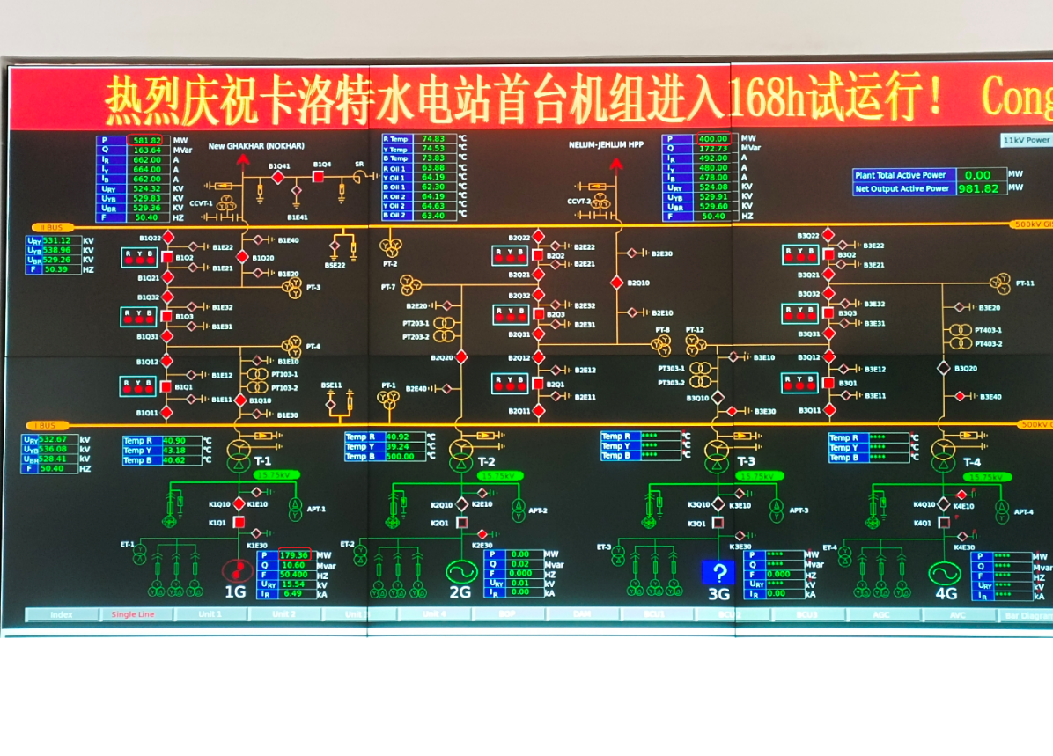
Project Pictures
  Transmission Line
  Units in Operation
卡洛特电力有限责任公司
Karot Power Company (Pvt.) Ltd.

Slide 31
Community Investment Plan (CIP)
卡洛特电力有限责任公司
Karot Power Company(Pvt.) Ltd.

Slide 32

Community Investment Plan (CIP)
Rs. 652 Million
Health Facilities
Drinking water
facilities
KPCL has developed a Community Investment Plan (CIP) to ensure that the project benefits are shared with local communities around the project. The CIP implemented is started in 2017 and will be completed in
2022 – 23.
Educational
Facilities
Infrastructure Improvement
Recreational Facilities

Slide 33
Community Investment Plan (CIP)
    Completed CIP Projects in Punjab
    1. Construction of Government Girls Primary School Channi Awan Kahuta
    2. Construction of Government Boys Primary School Kannad Karot
    3. Construction Rest House at Beor
    4. Construction of Government Dispensary at Brohi Azad Pattan (Punjab)
    5. Rehabilitation and Argumentation of Rural Water Supply Scheme at Brohi Area (Kahuta)
    6. Construction of New Emergency Block (Trauma Center) at THQ Hospital Kahuta
    7. Construction of Access Roads in Tehsil Kahuta Area in Punjab
    8. Rehabilitation of Kahuta Club
    9. Construction Care Unit at THQH Kahuta
    Completed CIP Projects in AJ&K
    1. Rehabilitation and Improvement of Basic Health Unit (BHU) Hollar (AJ&K)
    2. Construction of Government Boys Middle School Hollar (AJ&K)
    3. Construction of Government Girls Middle School Hollar (AJ&K)
    4. Rehabilitation and Construction of Access Roads (1st phase) Hollar AJ&K
    5. Establishment of Public Park Hollar AJ&K
卡洛特电力有限责任公司
Karot Power Company (Pvt.) Ltd.

Slide 34
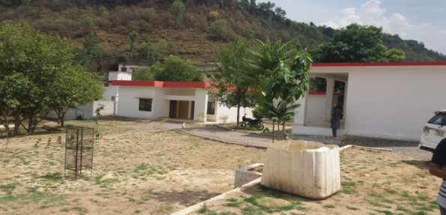
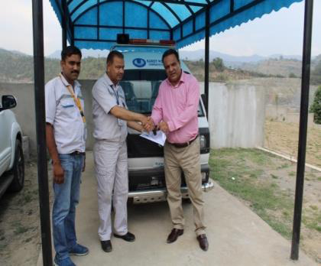
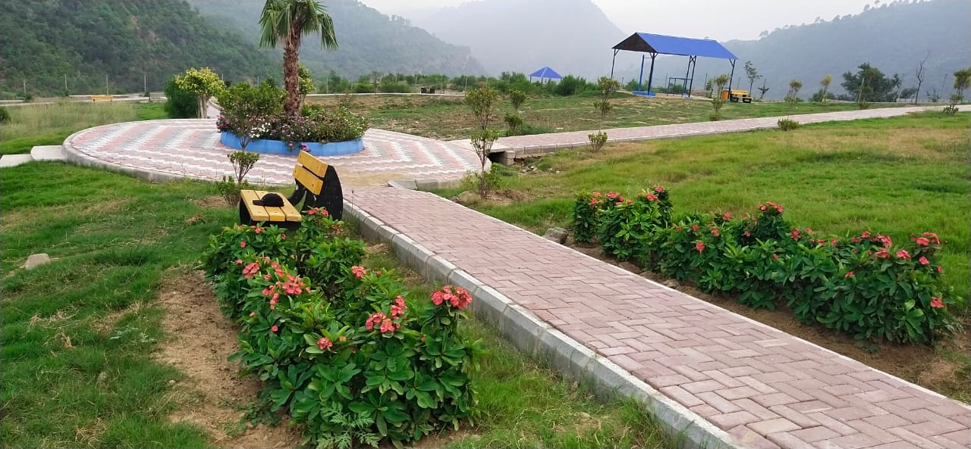
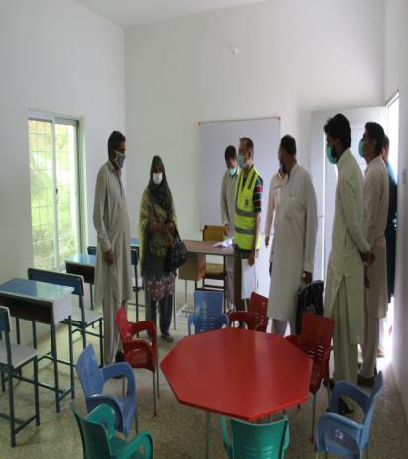
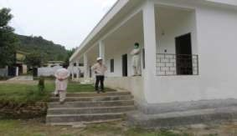
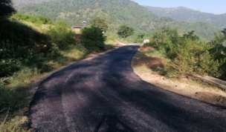
Glimpses of CIP Projects Completed in AJK
View of BHU Hollar
KPCL Provided Ambulance
A view of Public Park Established at Hollar
New classroom at Girls School Hollar
View of New Boys School Building Hollar
Newly constructed road in Hollar area (AJ&K)
卡洛特电力有限责任公司
Karot Power Company (Pvt.) Ltd.

Slide 35
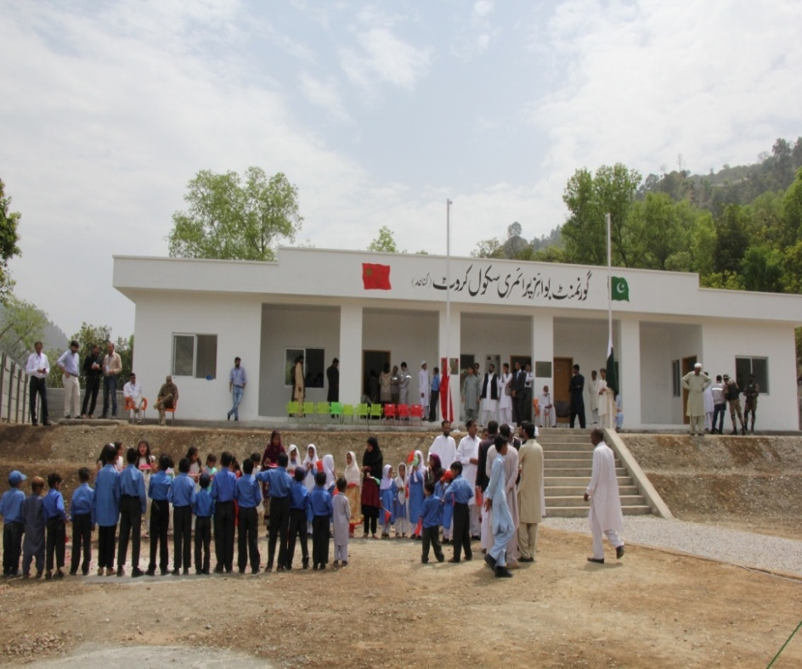
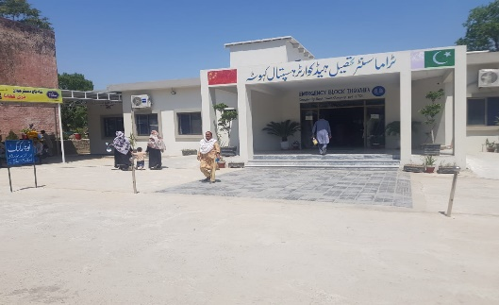
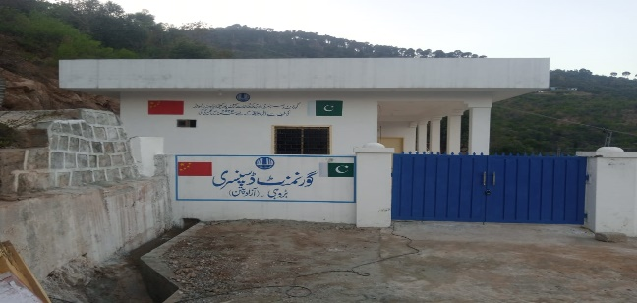
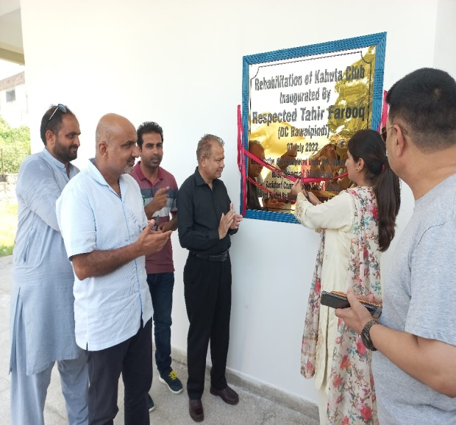
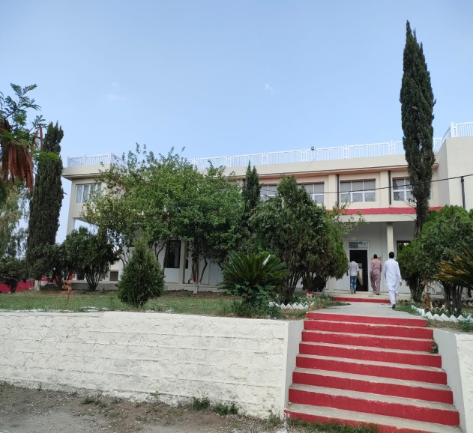
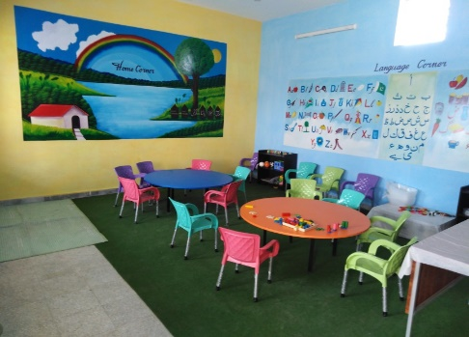
Glimpse of CIP Projects completed in Punjab
Newly Constructed Building for Government Boys Primary School in Kannad village near karot
New Trauma Center at THQ Hospital Kahuta
View of New Classroom at Channi School Kahuta
A view of new dispensary building at Brohi
Assistant Commissioner Kahuta Inaugurated the Rehabilitated Kahuta Club
卡洛特电力有限责任公司
Karot Power Company (Pvt.) Ltd.

Slide 36
Corporate Awards
卡洛特电力有限责任公司
Karot Power Company (Pvt.) Ltd.
Notes:
南亚公司在巴基斯坦共有员工170人，其中巴方员工占比61%，属地化程度高。
其中三峡国际派驻员工27人，借调员工人14人，国内第三方劳务派遣25人。
巴方管理类员工大多数具有多年水电开发管理经验，入职后能有效推进工作开展。
中方大多数员工都很年轻，在巴基斯坦历经不同岗位的锻炼，成长迅速，很多都能独当一面。

Slide 37
Corporate Awards
A Pakistani employees of KPCL was awarded the Pakistan excellent employee award of the China-Pakistan Economic Corridor (CPEC) project
720 MW Karot Hydropower Project won the Asia Pacific Hydro Deal of the Year (2017), awarded by IJ Global, the global energy infrastructure authority
Karot project camp won the 2018 China overseas project excellent camp award
Karot Hydropower Project won the "2019 China International Sustainable Infrastructure Project Award", awarded by China International Contractors Association in December 2019 in Changsha, China
CSR Awards Achievement during 2019 for Education and Health
NEPRA CSR STALWART Award Year 2022
NFEH CSR Award Year 2022
卡洛特电力有限责任公司
Karot Power Company (Pvt.) Ltd.
Dam left abutment excavation Dam right abutment excavation

Slide 38
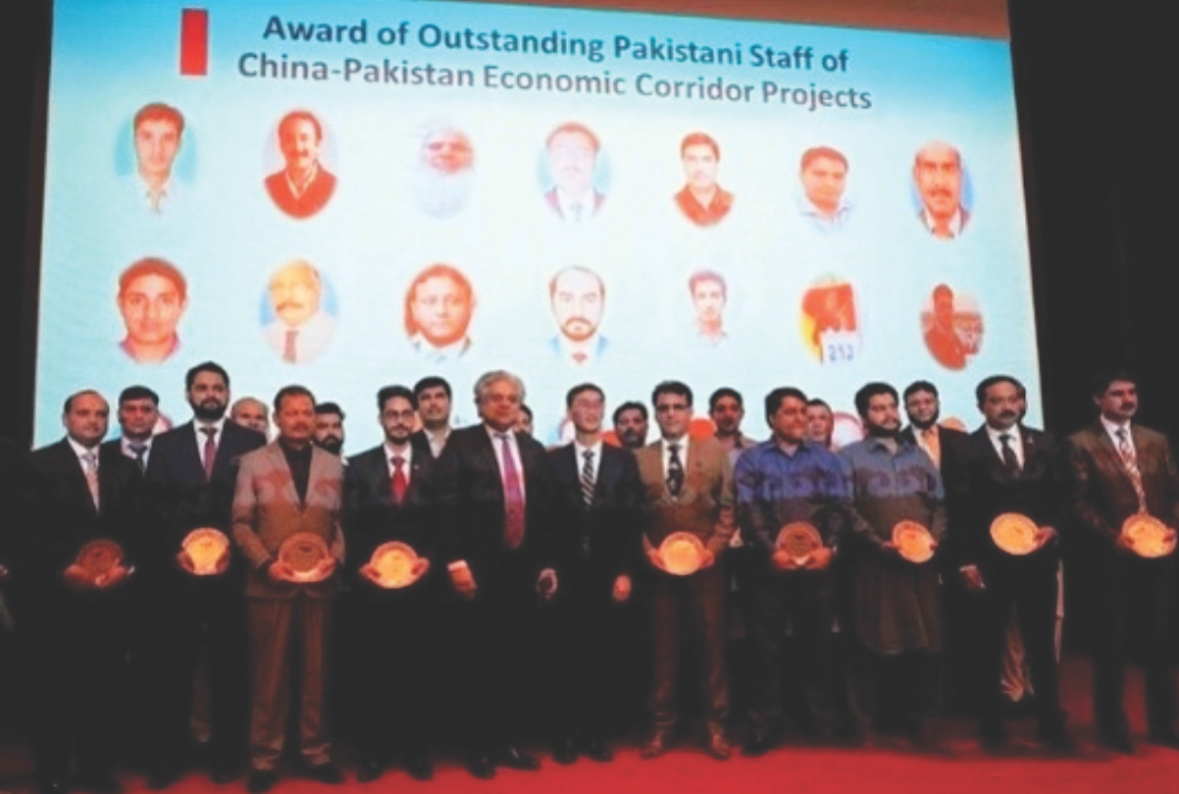
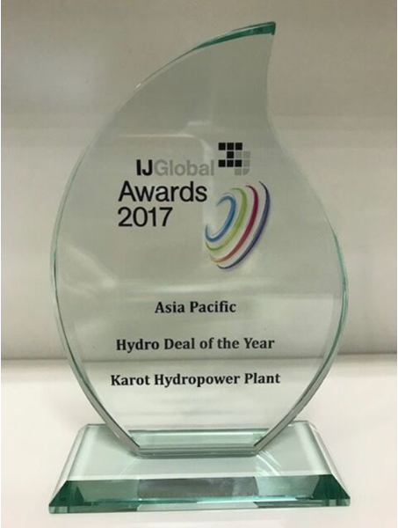
Corporate Awards
A Pakistani employees of KPCL was awarded the Pakistan excellent employee award of the China-Pakistan Economic Corridor (CPEC) project
720 MW Karot Hydropower Project won the Asia Pacific Hydro Deal of the Year (2017), awarded by IJ Global, the global energy infrastructure authority
卡洛特电力有限责任公司
Karot Power Company (Pvt.) Ltd.
Dam left abutment excavation Dam right abutment excavation

Slide 39
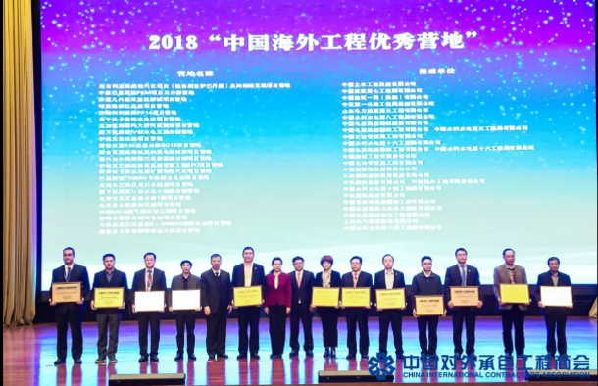
Corporate Awards
Karot project camp won the 2018 China overseas project excellent camp award
卡洛特电力有限责任公司
Karot Power Company (Pvt.) Ltd.
Dam left abutment excavation Dam right abutment excavation

Slide 40
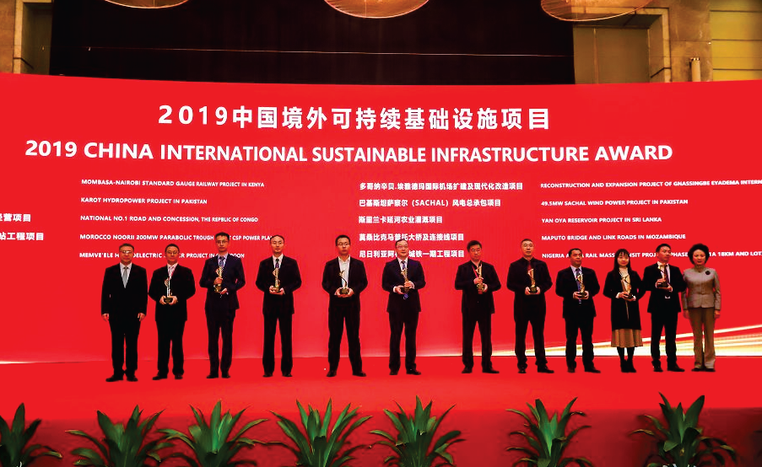

Corporate Awards
Karot Hydropower Project won the "2019 China International Sustainable Infrastructure Project Award", awarded by China International Contractors Association in December 2019 in Changsha, China
卡洛特电力有限责任公司
Karot Power Company (Pvt.) Ltd.
Dam left abutment excavation Dam right abutment excavation

Slide 41
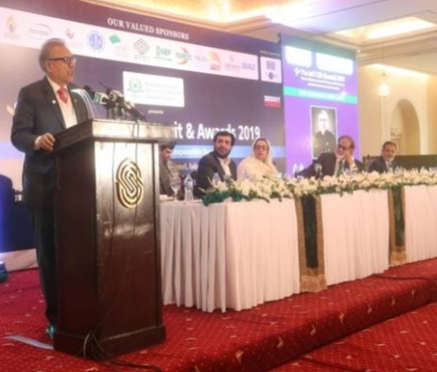
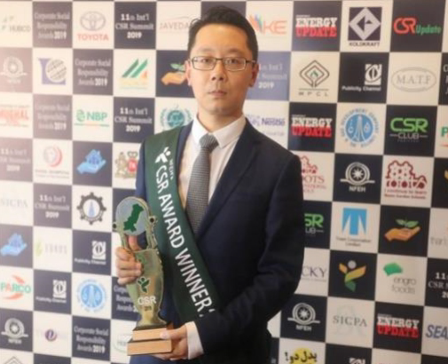
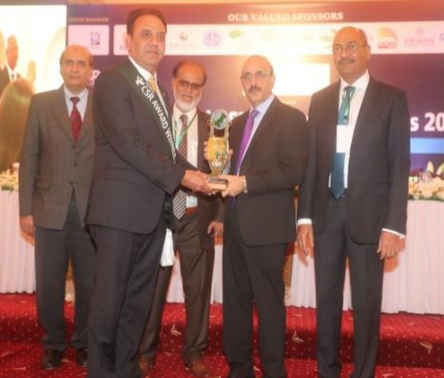
Corporate Awards
CSR Awards Achievement during 2019 for Education and Health
卡洛特电力有限责任公司
Karot Power Company (Pvt.) Ltd.
Dam left abutment excavation Dam right abutment excavation

Slide 42


Corporate Awards
NEPRA CSR STALWART AWARD IN YEAR 2022
卡洛特电力有限责任公司
Karot Power Company (Pvt.) Ltd.
Dam left abutment excavation Dam right abutment excavation

Slide 43


Corporate Awards
NFEH CSR Award Year 2022
卡洛特电力有限责任公司
Karot Power Company (Pvt.) Ltd.
Dam left abutment excavation Dam right abutment excavation

Slide 44
Karot Project Key Successes and Challenges
Notes:
南亚公司在巴基斯坦共有员工170人，其中巴方员工占比61%，属地化程度高。
其中三峡国际派驻员工27人，借调员工人14人，国内第三方劳务派遣25人。
巴方管理类员工大多数具有多年水电开发管理经验，入职后能有效推进工作开展。
中方大多数员工都很年轻，在巴基斯坦历经不同岗位的锻炼，成长迅速，很多都能独当一面。

Slide 45
720 MW Karot HPP – Key Successes
  The project was completed in Jun 29, 2022 one year ahead of time line envisaged in IGCEP 2021-30
  The Project completed with some cost saving
  Approvals from relevant Government Departments / Entities
  Acquired total 24,261 Kanals of land in Punjab and AJK without much hassle.
  Sought timely approvals from GOP / GOAJK for IA, PPA and WUA, ESIA Study NOC
  Mechanism for tax sharing between Federal, Punjab and AJK Governments developed with consensus of all.
  Resolved 16 % sales tax on Construction Contractor levied by Government of Punjab and GOAJK amicably.
  KPCL obtained the consent for the design of seven bridges from Governments of Punjab and AJK and the relevant roads and Bridges have been transferred to AJK/Punjab Highway Departments

Slide 46
Conclusion
  The success of the Karot Project is the first step toward development of other mega Hydro Power Projects in Private Sector in Pakistan and has inculcated interest of the investors and lenders in development and implementation of Hydro Power Projects.

Slide 47

Thank you!
Contacts:
N A Zuberi
0300-5317303
zuberippib@gmail.com

