Slide 1
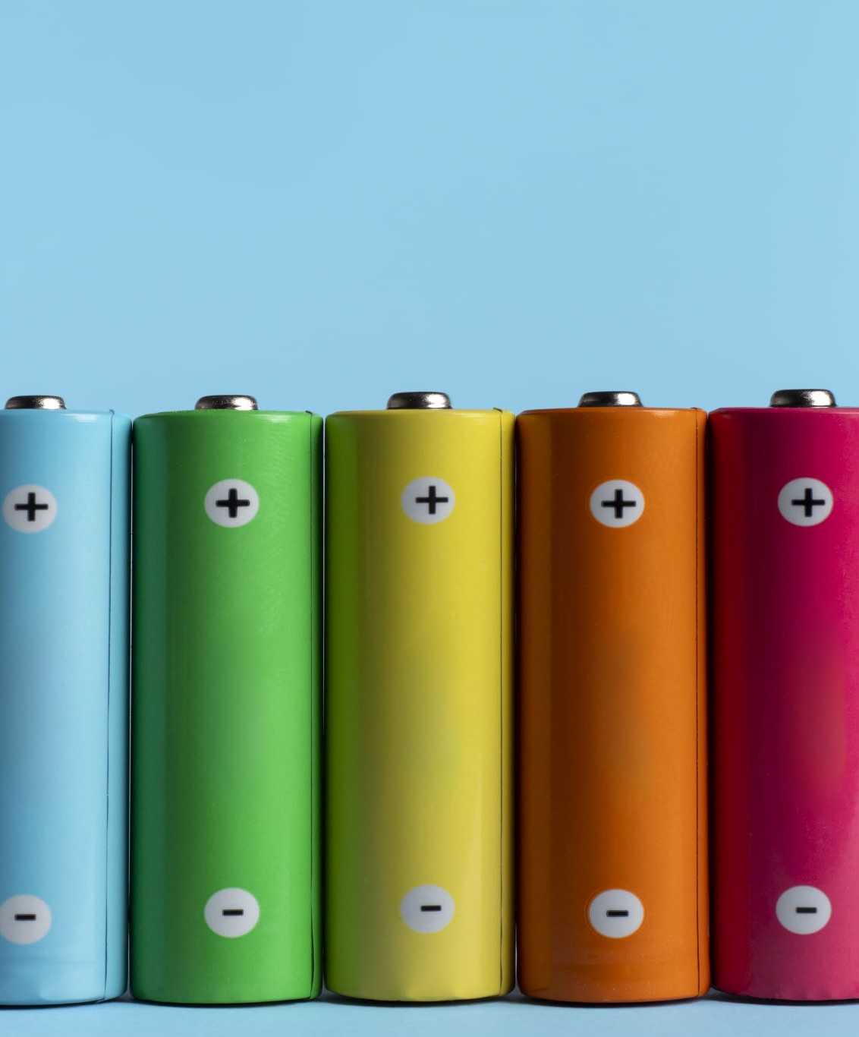
Battery Energy Storage System (BESS) – A solution for higher electricity cost
Dr. Muhammad Mohsin Aman

Slide 2
What is BESS?
Battery storage is a technology that enables power system operators and utilities to store energy for later use.
Several battery chemistries are available or under investigation for grid-scale applications, including lithium-ion, lead-acid, redox flow, and molten salt (including sodium-based chemistries). However, Lithium-ion batteries are most commonly used for large-scale utility applications.

Slide 3
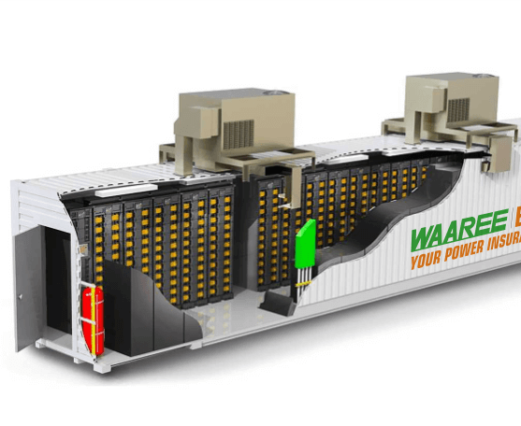
BESS- Standardized container sizes
Utilize standardized ISO container sizes for the BESS enclosure to simplify transportation, logistics, and installation.
Common sizes include 20-foot, 40-foot, and 45-foot containers, which are widely available and easily transportable by trucks, trains, or ships.

Slide 4
Why Li-Ion batteries?
High Energy Density: Li-ion batteries can store a large amount of energy in a compact size, maximizing energy storage capacity in limited spaces.
Scalability: Li-ion battery systems can be easily scaled up to meet the power and energy requirements of grid-scale applications. They offer flexibility in expansion or replication through modular designs.
High Efficiency: Li-ion batteries have high charge and discharge efficiency, above 90%, minimizing energy losses and improving overall system efficiency.
Long Cycle Life: Li-ion batteries can undergo thousands of charge-discharge cycles while maintaining performance, making them suitable for long-term grid-scale applications.
Fast Response Time: Li-ion batteries have quick response times, enabling rapid power delivery for grid services like frequency regulation, voltage support, and grid stabilization.
Established Technology and Cost Reduction: Li-ion battery technology has seen significant advancements and cost reductions due to widespread use in consumer electronics and electric vehicles, making it more affordable and accessible for grid-scale applications.

Slide 5
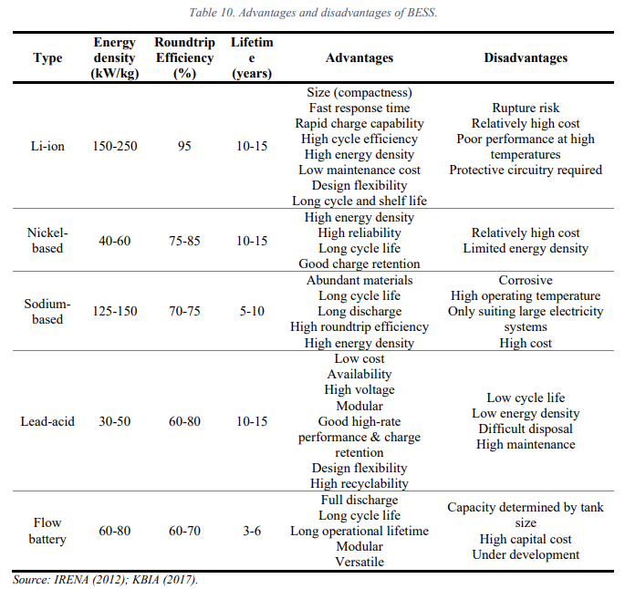
Why Li-Ion batteries?

Slide 6
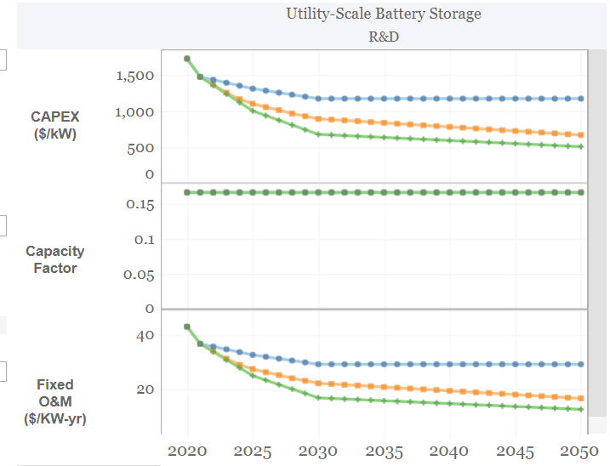
Utility Scale BESS
Three scenarios, namely the Conservative, Moderate, and Advanced Technology Innovation Scenarios, are defined.
The Conservative Scenario (blue one) represents the maximum cost projections in 2020, 2025, and 2030, with a 25% assumed cost reduction from 2030 to 2050.
The Moderate Scenario represents the median cost projections in the same years, with the same 25% assumed cost reduction.
The Advanced Scenario (green one) represents the lowest cost projections, with a 39% assumed cost reduction from 2030 to 2050. These scenarios provide different perspectives on technology innovation and cost reductions in the given context.

Slide 7
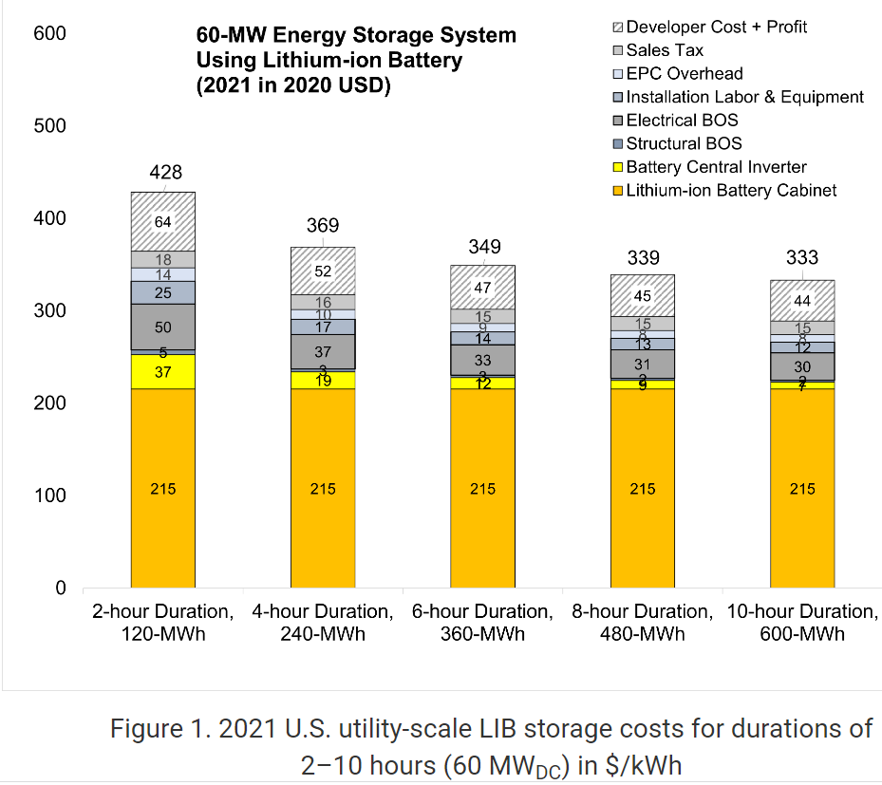
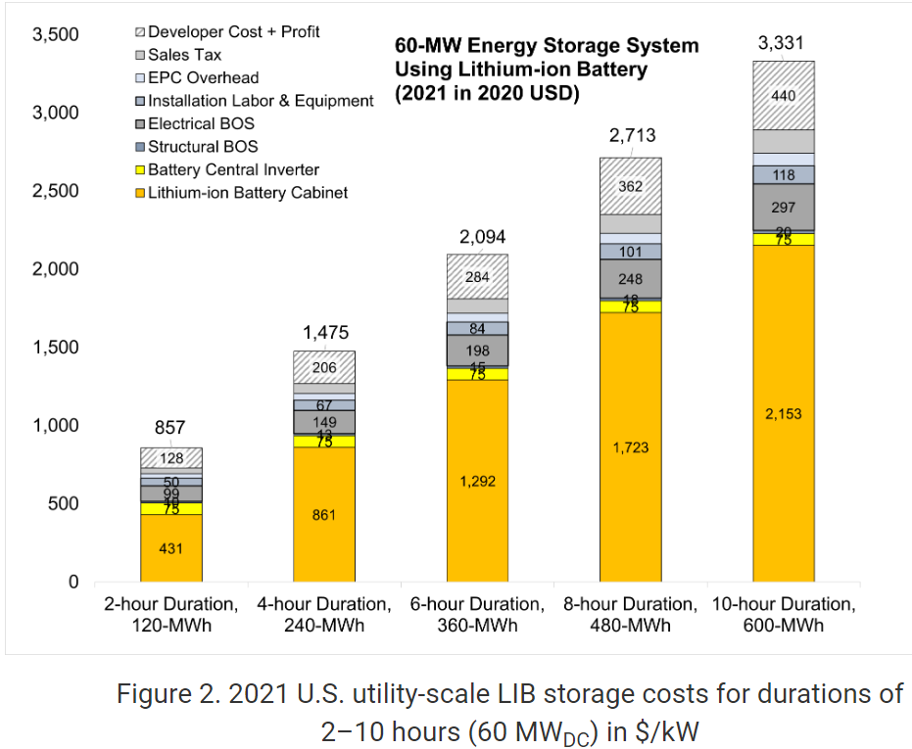
Utility Scale BESS
Using the detailed NREL cost models for LIB, the base year costs for a 60-MW BESS with storage durations of 2, 4, 6, 8, and 10 hours are shown in terms of energy capacity ($/kWh) and power capacity ($/kW) in Figure 1 and Figure 2 respectively.
Base year installed capital costs for BESS in terms of $/kWh decrease with duration, and costs in $/kW increase.

Slide 8
Utility Scale BESS
The installed capital costs of Battery Energy Storage Systems (BESS) decrease in terms of $/kWh as the duration increases. This means that for longer-duration BESS installations, the cost per unit of energy storage capacity decreases.
On the other hand, the costs of BESS increase in terms of $/kW, indicating that as the power rating or capacity of the BESS system increases, the cost per unit of power capacity increases.
These trends reflect the relationship between the duration and power capacity of BESS installations and their associated costs, providing insights into the cost dynamics of BESS technologies.

Slide 9
BESS- Advantages
BESS systems have several advantages, including:
Ancillary Services: Ancillary services are deployed by grid operators to maintain grid stability and reliability in response to real-time variances in power supply and demand. BESS can provide ancillary services to the grid, such as frequency regulation and voltage support, improving the overall stability and efficiency of the power system.
Peak Shaving: BESS can be used to reduce electricity demand during peak periods by discharging stored energy, thus avoiding the need for expensive additional generation capacity.

Slide 10
BESS- Advantages (Pros)
Load Balancing: BESS can balance the intermittent nature of renewable energy sources by storing excess energy during times of high generation and releasing it during periods of low generation.
Backup Power: BESS can provide backup power during grid outages or emergencies, ensuring a reliable electricity supply for critical loads.
BESS technology continues to evolve, with advancements in battery chemistry, system efficiency, and cost reduction. As a result, BESS is increasingly being deployed in various applications, including utility-scale energy storage projects, commercial and industrial facilities, and residential energy storage systems.

Slide 11
What are the key characteristics of battery storage systems?
Rated power capacity is the total possible instantaneous discharge capability (in kilowatts [kW] or megawatts [MW]) of the BESS, or the maximum rate of discharge that the BESS can achieve, starting from a fully charged state.
Energy capacity is the maximum amount of stored energy (in kilowatt-hours [kWh] or megawatt-hours [MWh])
Storage duration is the amount of time storage can discharge at its power capacity before depleting its energy capacity. For example, a battery with 1 MW of power capacity and 4 MWh of usable energy capacity will have a storage duration of four hours.

Slide 12
What are the key characteristics of battery storage systems?
Cycle life/lifetime is the amount of time or cycles a battery storage system can provide regular charging and discharging before failure or significant degradation.
Self-discharge occurs when the stored charge (or energy) of the battery is reduced through internal chemical reactions, or without being discharged to perform work for the grid or a customer. Self-discharge, expressed as a percentage of charge lost over a certain period, reduces the amount of energy available for discharge and is an important parameter to consider in batteries intended for longer-duration applications.
State of charge, expressed as a percentage, represents the battery’s present level of charge and ranges from completely discharged to fully charged. The state of charge influences a battery’s ability to provide energy or ancillary services to the grid at any given time.

Slide 13
What are the key characteristics of battery storage systems?
Round-trip efficiency, measured as a percentage, is a ratio of the energy charged to the battery to the energy discharged from the battery. It can represent the total DC-DC or AC-AC efficiency of the battery system, including losses from self-discharge and other electrical losses. Although battery manufacturers often refer to the DC-DC efficiency, AC-AC efficiency is typically more important to utilities, as they only see the battery’s charging and discharging from the point of interconnection to the power system, which uses AC (Denholm 2019).

Slide 14

BESS in the World

Slide 15
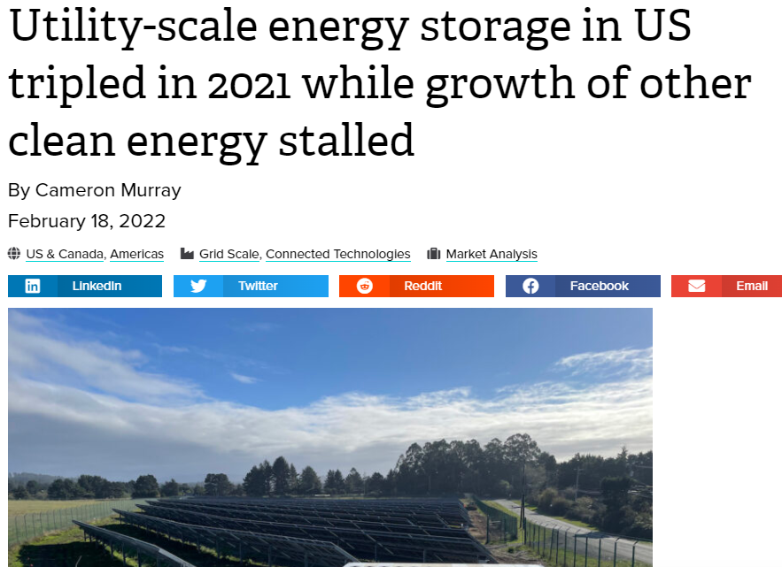
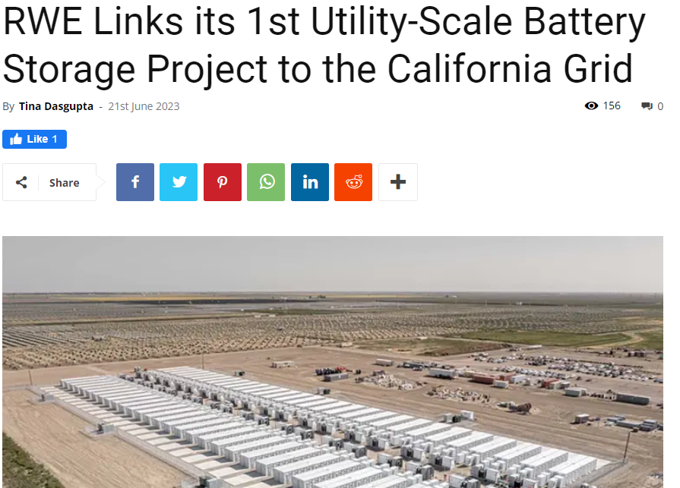
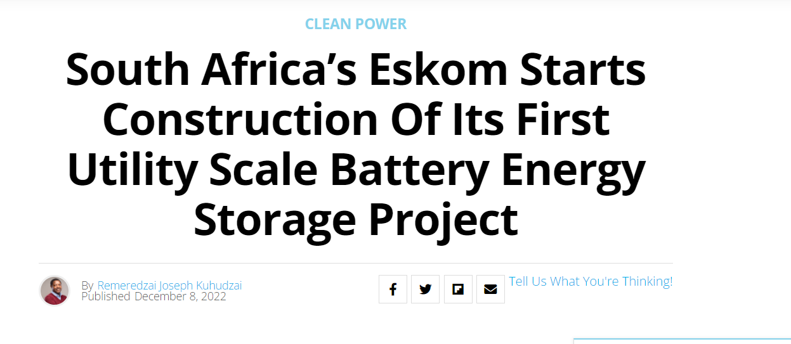

Slide 16
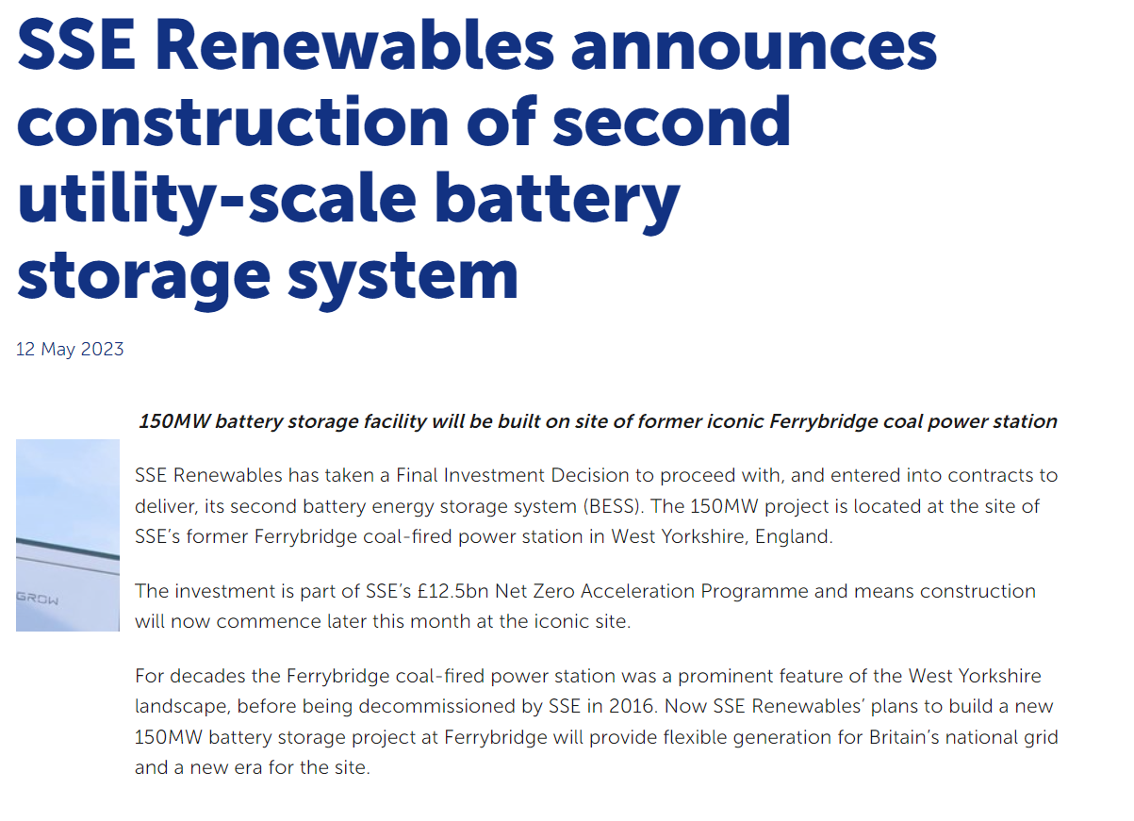
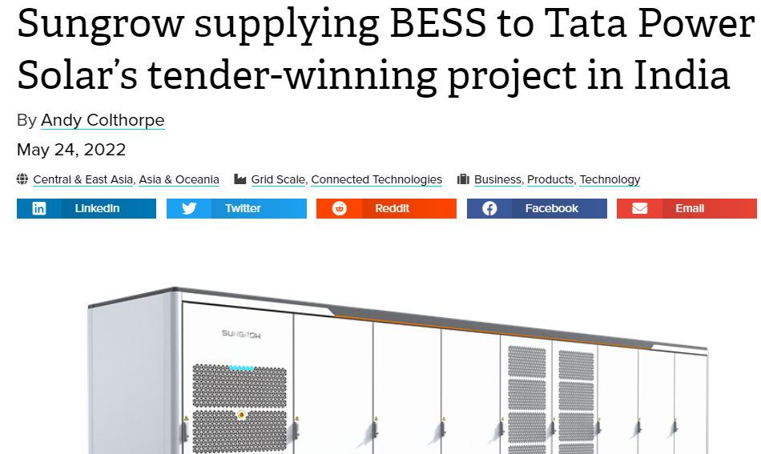

Slide 18
Ferrybridge 150MW Project Scottish)

Slide 19

BESS in the World
Countries like Japan, Chile and Mexico have begun requiring new RE plants to be co-located with Energy Storage Solutions. And in days to come, developers may be required to provide more precise generation forecasts and network operators may ask to export energy at a given time of day citing grid stability.
To make a deferral in Transmission and Distribution (T&D) capacities, BESS should be added in the substations.
Countries like South Africa have proposed huge BESS addition for T&D deferral.

Slide 20
BESS in Pakistan
Reon has installed one project for an industry.
We need to think, about the utility scale project.

Slide 21

Question Answers
Thank you for your attention

