Slide 1
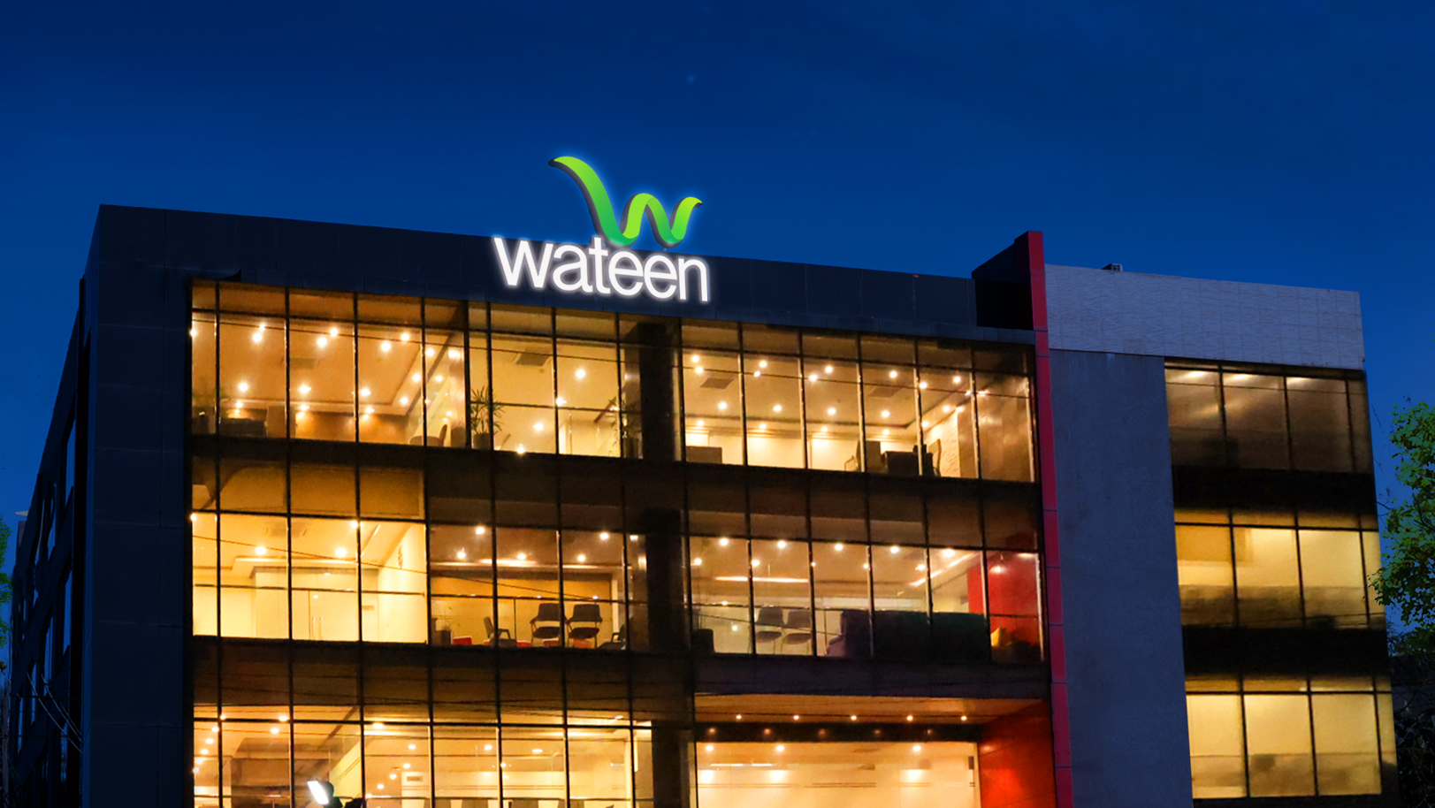

Slide 2
GLOBAL TRENDS & DEVELOPMENT
LEARNING TO REAP BENEFITS FROM RENEWABLE ENERGY
SOHAIB ASIF SIPRA
VP – ENERGY SOLUTIONS
July 18, 2023

Slide 3
Journey
Cold Chain Development
Bulk Vending
Model dairy farms
Domestic Biogas Plants
Technology Transfer – China & Europe
Capacity Building – Solar & Bio (UKAID, USAID, Winrock)
Agri Solutions – Pumping & Bio-Energy
GoP, GoPb, GoKP & Private Sector – 30MW +
Product Dev. & Launch
5000 + Domestic Solar Systems
Solar Specialists – 2,000 +
C&I Solar Installations – 50MW +
Next Generation – Energy Solutions
Energy Conservation – IoT Solutions
State of the Art – Enterprise, SME/SOHO, RESI Solutions
Asset Management – O&M
5MW + installed base & Counting …

Slide 4
WATEEN OVERVIEW

Slide 5
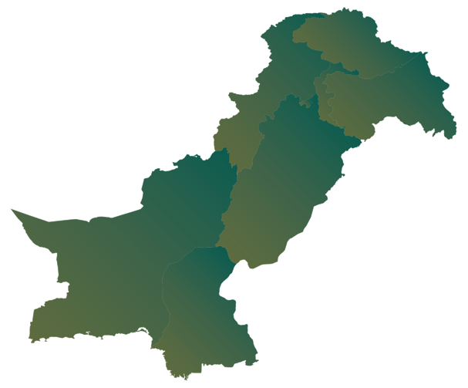
Wateen - Overview
3.5GHz
Spectrum, which is
earmarked for 5G rollout
9.6TB Backbone capacity for 5G transmission
40,000 KM+
240+ Cities
Presence along with exclusive footprint
in Balochistan
2,500+
Employees nationwide
for service delivery
Leading
Connectivity provider for
Enterprise & SME segments
Long haul & metro fiber
infrastructure
170+
Maintenance teams
nationwide for O&M
Largest
Fiber-to-the-tower and fiber infrastructure partner
200+
Points of presence across Pakistan
LDI
International voice
services player
with Wateen Malaysia
Karachi | Sialkot
Lahore | DG Khan
Quetta | Jhang
Multan | Hyderabad
Faisalabad | Mandi Bahauddin
Gujranwala | Mardan
Gujrat | Abbottabad
Bahawalpur | Takhtbhai
Sargodha
24x7
NOC operations to
deliver great
customer experience
Wateen is the
only carrier neutral national fiber infrastructure service provider in Pakistan.

Slide 6
More than 15 Years of Success
The Journey
Connected 100+ universities
Connecting
every district
Branchless banking in your hands
50%+ banking
networks
Connecting remote
areas of the country
Enabling e-commerce business
Thar Wi-Fi village
Connected 240+ cities of Pakistan
On-line registration on land
99.5% availability 40,000+ KM 200 points of presence
Wateen Network

Slide 7
85+ Resources
145+ Certifications
Technology Partners
9
4
22
11
3
5
3
4
3
3
Highest numbers of certified resources in Pakistan
The Energy Team also owns experience of more than 250MW projects

Slide 8
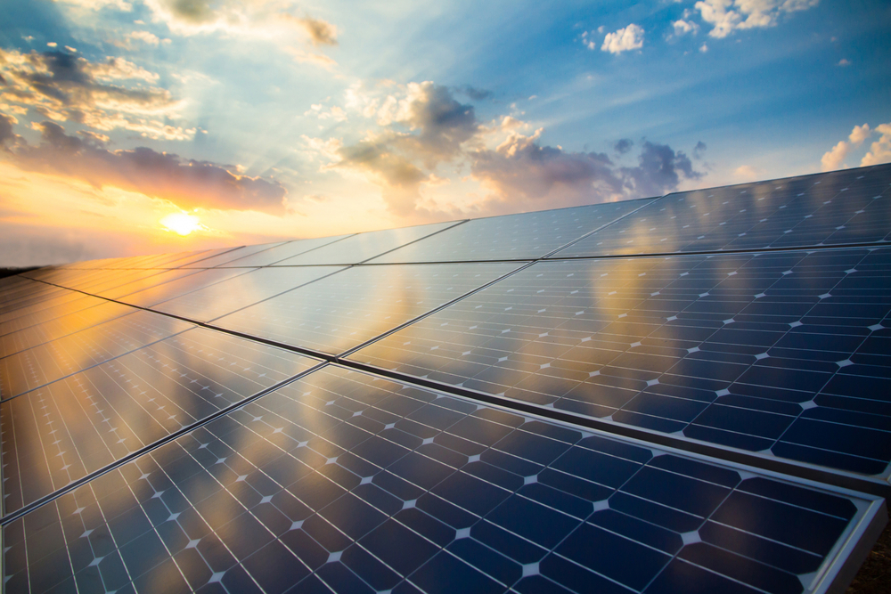
Wateen Energy
Energy is consumed in every segment of society and industry, however in different forms.
Wateen Energy division was launched last year.
Wateen Energy caters to the custom requirements of each client by offering a wide spectrum of products and services.
Wateen has secured more than 8Mws of projects within the time frame of 1 year and is moving ahead with its contribution at the national level and globally.
Residential Hybrid & Grid Tied Systems
Industrial Hybrid & Grid Tied Systems
BIPV Systems
Floating Solar Systems
BTS Solar Solutions
EV Charging
Stations

Slide 9
Wateen Energy Solutions – Offering
Industrial
Scale ESS
Industrial &
Enterprise Solutions
BTS Solarization
Banking Sector
BIPV
Floating PV
EV Charing
Station
Wateen has strong presence in the Carrier & Corporate segment. We offer complete
end-to-end solutions along with fiber infrastructure, tower fiberization and connectivity solutions.
With extensive reach, Wateen can efficiently provide solar-based green & efficient solutions to its wide range of customers.

Slide 10
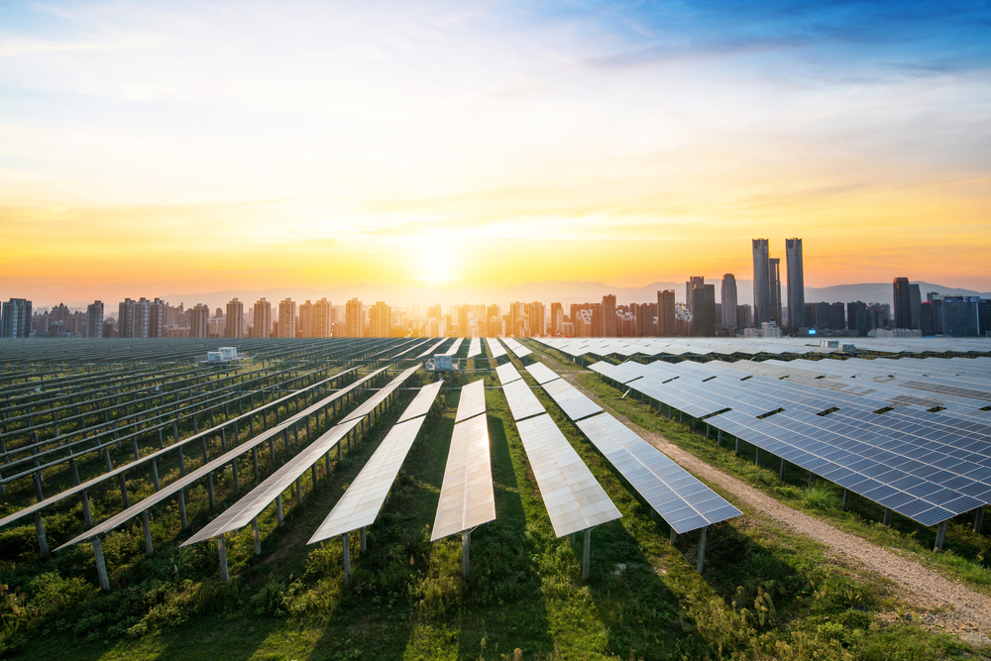
Our Partners for Solar Energy Solutions
Solar Panels Partners:
Solar Inverter Partners:
Other Partners:
The following renowned Solar panel manufacturers will be partners for Wateen in its projects.
Following renowned Solar inverter manufacturers will be partners for Wateen in its projects.
Wateen also has partners for civil & structural work and design, power cables, ware housing, etc. as we are already handling a large scope in OFC domain Nationwide. Following are some of the partners for these additional categories;

Slide 11
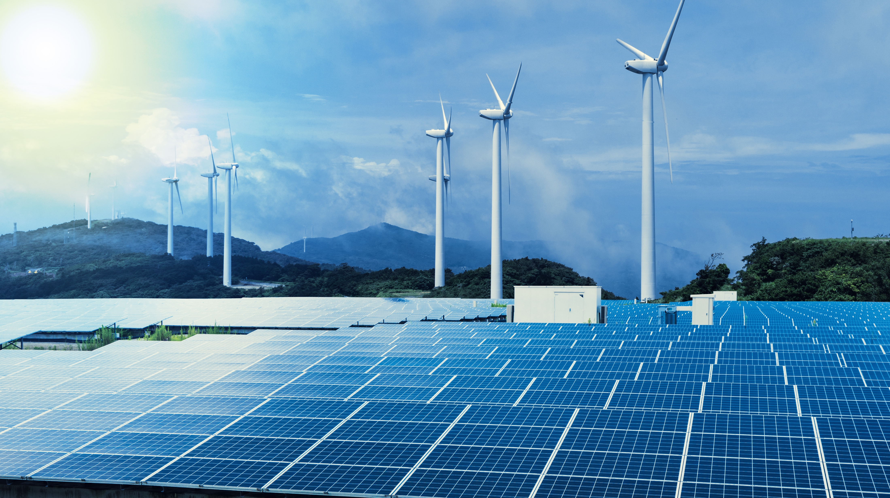
Renewables
Sustainable & Brighter Future
Hydropower
Wind Energy
Solar Energy
Biomass / BioEnergy
Geothermal Energy
Ocean Energy
Hydrogen

Slide 12
WORLD & RENEWABLES

Slide 13
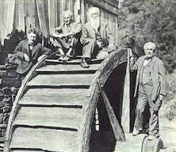
Renewable Energy – History
Waterwheels – 200 BC

Slide 14
Solar Cells to generate Energy – 1876
London 1876, William Grylls Adams, Professor of Natural Philosophy at King’s College, has demonstrated to a board of fellow professors how you can use selenium cells to harness rays from the sun and generate electricity.
Solar Goes to Space – 1958
the first US satellite use solar energy as its power source. The Vanguard 1 launched on St. Patrick’s Day, and it left behind a legacy that’s remembered on par with the American moon-landing that came 11 years later.
Windmills – 1590s
Staying in Europe – the Netherlands, when the popularity of windmills was at its peak. You know the type: those towering edifices that speak for a large part of Dutch industry and culture
Windmills Round II – 1887
In 1888, Charles F. Brush invented the first windmill used to generate electricity on a farm in Cleveland, Ohio. By 1908, there were 72 wind turbines generating electricity in Denmark. And by the time the 1930s rolled around, they were widespread across the US.
Waterwheels – 200 BC
It all started with ‘waterwheels’, which mimic the workings behind hydropower.
Started in Europe. Of course, this was a brute form, but it created the premise for today’s technological feats.
World’s 1st Solar Energy System – 1860
France, where in 1860 the world’s first solar energy system was invented by French investor Augustin Mouchot.

Slide 15
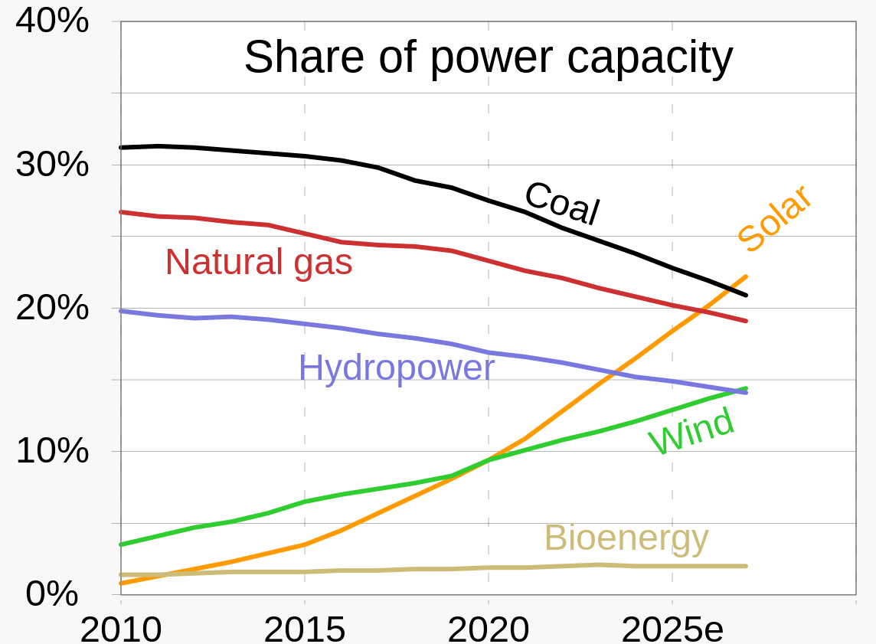

Slide 16
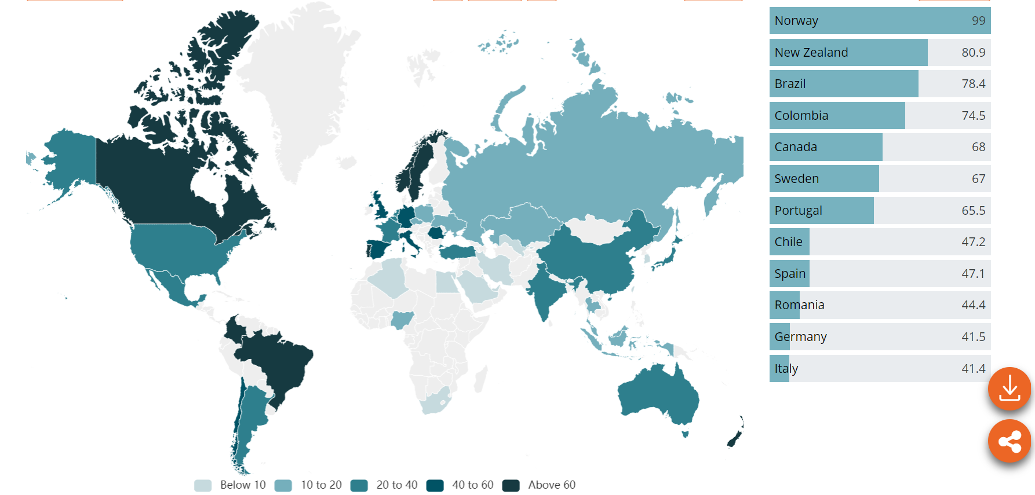
Percentage of RE Adopted by Countries
Pakistan

Slide 17
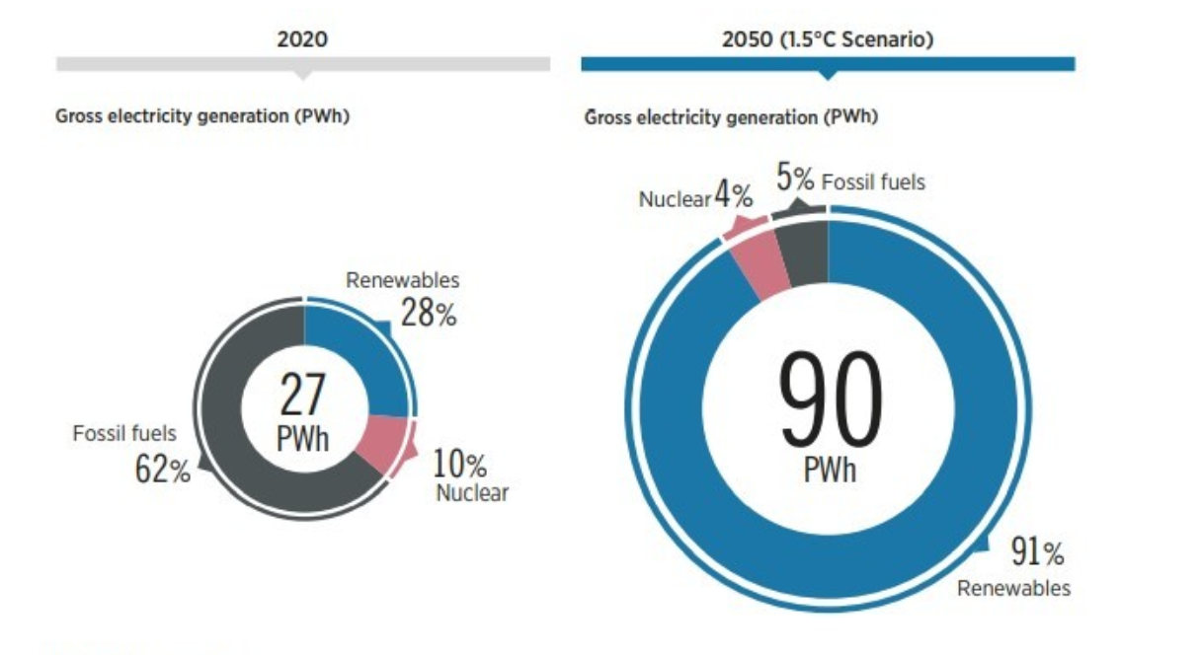
Renewables Energy – Growth Trajectory
Paris Agreement’s Goal
"to avoid dangerous climate change by limiting global warming to well below 2°C and pursuing efforts to limit it to 1.5°C."

Slide 18
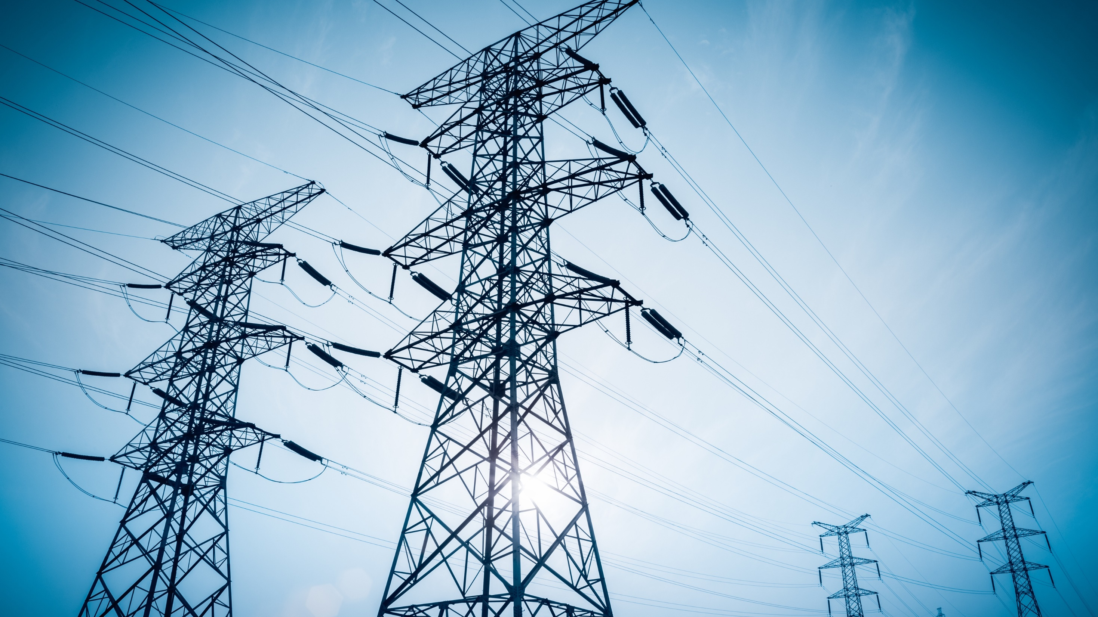
PAKISTAN & RENEWABLES

Slide 19
Renewables
Sustainable & Brighter Future
1
Biogas Projects:
70-80’s Era
Actual Progress after 2005
2
Solar:
Journey started around 2010
Few Projects 2011 – 2016
Boom 2017 onwards
3
Wind:
Journey started in 2013
Till now 36 projects with commercial operations – 1845.475MW

Slide 20
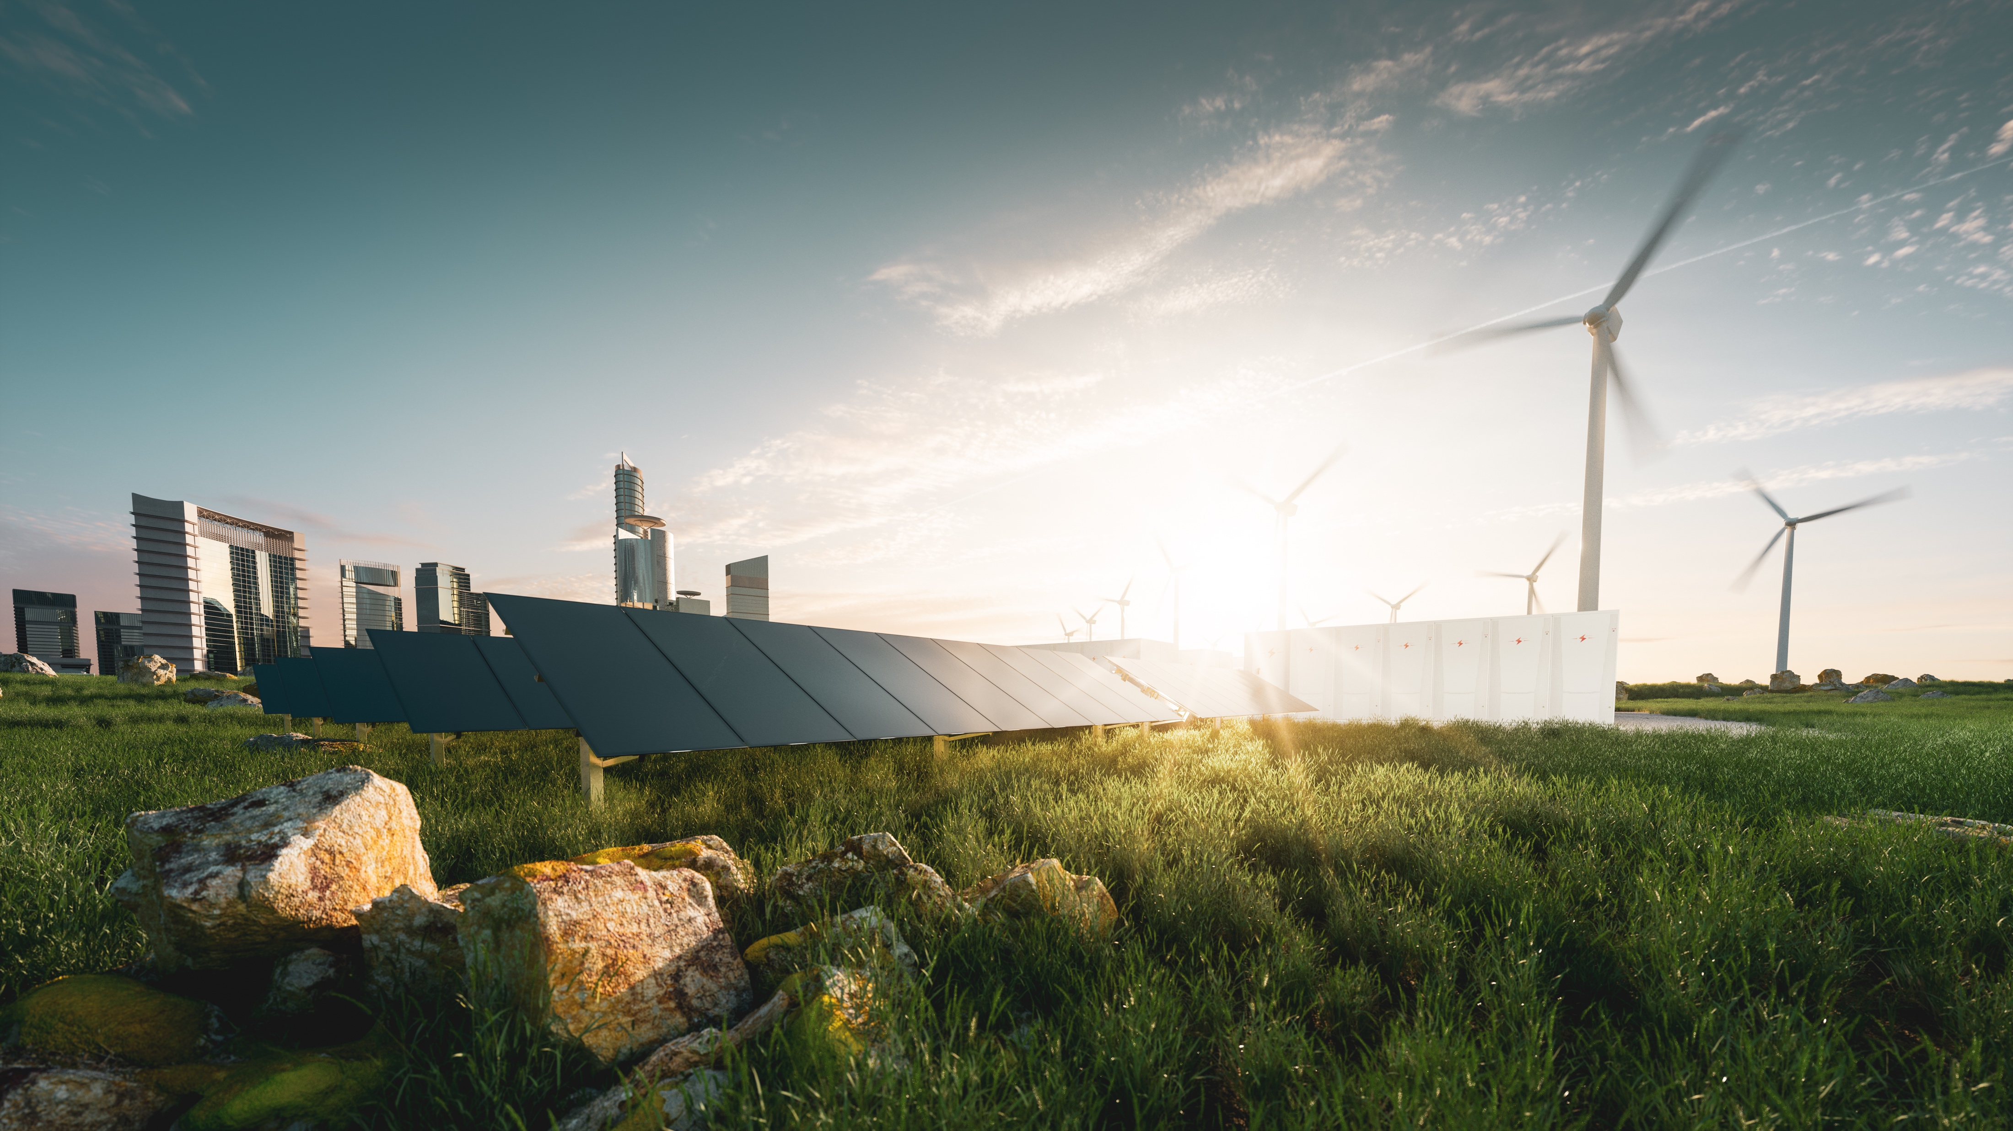
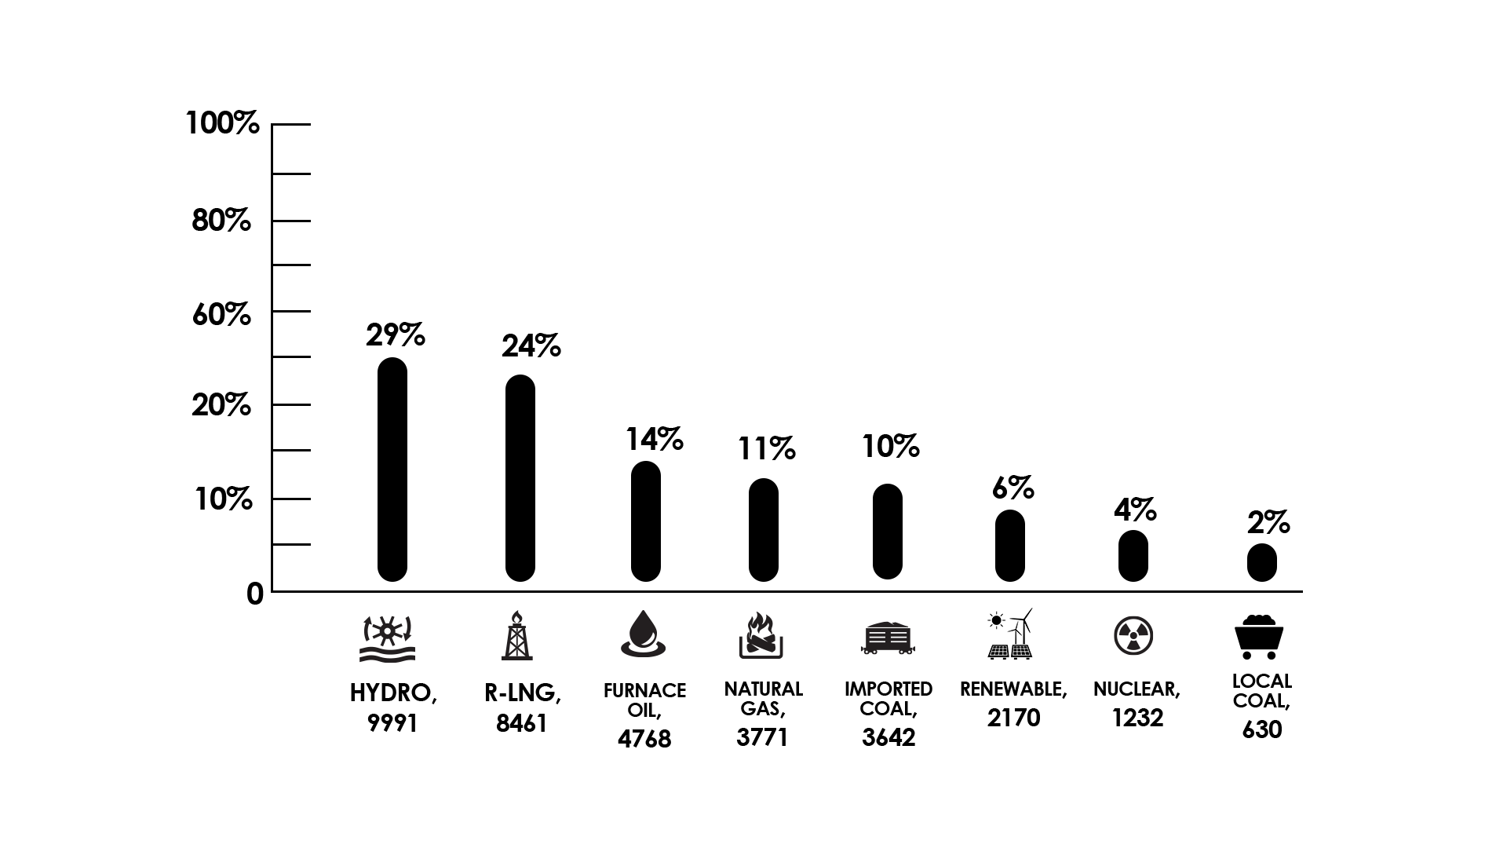
Pakistan Energy Mix & Grid Power Challenges
Inadequate Capacity
High Generation Cost
Reliance on Fossil Fuels
Increased Import Bill & Circular Debt
Pollutant Emissions
70 Years Old Grid (Old and Inefficient Distribution)
System & Process Bottlenecks
Electricity Theft

Slide 21
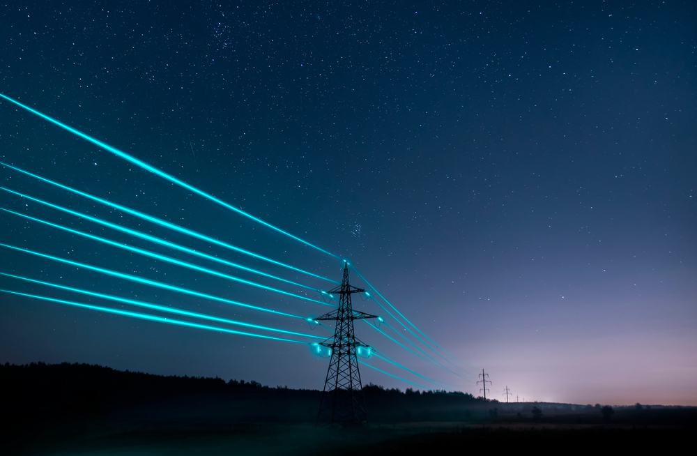
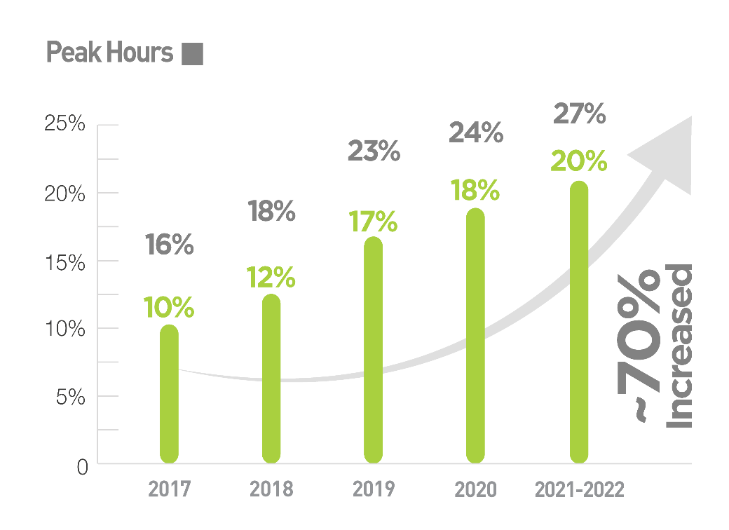
Electricity Price Trend in Pakistan
Electricity prices have increased incredibly in Pakistan in the last 05 years (By almost 70%) and will keep on increasing due to dependency on an inefficient energy mix.
For Telecom Sector, electricity prices are a major source of concern, in terms of OPEX which is affecting their profitability badly.

Slide 22
Electricity Units' Consumption – 2021/22

Slide 23
Solar Industry Challenges
Energy Security – in both terms i.e., availability and mix
Mushroom Growth
Unskilled Staff
Lack of Associations and Public/Private Partnerships
Regulations – Not User Friendly
Limited access to Investments
Technical Barriers – Lack of Local Industry Development
Lack of Standardisation

Slide 24
THE BEST OF SOLAR ENERGY GROWTH IS YET TO COME

Slide 25
Interesting Facts – Solar
1) 174,000 terawatts of energy consistently strikes the earth as solar radiation at any moment, even on the cloudiest of days. 2) One hour of sunlight is equivalent to one year’s worth of energy for the planet. 3) Solar is the most abundant form of energy available and the cheapest one too. 4) Solar is the fastest energy source to deploy. 5) Solar Electricity has been around since 1839 and today’s Solar Panel Efficiency is higher than ever. 6) Solar Power is the fastest-growing energy source.
Pakistan
Documented 2 – 3 GW
Assumption 10 GW

Slide 26
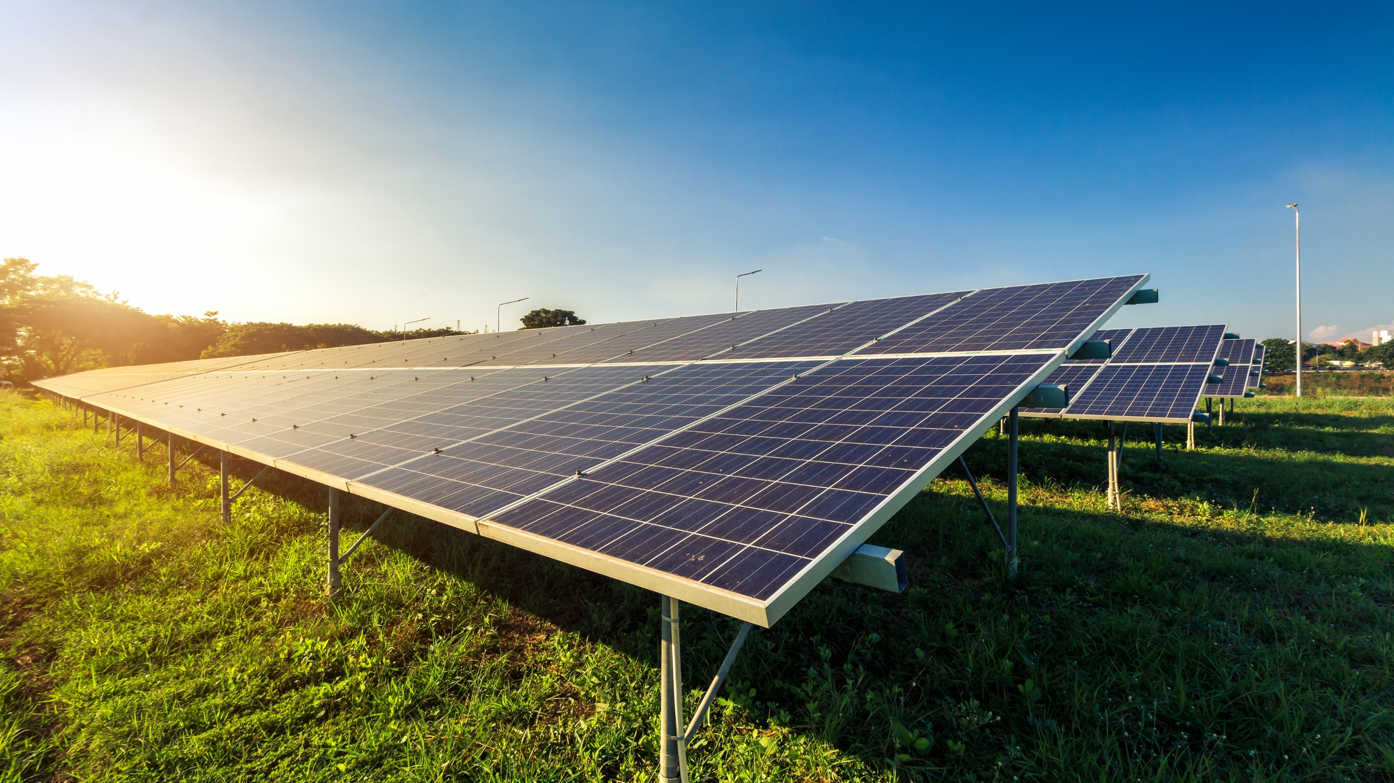
Solar Energy Potential in Pakistan
100 GW +

Slide 27
How to Move Forward
Policy reforms: We firmly believe that the government of Pakistan holds a pivotal role in fostering favorable policies such as net metering (for 1MW and above), feed-in-tariffs, and tax incentives. Such measures would stimulate investments in the solar industry and promote its overall growth.
Awareness campaigns: Stakeholders within the solar industry can take the lead in launching awareness campaigns to educate the public about the benefits of solar energy and guide them in making informed decisions about the right equipment and solutions. By increasing awareness, we can generate greater demand for solar energy and expand the market for the industry.
Capacity building programs: Both the government and private sector can focus on enhancing the capacity of local solar industry players through comprehensive technical and vocational training programs. This will elevate the quality of solar installations, boost productivity, and reduce overall costs.
Access to financing: Collaborative efforts between the government and private sector can foster the development of innovative financing approaches, providing affordable credit facilities to solar industry players. This will facilitate industry growth by ensuring adequate capital for projects. Additionally, the reactivation of the green financing scheme, which has been on hold since last year, is crucial and should be made easily accessible across all sectors.
Improved regulation and enforcement: The government should prioritize the enforcement of existing regulations governing the solar industry. This will ensure the delivery of high-quality installations and services, while protecting consumers from fraudulent practices. The presence of seasonal players in the market has a detrimental impact on the sector and should be addressed.

Slide 28
OUR CUSTOMERS

Slide 29
Key Customers

Slide 30
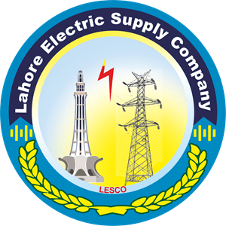
Key Customers

Slide 31
Thank You!
CONTACT US:
Main Walton Road, Opp. Bab-e-Pakistan,
Walton Cantt., Lahore, Pakistan.
www.wateen.com
Tel: +92 42 111 365 111
customercare@wateen.com

