Slide 1




DRIVING THE WORLD'S
SMART ENERGY FUTURE
GoodWe Company Introduction

Slide 2





VISION & MISSION
Vision
Driving the world's smart energy future.
Mission
We are determined to be the main driving force in the global energy transition, create a sustainable future for earth, for mankind, and for future generations.
4
78000
7800
M UNITS
GWh
M TON
Total installed
Annual Power Generated
Annual CO2 Saved
02
GOODWE TECHNOLOGIES CO., LTD.

Slide 3














MILESTONES
2010
2011
2012
2013
2014
2015
2016
Company
Establishment
Established R&D Center
GoodWe’s First PV Inverter
GW4000-SS PHOTON AA Award
Efficiency World Top 3
GW17K-DT PHOTON AA Award
Efficiency World Top 5
Launched Asia's First Energy Storage Inverter ES Series
Established GoodWe UK
Established Dutch Service Center
Officially Listed on the NEEQ
(Stock Code: 835209)
Established GoodWe Solar Academy
Established GoodWe Australia
TÜV Rheinland Quality Award
Launch of SEMS
Displayed in IKEA across EU
2017
2018
2019
2020
2021
2022
Established Shenzhen R&D Center
Established India Service Center
Established European
Headquarter in Germany
Established Mexico & Brazil
After-sales Service Centers
GoodWe New Headquarter
Established GoodWe Benelux
Listed on Shanghai Stock
Exchange(Stock Code: 688390)
Licensing Partner of GE
Established GoodWe USA & Japan
Provide One-stop Storage Solution
Set up Global Call Center
7 Years of TÜV Rheinland Quality Awards
Global Rebranding,
a brand new GoodWe
Ground-breaking ceremony of GoodWe Smart Energy R&D Center
03
GOODWE TECHNOLOGIES CO., LTD.

Slide 4
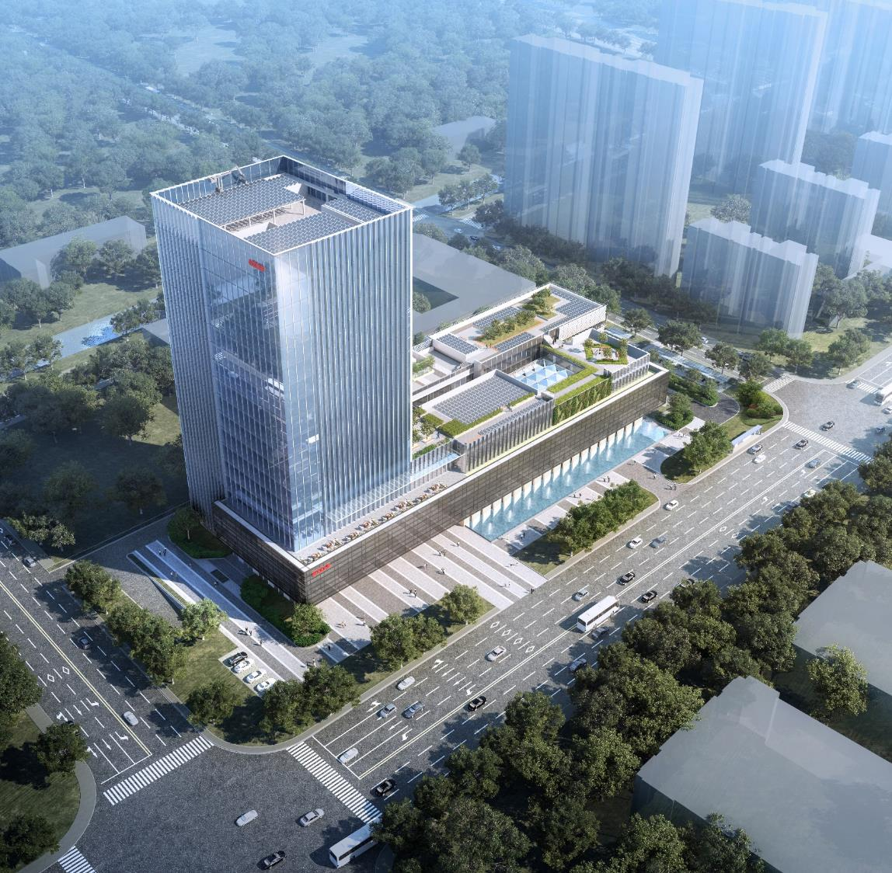




GOODWE FAMILY
4600
+
850
+
150
+
Total number of employees
R&D staff
Overseas employees
GLOBAL SALES REVENUE
Turnover (Millions USD)
780.00
420.5
244.44
161.57
128.83
145.44
65.34
2016
2017
2018
2019
2020
2021
2022
04
GOODWE TECHNOLOGIES CO., LTD.

Slide 5









GLOBAL PRESENCE
Branches
Poland
Netherlands
Hong Kong, Australia, Germany, Benelux, United Kingdom, Japan, United States, South Korea, Spain, Poland, Singapore
UK
Belgium
Turkey
Sales & Service Centers
France
Australia, United Kingdom, Netherlands, Germany, Mexico, Brazil, Poland, Spain, Italy, South Africa, Chile, Argentina, Portugal, Greece, India, Turkey, Japan,
United States, Vietnam, Thailand
Portugal
Spain
China
Korea
USA
Vietnam
Japan
R&D Centers
Germany
India
HK
Suzhou R&D center, Shenzhen R&D center,
Wuhan R&D center, Nanjing R&D center
Mexico
Greece
UAE
Italy
Thailand
Malaysia
Production Facilities
Brazil
Singapore
Suzhou Manufacturing base
Guangde Manufacturing base
Chile
South Africa
Australia
Argentina
05
GOODWE TECHNOLOGIES CO., LTD.

Slide 6

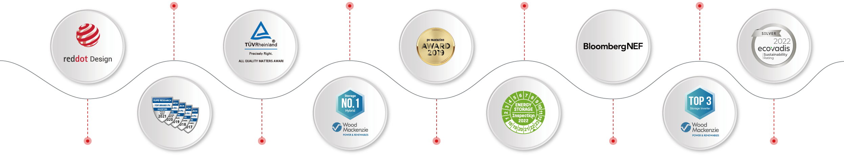
GOODWE AWARDS
2017-2021
2019
2021
2022
EuPD Top Brand for 5 Consecutive Years
(AU & NL & PL & ES & PK & RSA & BR & VN)
World’s No.1 Residential
Inverter Supplier
EH Series 5kW No.2
ET Series 10kW No.5
World's Top 3
Storage Inverter Supplier
2018
2015-2021
2019
2021
2022
Reddot Design
The Sole
Inverter Brand to Have Won the Award for
7 Consecutive Years
PV Magazine Award
The Most Financially
Stable Inverter Company
Silver Medal by
EcoVadis
06
GOODWE TECHNOLOGIES CO., LTD.

Slide 7
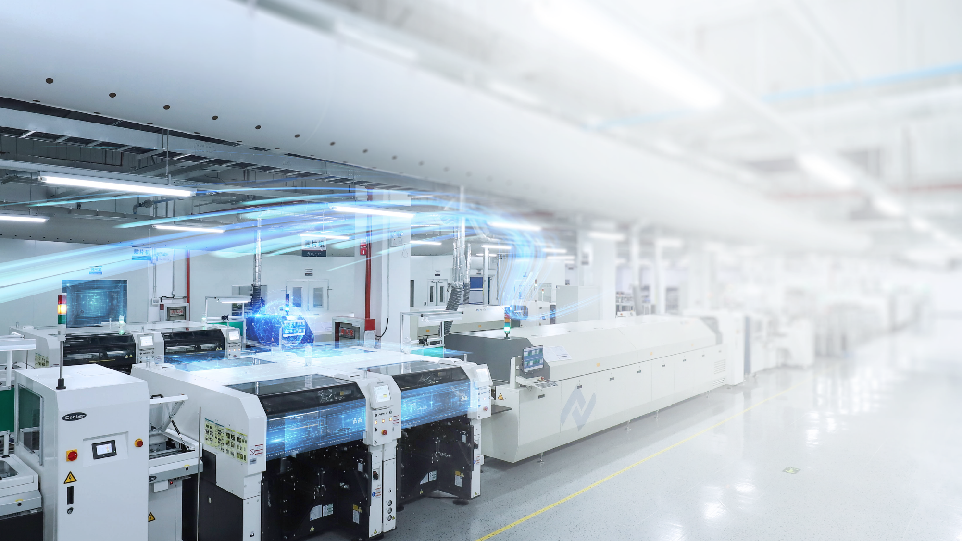


Production Capacity
GoodWe’s manufacturing integrates the latest and most sophisticated processes and the most advanced automation solutions to deliver unparalleled quality and maximum efficiency.
30
2.1
GW
GWh
Solar Inverters Capacity
Battery Capacity
07
GOODWE TECHNOLOGIES CO., LTD.

Slide 8
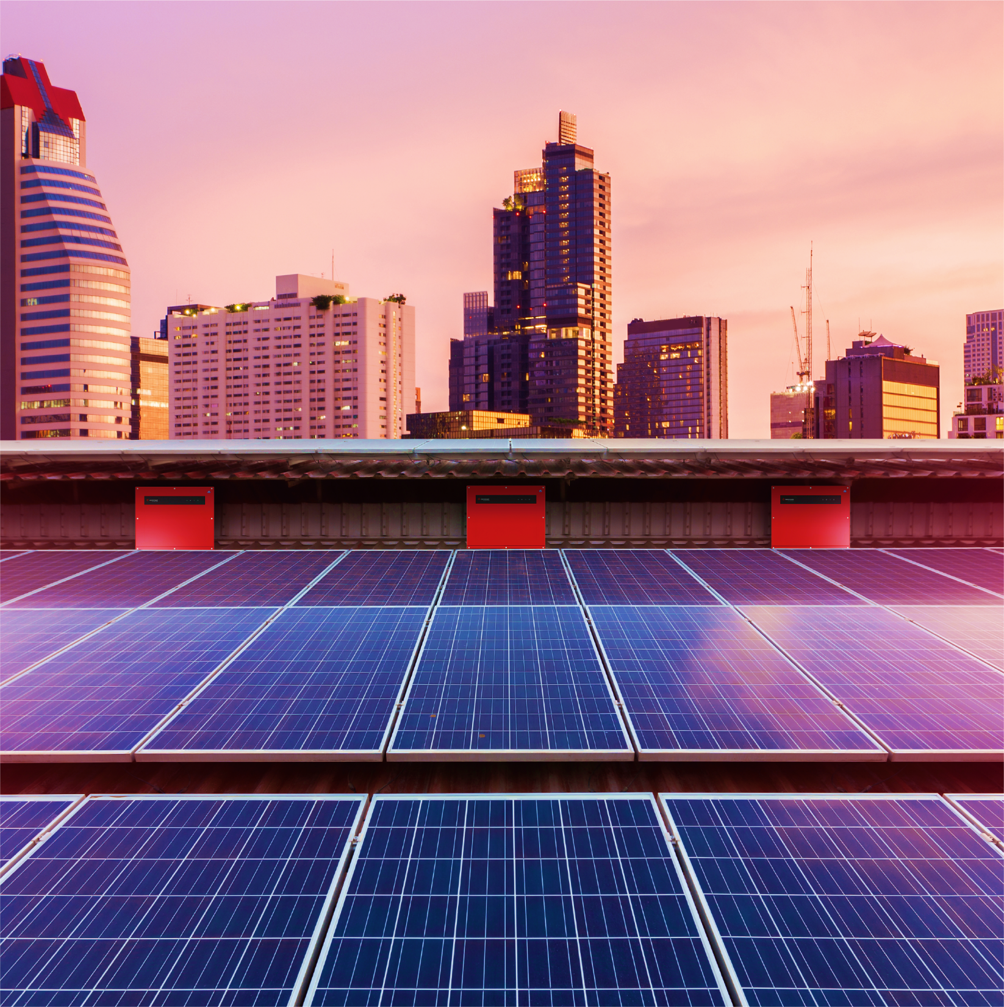





Global Installation
With an accumulative installation of 52 GW installed in more than 100 countries, GoodWe solar inverters have been largely used in residential and commercial rooftops, industrial and utility scale systems, ranging from 0.7kW to 250kW.
52
GW
Global Accumulative Capacity
2
GW
24
GW
Energy Storage
Residential
3
GW
23
GW
Utility
Commercial & Industrial
08
GOODWE TECHNOLOGIES CO., LTD.

Slide 9









MARKET SHARE
Czech
Poland
50%
15%
（Rooftop）
Korea
Netherlands
Germany
10%
30%
15%
20%
China
（C&I）
（Storage）
（Residential）
20%
Mexico
Spain
Italy
（Rooftop）
Turkey
Vietnam
20%
35%
12%
（Rooftop）
20%
7%
（ Storage ）
Brazil
Australia
India
15%
South Africa
30%
20%
10%
（Rooftop）
（Storage）
09
GOODWE TECHNOLOGIES CO., LTD.

Slide 10


OVERSEAS WAREHOUSES
Netherlands
Warehouse
(Rotterdam)
Turkey
Bonded warehouse
(Istanbul)
USA
Warehouse
(Fontana, CA)
Netherlands
Germany
Warehouse
(Alphen aan den Rijn)
Warehouse
(Bergheim)
Japan
Warehouse
(Kanagawa)
India
Brazil
Warehouse
(Panvel)
Warehouse
(Cariacica)
Australia
Warehouse
(Dandenong South)
Australia
Warehouse
(Braeside)
10
GOODWE TECHNOLOGIES CO., LTD.

Slide 11



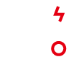





GOODWE PRODUCT PORTFOLIO
Residential
Inverters 0.7-20kW
Energy Storage
Inverters 3-100kW
Lithium
Batteries
Utility-scale
Inverters
225-250kW
Smart Energy
Management System
Commercial &
Industrial Inverters 25-120kW
Building
Integrated PV
11
GOODWE TECHNOLOGIES CO., LTD.

Slide 12





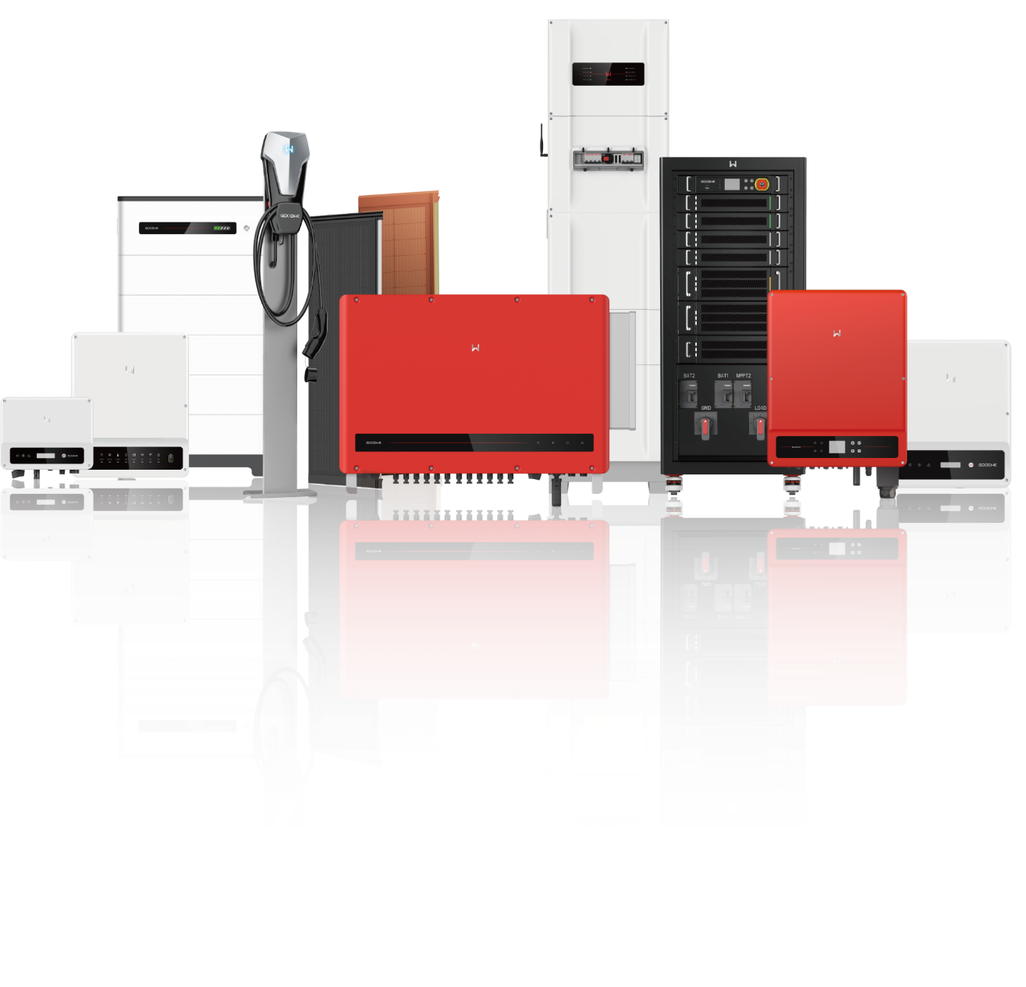
GOODWE SOLUTIONS
0.7-250kW
12
GOODWE TECHNOLOGIES CO., LTD.

Slide 13
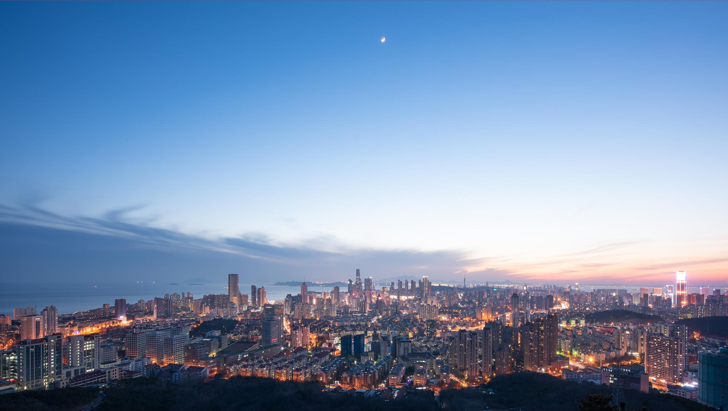
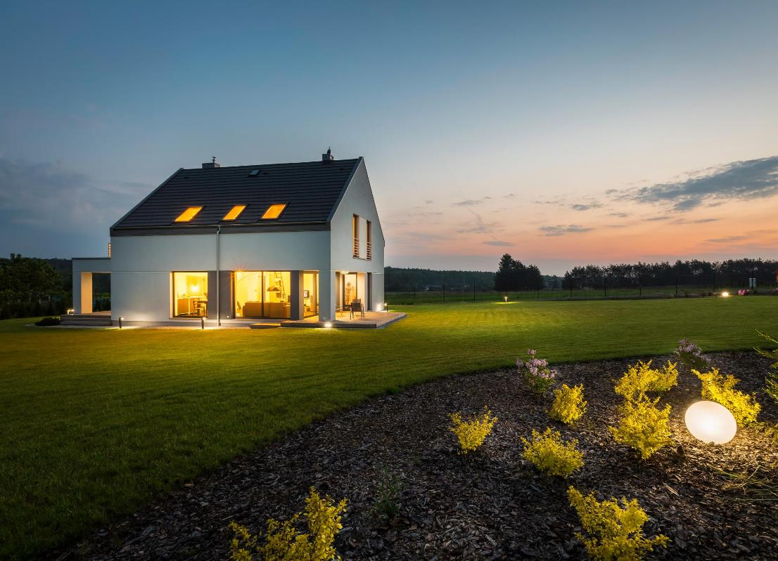
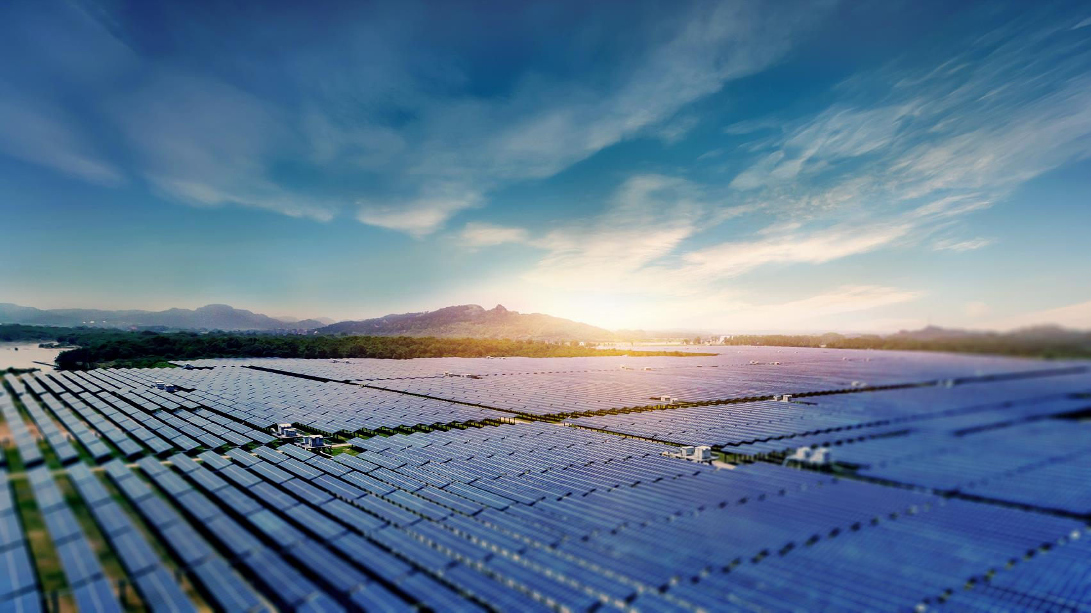
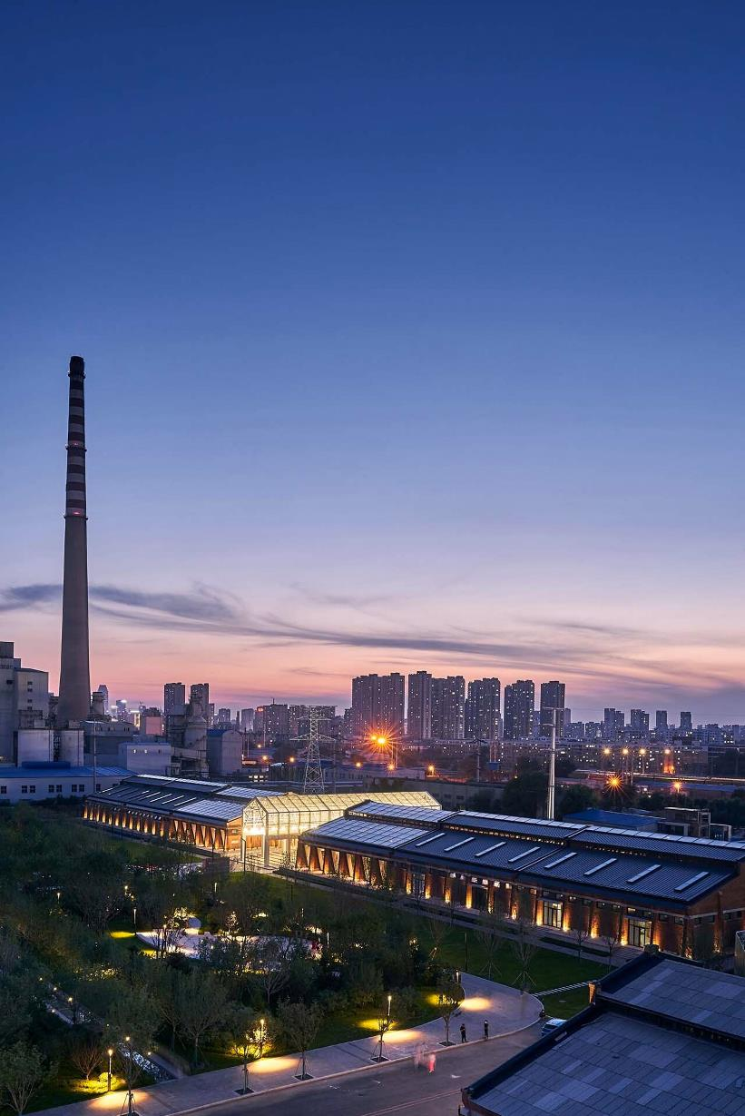
A WORLD-LEADING
SMART ENERGY SOLUTION
PROVIDER
EcoSmart Home
EcoSmart Commercial
Utility
13
GOODWE TECHNOLOGIES CO., LTD.

Slide 14

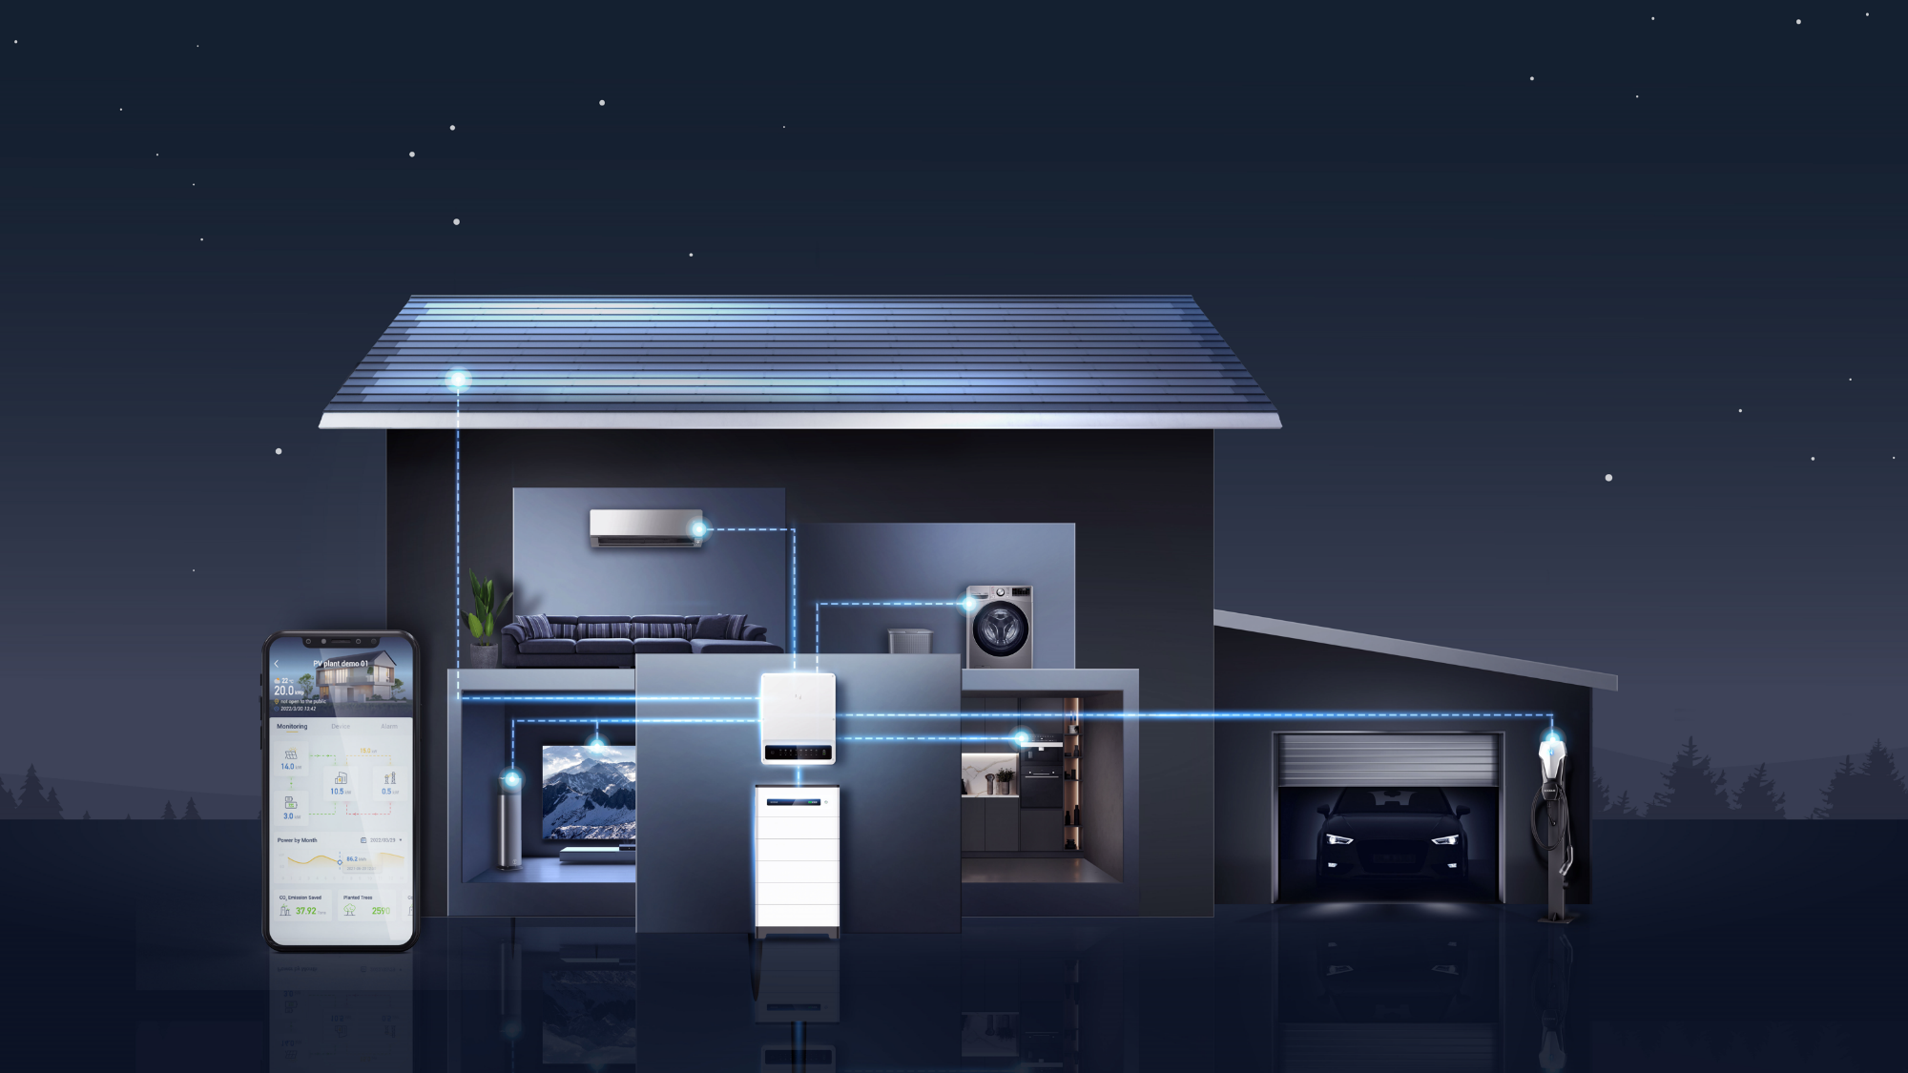
POWER YOUR HOME WITH SMART AND VERSATILE SOLUTIONS
PVBM
SEMS
Energy Storage System
EV Charger
14
GOODWE TECHNOLOGIES CO., LTD.

Slide 15

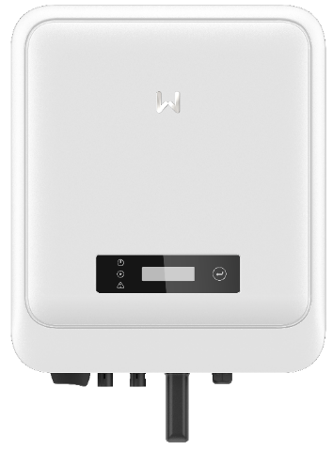
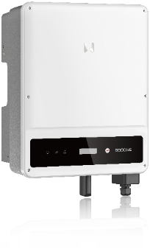
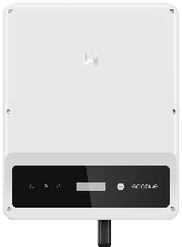
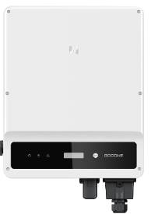
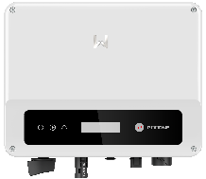



RESIDENTIAL INVERTERS
0.7-20kW
Up to 100%
Oversizing
Compact & Light
Weight
Arc-Fault Circuit
Interrupter
Max. Input
Current 25A
Up to 3 MPP
Trackers
DNS G3
3-6kW / 2 MPPT
MS
SDT G2
SDT G2 PLUS+
XS
5-10kW / 3 MPPT
4-15kW / 2 MPPT
4-20kW / 2 MPPT
0.7-3kW / 1 MPPT
15
GOODWE TECHNOLOGIES CO., LTD.

Slide 16

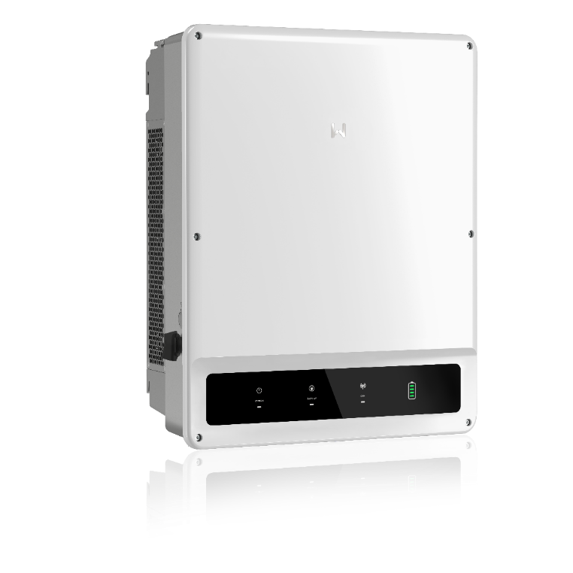
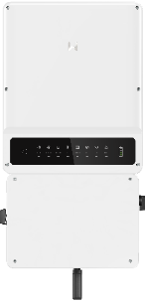
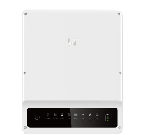
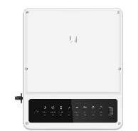
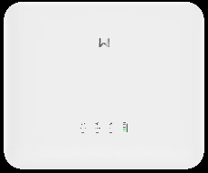



ENERGY STORAGE INVERTERS 3-30kW
Maximize
Self-Consumption
UPS-Level
Switching
Wide Battery
Voltage Range
100% Unbalanced
Output
ET（HV）
ET PLUS+（HV）
EH PLUS+（HV）
SBP G2（LV）
ES G2（LV）
AES（HV）
5-10kW
3.6-6kW
3.6-6kW
3-6kW
(Americas Only) 5-9.6kW
15-30kW
16
GOODWE TECHNOLOGIES CO., LTD.

Slide 17
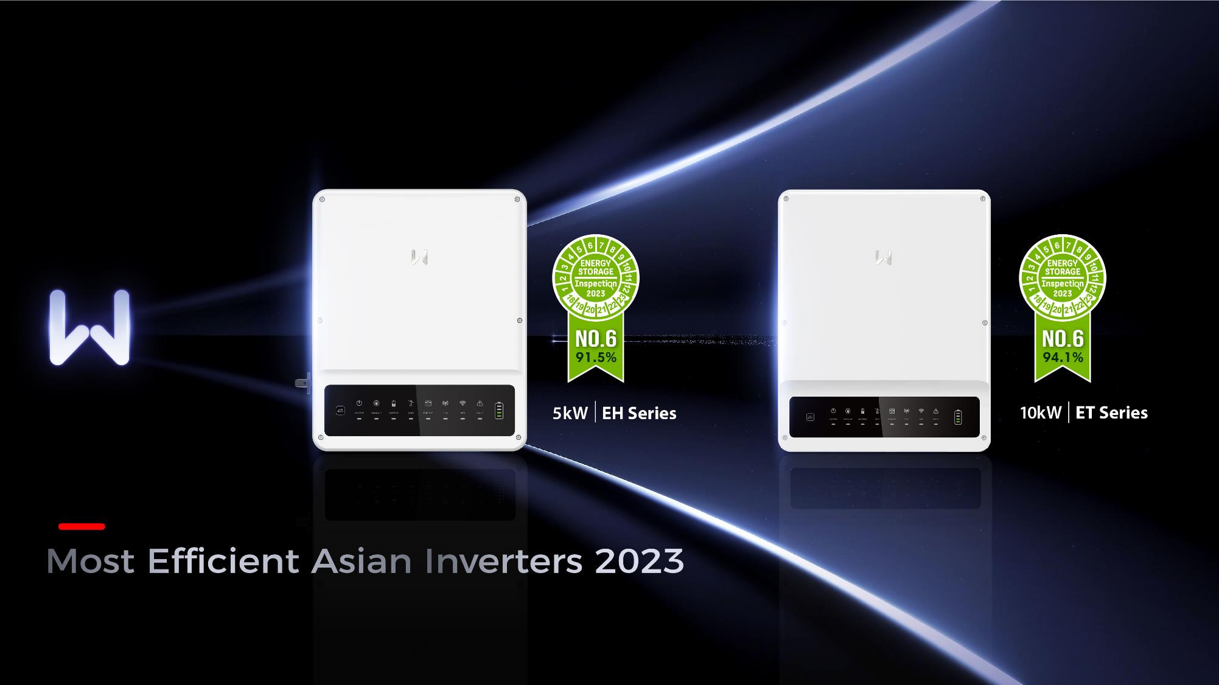
17
GOODWE TECHNOLOGIES CO., LTD.

Slide 18
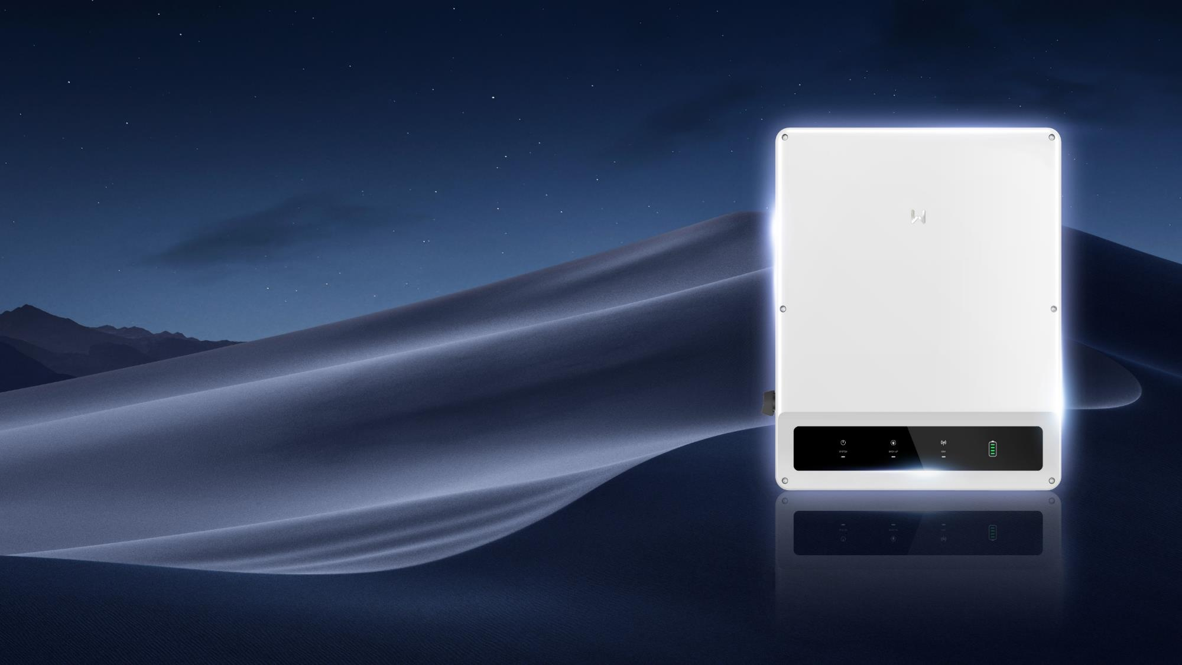






Energy Storage
Inverter 15-30 kW
Integrated Dry Contact
for External Loads
Peak Shaving
100% Unbalanced
Output
Powerful
Backup Overload
18
GOODWE TECHNOLOGIES CO., LTD.

Slide 19
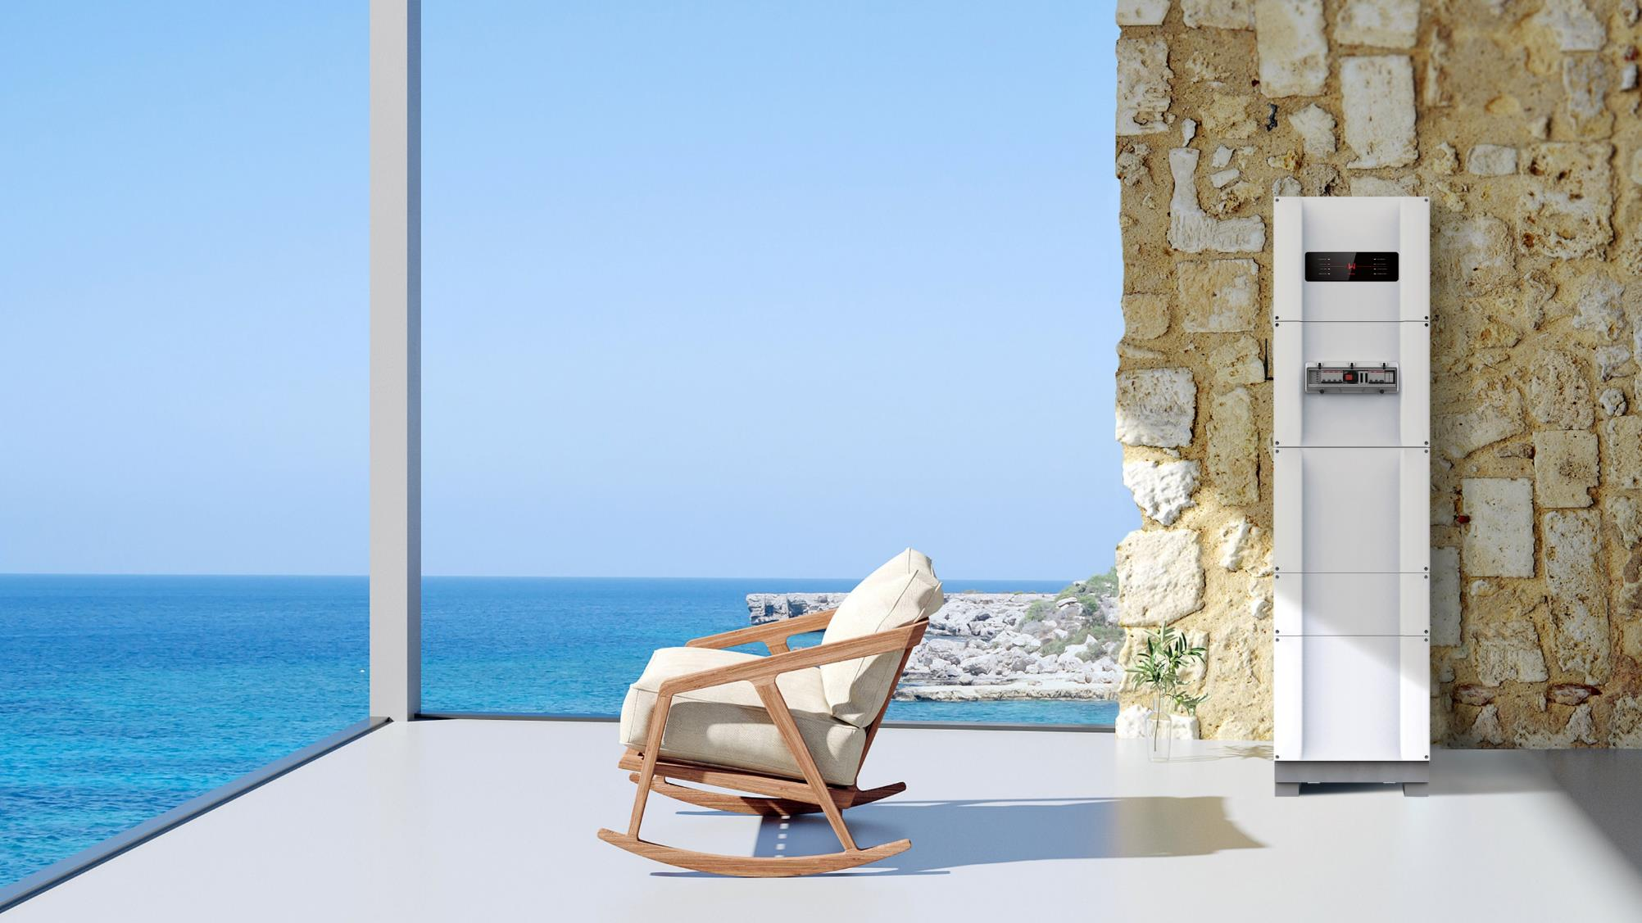



All-in-one Storage
Solution
Save up to 50% installation time
Pre-wired
Modular Design
UPS-Level
Switching
5kW / 10.8kWh
19
GOODWE TECHNOLOGIES CO., LTD.

Slide 20

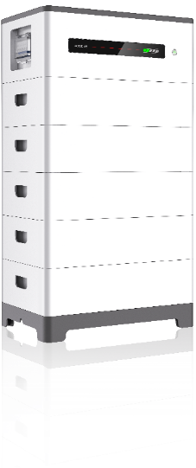
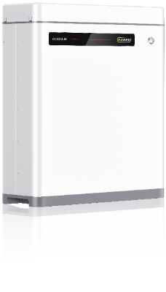


LITHIUM
BATTERIES
Module Auto
Recognition
Remote Monitoring & Upgrade
Safe & Reliable
Lynx Home U Series（LV）
Lynx Home F Series（HV）
5.4-32.4kWh
6.6-16.4kWh
20
GOODWE TECHNOLOGIES CO., LTD.

Slide 21
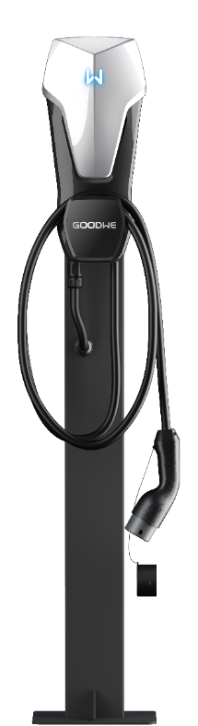
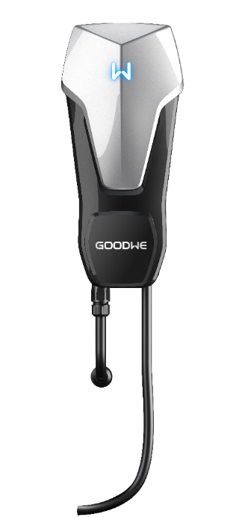




SOLAR-POWERED EV CHARGER
For Green & Cost-efficient Transportation
Smart charging management
Compatible with all EV brands
Charging cable included
AC Charger I 7 kW I 11 kW I 22 kW I Single / Three Phase
21
GOODWE TECHNOLOGIES CO., LTD.

Slide 22
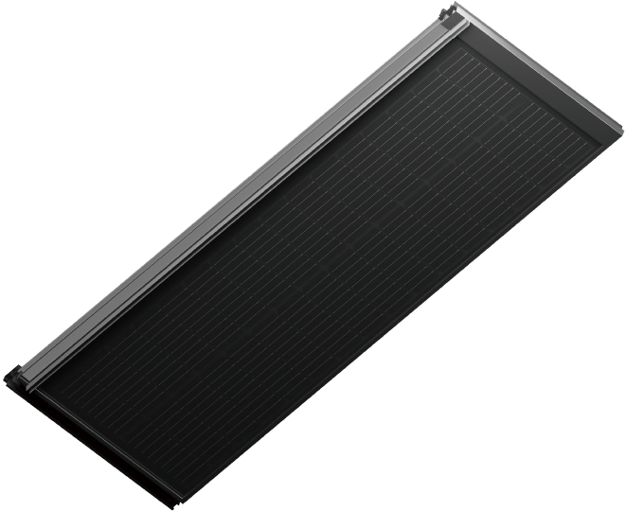
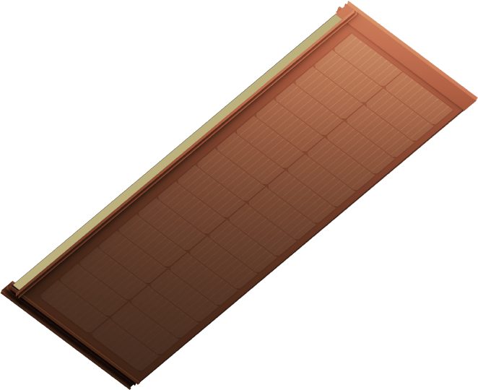
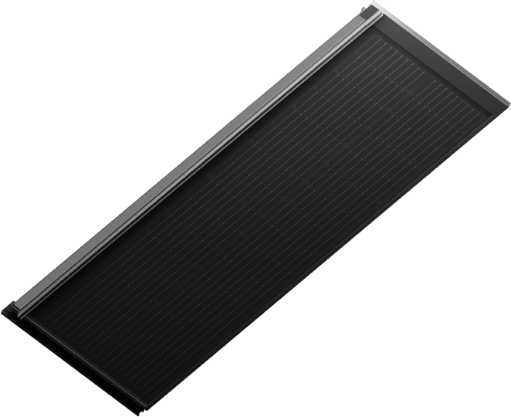








SUNSHINE SERIES
BUILDING INTEGRATED PV
Compliant with mandatory
certification standards for
building materials
Structural wind
resistance
Lightweight and
rapid installation
Self-cleaning and
unobstructed
drainage
High impact resistance
lifecycle comparable to
building itself
Structural
waterproofing
and cooling
Traditional tiles
compatible
Low reflectivity
panels
22
GOODWE TECHNOLOGIES CO., LTD.

Slide 23
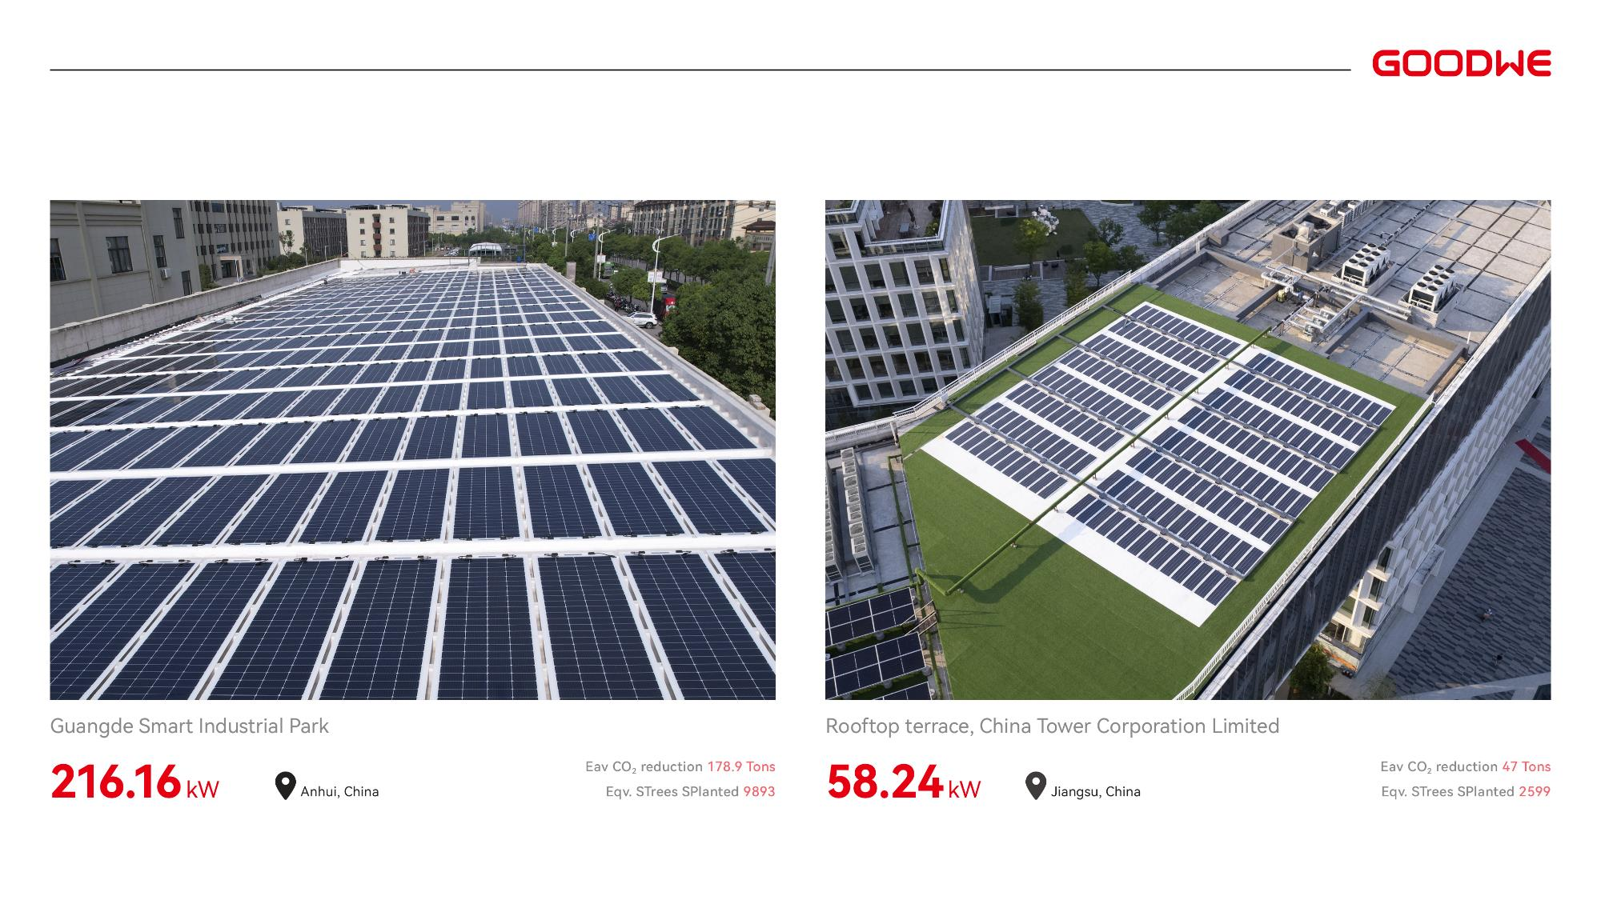
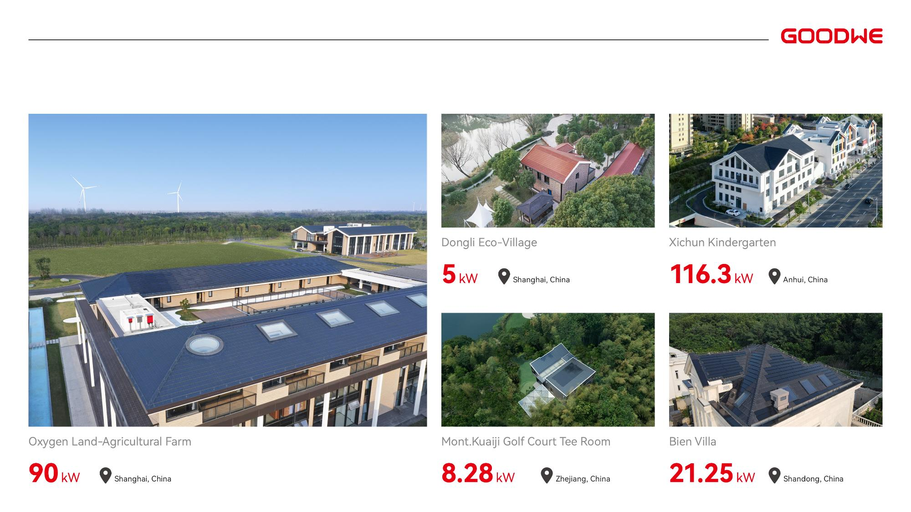
RESIDENTIAL PROJECTS
23
GOODWE TECHNOLOGIES CO., LTD.

Slide 24















ECOSMART HOME SOLUTION
RS483/Wifi
Micro Inverter/ RSD 2.0
Smart Meter
Ezlogger
GW Cloud
SolarGo 2.0
Grid
On-Grid Inverter
Hybrid Inverter
Heat Pump
Off-Grid
Inverter
Recreational Vehicle
Portable
Power Supply
EV Charger
Off-Grid Load
Battery
Lower Energy Bill
Reduced Carbon Footprint
Maximum Availability, Flexibility, and Reliability
24
GOODWE TECHNOLOGIES CO., LTD.

Slide 25

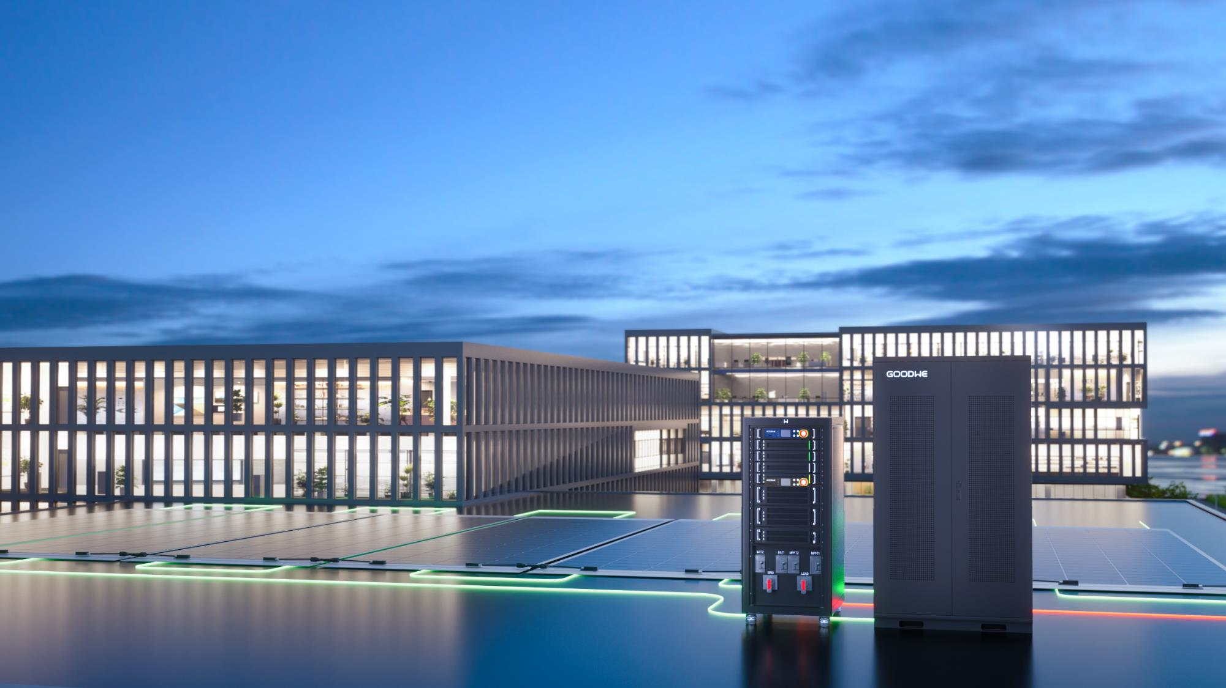






BOOST YOUR BUSINESS WITH ECONOMICAL AND
ECOLOGICAL SOLUTIONS
C&I Scenarios
25
GOODWE TECHNOLOGIES CO., LTD.

Slide 26

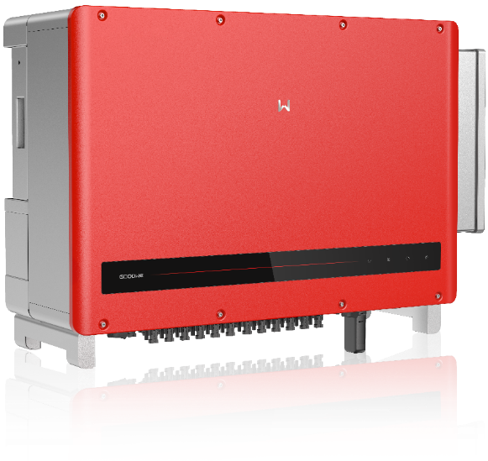
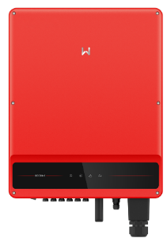
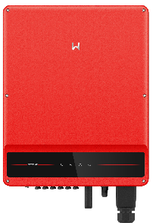
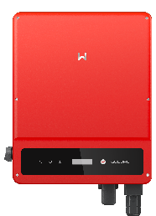


COMMERCIAL & INDUSTRIAL
INVERTERS 25-120kW
Up to 12 MPPT
Full Load Operation
at 50℃
Up to 15% AC Output
Overloading
Arc-Fault Circuit
Interrupter
Up to 50%
DC Oversizing
Power Line
Communication
HT
SMT
SMT（LV）
SDT
100-120kW / up to 12 MPPT
50-60kW / up to 6 MPPT
25-36kW / 3 MPPT
25kW / 2 MPPT
26
GOODWE TECHNOLOGIES CO., LTD.

Slide 27
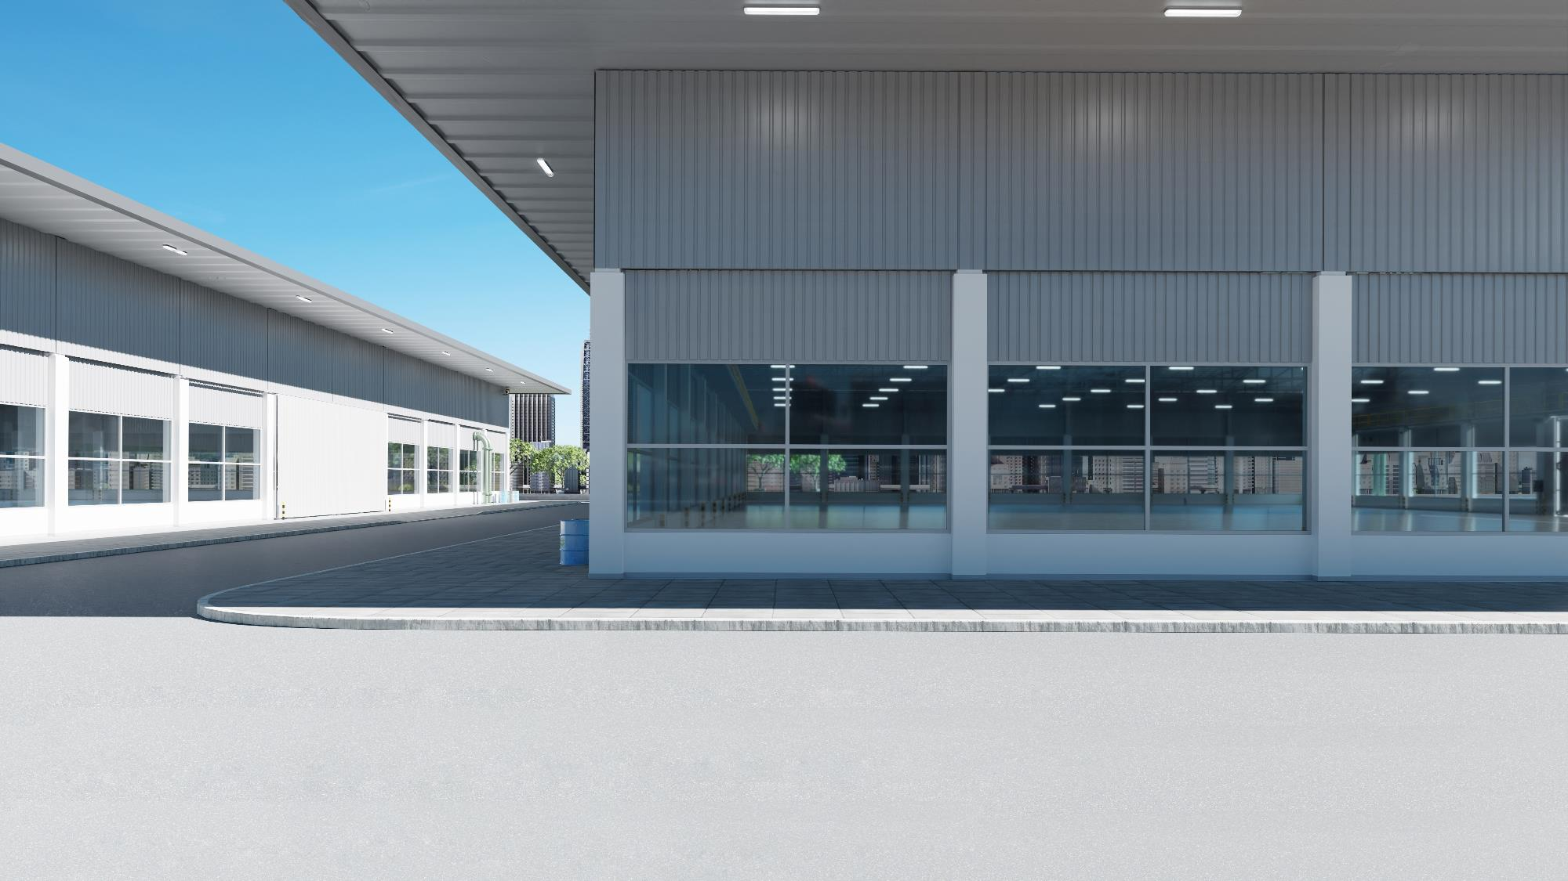
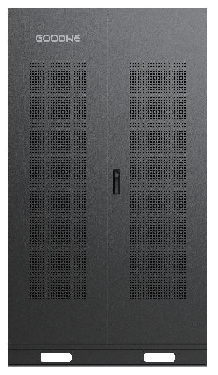
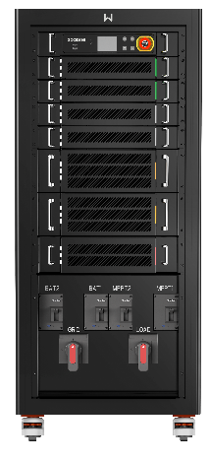




Energy Storage Solution
ETC/BTC
Lynx C Series
Lower Electricity Cost
Reduced Peak Demand
Uninterrupted Power Supply
Maximized
self-consumption
High Voltage Battery I 101-156 kWh
Hybrid/AC-Coupled Inverters I 50/100 kW
27
GOODWE TECHNOLOGIES CO., LTD.
Notes:
机器换成ETC 100kW的

Slide 28
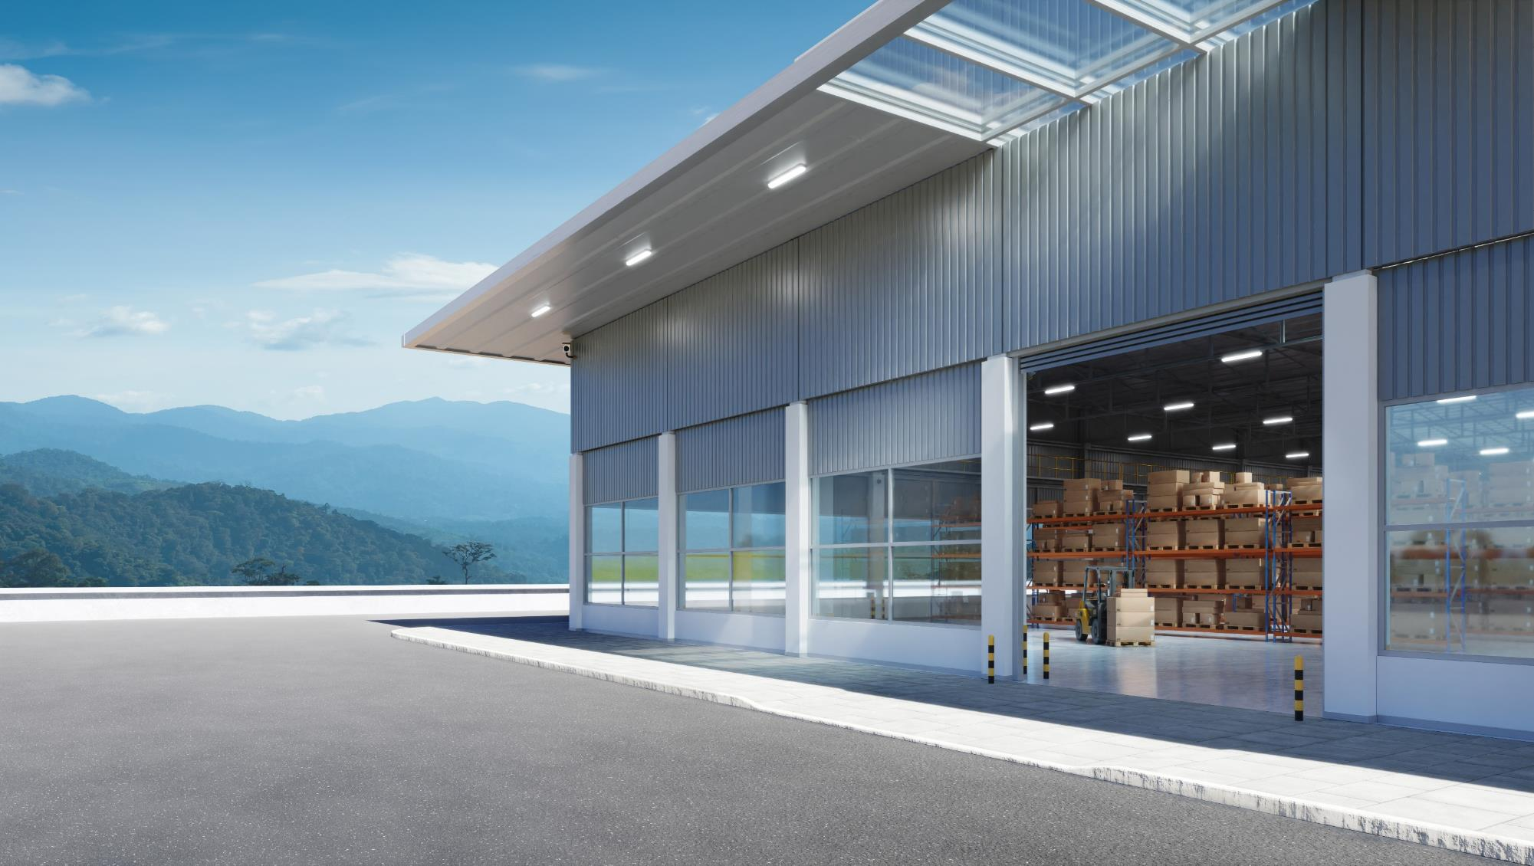



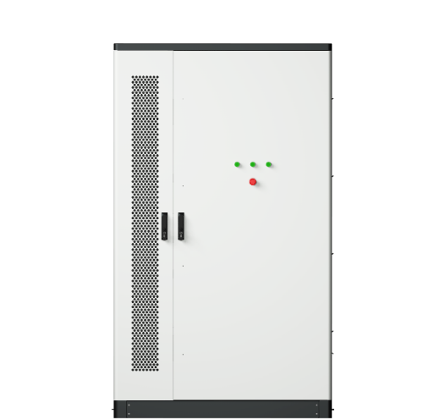
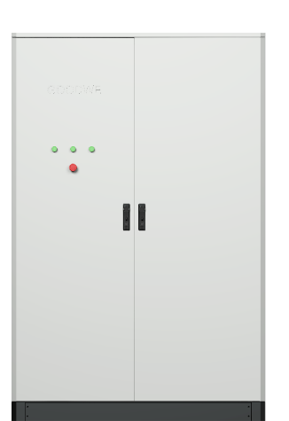


All-In-One Outdoor Energy Storage Cabinet
Higher
Usable Capacity
Smart
O&M
Safe &
Reliable
30kW/60kWh
50kW/100kWh
28
GOODWE TECHNOLOGIES CO., LTD.

Slide 29
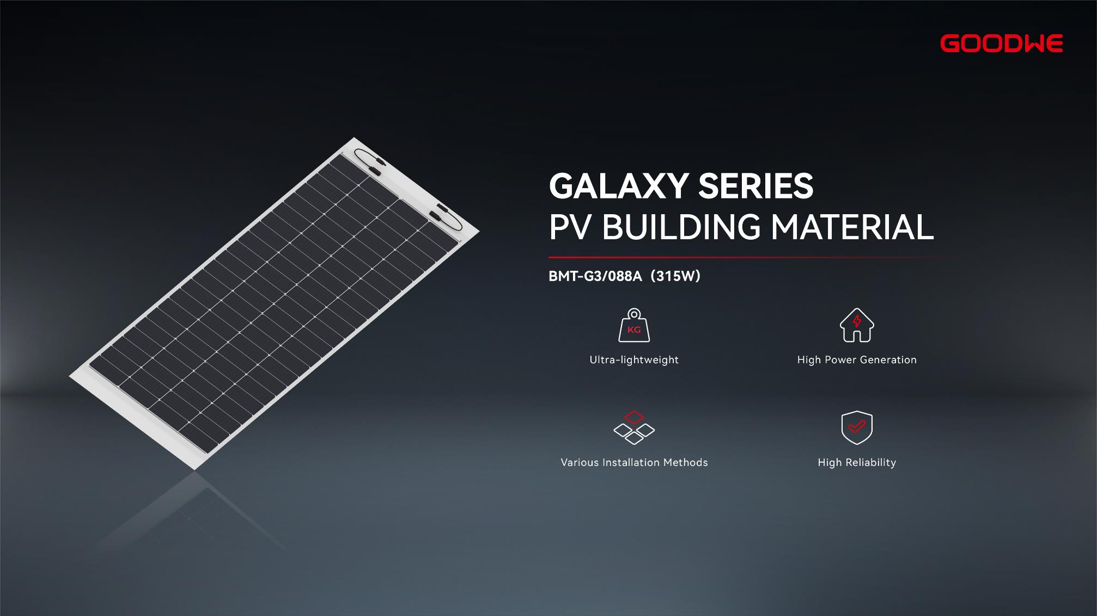
29
GOODWE TECHNOLOGIES CO., LTD.

Slide 30
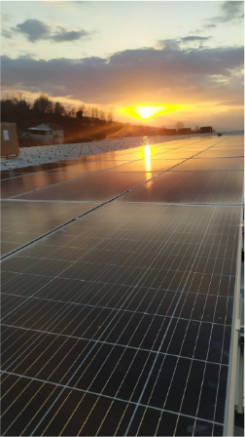
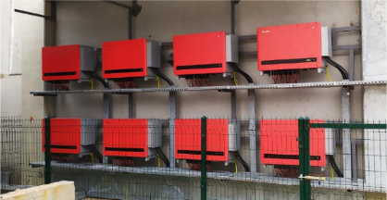

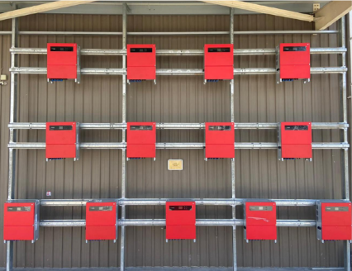
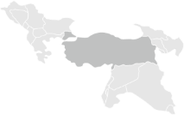
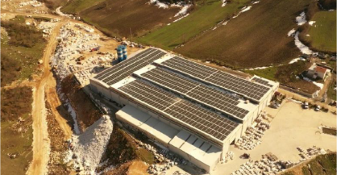



C&I PROJECTS
8
MW
Istanbul, Turkey
800
kW
Turkey
500
2
kW
MW
Konya, Turkey
Amsterdam,
The Netherlands
30
GOODWE TECHNOLOGIES CO., LTD.

Slide 31
C&I PROJECTS
31
GOODWE TECHNOLOGIES CO., LTD.

Slide 32









ECOSMART COMMERCIAL SOLUTION
VPP/ Grid Cloud
EMS
GW Cloud
· Easy Installation
· Flexible Expansion
· Safe & Reliable
Grid
Application
· Maximized Self-consumption
· Time of Use
· Peak Shaving
On-Grid Inverter
All-In-One Energy Storage Cabinet
Diesel Generator
EV Charger
Industrial Load
· Backup
· Microgrid Combining Solar PV,
Storage and Diesel Generators
PV Module & RSD
32
GOODWE TECHNOLOGIES CO., LTD.

Slide 33









OPTIMIZE PROJECT RETURNS WITH SMART AND TURNKEY SOLUTIONS
SolarOS
Fault Recording
33
IV Curve
SCU3000
GOODWE TECHNOLOGIES CO., LTD.

Slide 34








Utility-scale
Inverter 225-250kW
Compatible with
High-power Modules
Power Line
Communication 2.0
I-V Curve
Diagnosis
Internal Humidity
Detection
SVG Function
Available
34
GOODWE TECHNOLOGIES CO., LTD.

Slide 35



Easy O&M Compact Structure Convenient Shipment Upgraded Safety
35
GOODWE TECHNOLOGIES CO., LTD.

Slide 36




SolarOS
GoodWe Newly-Developed Smart Utility Plant O&M Platform
Full Lifecycle Monitoring
One-Click Building of PV Plant Topology
Flexible Deployment - Public Cloud, Private Cloud, On-premise
Smart Device Management, Maintenance, and Upgrade
36
GOODWE TECHNOLOGIES CO., LTD.

Slide 37



UTILITY PROJECTS
74
MW
Thessaloniki, Greece
24
37
GOODWE TECHNOLOGIES CO., LTD.

Slide 38





UTILITY PROJECTS
40
MW
Gansu, China
40
MW
Gansu, China
38
GOODWE TECHNOLOGIES CO., LTD.

Slide 39







GOODWE UTILITY SOLUTION
HPLC
PV Module
On-Grid Inverter
Smart Transformer
Grid
104/TCP/GOOSE
Containerized Battery System
String Converter
SCADA
Modbus RTU/TCP
MQTT
SCU3000
SolarOS
Optimal LCOE
Smart O&M
Upgraded Safety and Reliability
Grid Friendly
39
GOODWE TECHNOLOGIES CO., LTD.

Slide 40





EMBRACING DIGITALIZATION OF POWER PLANTS
Comprehensive Smart Energy Solutions
Solar · Storage · Charging · Load · Carbon · Trading
Industry Ecosystem Services
Energy Planning and Design
Energy Finance and Investment
Equipment Selection and Supply
Energy Construction and Operation
Digitalize
Systemize
Intelligentize
GoodWe Smart Energy Management Platform
40
GOODWE TECHNOLOGIES CO., LTD.

Slide 41








DISTRIBUTED ENERGY INTEGRATED TO VIRTUAL POWER PLANTS
Power Market
Power Ancillary Service Markets
Carbon Market
Smart Platform to Manage Virtual Power Plants
Resource
Aggregation
Dispatching
& Monitoring
Trade
Management
Settlement
Management
Control Instruction
Data Stream
IoT Access and Data Warehouse
Control Instruction
4G/GPRS/Data Stream
485/MQTT/MDDBUS
Edge Controller
Smart Gateway
Adjustable Loads
Energy Storage
Distributed PV
41
GOODWE TECHNOLOGIES CO., LTD.

Slide 42




GOODWE SMART ENERGY MANAGEMENT PLATFORM
WE-Seeds
Smart PV Power Plants
WE-Power
Integrated Energy Management
WE-Star
Virtual Power Plants
Digital Management and Operation of PV Assets
Integrated Energy Digital Management in Industrial Parks
Aggregation and Management of Multiple Energy Loads and Power Trading
42
GOODWE TECHNOLOGIES CO., LTD.

Slide 43


THANK YOU
GOODWE TECHNOLOGIES CO., LTD.

