Slide 1

An Overview of Pakistan’s Renewable Energy Sector
Alternative Energy Development Board Ministry of Energy (Power Division)
Islamabad, Pakistan

Slide 2
Pakistan’s Current Scenario
    Population of over 225 million - 12% (~ 27 million) unelectrified
    Per capita electricity consumption 550 kWh - World average 3,081 kWh – indicates a significant latent demand for future investments
    Target of 100% electricity access by 2030
    Projected demand increase of 4.3% per year, annual addition of 3,556 MW ( IGCEP)
    Push towards reducing reliance on imported fuels
    Consumers are being encouraged to utilize RE potential by self-generation
    Net-metering, distributed generation & micro-grid options

Slide 3
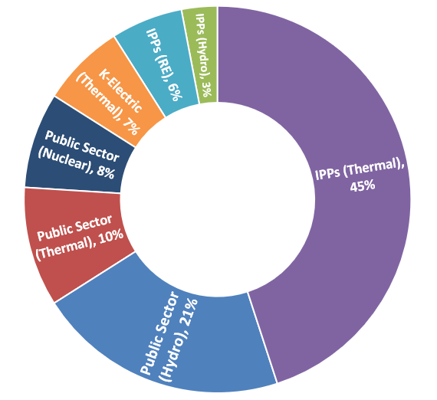







Overview Of Pakistan Power Sector – Total Installed Capacity
PUBLIC SECTOR
Hydro 9,331 MW (21%)
Thermal 4,507 MW (10%)
Nuclear 3,545 MW (8%)
Total 17,383 MW (39%)
Fuel Mix
Hydro
23.58%
Gas/R-LNG 29.61%
Oil
16.18%
Coal
16.10%
Nuclear 8.03%
Renewable
Energy
6.51%
PRIVATE SECTOR
Hydro IPPs 1,205 MW (3%)
Thermal IPPs 20,539 MW (45%)
RE 2,854 MW (6%)
KE (Oil/Gas/RE) 2,962 MW (7%)
Total 27,560 MW (61%)
44,943 MW
Total 44,943 MW
NTDC System 41,981 MW
RE - Wind 1845 MW, Solar 500 MW, Bagasse 364 MW, SHPP 145 MW, KE (Solar) 100 MW
3

Slide 4
Pakistan’s Planned Energy Transition
2023
Total Installed Capacity 45 GW
2031
Total Installed Capacity 63 GW
Solar – 2%
Wind – 4%
Hydro –24%
Bagasse – 1%
Total RE – 31%
Solar – 19%
Wind – 10%
Hydro – 33%
Bagasse – 0.5%
Total RE – 62%
Power Mix 2023
Power Mix 2031

Slide 5
National Electricity Policy objectives
  Universal access to electricity and self-sustainable power sector
    Optimal utilization of indigenous resources
    Integrated planning approach
    Efficient, dynamic and competitive market design
    Affordable and environment friendly outcome for consumers
Efficiency
Environmental Responsibility
Transparency
Key Guiding Principles
  Based on these guiding principles, a National Electricity Plan and
  sectoral policy
  frameworks are
  being developed
Indigenization, Research & Development
Competition
Financial Viability
5

Slide 6
Current Policies / Frameworks for private investments in Renewable Energy sector
ARE POLICY 2019
    IGCEP Outputs will form the basis of all on-grid capacity procurements
    Development of ARE projects primarily through Competitive Bidding
    Un-solicited mode limited to G2G & New Technologies
    Promotes non-utility procurements (Captive, B2B, Mini-Grids)
Framework Guidelines 2022
(FastTrack Solar PV Initiatives)
  Substitution of Expensive Imported Fossil Fuels with Solar PV Energy
  Solar PV Generation on 11 kV Feeders
  Solarization of Public Buildings
  Overall target of 10,000 MW solar PV under these initiatives.

Slide 7
Fast Track Solar PV Initiatives – Framework Guidelines
  Straight-Line Tariff through single-stage, two-envelope bid process
  70% $ Indexation of Tariff on quarterly basis
  GOP (CPPA-G) to purchase all Power Generated on 25 Year BOOT basis
  GOP to provide land and power off-take
  GOP to provide exemption from all Import related Duties and Taxes
  In addition to GOP Guarantee, the energy payment also ensured through direct debit mechanism
  15% income tax on profits and gains of IPP
  COD within 20 months of EPA signing
  Foreign Exchange requirement for installation of Projects shall be arranged from abroad
  6000 MWp to be installed under the fossil fuel substitution initiative

Slide 8
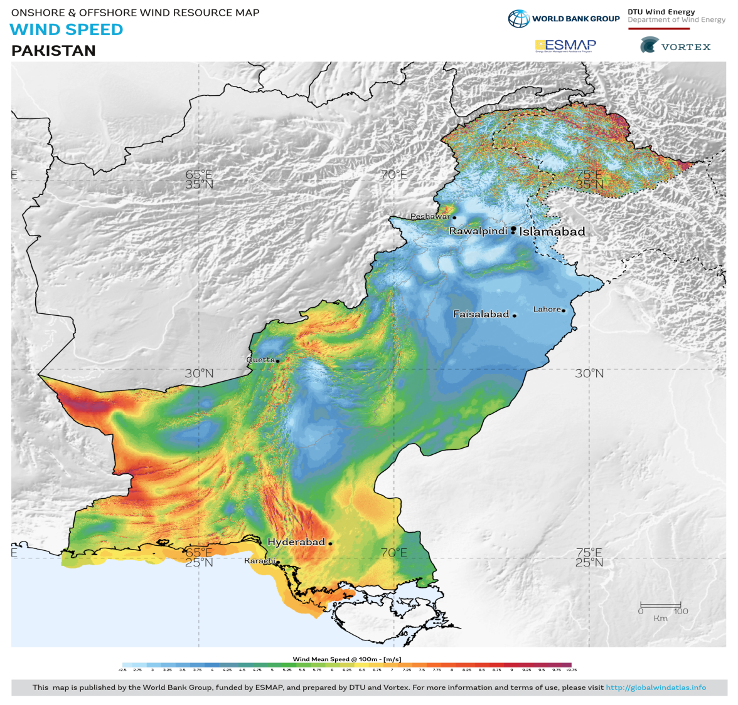
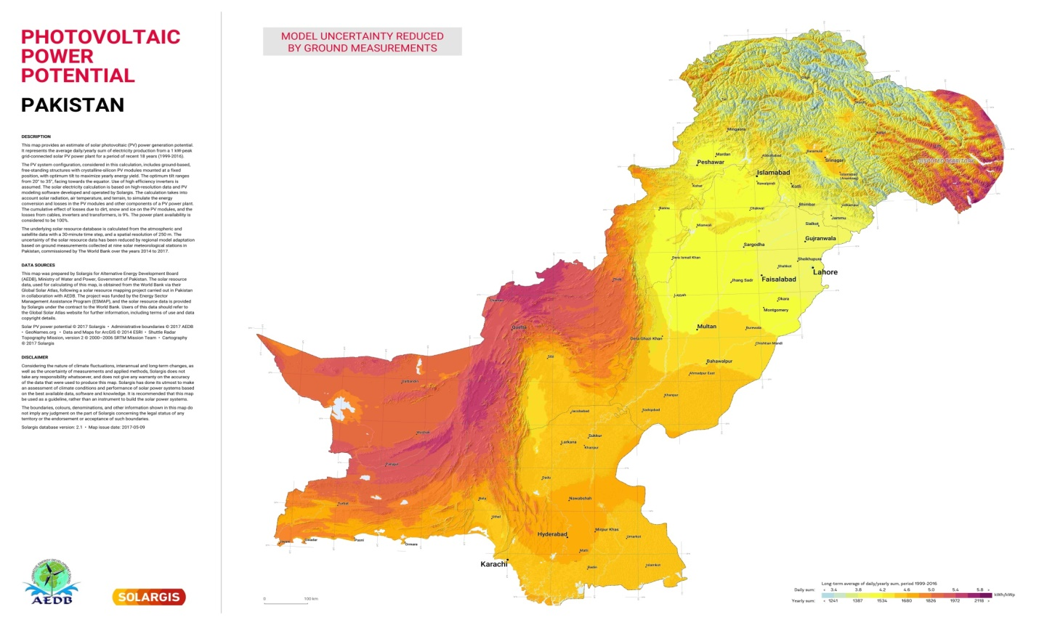





Renewable energy potential
  Estimated RE potential:
    Solar: ~2,000 GW
    Wind: ~100 GW
    Hydro: ~60 GW
    Biomass:~ 2 GW
    Waste-to-energy:~ 0.4 GW

Slide 9

Investment Opportunities

Slide 10
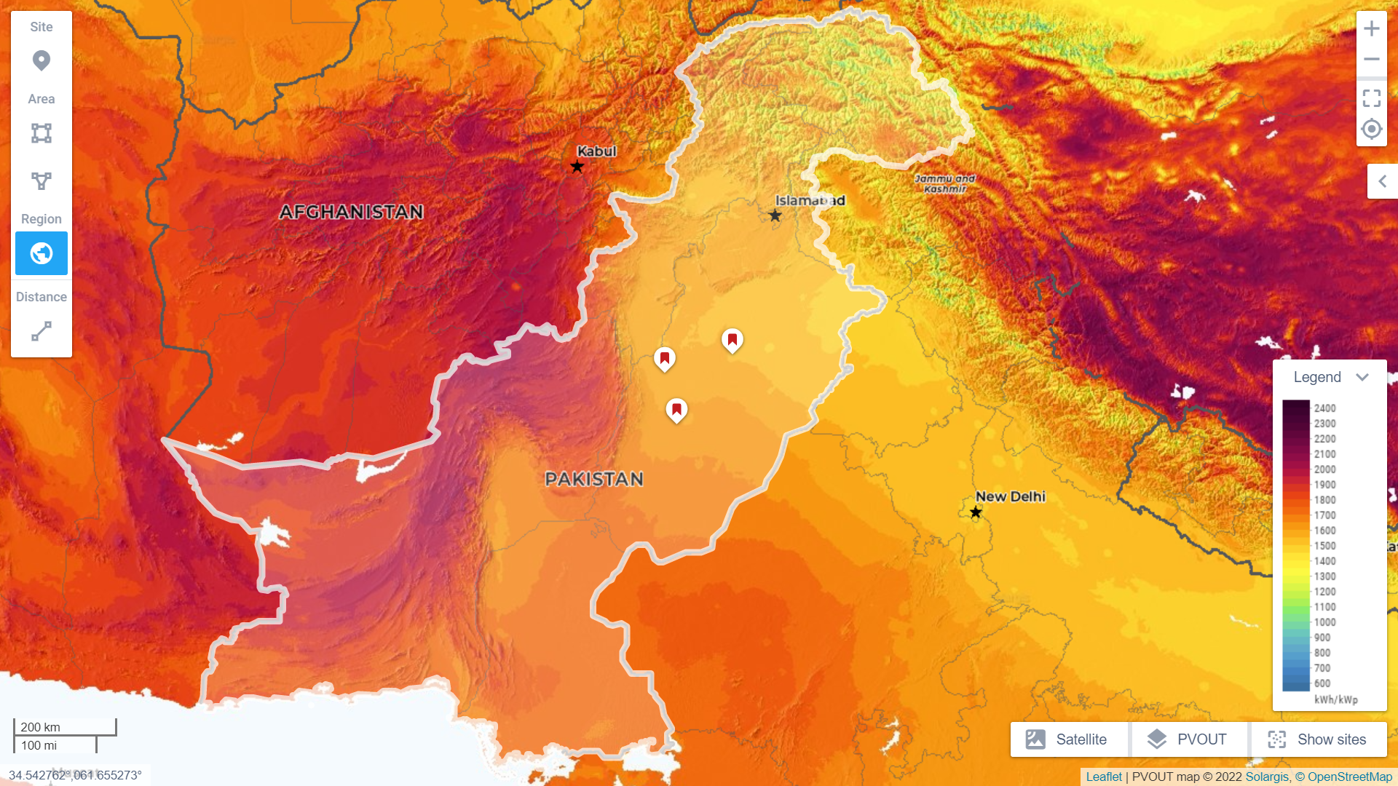
Investment in ARE Sector of Pakistan – Conversion of Fossil Plants to Solar PV Farms
600 MW_{p} Solar PV project at Kot Addu / Muzaffargarh through competitive bidding
1800 MWp solar PV projects in Punjab are also planned to be developed
RFP for 50 MW Solar PV Project in Sindh is being prepared and is expected to be floated in last quarter 2023
Another 500 MW wind capacity and 2500 MW solar PV capacity to be procured from Category-III projects
Jhang
600 MWp
Layyah
1200 MWp
Kot Addu / Muzaffargarh 600 MWp
Kot Addu / Muzaffargarh 600 MWp
Manjhand 50 MWp

Slide 11
Future Renewable Energy Addition
  Apart from committed pipeline projects, the IGCEP requires an addition of 13,391 MW of alternative and renewable energy powered generation by 2031
Fiscal Year | Solar PV MW_{p} | Wind MW | Hydro MW | Annual Capacity Additions MW
2024 | 500 | - | 579 | 1,079
2025 | 4,020 | 550 | 2,455 | 7,025
2026 | 2,200 | 550 | 2,607 | 5,357
2027 | 1,244 | 50 | 2,558 | 3,852
2028 | 150 | 2,944 | 545 | 3,639
2029 | 150 | 633 | 886 | 1,669
2030 | 150 | 50 | 1,525 | 1,725
2031 | 150 | 50 | 2,979 | 3,179
Total | 8,564 | 4,827 | 14,134 | 27,525
Notes:
11
11

Slide 12
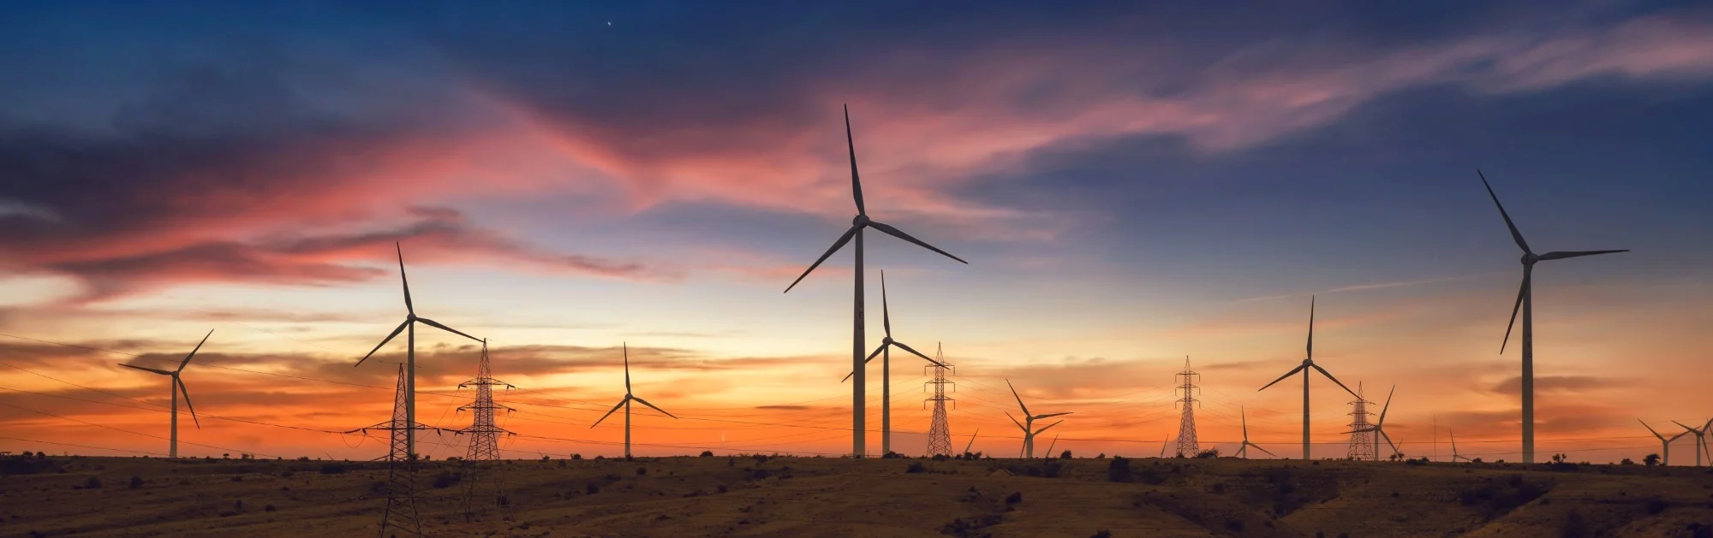
Thank you!

