Slide 1

3rd International Conference & Expo
SOLAR CLEAN ENERGY , PAKISTAN
PROSPECTS & PROJECTS OF SSEP
Presented by:
Mehfooz Ahmed Qazi
Project Director
Energy Department, Government of Sindh
18th July 2023, Marriot Karachi

Slide 2
Presentation Outline
Introduction
Component – II
Component -- IV
Scope of the Project
Component -- III
Component – I
End

Slide 3

Scope of the Project
SSEP has been designed to :
    Scale up solar power in the province
    Increase the access to electricity.
    Establish the low cost of Solar PV Power Plant
Demonstrate solar PV on-Grid/Grid Tied project that can be integrated into the grid.
Following are four major components of the project:
  Component – 1 – Utility Scale Solar (USD 15Million)
  Component – 2 – Distributed Solar (USD 50 Million):
  Component – 3 – Solar Home Systems (USD 33 Million)
  Component – 4 –Capacity Building (USD 2 Million)

Slide 4
Project Targets
Sindh Solar Energy Project (SSEP) is an initiative of the Government of Sindh, financed by a $100 million concessional loan from the World Bank that was approved by the WB Board in June 2018. It has four components:
Development of solar parks to facilitate at least 400 MW of utility-scale solar through competitive bidding;
Installation of 50 MW of distributed solar on and around public buildings in Karachi and Hyderabad;
Scaling up the market for solar home systems to provide electricity access to at least 200,000 households in Sindh;
Technical assistance and capacity building in support of the above, including training and two comprehensive household energy surveys.

Slide 5
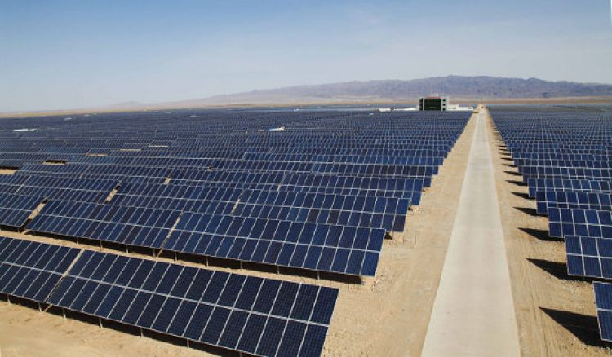
Component – I (Utility Scale Solar)
This component will finance one or more ground mounted Solar PV power plant/accumulatively sized at approximately 400 MW. The 1st 50 MW pilot power plant will be located at Manjhand Distt Jamshoro for supply at Khanote Grid Station.

Slide 6
LAND ALLOTTED
Component 1:Utility-Scale Solar (ON-Grid Solar projects upto 400 MW)
The 3 sites has been identified and 1462 acres allotment of land is placed in the upcoming Cabinet meeting scheduled on 15th November 2022 as under:
250 Acres for 50 MW at Manjhand, Distt Jamshoro.
612 Acres for 175 MW in Deh Halkani /Murad Band, Distt West Karachi
600 acres for 175 MW in Deh Mitha Ghar, Distt Malir

Slide 7
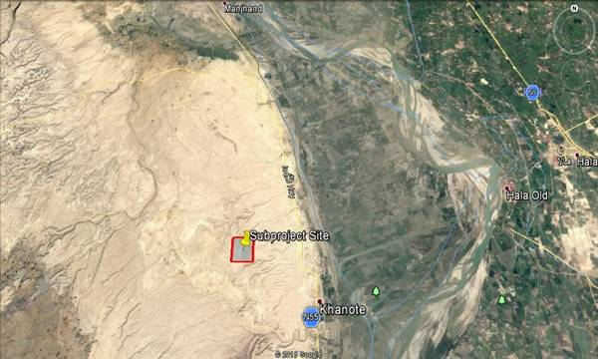
Manjhand near Khanot Grid Station, Jamshoro
Component – I (Location Map)

Slide 8
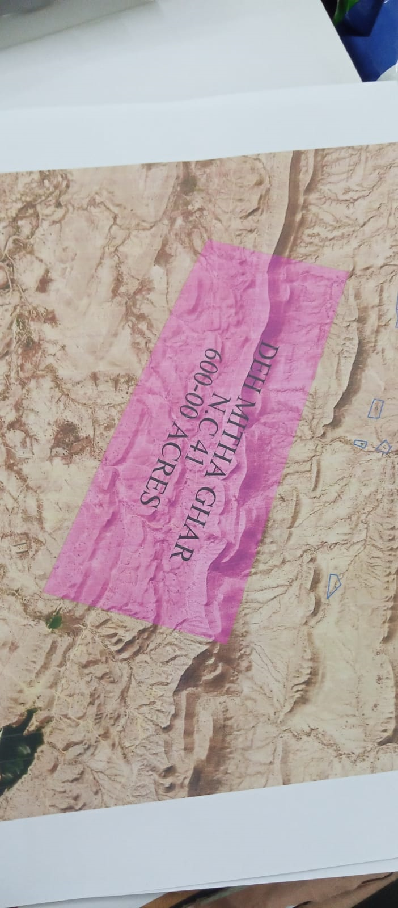
Distt Malir, Karachi

Slide 9
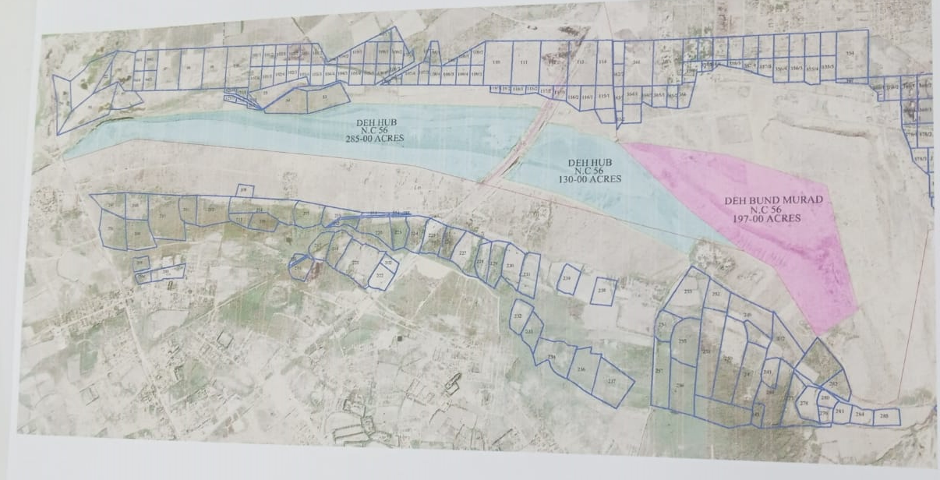
Distt West, Karachi

Slide 10
Status for Component 1 Preparatory Works
Land: 250 Acres land has been reserved at Manjhand. LOI of 50 MW issued under 2006 Policy.
Feasibility Studies carried out with WB support.
Environmental Studies Carried out and SEPA approval of ESMP/ESIA received in April 2019. revised approval with some changes is pending with EPA.
Grid Interconnection study completed and are submitted to NTDC for approval for Manjhand. KE approve dthe Grid interconnections .
Transactional Advisor Hired : M/S Bridge Factor JV to carryout competitive bidding on 1st 50 MW project at Manjhand. Bidding process is expected by the end of March 2020.
Prequalification process: completed.
RFP under process.

Slide 11
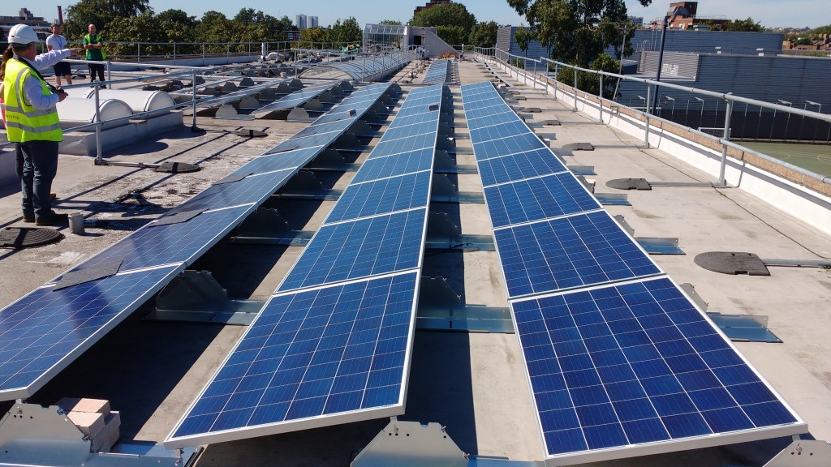
Component – II (Distributed Solar)
This component will finance rooftop solar PV systems for public sector buildings, including schools, hospitals, water pumping and purification stations and other office buildings available abundance free space for solar panels in the cities of Karachi and Hyderabad. The system will be connected to the nearby grid under NEPRA’s net-metering policy.

Slide 12
Key Elements of Component 2
Building Survey: Elan & Partners and Tekcellent contracted to carry out a building survey in Karachi and Hyderabad covering 200 sites (from a longlist of 400).
Distributed solar and energy efficiency retrofits: 50 MW of solar PV, reflective roofing, and upgrading of lighting and cooling
Private firms contracted to build and operate: Framework EPC contracts awarded followed by mini-RFP process for each ‘lot’
Supervision engineer: SED to contract a supervision engineer to verify compliance with technical standards and milestones and authorize payments.
33 Hospitals dealing with COVID -19 were solarized including JPMC, Civil Hospital Karachi, LMC Hyd , Liyari, Dadu , Abdullah Shah Institute Sewhan etc. in Round -I
23 Buildings contract awarded for Round-II including Sindh assembly, Central jail, Shehbaz Building , Sindh sect –No.2, Sindh Museum, Malir Jail, KDA building, etc.

Slide 13
CIVIL HOSPITAL KARACHI
A Case Study
PROJECT INTRODUCTION
A green initiative was taken by SSEP (Sindh Solar Energy Project) to Solarize major hospitals in Sindh to increase solar power generation capacity across the province.
Funded by The World Bank, the project was awarded to Renewable Power. Pvt. Ltd by SSEP to Solarize Civil Hospital Karachi.

Slide 14

Key Features of the Project
Total System Size: 1.5MW
No of PV Modules: 3370 pcs
Total No of Buildings: 20
Solarized Buildings: 16
Heritage Buildings: 04
Structure: Rust proof Aluminum, Galvanized Iron Structure.

Slide 15
Key Features of the Project
Total Cost: 144,000,000.00 PKR
Unit Generation Each Year: 2,371,000.00 KWH
CO2 Avoidance: 1851 Tons Each Year
Payback Period: 3 Years

Slide 16
Power Generation and Consumption
Production Each Year: 2,371,000.00 KWH
25 Year Production: 28,713,484.77 KWH
Consumption Each Year: 7,758,075.00 KWH
Grid Import After Solar: 5,387,075 KWH

Slide 17
Power Generation and Consumption
Solar Contribution
Grid Import
30% Reduction in Grid Import

Slide 18
Payback (Return on Investment)
Unit Charged by K.E: 24.20 PKR
Revenue Each Year: 48,000,000 PKR
25 Year Revenue: 694,866,331.43 PKR

Slide 19
Payback (Return on Investment)

Slide 20
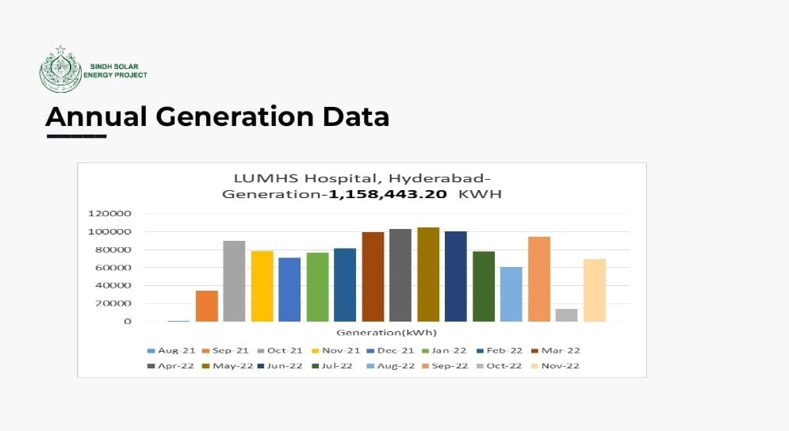

Slide 21
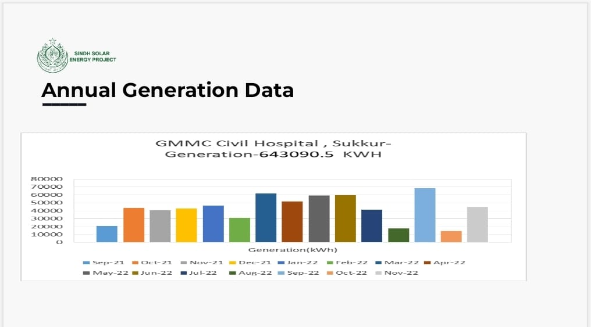

Slide 22
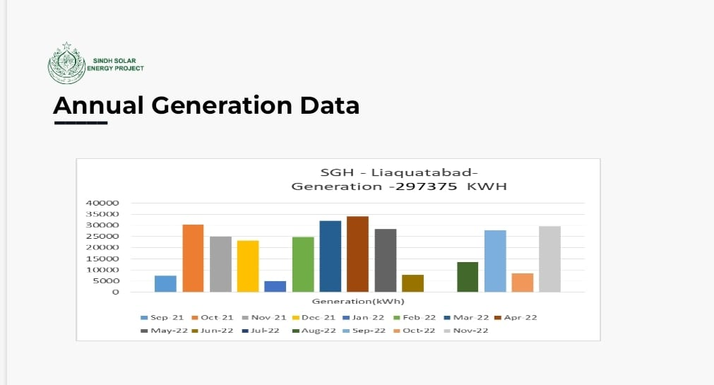

Slide 23
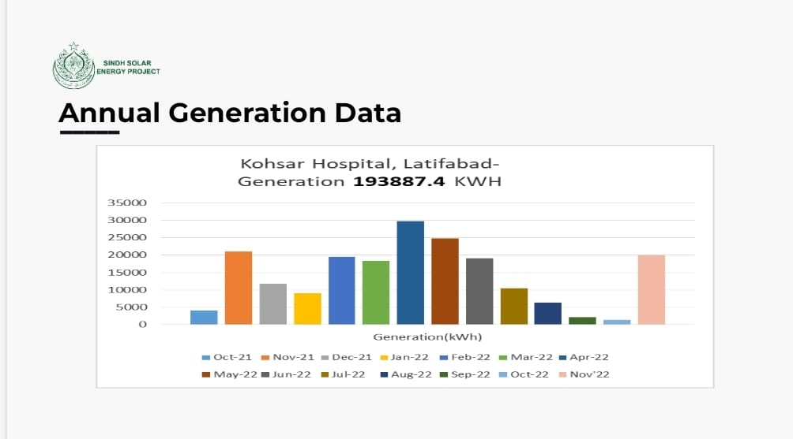

Slide 24
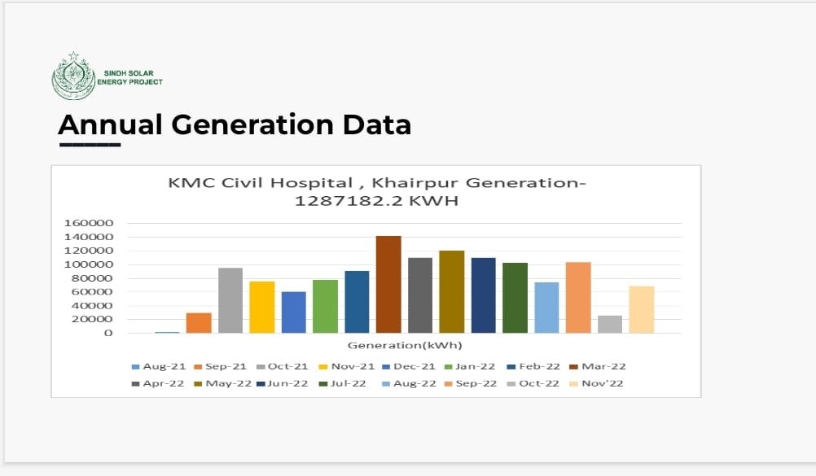

Slide 25
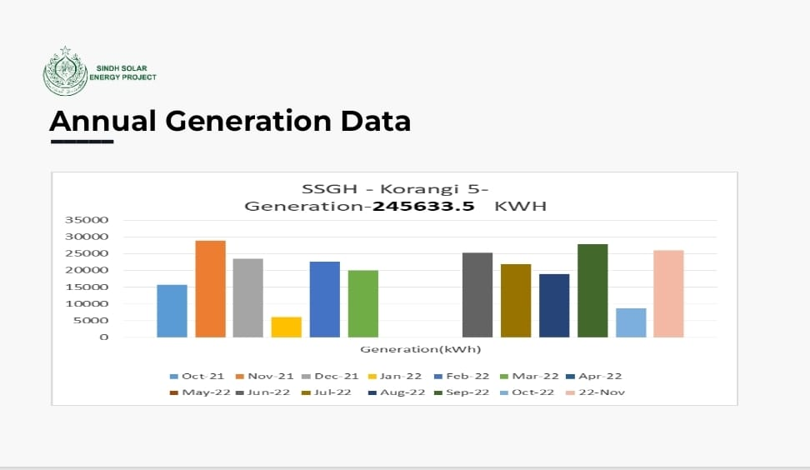

Slide 26
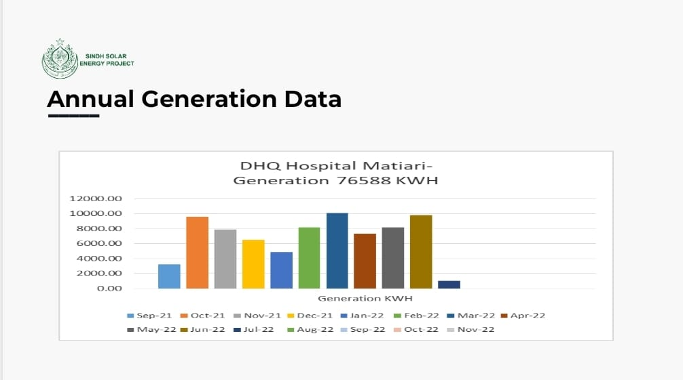

Slide 27
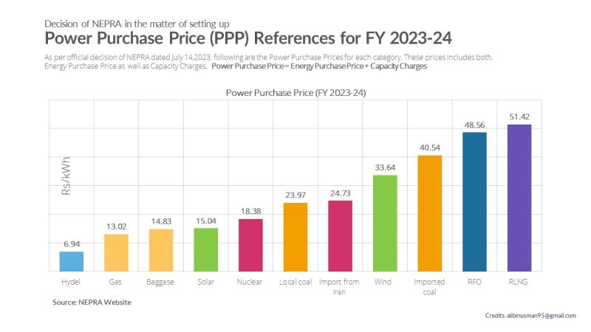
National Average Power purchase price has been calculated as Rs. 22.42 per kWh.

Slide 28
Up till now 30 buildings completed with an installation of 21 MW, approximate 2Billion Kwh has so far been generated under rooftop component.
The price of Kwh at the time of project approval in 2018 was PKR 18/kwh, which is PKR 33/kwh and now with average increase of Rs. 4.5./kwh by NEPRA , it will further reduce the pay back period, around two years.
Carbon credits are in addition to save the environmental safeguard.

Slide 29
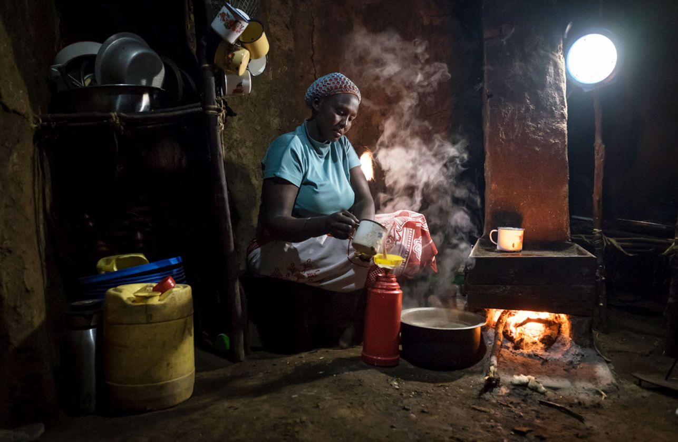
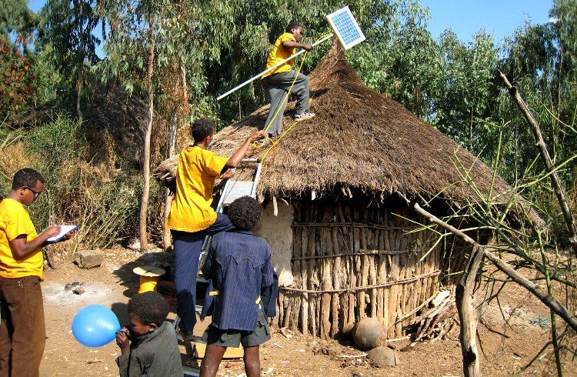
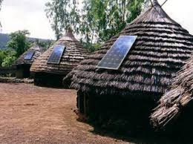
Component – III (Solar Home System)
This component will finance GoS’s electrification program to help provide modern energy services to people in remote rural areas not connected to the Grid and low electricity areas.

Slide 30
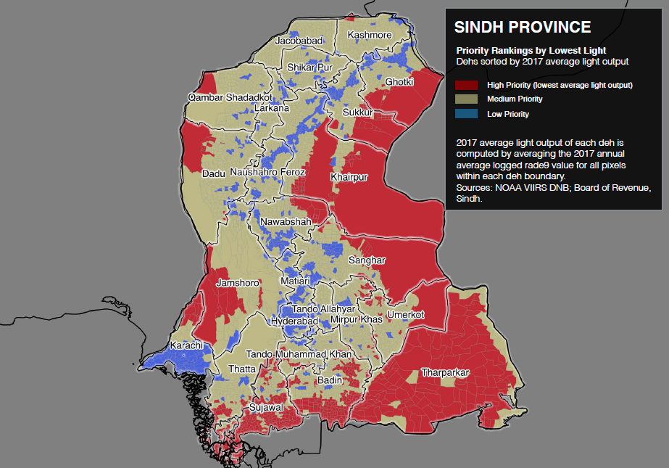
Component – III (Districts in Sindh)
Scaling up the market for solar home systems to provide electricity access to at least 200,000 households in Sindh.
1. Badin
2. Ghotki
3. Jacobabad
4. Kashmore
5. Khairpur
6. Qambar Shahdadkot
7. Sanghar
8. Tharparkar
9. Sujjawal
10. Umerkot
Now entire Sindh Province
All Districts

Slide 31
Key Elements of Component 3
SHS suppliers: Private firms with verified credentials apply to participate, and responsible for making sales of SHSs in target districts.
Partial grant to households: A grant of around 40% of SHS cost will be provided to each household that purchases a SHS installed in the target districts, upon verified installation.
Consumer awareness campaign: A firm will be hired to undertake marketing activities directed at the consumer, to build awareness and facilitate the purchase of SHS by consumers. This will complement the marketing activities of private SHS suppliers.
Installation verification and quality control (IVQC): A separate firm will be hired to implement a robust IVQC program covering product testing, installation verification, household complaints hotline, supplier compliance, and results monitoring.

Slide 32
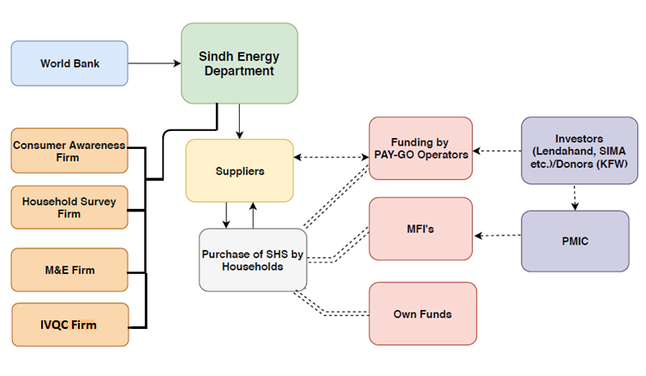
Previous SHS Supplier Model
Notes:
Previous Model

Slide 33
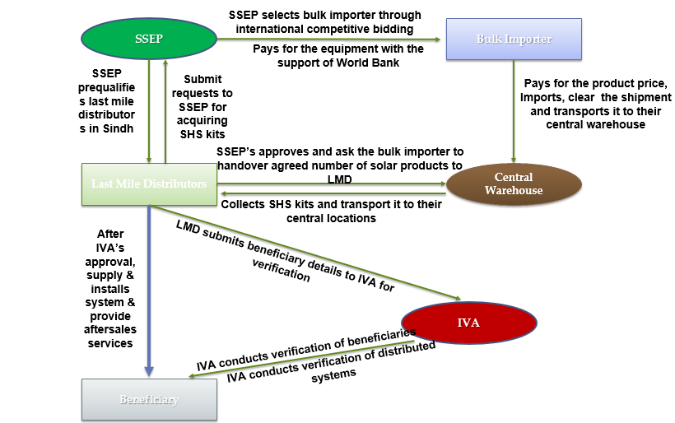
New Implementation Strategy
BULK Supply Procurement

Slide 34
Last Mile distributor roles and responsibilities
Collection of SHS:
  The Last Mile Distributors (LMDs) must collect Solar Home System kits (including DC fans and solar panel frames) in batches of 500 or 1000 kits. To collect these kits from the central warehouse in Karachi, LMDs need to submit a Surety/Solvency Certificate and prior approval from the Sindh Solar Energy Project (SSEP) is essential before obtaining the kits. After the LMDs install 75% of the SHS kits from the current batch, SSEP will grant approval for the release of the next batch and this cycle will continue which may result competition among LMDs.
Identification of eligible households and sales activities:
  Households will be identified by SSEP from the NSER survey data of BISP and LMDs will be responsible to supply and install SHS kits at the house of identified households that meet the eligibility criteria for receiving SHS.
  They are responsible for engaging in sales activities to promote and market the SHS to eligible households.
Payment collection and financing:
  LMDs are responsible for arranging the payment collection from households for the costs associated with them and SSEP will cap the limit against LMDs cost.

Slide 35
Last Mile distributor roles and responsibilities
Supply and installation of SHS:
  LMDs should ensure the timely supply and installation of SHS in eligible households. This involves delivering the systems to the households and completing the installation process according to the required standards.
Cooperation with IVA:
  LMDs are expected to cooperate and facilitate the Independent Verification Agents (IVAs) in conducting any necessary checks or follow-up visits related to the SHS supply and installation.
After sales service:
  LMDs should provide after-sales service, including addressing any faults or issues with the SHS during the warranty period.
  They are responsible for coordinating with the bulk importer (the entity responsible for importing the SHS) for the replacement of faulty SHS, if needed.
Monthly reporting:
  LMDs are required to submit monthly reports to the SSEP regarding the supply and installation of SHS. These reports should provide detailed information on the number of systems installed, households served, and any other relevant data.

Slide 36
Qualification Criteria for LMDs
Registered with Security Exchange Commission of Pakistan (SECP), or any other similar registration body in Pakistan, must have local tax and sales tax registrations (as relevant).
Demonstrated prior experience of working with the government/donors, with a preference for prior experience with solar product distribution or financing;
Demonstrated financial, operational and fiduciary performance of last three years;
Experience in working with solar PV and/or SHS distribution will be considered as an added qualification.
Demonstrated access, presence and/or coverage in rural and pre-urban areas in Sindh with documented proof i.e. Utility Bills/ Lease or Rental Agreement/ Official letter from recognized institution for their physical presence in the respective districts;
Proposed logistical and operational arrangements;
Demonstrated level of adherence/compliance with the project guidelines on environmental and social safeguards.
Demonstrated reporting and fiduciary compliance mechanisms;
Provide Surety or Solvency Certificate against the number of SHS kits along with fan which -they collect from Importer’s warehouse for free of cost.

Slide 37

Component – IV(Technical Assistance)
This component will help support technical assistance and capacity building activities of Sindh Energy Department, Directorate of Alternative Energy, STDC, Sindh Planning & Development Board (Technical Wing)
Quality Assurance Laboratory / Survey etc

Slide 38
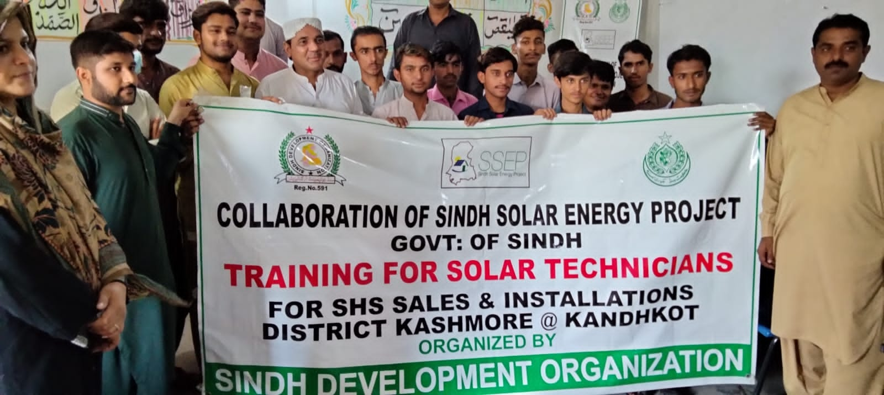
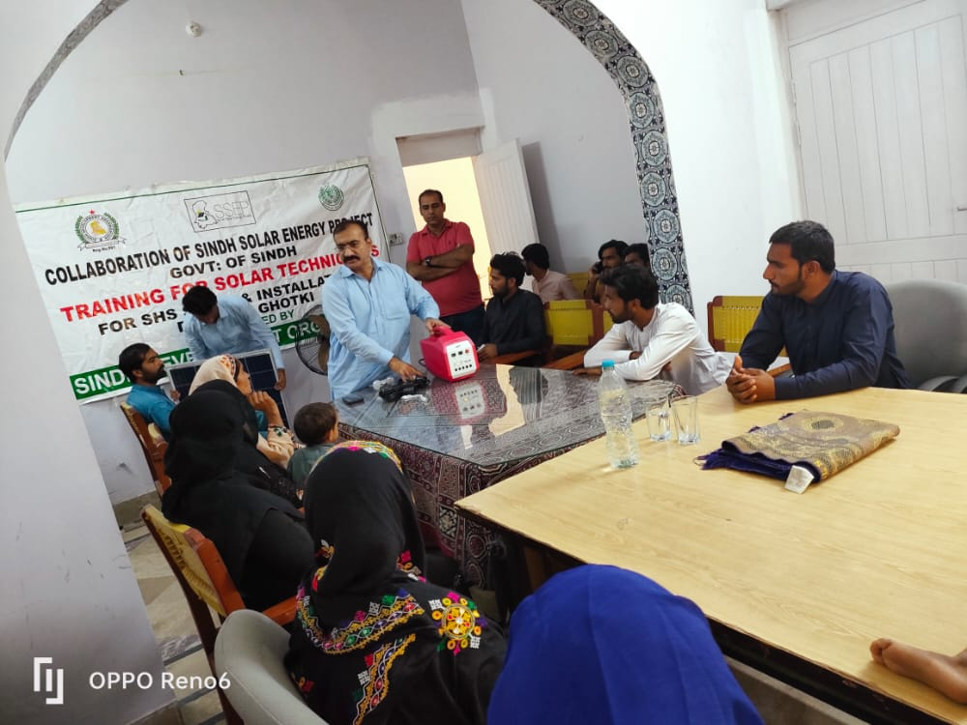
Solar Technician Trainings has been conducted in 10 districts and up till 300 technicians with 50% participation of females in rural areas has been carried out.
Further, the capacity building of Universities NED and Mehran is on the way to establish their solar quality control laboratories.

Slide 39
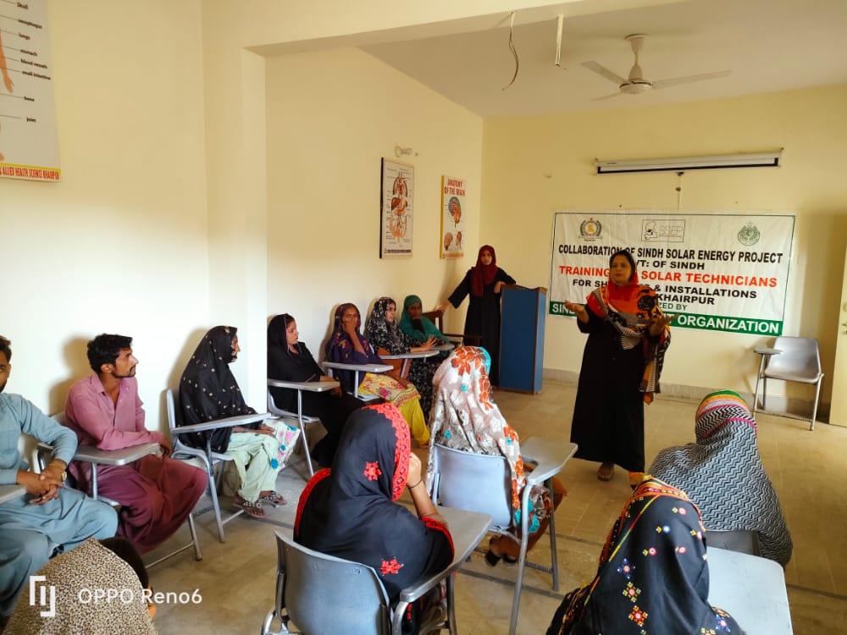
With particular participations of Females at Union Council Level.

Slide 40
Thank You

